Slide 1
Community & Economic Development
Engineering Services

Slide 2
Site Assessment Matrix
Parcel Area
Topographic Analysis (U.S.G.S. Topography Data)
Zoning Analysis
Re-Zoning Potential
Ownership
National Wetlands Inventory (N.W.I.)
National Flood Insurance Maps (F.I.R.M.)
Presence of Streams
Buffer Requirements
G.D.O.T. Road Classifications
Relative distance to Transportation Infrastructure (Airports, Ports, Rail, Intermodal Facilities etc.)
Relative distance to Utility Infrastructure (Water, Sewer, Electrical Sub-Station, Electric Transmission, Natural Gas)
Notes:
6

Slide 3
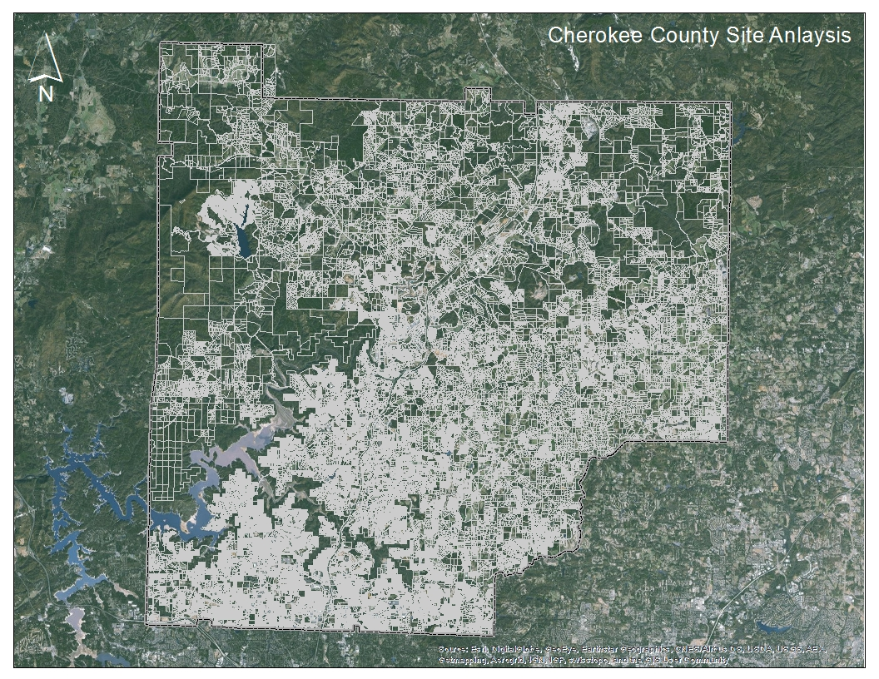
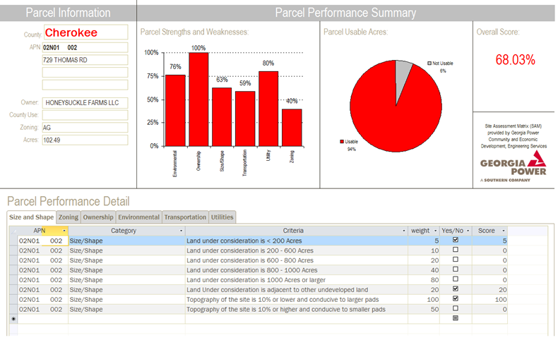
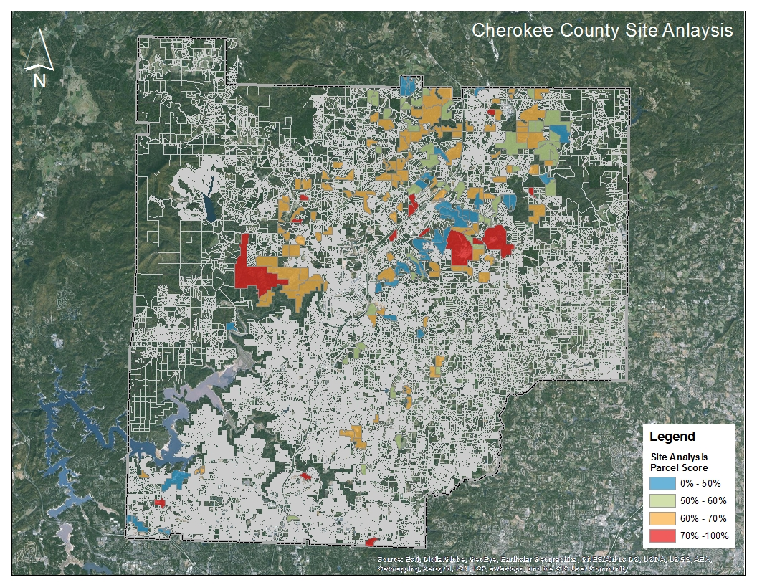
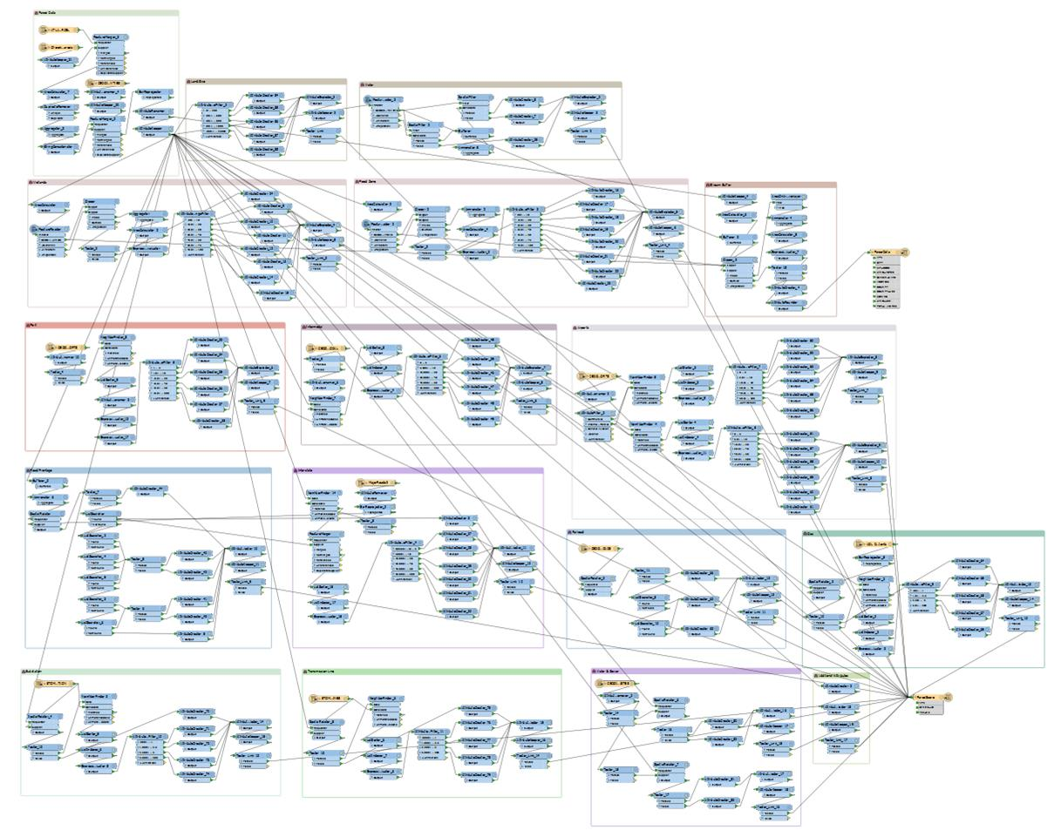
Site Assessment Matrix

Slide 4
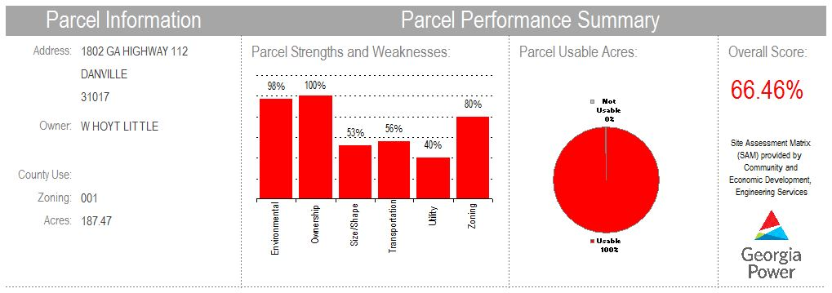
Site Assessment Matrix
What report tells us about the parcel:
Where is the parcel (address)
Who owns the property (owner(s))
How big is the property (acreage)
What the report tells us about the parcel:
What criteria is being analyzed
How does the parcel scores in that criteria
What are the parcel’s relative strengths (Ownership / Environmental / Zoning) and weaknesses ( Transportation / Utilities)
What critical component may be missing
What the report tells us about the parcel:
How much of the parcel can be developed
How much of the parcel has to be protected, will require special treatment or additional engineering efforts to develop
What the report tells us about the parcel:
Overall Score =
(AVG Criteria Score) X (% Usable Land)
Relative site desirability
What the report does not tell us:
Is the parcel for sale
Can the parcel be acquired
Will this be a successful location

Slide 5
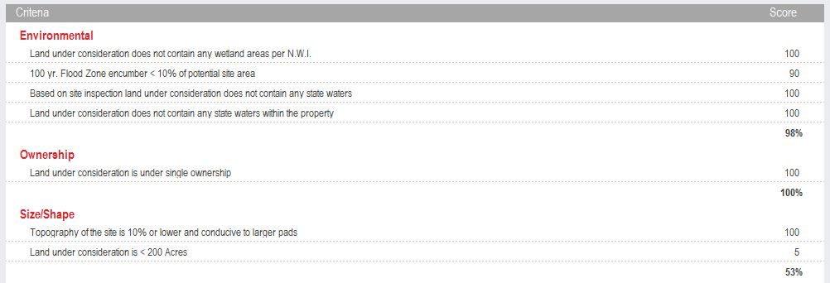
Site Assessment Matrix
What these results tell us about the parcel:
Criteria being analyzed
Score received for each factor within a given criteria
Score achieved for the criteria

Slide 6
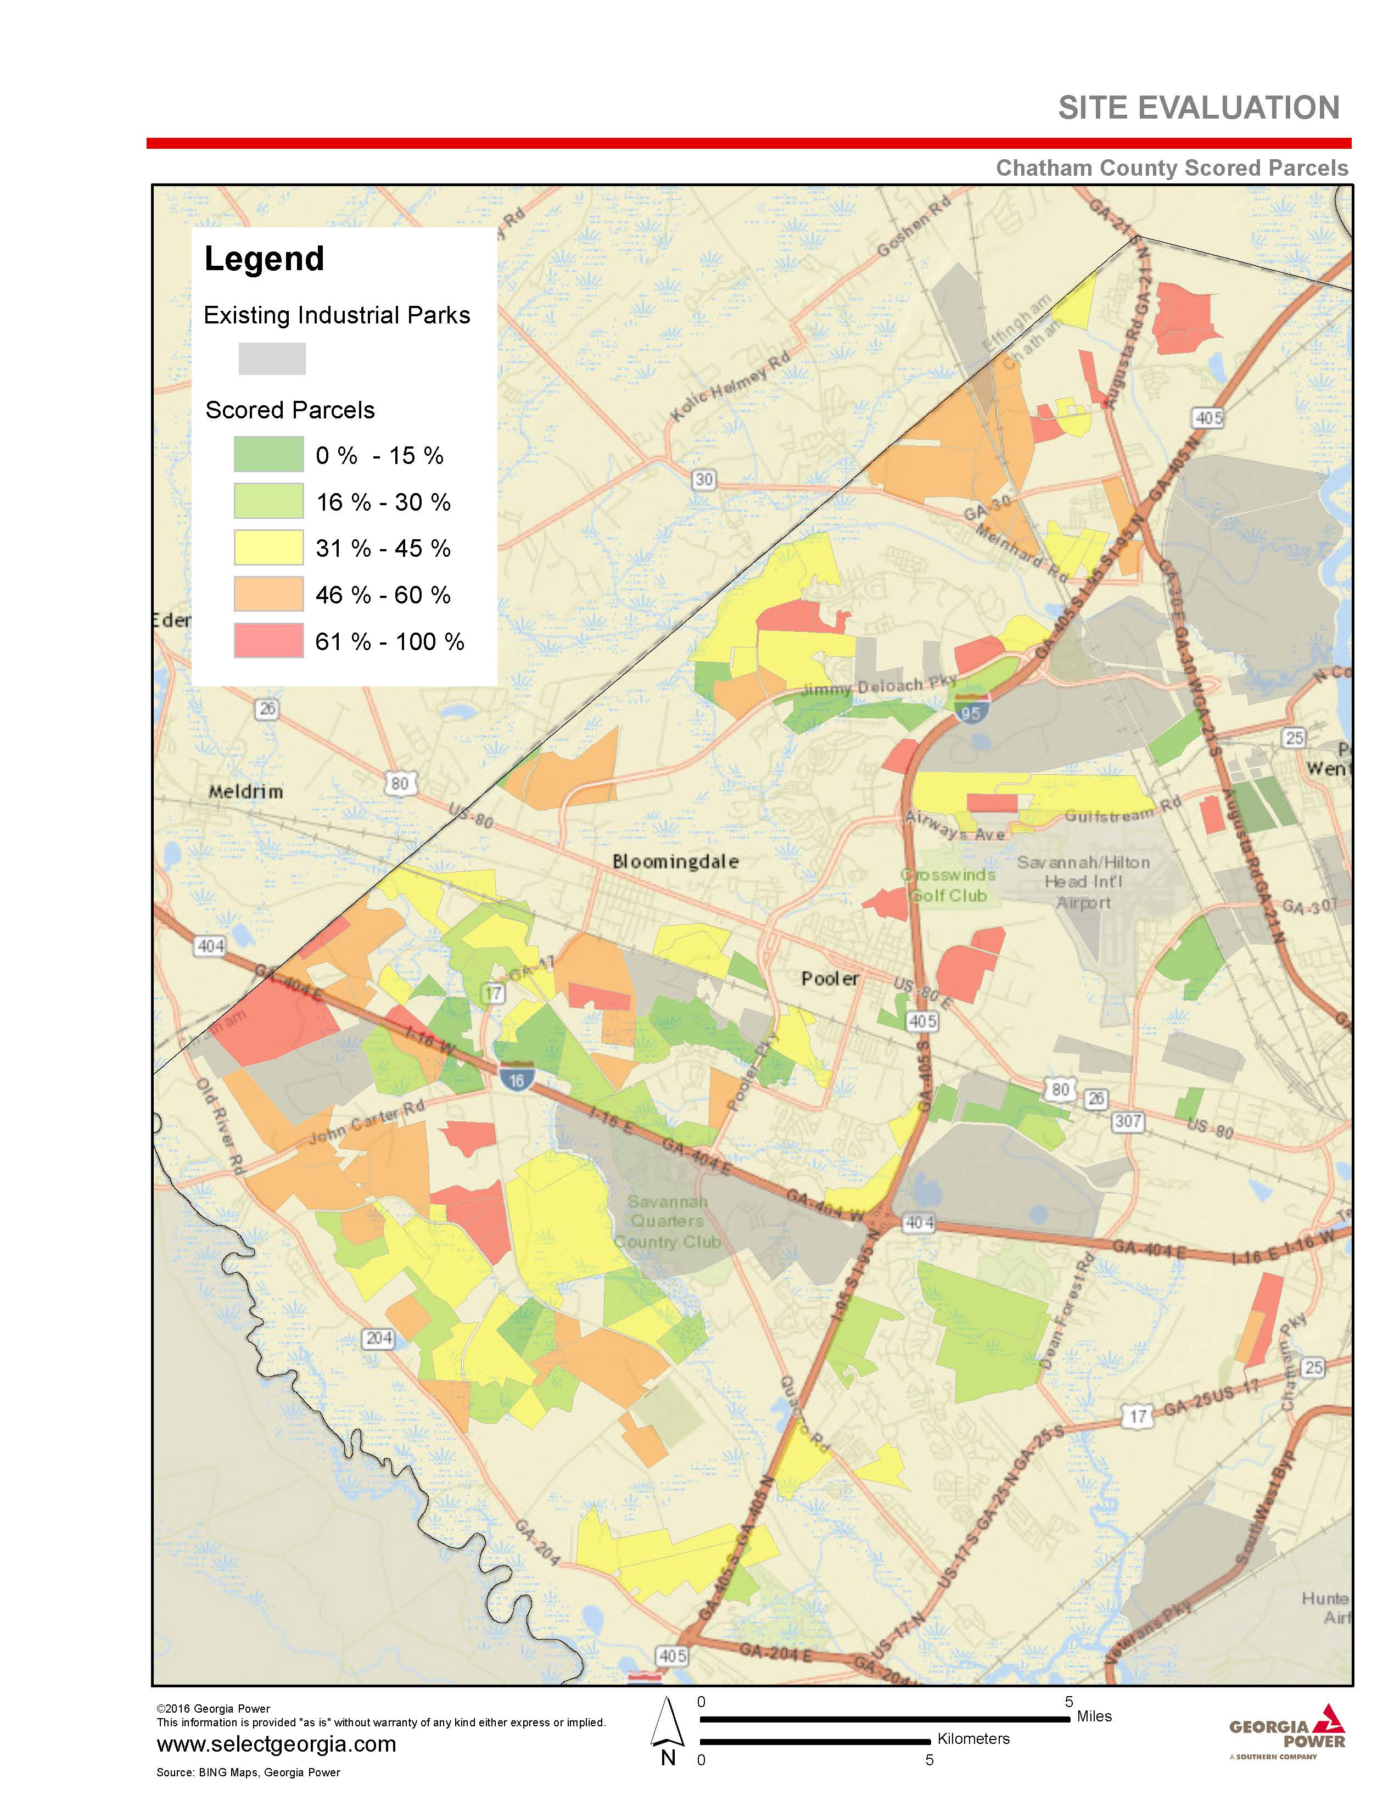
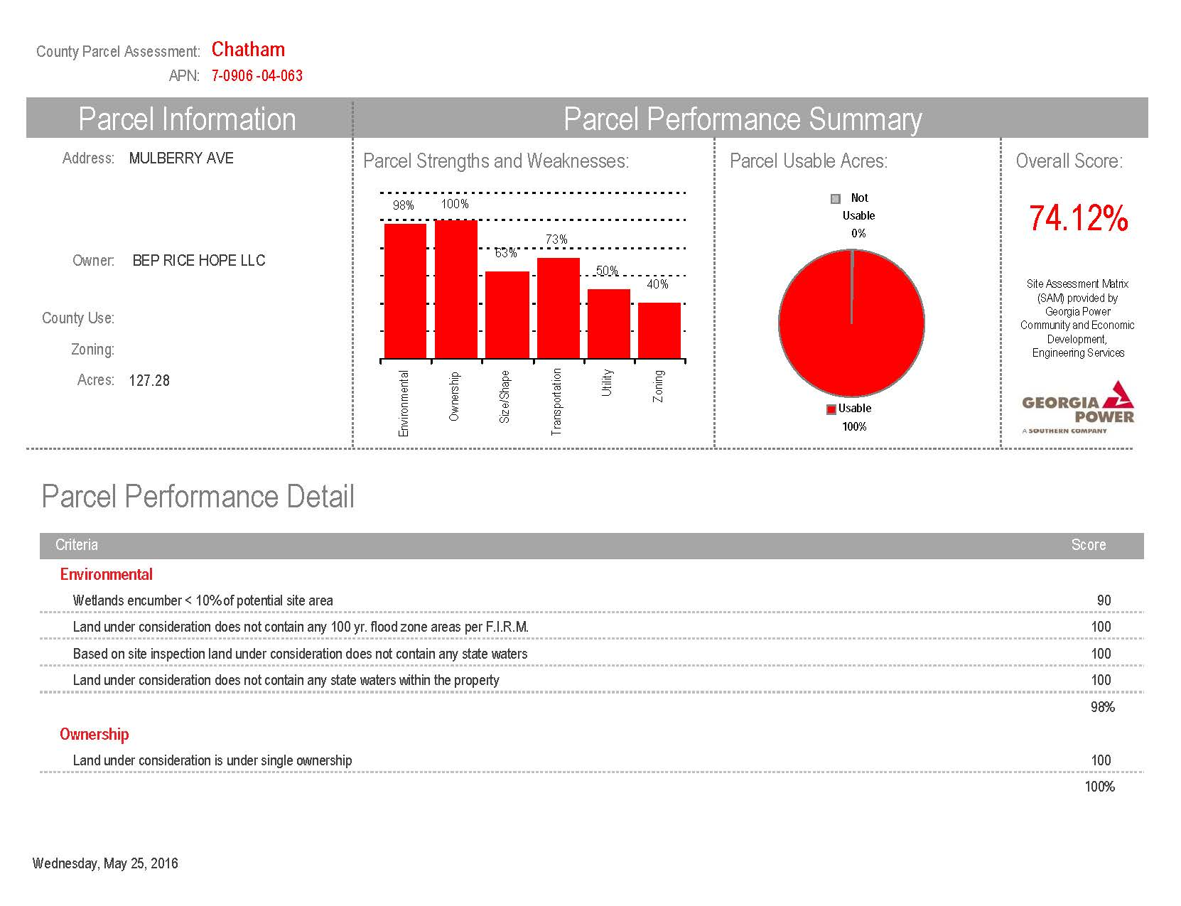
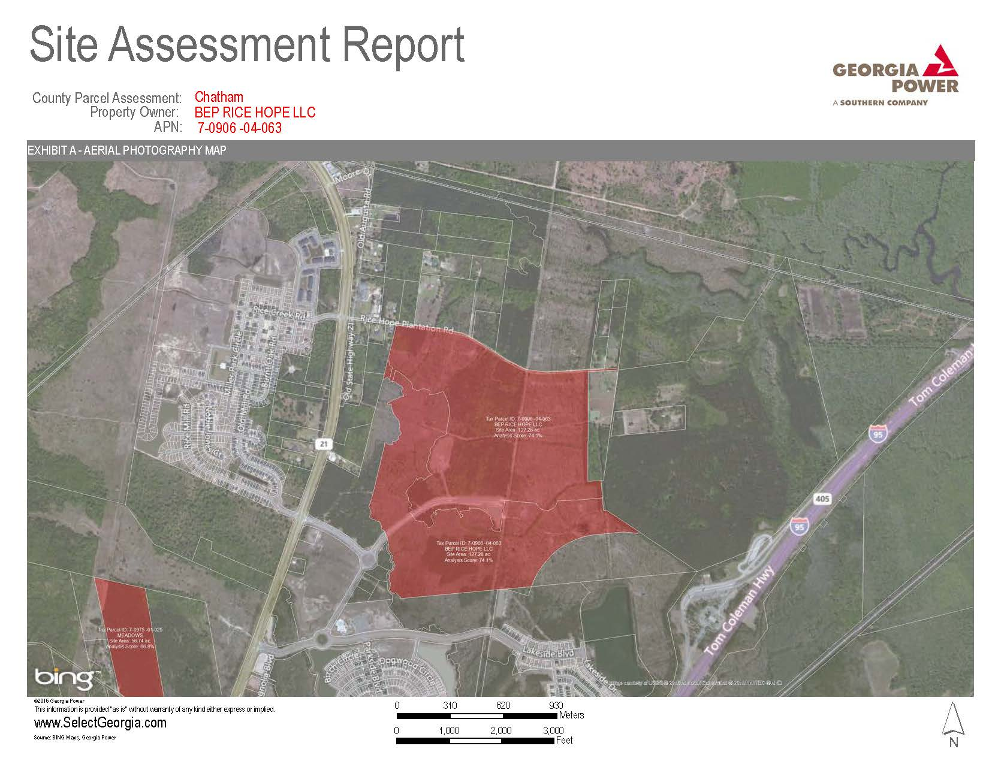
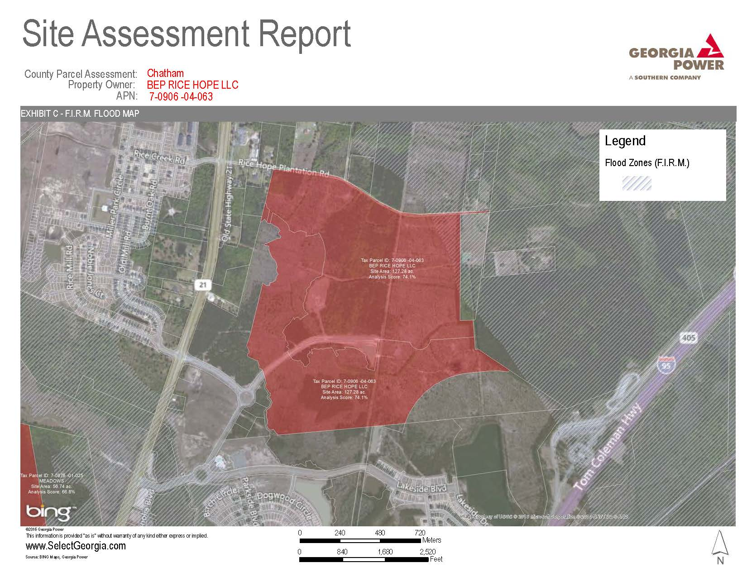
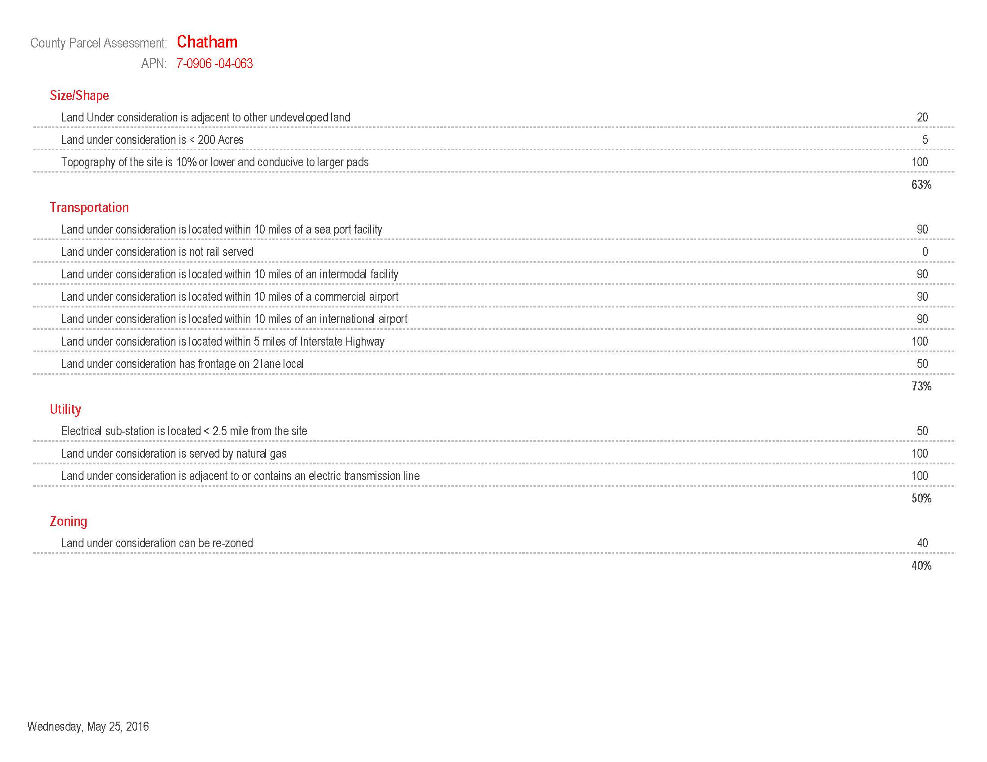
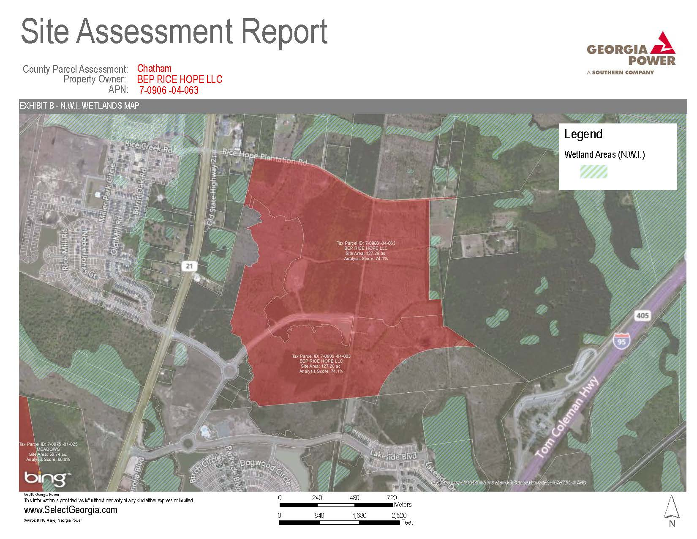
Site Assessment Matrix

Slide 7
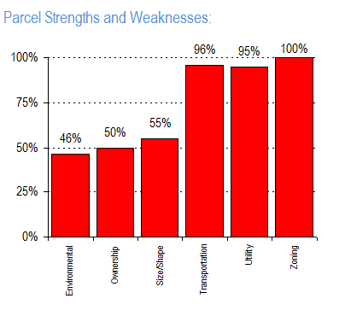
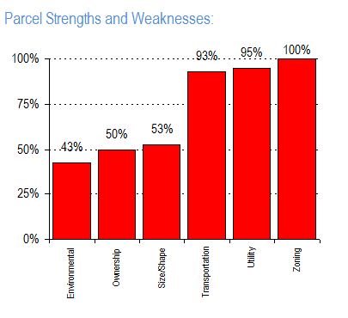
Site Assessment Matrix
Chatham County
Brownfield Site No. 1
Chatham County
Brownfield Site No. 2

