Slide 1
Georgia Brownfield Program Update
Shannon D. Ridley
Brownfield Coordinator
Georgia Brownfield Association Seminar
April 20, 2017

Slide 2
Agenda
Program Results to date
Emerging Issues

Slide 3
Program Results to Date
800 Brownfield Applications
450 final limitations of liability issued
4840 acres of land made ready for reuse
Over 840,00 tons of soil remediated

Slide 4
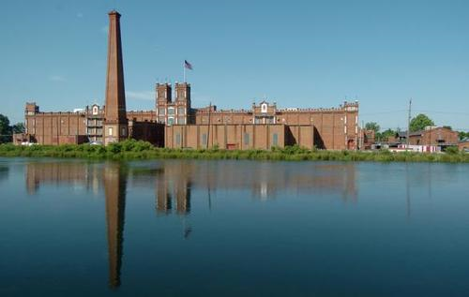
Major RedeVelopment Projects
Sibley Mill, Augusta, Georgia, Site of Augusta Cyberworks
Photo credit: Copyright 2014, 2015, DataFortress LLC, a Cape Augusta Company

Slide 5
Major Redevelopments
Underground Atlanta
GA Cyber Innovation and Training Center in Augusta
Turner Field Development

Slide 6
Emerging Issues
Funding
Brownfield Cost Certifications
Regulated Brownfield Properties

Slide 7
Funding
Federal Brownfield Grant
Brownfield Fees

Slide 8
Federal Brownfield Funding

Slide 9
Uses of Grant Funding
Outreach events and public participation
Technical assistance to EPA grantees and grant applicants
Technical assistance on projects not enrolled in the Program
Inventory of brownfield properties
Certification of brownfield costs
Administration of grant
Staff development and training

Slide 10
Brownfield Application Review Fees
$3000 per application
Current hourly rate is $75/hour
Since 2002 amendments to GA Brownfield Law, $2,373,000 collected in application review fees
VRP Escrow Account Act passed in 2010
Allows retention and use of application fees by Brownfield Program for oversight of brownfield projects

Slide 11
Brownfield Application Fees

Slide 12
Future in Brownfield Funding
Continual decline in federal funding
Increase in application review rate
Shift of some programmatic activities from grant to escrow account

Slide 13
Brownfield Cost Certifications
Certain construction methodologies as “eligible” costs
More scrutiny by county tax assessors
Unclear if costs were incurred because the property is environmentally impacted
Need to consider submission of brownfield costs during development of CAP
May be prudent to amend CAP in anticipation of certifying costs

Slide 14
Regulated Brownfield Properties
Qualifying properties with existing State corrective action consent orders, corrective action only permits, and existing institutional controls (i.e. ECs.)
Not properties that a currently permitted for the treatment, storage, and disposal of hazardous wastes or properties with post-closure care permits

Slide 15
Contact Information
Ms. Shannon D. Ridley
Response and Remediation Program
Brownfield Coordinator
2 Martin Luther King Jr. Drive
Atlanta, GA 30334
(404) 657-8616
shannon.ridley@dnr.ga.gov

