Slide 1
Commercial Project Management:
The Challenges and Opportunities of Designing an SSD System for a Large Redevelopment Project.
-Tony McDonald

Slide 2
Project Dimensions
A-Z was contracted to design/build Sub Slab Depressurization (SSD) Systems in three buildings being constructed during the redevelopment of the Flats in Cleveland, OH:
Toby Keith’s I Love this Bar and Grill – Single story 18,000 ft² steel and concrete building.
Alley Cat Oyster Bar – Two story 8,000 ft² steel building.
Building 4 – 500,000 ft² 8 story retail/ residential mid rise building. Cast in place concrete building with post tension cables in every floor slab.

Slide 3
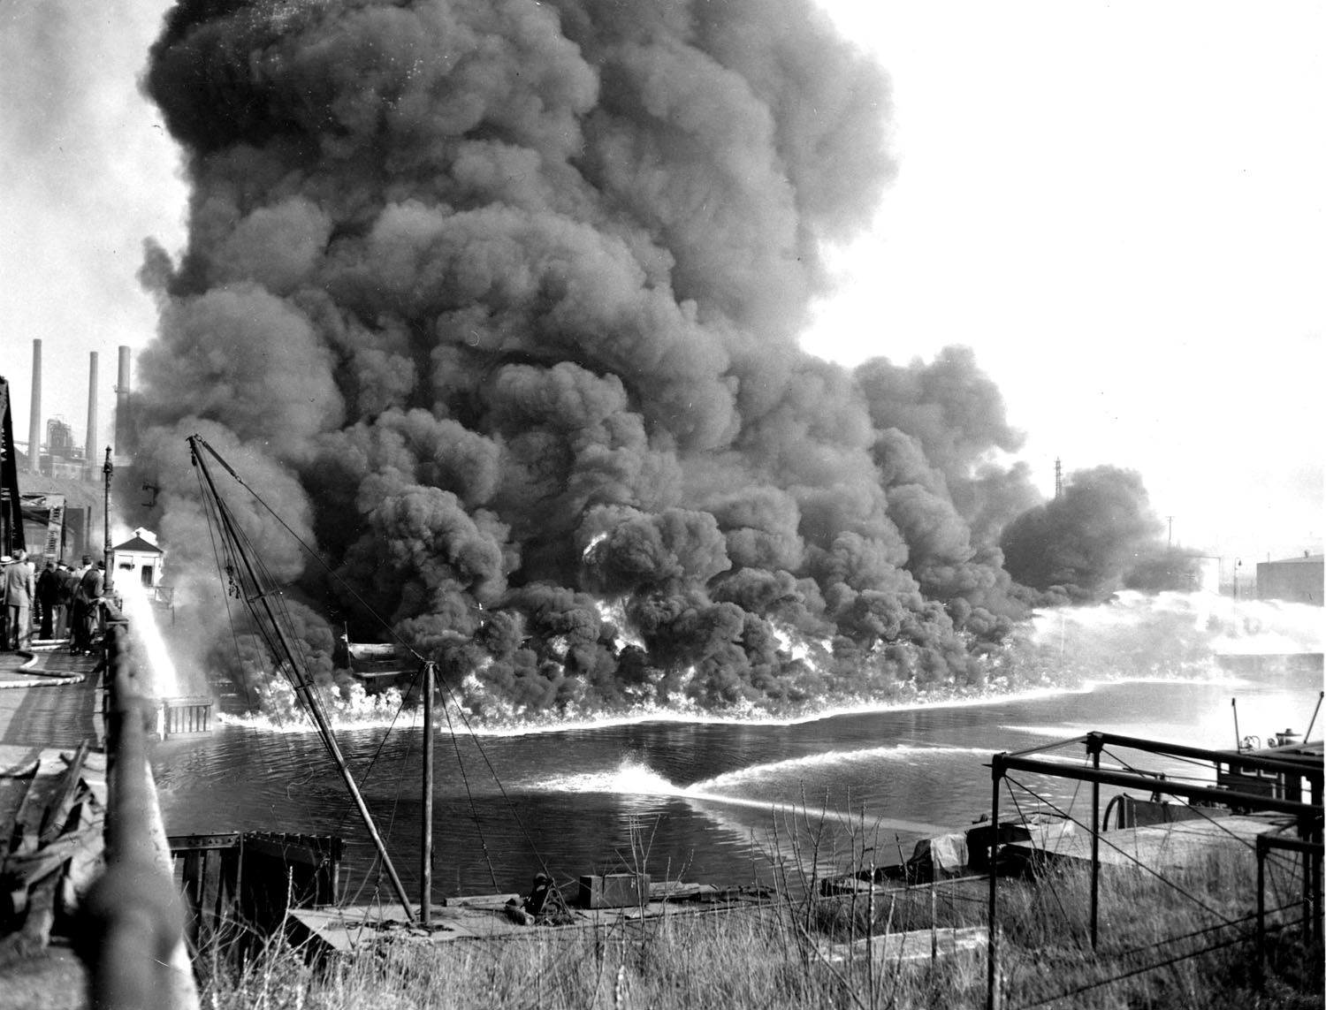
Chemicals of Concern

Slide 4
Design Requirements
Constantly prevent VOC from entering building.
Solution had to be repairable by general contractors.
Low/no maintenance.
Energy efficient design.
Must coordinate installation with other trades.
No ability to make adjustments after installation.

Slide 5
No Room for Error
This was all of the accessible piping on the first floor when the fans were energized

Slide 6
Other Project Requirements
Design Assist, not Design/Build.
Weekly coordination meetings.
Union Labor.
Each building was built by a different Construction company.
Building 4 had 9 different restaurant build outs on the first floor completed by 5 different companies.

Slide 7
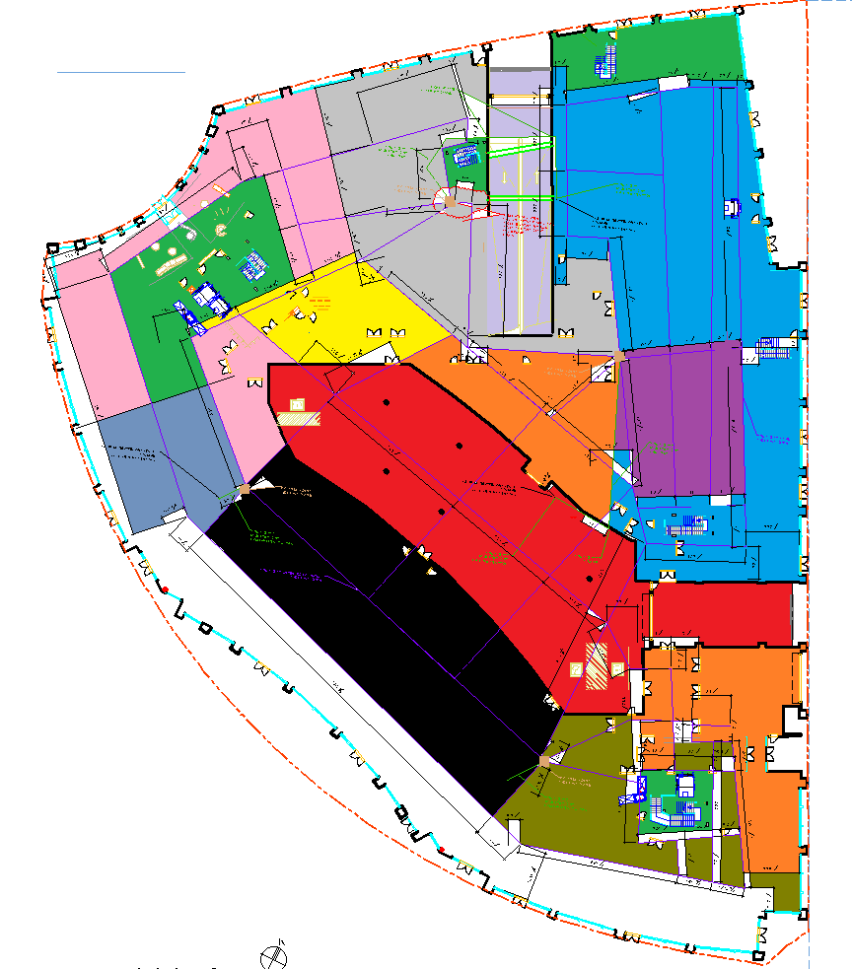
12 Different Concrete Pours by 5 different contractors

Slide 8
Active vs Passive Design
Passive systems work via the stack effect. Warm air rises through from the soil to the roof via a system of pipes. Works best with large temperature differences between outside and inside.
Active systems utilize a fan assembly to create a negative pressure field where the ground level concrete meets the soil. The fans run constantly for the life of the building or remediation project.

Slide 9
Passive System Highlights
Passive Systems typically consist of:
Vapor collection matting installed in a 20’ grid system.
Spray applied 60 mil vapor barrier installed by specialty contractor.
4” PVC vent stacks typically spaced every 8,000 ft2.
Designed with no exhaust blowers.
System effectiveness tested via IAQ sampling.

Slide 10
Active System Highlights
Active Systems typically consist of:
Vapor collection matting installed in a 60’ grid system.
20 mil vapor sheet barrier installed by concrete contractor.
8” PVC vent stacks typically spaced every 25,000 ft2.
Exhaust blowers incorporated into design.
Measure effectiveness by either Pressure Field Extension (PFE) or IAQ sampling.

Slide 11
Active vs Passive Compared - Building 4 -
 | Passive | Active | Advantage
Matting | 20,000 LF | 3,000 LF | Active
Installed By | Specialty Contractor | Concrete Contractor
Suction Pits | 0 | 4 | Passive
Installed By | Specialty Contractor | Concrete Contractor
Vapor Barrier | 1,000,000 FT2 Spray - Applied | 1,000,000 FT2 Sheet - Applied | Active
Installed By | Specialty Contractor | Concrete Contractor
Conveyance Piping | 20 - 4” PVC Pipe Stacks | 4 - 8” PVC Pipe Stacks | Active
Installed By | Plumbing Contractor | Plumbing Contractor
Fan Assemblies | 0 | 4 | Passive
Installed By | - | General Contractor

Slide 12
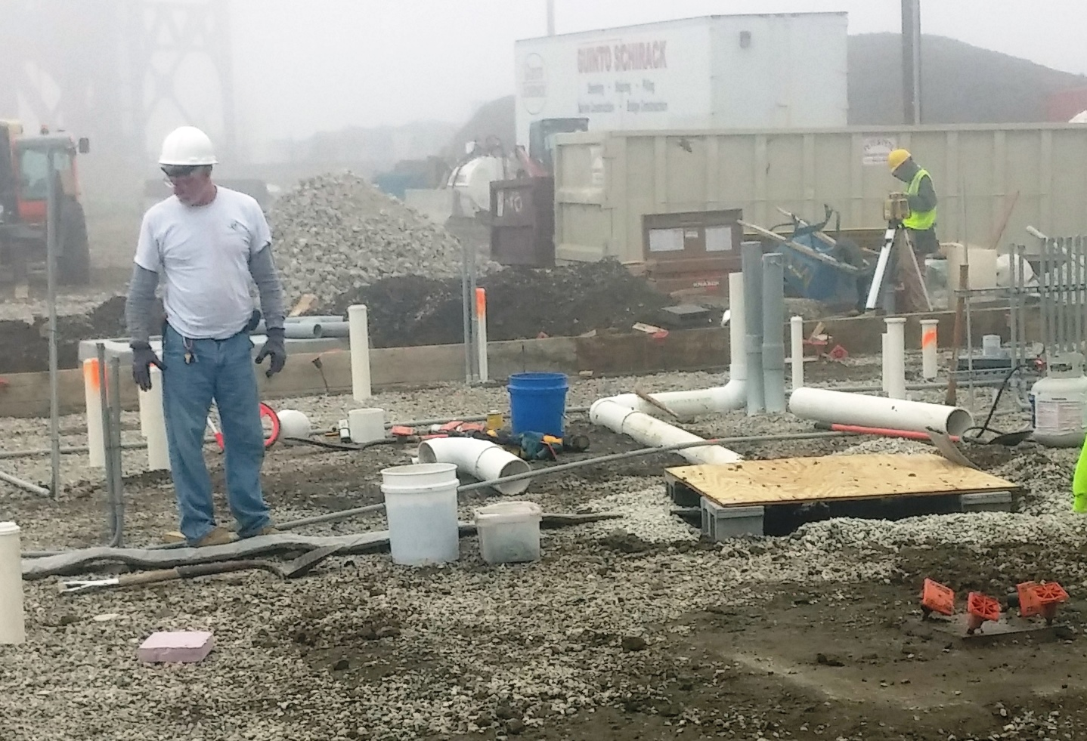
COMMON DESIGN ELEMENTS

Slide 13
Under Slab Vent Matting

Slide 14
Suction Pits

Slide 15
Aggregate Layer

Slide 16
Underground Work
A-Z installed the undergrounds at this property. The concrete company was uncomfortable installing the system.

Slide 17
Vapor Barrier

Slide 18
Conveyance Piping

Slide 19
High Flow Exhaust Fans

Slide 20
System Monitoring

Slide 21
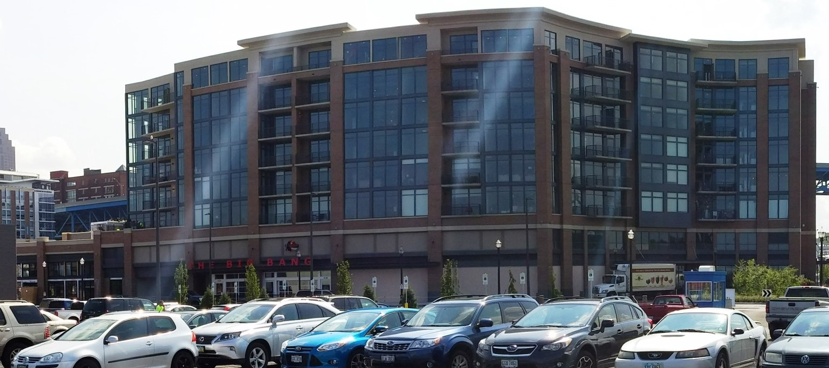
BUILDING 4
500,000 FT² 8 STORY BUILDING
1ST FLOOR -RETAIL
2ND Floor – Parking
3rd THRU 8th FLOOR – LUXURY APARTMENTS

Slide 22
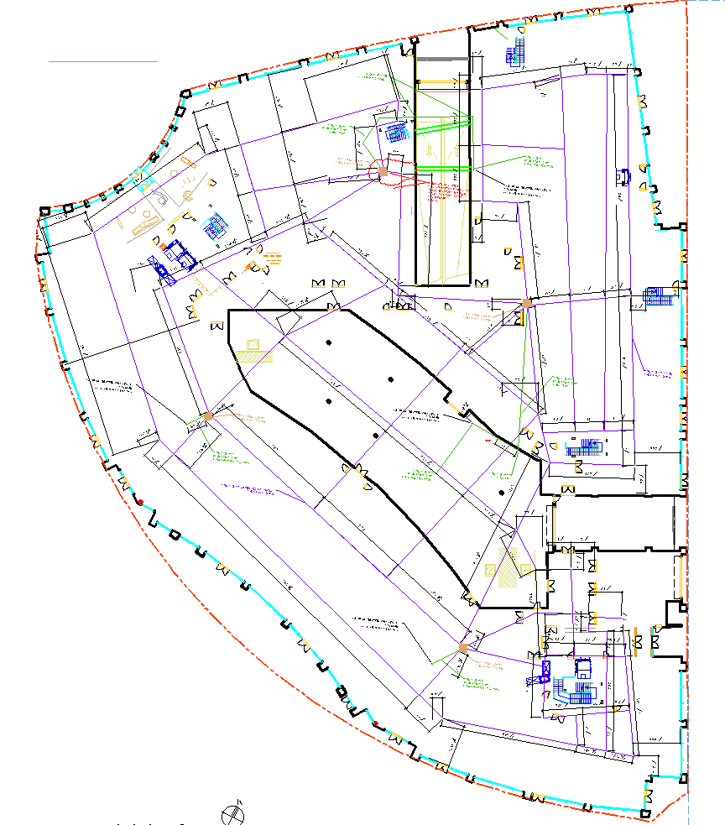
Design Components
4 total systems
3,500LF vent matting
4 Suction Pits
600LF of 8: SCH40 Conveyance Piping
4 Fantech FDK 12XL Blowers
4 System monitors wired to a central monitoring point.
10 permanent sub slab pressure monitoring points.

Slide 23
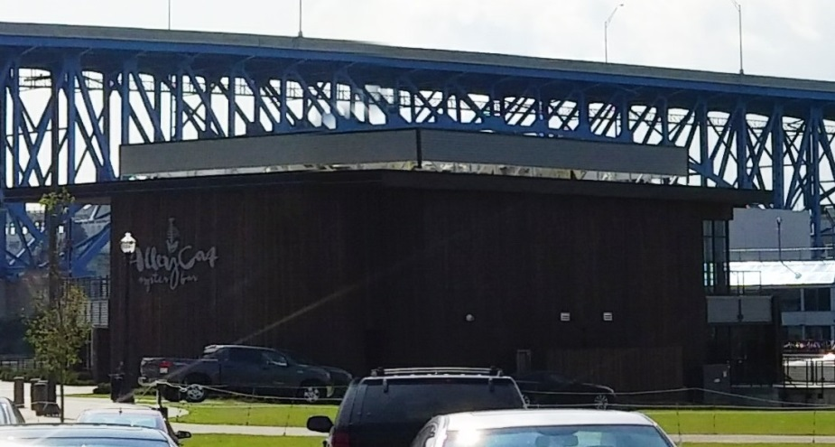
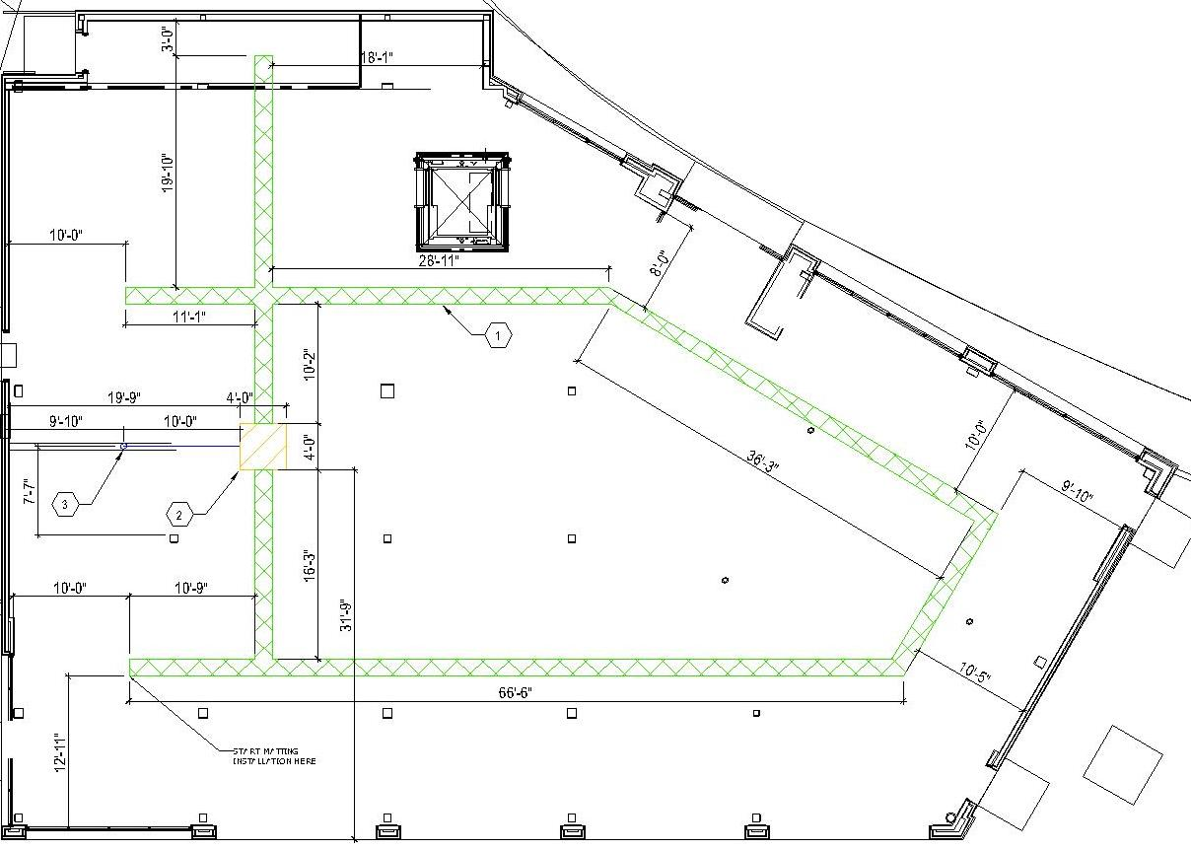
Alley Cat Oyster Bar
8,000 FT² 2 story restaurant.
A-Z scope of work:
Design
Oversight
Install Underground Piping

Slide 24
Design Coordination with other Trades
The MEP trades have to coordinate their installations so there are no installation conflicts.
These coordination drawings are part of the construction documents and are critical to the success of the project.
Every floor penetration in building 4 needed to run though a sleeve that was installed before the concrete floor was poured.
All penetrations needed to be on the drawings so engineering could make sure they would not conflict with the post tension cables.
The plumbing company installed SSD sleeves.
The foreman called to get permission to move a sleeve ¼” north.

Slide 25
Draft Design

Slide 26
Architect’s Response

Slide 27
Final Design

Slide 28
Building 4 - Installation Timeline
March 2014 – Building foundation piers started
May 2014 - A-Z design work begins.
June 2014 – SSD Initial Design Completed.
November 2014 –
SSD System design change for new tenants.
New design has blowing lanes and sunken areas on first floor.

Slide 29
Building 4 - Timeline Continued
March 2015 –First floor restaurant buildouts begin.
June 2015 –
2 Tenant spaces are not leased.
1 of the 4 main suction pits was now in an unrented space.
“Will this system work with only 3 systems running?”
We decide to install gravel and VB only in these two spaces.
July 2015 –
First floor concrete is finally finished in most spaces.
Most build outs are completed.
Attempt 1 at installing the fans.

Slide 30
Timeline Continued
August 2015 -
Fans actually installed and energized.
Monitoring system installed.
PFE Testing – FINALLY.
Several restaurants open.
15 Months in total!

Slide 31
Suction Pit Issues

Slide 32
Toby Keith Suction Pits
This box is set to high. Plywood top will be flush with floor.
CMU block around perimeter of suction point

Slide 33
Building 4 - Suction Points
This debris was found inside a suction pit. The pit was also 6” too low and the block were mortared together.
Repaired suction pit by A-Z at correct Height.

Slide 34
Alley Cat Suction Pit
Installed initially by A-Z.

Slide 35
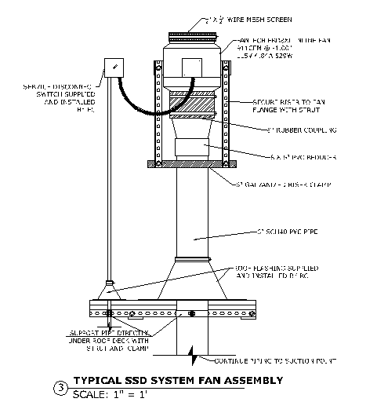
Alley Cat - Final Inspection

Slide 36
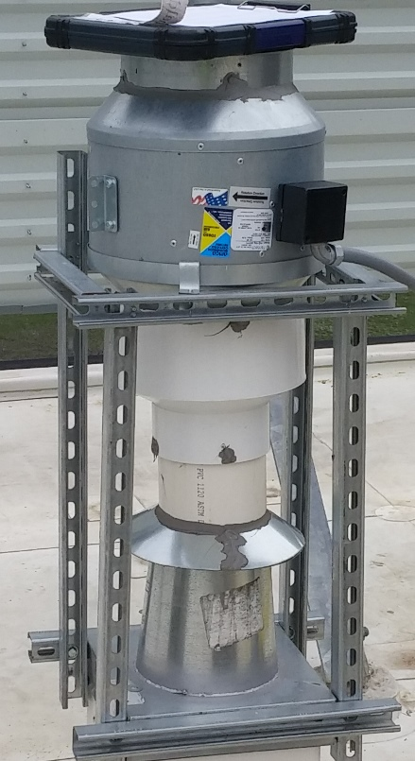
Deficiencies
No Rubber Coupling
Wrong Support Assembly
Fan upside down.
Motor seized.
Wrong size Motor.
Sticker flipped over to show proper flow.

Slide 37
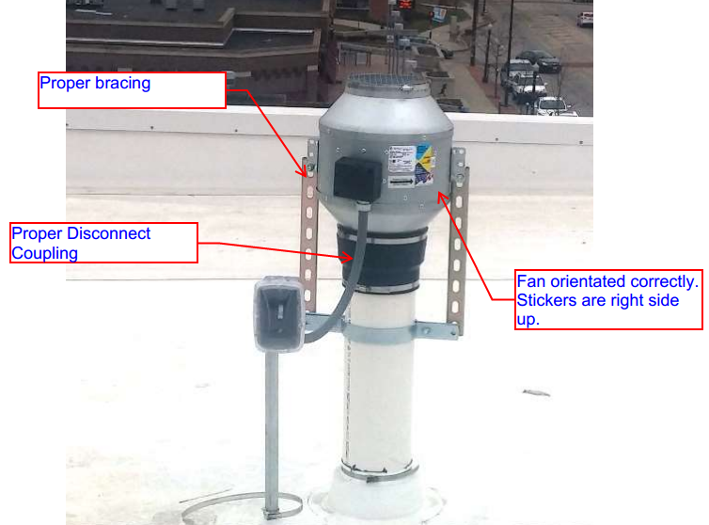
Corrective Action
Issued paperwork outlining necessary corrective action.
Included this picture from previous project.

Slide 38
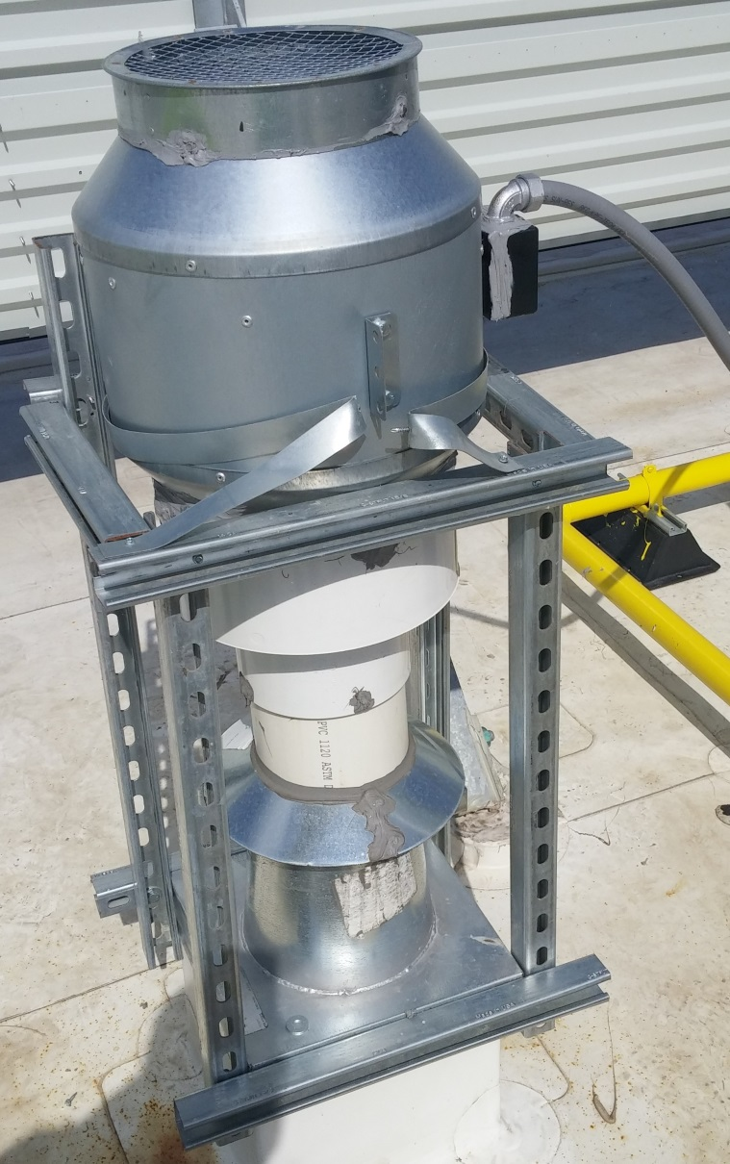
Follow up Inspection
Not much better.
New fan.
Still wrong model.
Orientated correctly.
Still no rubber coupling
Wrong Support Assembly.
Lots of caulking.

Slide 39
Building 4 - New Patented Design

Slide 40
System Startup and Testing

Slide 41
Final PFE Readings
Fan Info
Manufacturer | Fantech
Model | FKD 10XL
Operating Pressure | -2.5”
CFM | 350

Slide 42
Toby Keith Installation

Slide 43
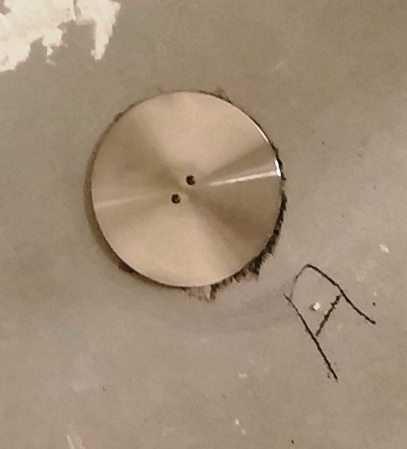
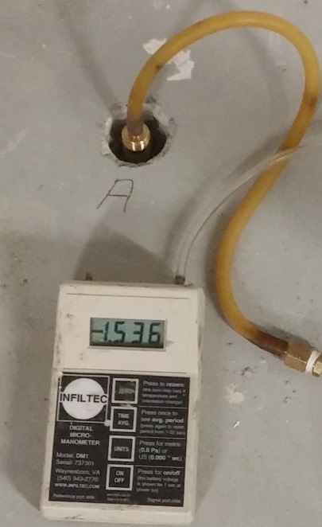
Building 4- Final Results
PFE Results
Point | Pressure | Distance
1 | -1.536” | 30’
2 | -0.006” | 50’
3 | -0.029” | 60’
4 | -0.010” | 65’
5 | -0.007” | 109’
6 | -0.044” | 40’
7 | -0.011” | 74’
8 | -0.036” | 85’
9 | -0.021” | 56’

Slide 44
Final Metrics
 | Building 4 | Alley Cat | Tobey Keith | Total
Building Footprint | 100,000 ft2 | 8,000 ft2 | 16,000 ft2 | 124,000
Fan Assemblies | 4 | 1 | 2 | 7
Total Wattage | 2124 | 327 | 654 | 3105
Monthly Electrical | 152.93 | 23.55 | 47.09 | 223.57
Cost Per ft2 | $0.001 | $0.003 | $0.003 | $0.002
Efficiency Ft2 Depressurized / Watt | 47:1 | 25:1 | 25:1 | 40:1

Slide 45
30 Year OMM Cost
 | Fans | AVG Life Span | Replacement Cost | 30 Year Total
Building 4 | 4 | 7 years | $850.00 | $13,600.00*
Toby Keith | 2 | 7 years | $650.00 | $5,200.00*
Alley Cat | 1 | 7 years | $650.00 | $2,600.00*
 |  |  | Fan Replacement Total | $21,400.00*
 | Monthly Electric |  | Yearly Electric | 30 Year Total
Building 4 | $152.93 |  | $1,835.16 | $55,054.80*
Toby Keith | $47.09 |  | $565.08 | 16,952.40*
Alley Cat | $23.55 |  | $282.60 | $8,478.00*
 |  |  | Electric Total | $80,485.20*
 |  |  | Grand Total | $101,885.20*
 |  | Cost per leasable ft2 of buildings |  | $0.20
* Cost does not include inflation in calculation

Slide 46
Let this be a lesson to all the lawyers in the room.

Slide 47
Questions?
Tony McDonald
Vice President
A-Z Solutions, Inc
Tony@vaporremoval.com

