Slide 1
Georgia Department of economic Development – trends and updates

Slide 2
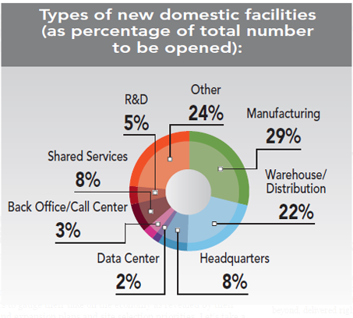
What Trends Are we seeing?
Automotive
Manufacturing and Reshoring
FDI
Germany/Benelux
Korea
Japan
Logistics and Port Activity
Health IT, FinTech and Headquarters

Slide 3
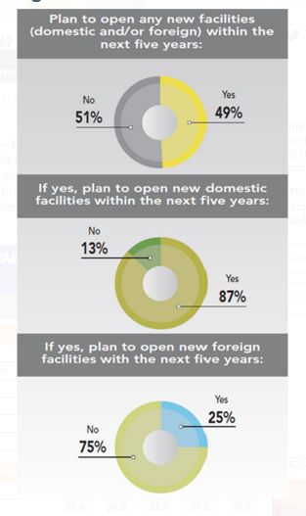
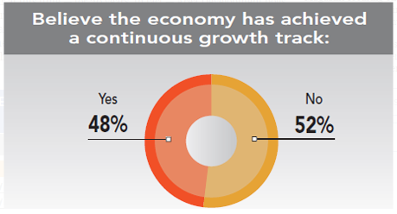
30th Annual Corporate Survey

Slide 4
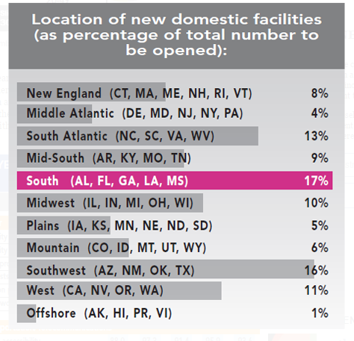
30th Annual Corporate Survey

Slide 5
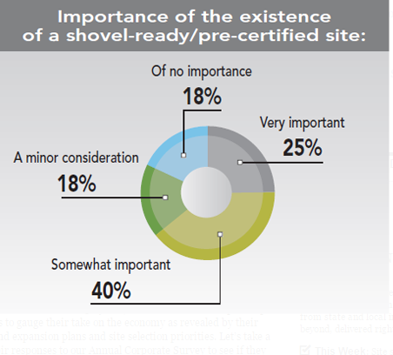
30th Annual Corporate Survey

Slide 6
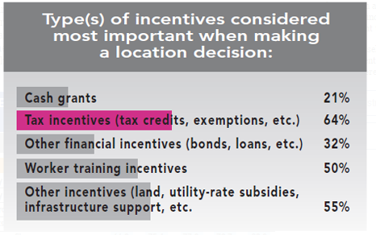
30th Annual Corporate Survey

Slide 7
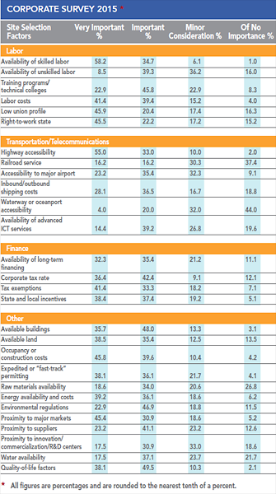
30th Annual Corporate Survey

Slide 8
