Slide 1

Community Engagement and Environmental Justice –
A Focus on Savannah
April 23, 2019
2019 Georgia Brownfield Association Seminar

Slide 2



I. Introductions/Summary
Introductions/Summary
Keith Ziobron, Cardno
City of Savannah’s Brownfield Program Development
Eric Chin, City of Savannah
Environmental Justice &
B2H Insight and Resources
Suzi Ruhl, EPA
A local Perspective
Dr. Mildred McClain, Harambee House, Inc.

Slide 3
II. City of Savannah’s Brownfield Program Development
Eric Chin, City of Savannah
2019 Georgia Brownfield Association Seminar

Slide 4
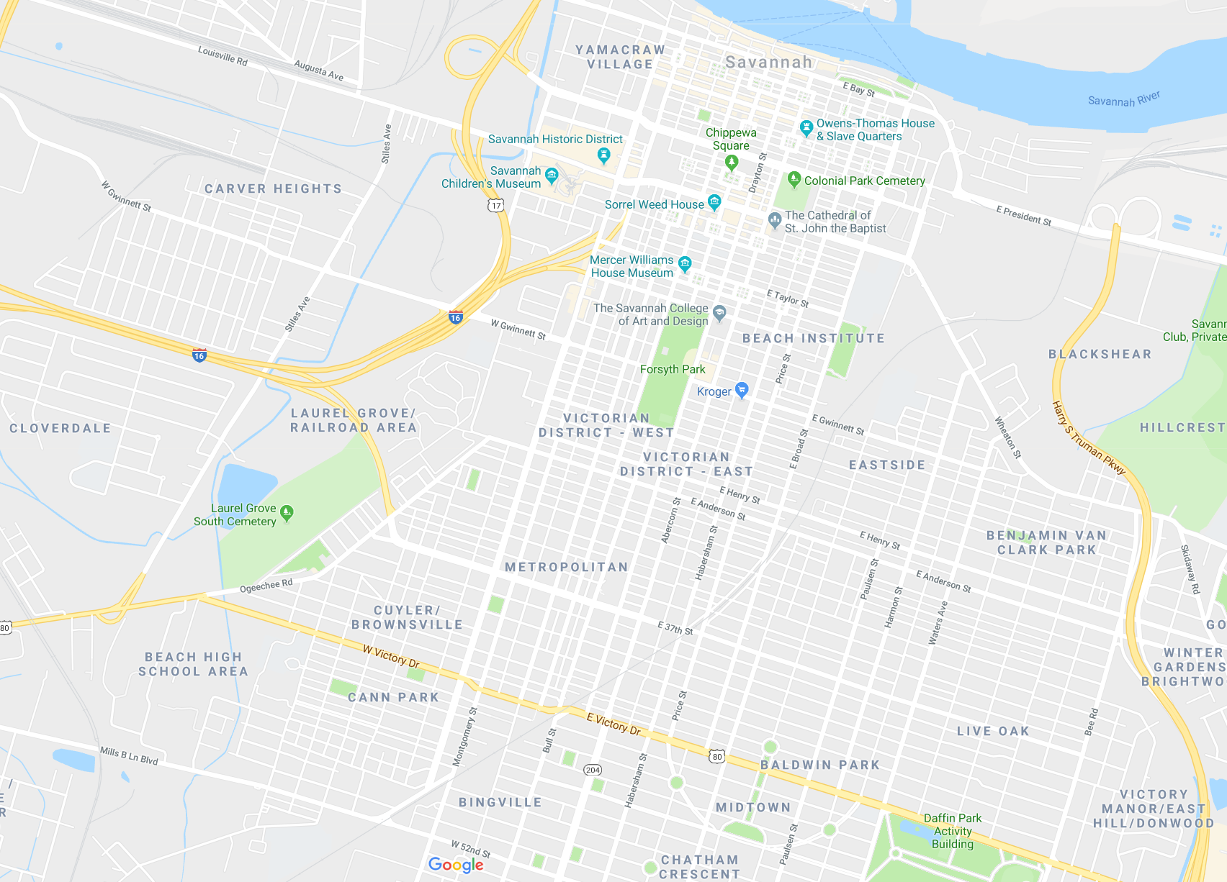
Assessment Grant Boundary

Slide 5
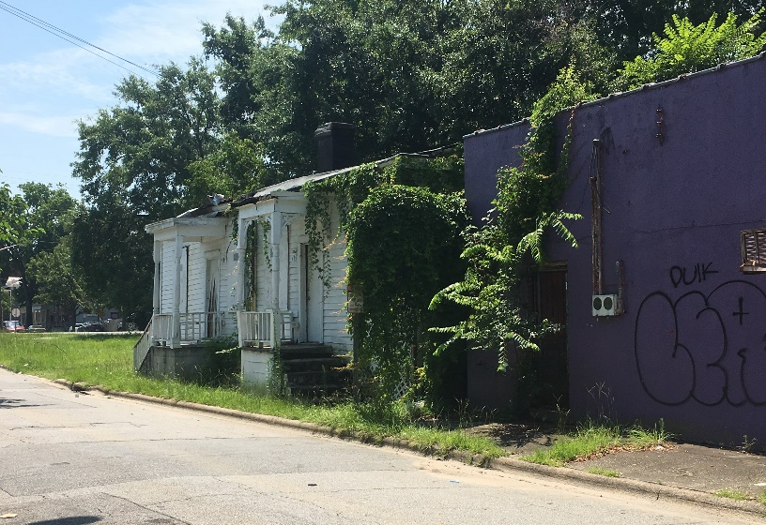
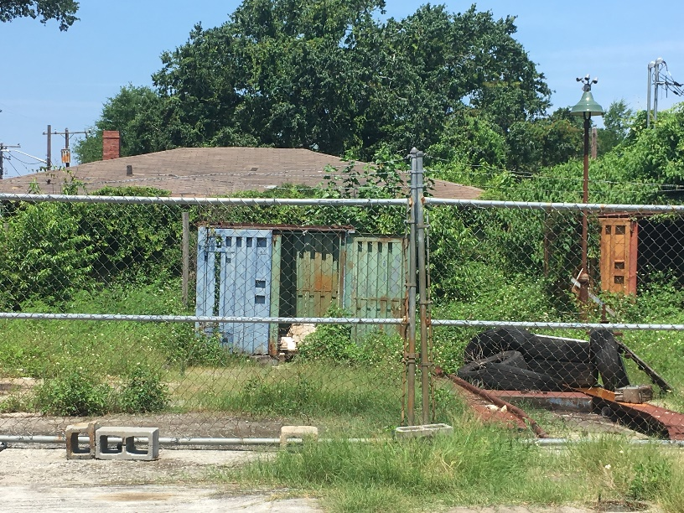
Corridor Details
Two-mile corridor with history of commercial and industrial use
Montgomery Street was previously the route for US HWY 17 into South Carolina
Western edge of the Historic District
Significant socio-economic disparities

Slide 6
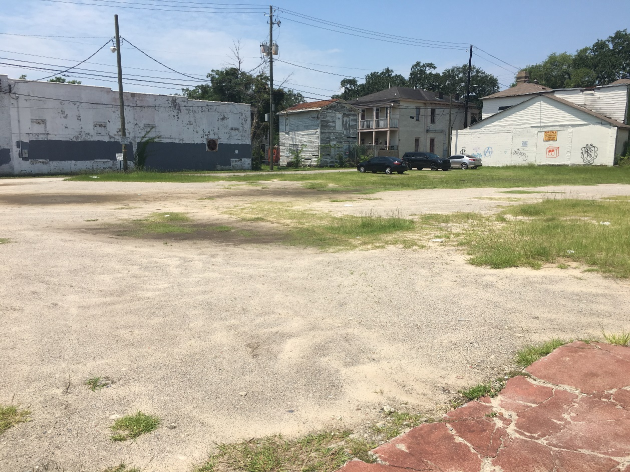
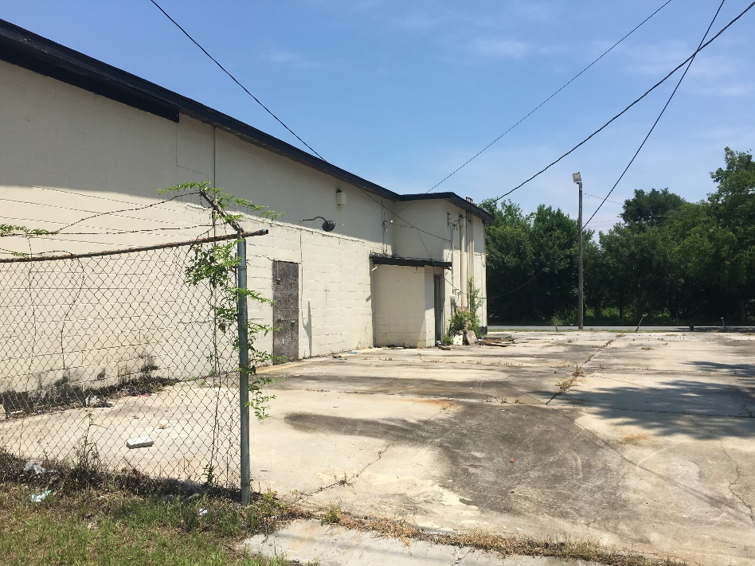
Identified Community Needs
Access to:
  Healthy food or green grocer
    (currently a food desert)
  Healthcare
  Affordable Housing
  Workforce training
  Connectivity / Transportation

Slide 7
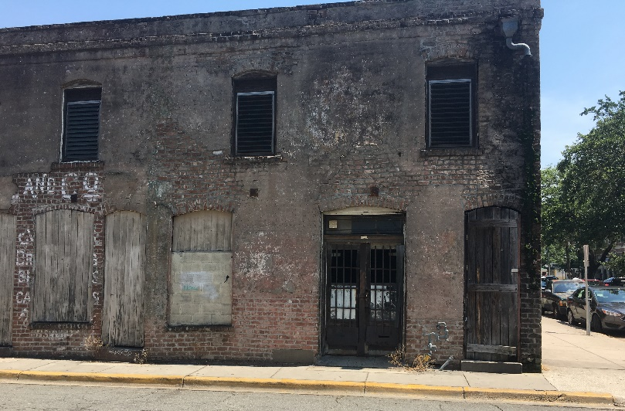
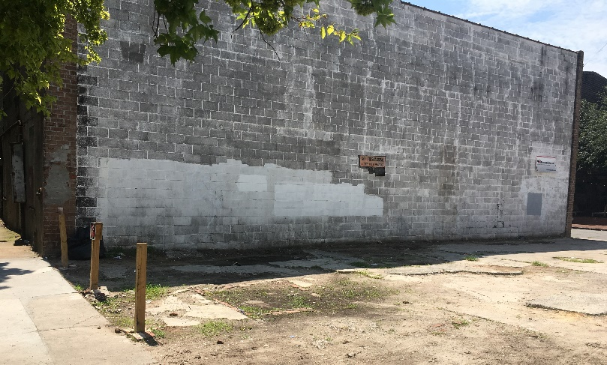
Brownfield Background
No previous municipal experience in EPA Brownfield program or grant awards
Applied for EPA’s Community-Wide Assessment Grant three times since 2015 prior to being awarded in 2018
Built partnerships with local nonprofits, community organizations, neighborhood associations

Slide 8
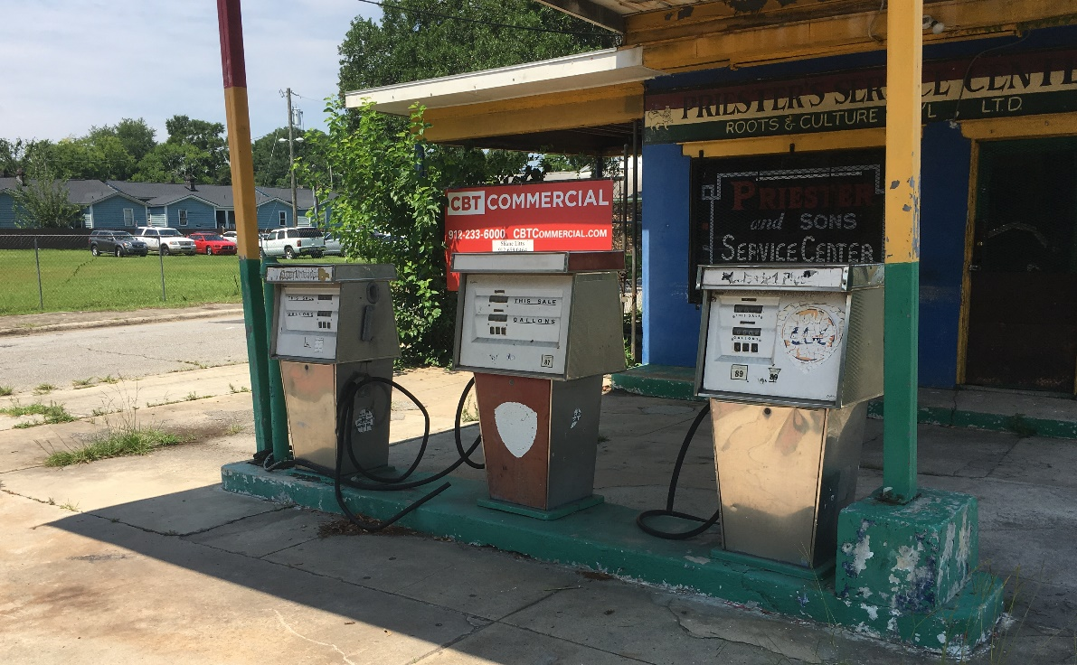
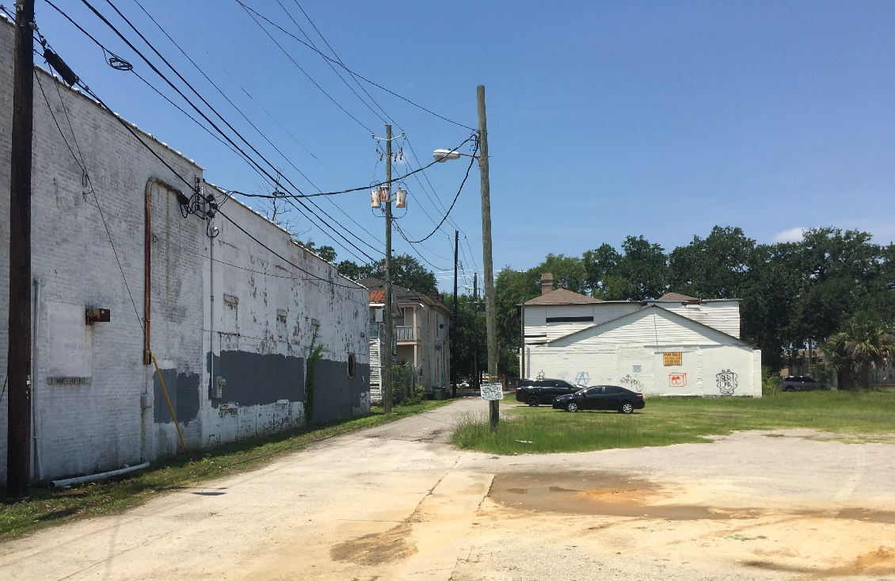
Brownfield Program
Intend to build a brownfield program that focuses on social equity, improves access to needed amenities and promotes residents staying in place
SSU partnership

Slide 9
Program Vision
3. FY 2021 Area-wide Planning Grant
5. FY 2025 Brownfield Job Training and Additional Assessment Grants
1. FY 2018 Community-wide Brownfield Assessment Grant
2. FY 2020 Cleanup Grant
4. FY 2023 Brownfield Revolving Loan Grant

Slide 10

Contact Information
Nick Deffley
Sustainability
Ndeffley@savannahga.gov
Eric Chin
Real Estate Services
Echin@savannahga.gov
Manuel Dominguez
Business Opportunity
Mdominguez@savannahga.gov

Slide 11
III. Environmental Justice & B2H Insight and Resources
Suzi Ruhl, EPA
2019 Georgia Brownfield Association Seminar

Slide 12
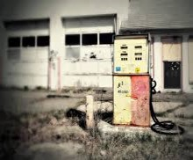
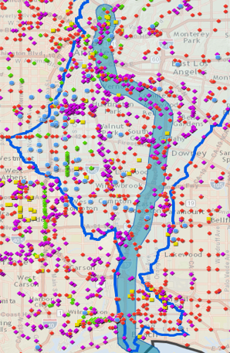
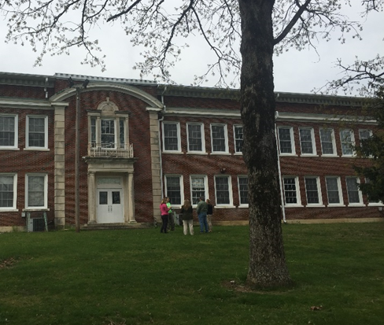
B2H Components
Advancing community health, environment and economy
IMPACTED COMMUNITY ENGAGEMENT
Brownfields
2
Healthfields
CONTAMINATED SITES
REMEDIATION AND REDEVELOPMENT
SITE REDEVELOPMENT
ADVANCES COMMUNITY TRIPLE BOTTOM LINE
Transforming contaminated properties to strengthen community health, equity, sustainability and resiliency for impacted vulnerable and underserved populations living in areas with pollution, disease, poverty and crime

Slide 13
Healthfields Redevelopment
Common Brownfields Sites
Abandoned gas stations
Former mines and tailings
Illegal dump sites
Meth labs
Landfills
Historic industrial operations
Maintenance yards
Former feed lots
Health Clinic
Community Center
Open Space/Recreation
Community Garden & Farmer’s Market
Grocery Store
School
Housing
Renewable Energy

Slide 14
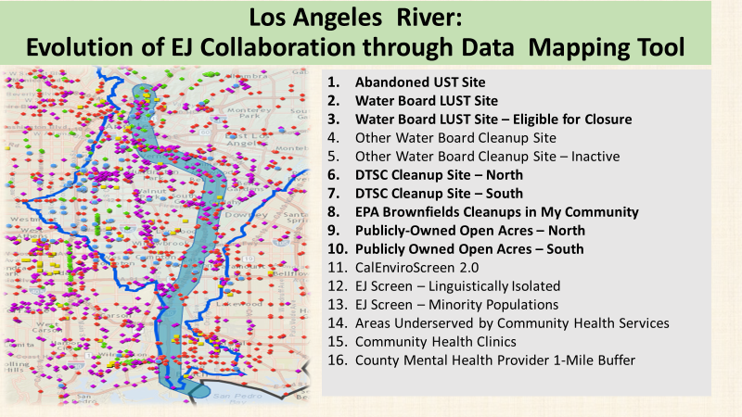

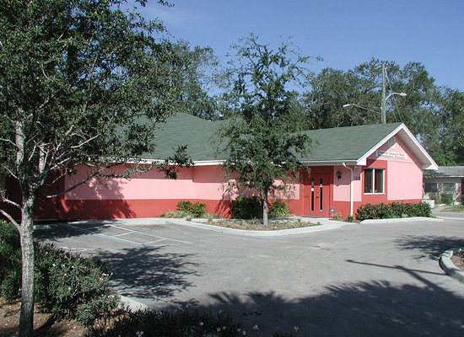
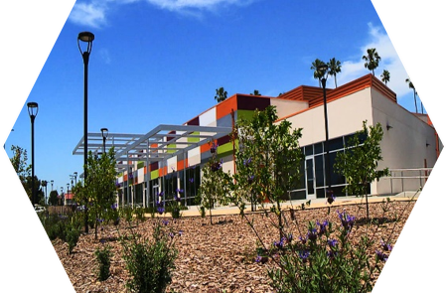
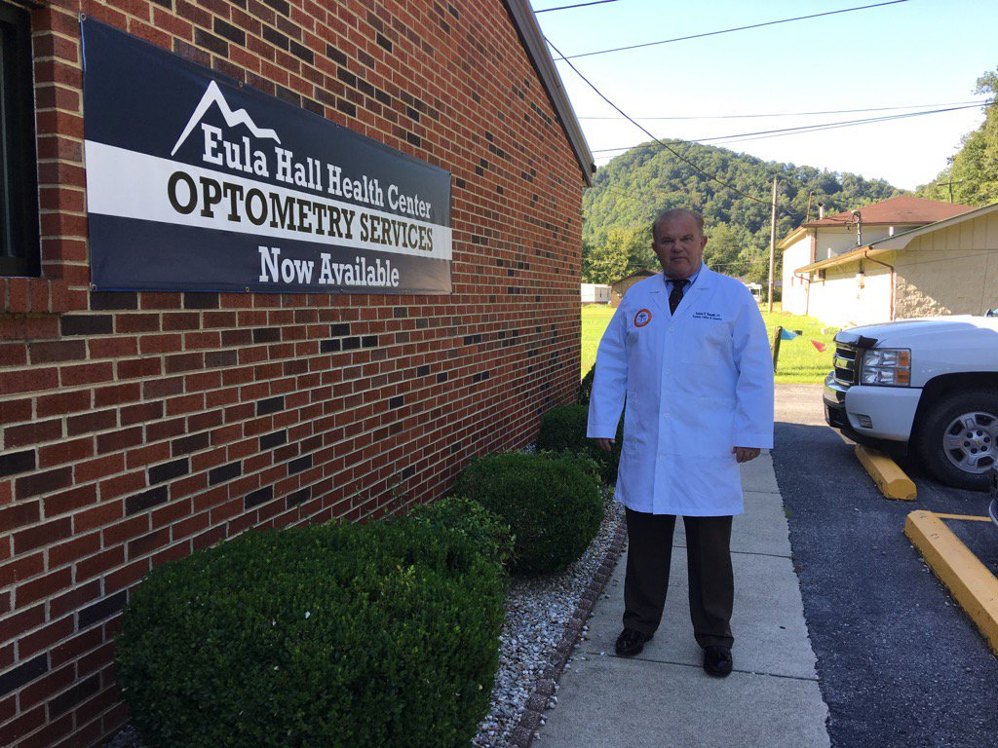
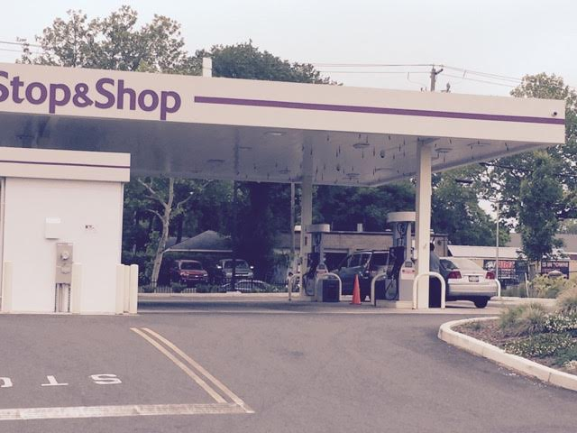
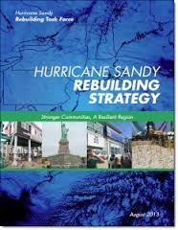
B2H National Project

Slide 15
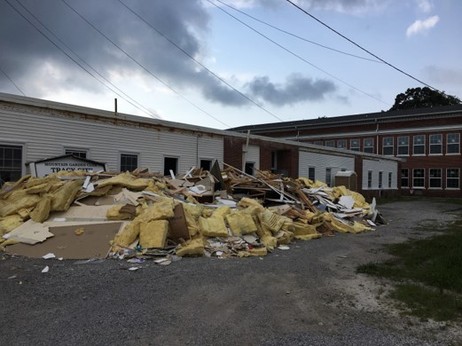
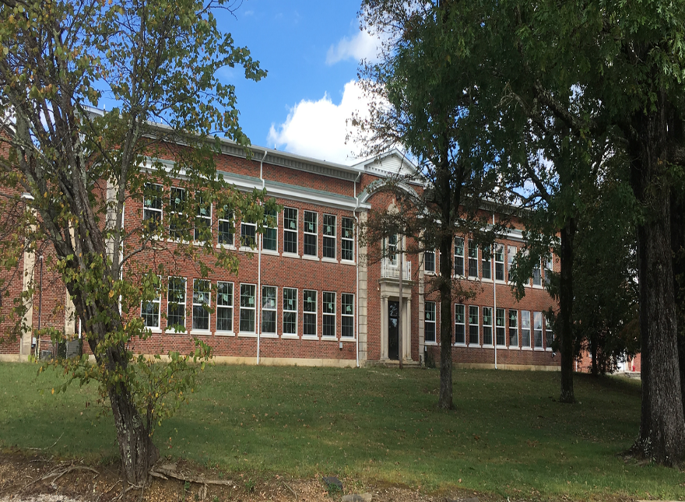
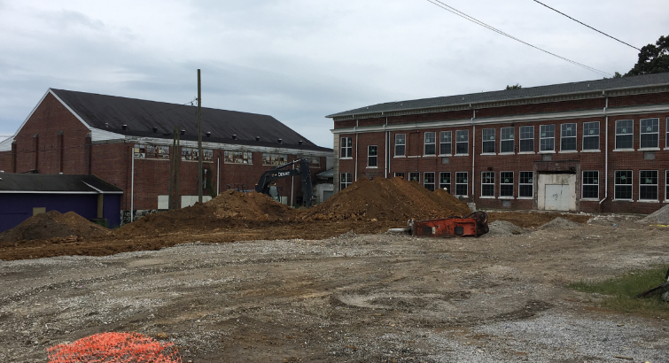
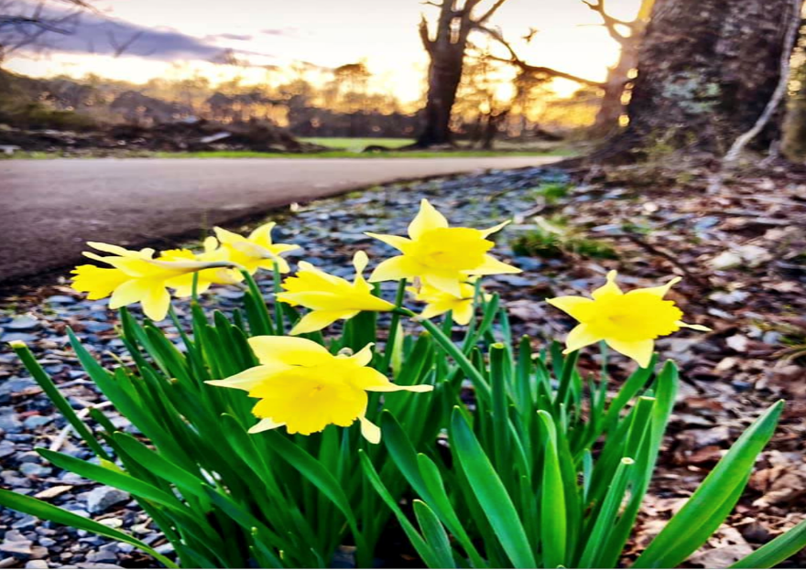
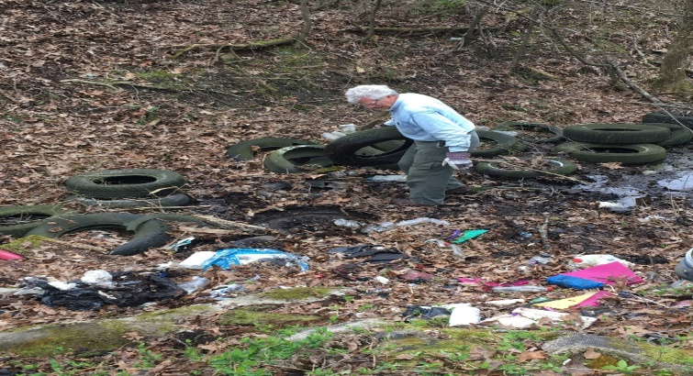

Rural Appalachia: From Poverty to Progress
BEFORE
AFTER
Resources Leveraged
From Multiple Sources
Appalachian Regional Commission
USDA
HUD CDBG
General Services Administration
US EPA
TN Dept of Health - Active Built Environment, Project Diabetes
TN Clean Energy
TN Local Parks and Recreation
South Cumberland Community Fund
TN Dept. of Transportation
TN Dept. of Conservation
Notes:
1. New windows and roof on two-story classroom section
2. The dilapidated and unsafe old library wing structure demolished
3. New landscaping of the grounds
4. Improved access to the back of the building
5. Currently, new electrical, HVAC, plumbing, lighting going in to first floor of 2 story
6. Painting will be done by volunteer/community
7. Limited electric and HVAC going on second floor while awaiting further funding to finish
8. Front ADA compliant entrance, porch and sidewalks, under construction
8. Gymnasium on track to begin renovation within the year

Slide 16










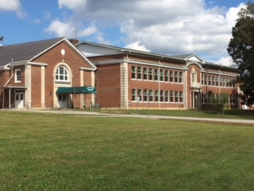






B2H:
Catalyzes Partners and Collaborators
Across Federal Family and External Stakeholders
Notes:
United States Department of Agriculture Natural Resource Conservation Services
Housing and Urban Development
US Environmental Protection Agency
Federal Reserve Bank of San Francisco
Neighborhood Housing Services
Moving Forward Network
American Optometric Association
Ketchum University
New Jersey’s Science and Technology University
UPIKE
HHS OMH & HRSA
GSA
South Cumberland Learning and Development Center & Mountain Goat Trail

Slide 17
Launching B2H in Savannah on Base of Progress
Federal Collaborators
US EPA Headquarters
  Office of Environmental Justice (OEJ)
  Office of Transportation & Air Quality (OTAQ)
US EPA Region 4
  Office of Environmental Justice and Sustainability
Federal Interagency Working Group on Environmental Justice (EJIWG)
Support Services
OEJ Community Support Services
EJIWG Strategy and Implementation Committee Place Based Project
OTAQ Near-port Community Capacity Building Project
Appreciative Inquiry Workshop
Air Monitoring Workshop
College Underserved/Community Partnership Program (CUPP)US EPA Region 4
Truck Count Project

Slide 18
IV. A Local Perspective
Dr. Mildred McClain, Harambee House, Inc.
2019 Georgia Brownfield Association Seminar

Slide 19
Dr. Mildred McClain
Harambee House, Inc.
Georgia Brownfields Conference
April 23, 2019
Atlanta, GA
Savannah Brownfields

Slide 20
Brownfields and Social Justice:
Implications?

Slide 21
Brownfields to Healthfields
What’s possible?

Slide 22
The Concept of Environmental Justice relates Environmental abuse to social justice

Slide 23

Thank You!
Questions?
Keith J. Ziobron, P.E.
Senior Principal & Branch Manager
Cardno, Inc.
678.787.9576
keith.ziobron@cardno.com

