Slide 1
City of Atlanta Brownfields Program
2019 GBA Brownfield Seminar
April 23, 2019
Jessica Lavandier
Notes:
Agenda: EPA brownfield Grants
COA Assessment Grants
COA Revolving Loan Fund Grant

Slide 2
EPA Brownfield Grants
Assessment Grants provide funding for brownfield inventories, site specific cleanup plans, environmental assessments, and community outreach. 3 year period.
  Community-wide Assessment Grants
  Site-specific Assessment Grants
Revolving Loan Fund (RLF) Grants provide funding to capitalize loans that are used to clean up brownfield sites.
Cleanup Grants provide funding to carry out cleanup activities at brownfield sites owned by the applicant.

Slide 3
CoA Brownfield Program Goals
  Improve the quality of life;
  Revitalize neighborhoods;
  Encourage sustainable redevelopment of brownfield sites;
  Protect human health and the environment;
  Support the retention and attraction of jobs;
  Maximize the effectiveness of the Brownfield Program through collaborative efforts; and
  Educate and engage with the community.
Promote the redevelopment of brownfields sites in Target Areas.

Slide 4
City of Atlanta EPA Brownfield Grants
Grant | Grant Amount | Phase I | Phase II | Facilities Assessment | Preliminary Assessments | Clean up plan | Notable Assessments
1996 Pilot Grant | $100,000 |  |  |  | 106 |  | Beltline Survey
2005 Assessment Grant | $400,000 | 12 | 9 |  |  |  | O4W Park, Memorial Dr. Greenway Project
2009 Brownfield Revolving Loan Fund | $2,450,000 |  |  |  |  |  | East Side and West side trails RDA to Cascade
2010 Assessment Grant | $400,000 | 11 | 7 | 4 | 14 |  | Greenspace, Westside Trail
2010 Area Wide Planning | $175,000 |  |  |  |  |  | Murphy Triangle
2013 Assessment Grant | $400,000 | 10 | 6 |  |  | 2 | Lifecycle Building, BeltLine park
2017 Assessment Grant | $300,000 |  | 2 |  |  | 1 | Beltline rail corridor, Pullman Site
Total | $4,225,000 | 33 | 24 | 4 | 120 | 3

Slide 5
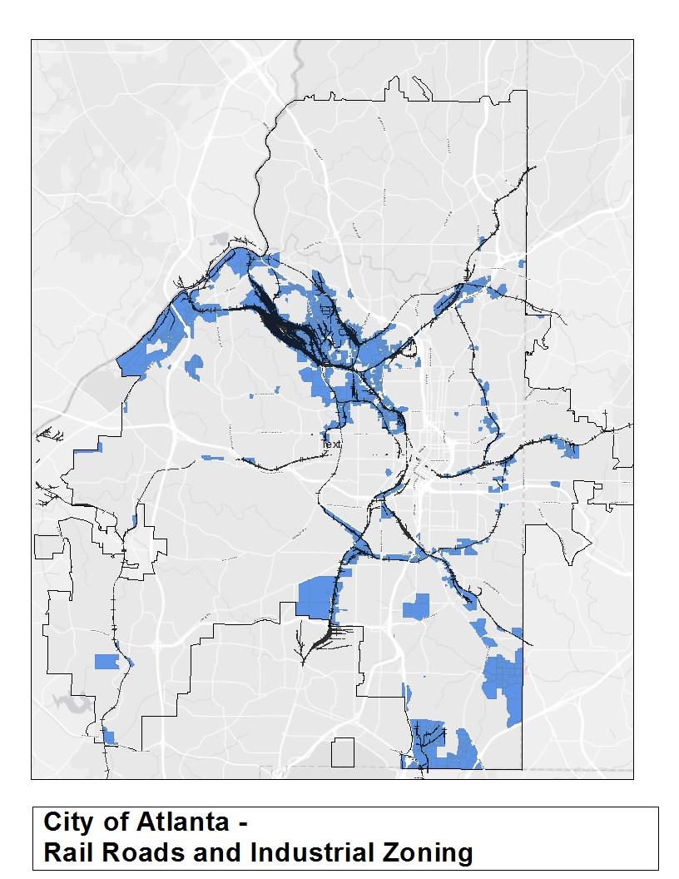
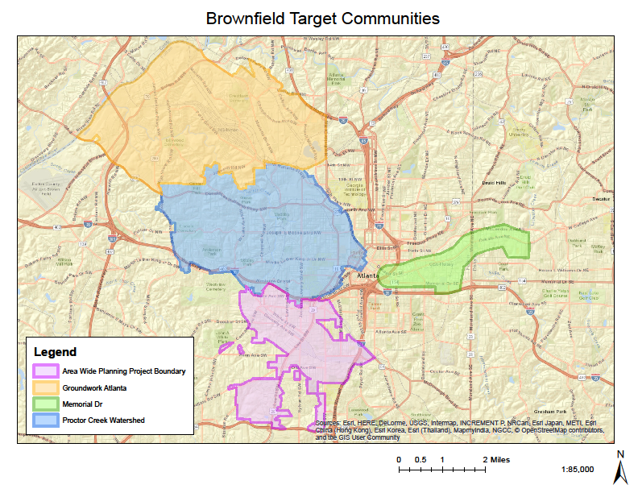
Target Areas

Slide 6
Assessment Grant
Project Management and Reporting
Community Involvement-
  Stakeholder Advisory Committee
Brownfield Assessment
  Phase I
  Phase II
Cleanup and Development Planning
The Goal is to Position Sites for Cleanup Grants and Future Redevelopment

Slide 7
Assessment Nomination
Site must be a Brownfield
Target Area Location
Previous Use
Redevelopment Time Frame
Proposed Use
Leverage Brownfield Program
Preservation of historic buildings
Transit Oriented Development

Slide 8
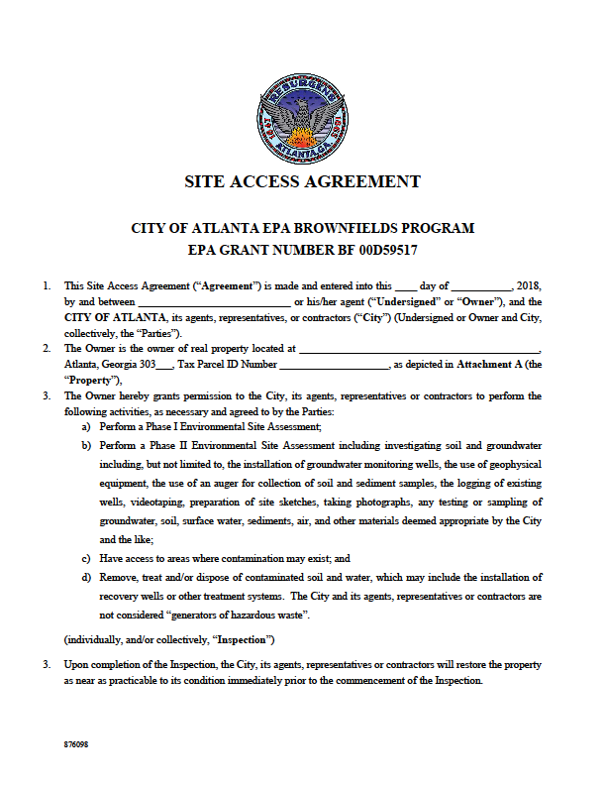
Site Access Agreement
Site access approval from the property owner is needed to conduct the Environmental Site Assessment.
ESA are subject to Open Records and are can’t be confidential.

Slide 9
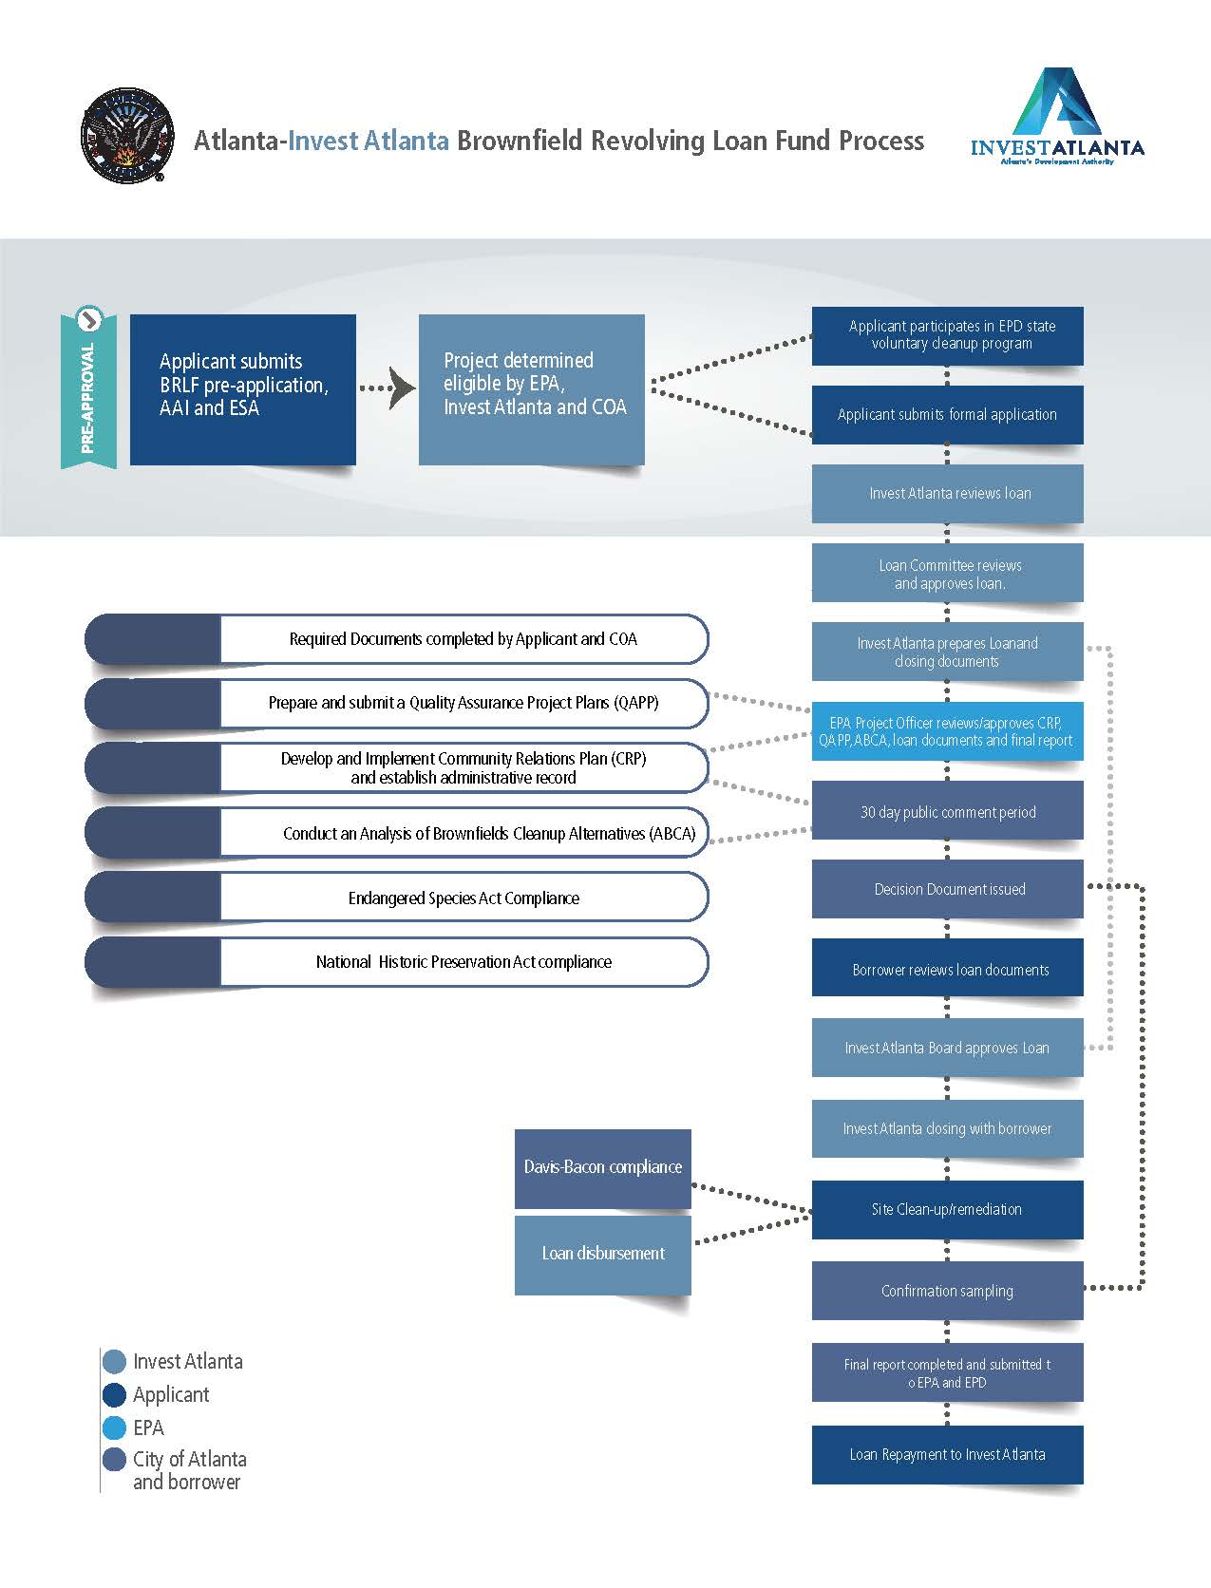
Revolving Loan Fund
Partnership with Invest Atlanta
Loan for 80% of remediation cost
Requires GA EPD Corrective Action Plan (CAP) or Prospective Purchaser Corrective Action Plan (PPCAP)
Notes:
Enrollment in the Georgia Brownfields Program
Community Relations Plan (CRP)- 30 day public engagement
Quality Assurance Project Plans (QAPP)
Analysis of Brownfields Cleanup Alternatives (ABCA)
Davis Bacon Compliance

Slide 10
RLF Program Administration
City of Atlanta – Cooperative Agreement Recipient
    QEP – Qualified Environmental Professional coordinates and direct cleanups.
Invest Atlanta – Fund Manager and Loan administrator
EPA Project Officer- Reviews and approves QAPP and substantial involvement in the process.
GA Environmental Protection Division –EPA will utilize GA EPD process for CAP amendments ie Compliance Status Reports
Loans and Subgrants recipient
  20% match required
  Subgrants to non-profits – limited to $200,000.

Slide 11
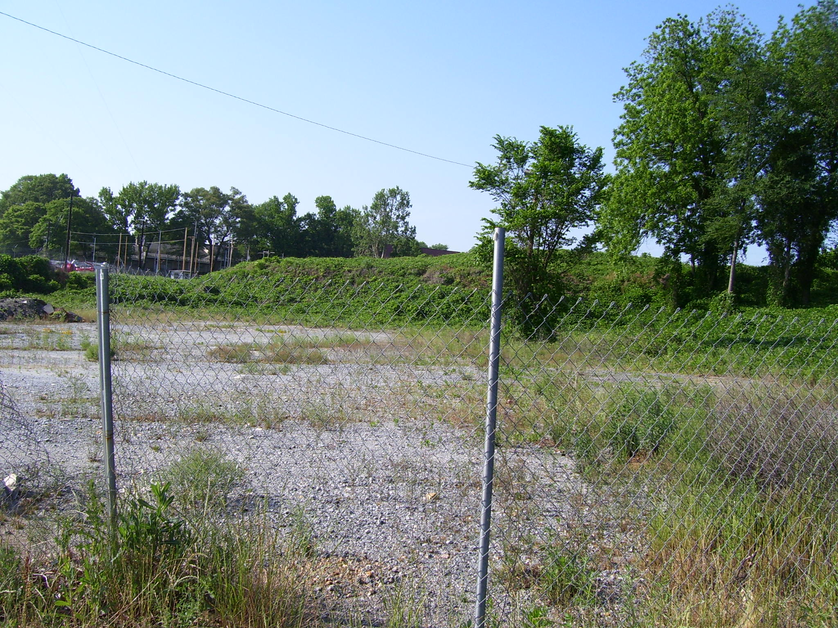
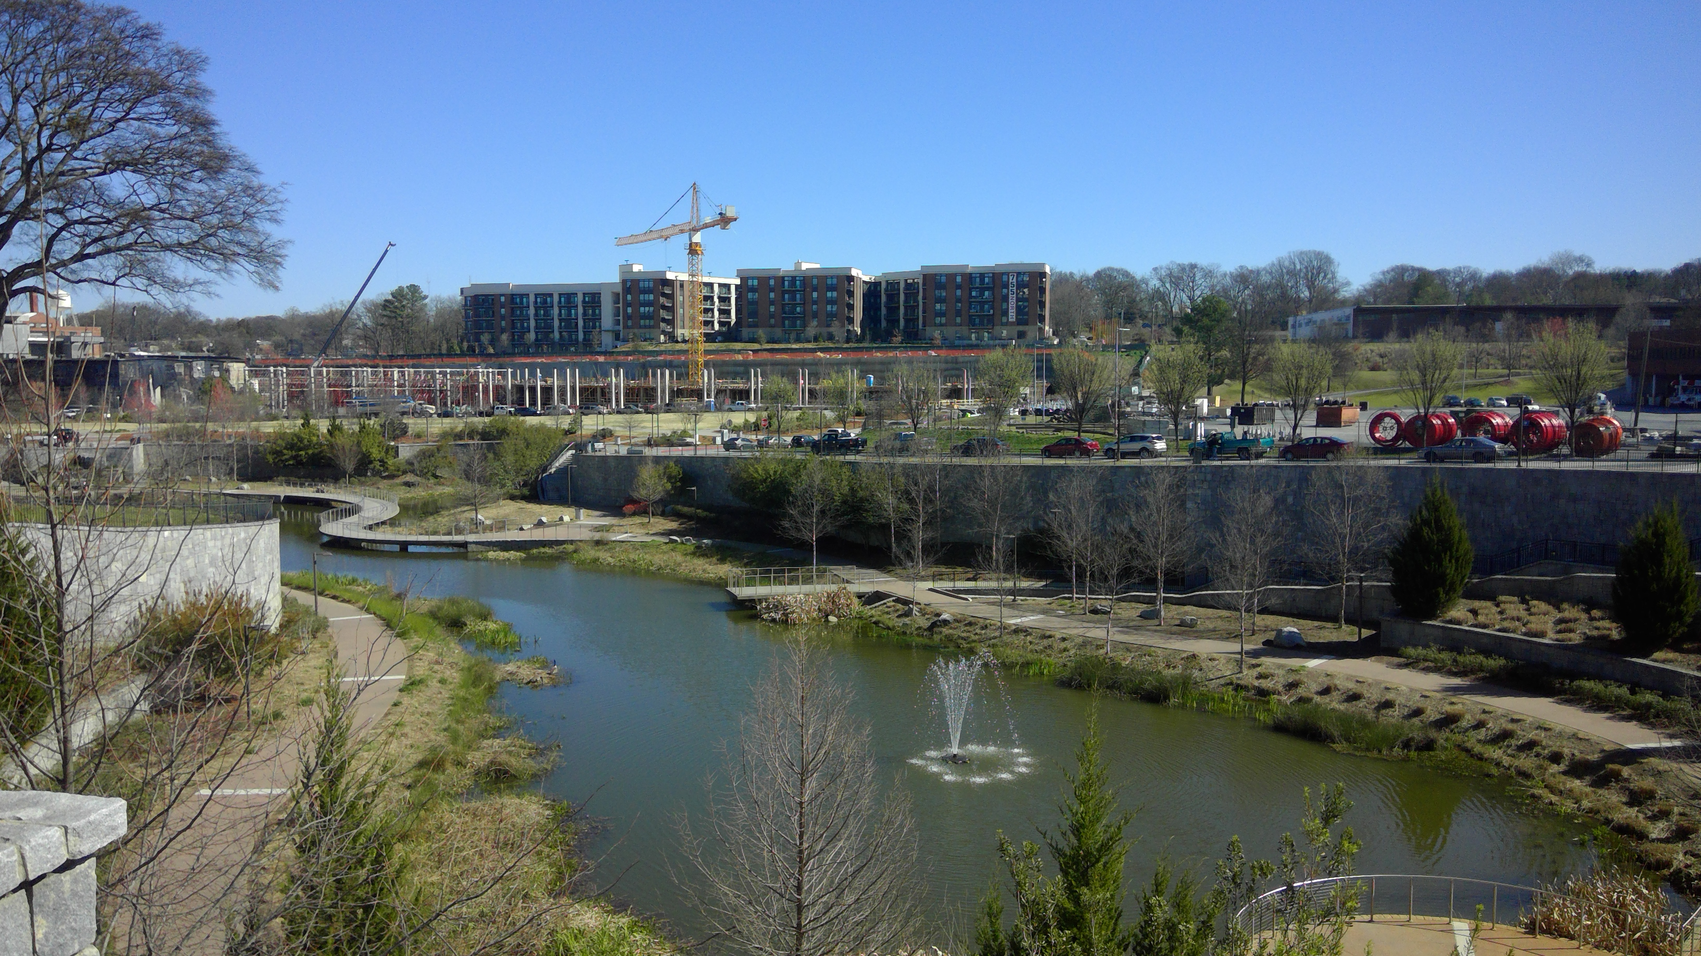
2005 Assessment Grant- Rankin & Dallas/O4W Park
Phase I

Slide 12
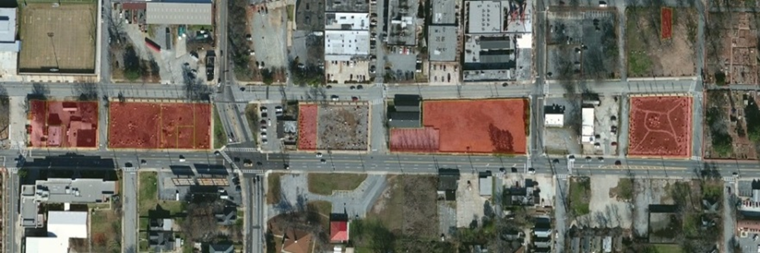
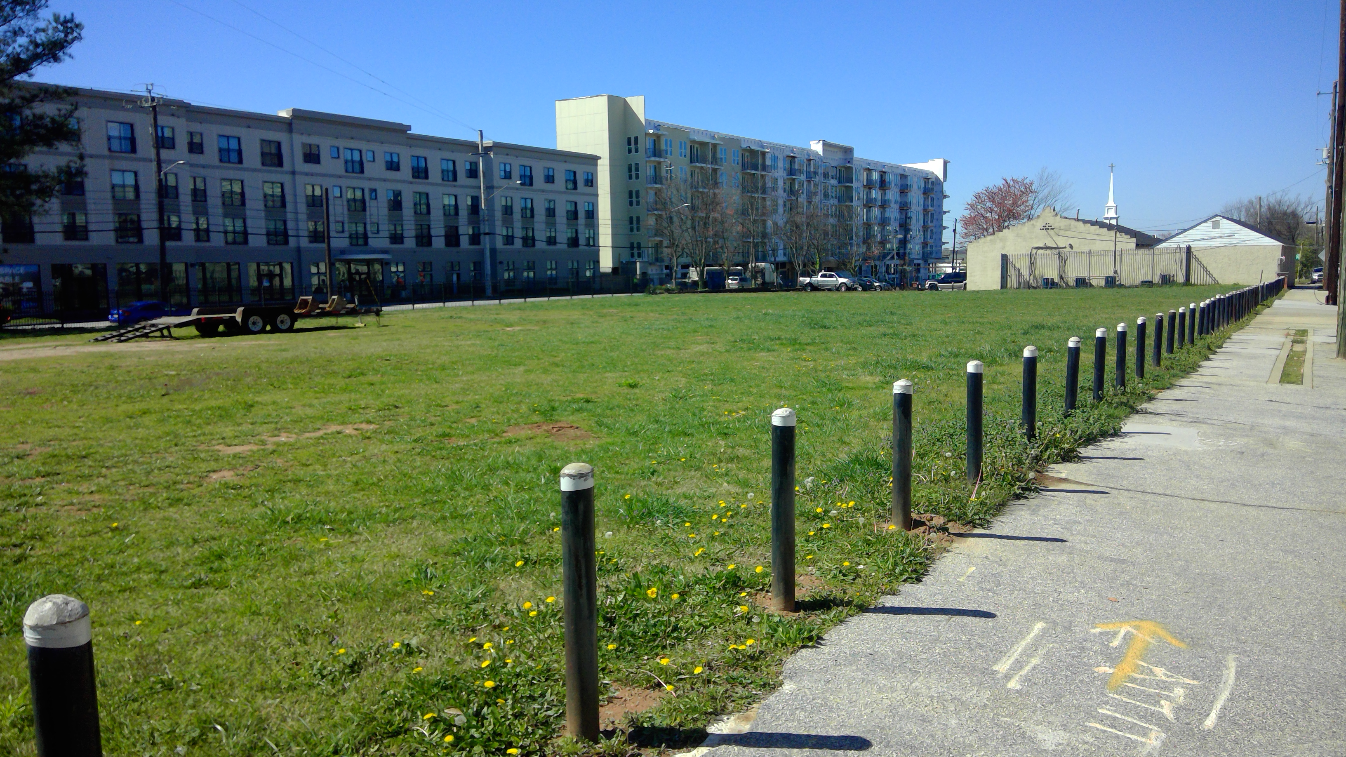
2005 & 2010 Assessment-
Memorial Dr. Greenway Project

Slide 13
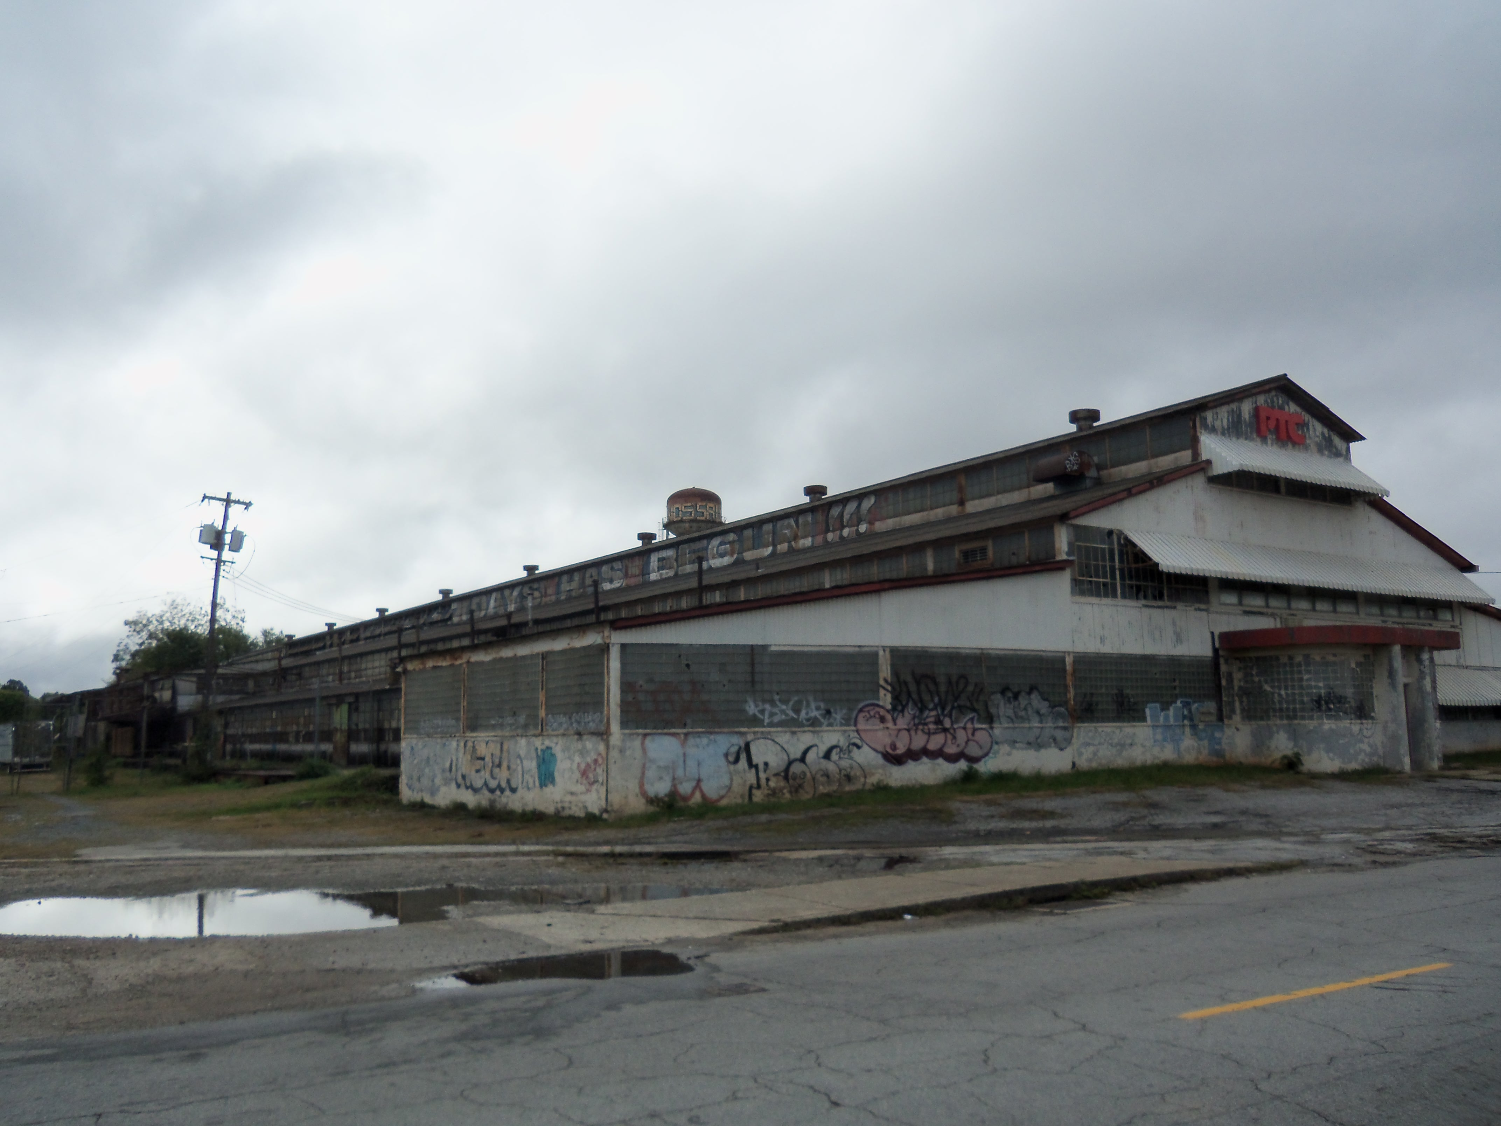
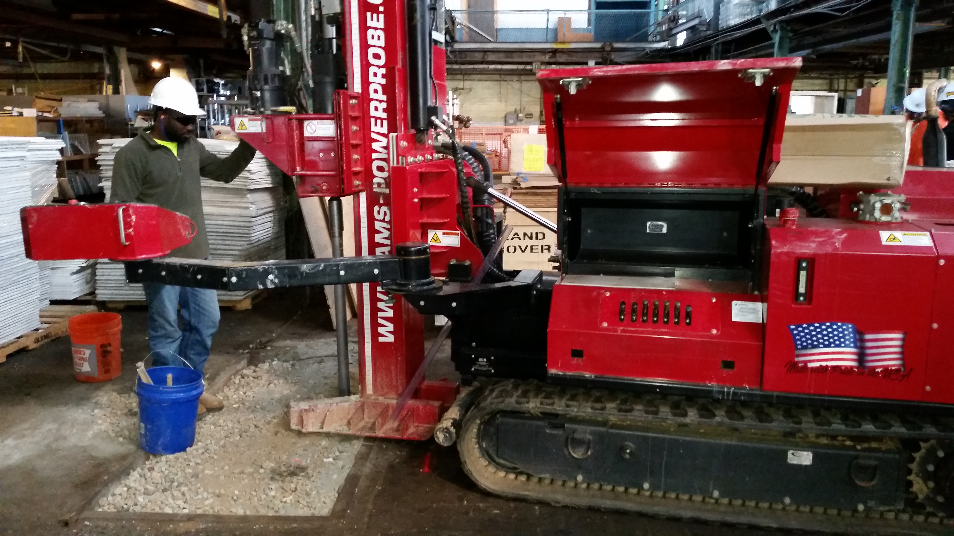
2013 Grant- Lifecycle Building Center
Phase I
Phase II
Supplemental Phase II
Cleanup Plan
Positioned site for EPA Cleanup Grant

Slide 14
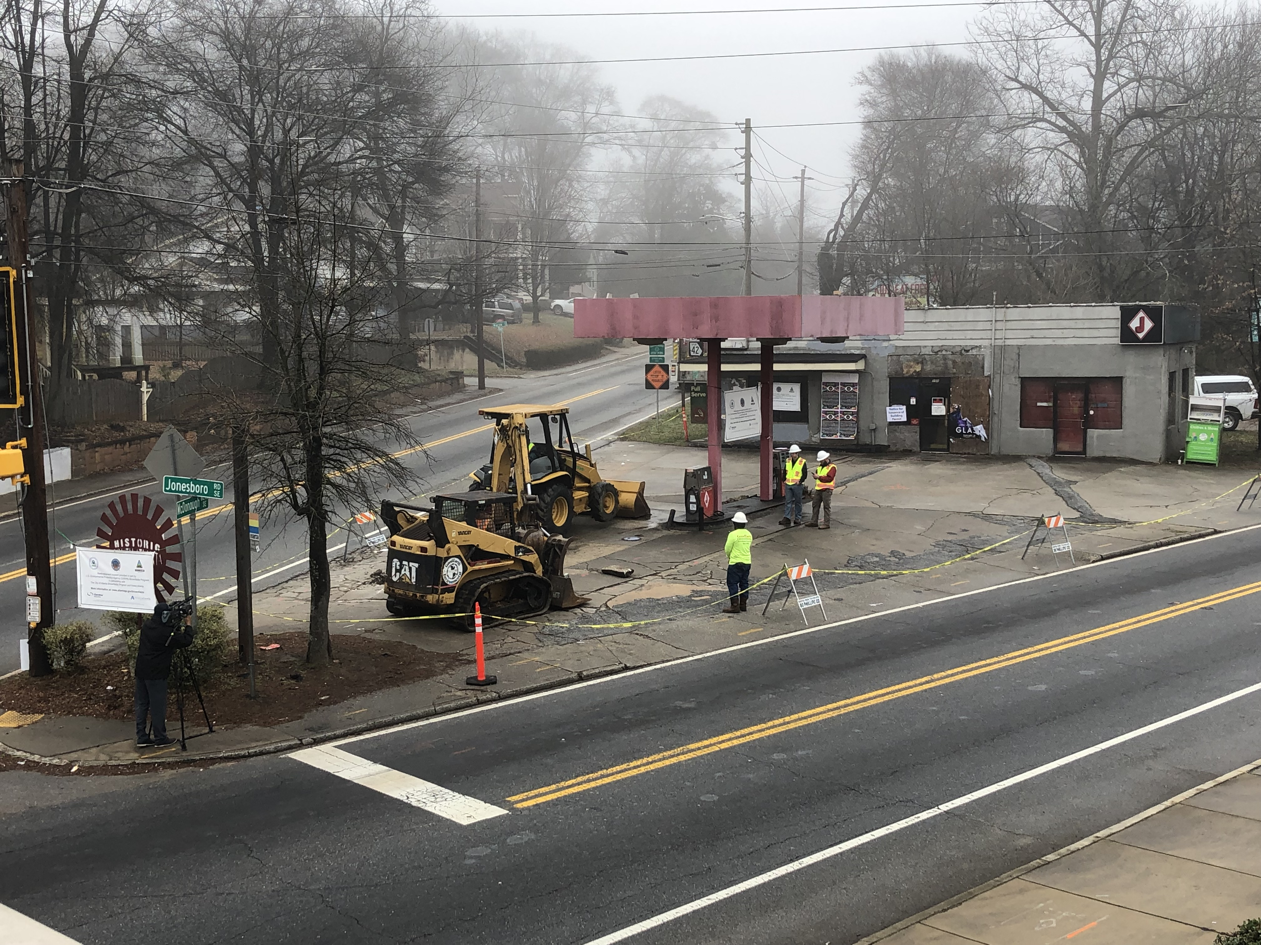
2017 Assessment Grant-105 McDonough
Phase II
UST Tank Removal

Slide 15
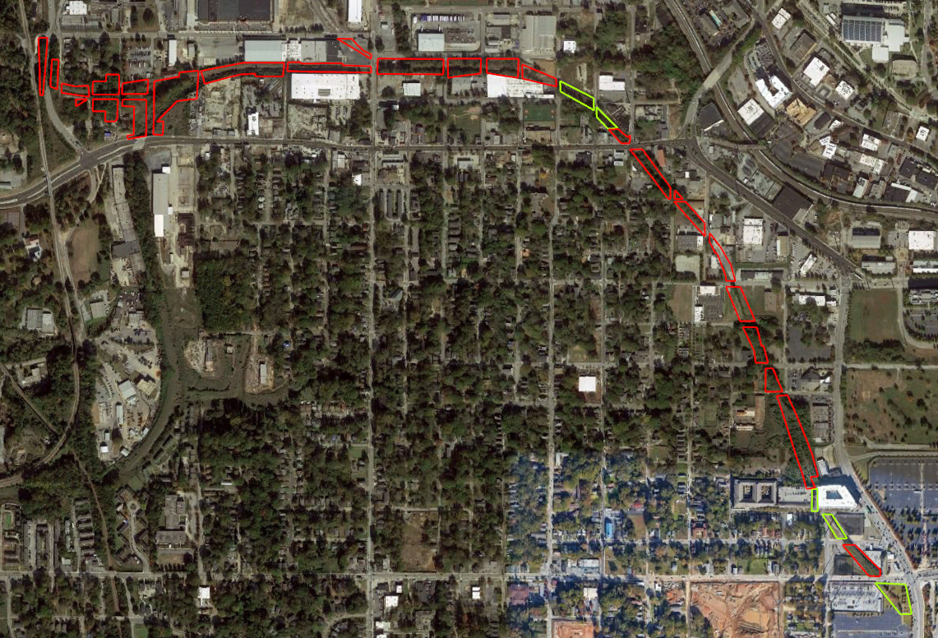
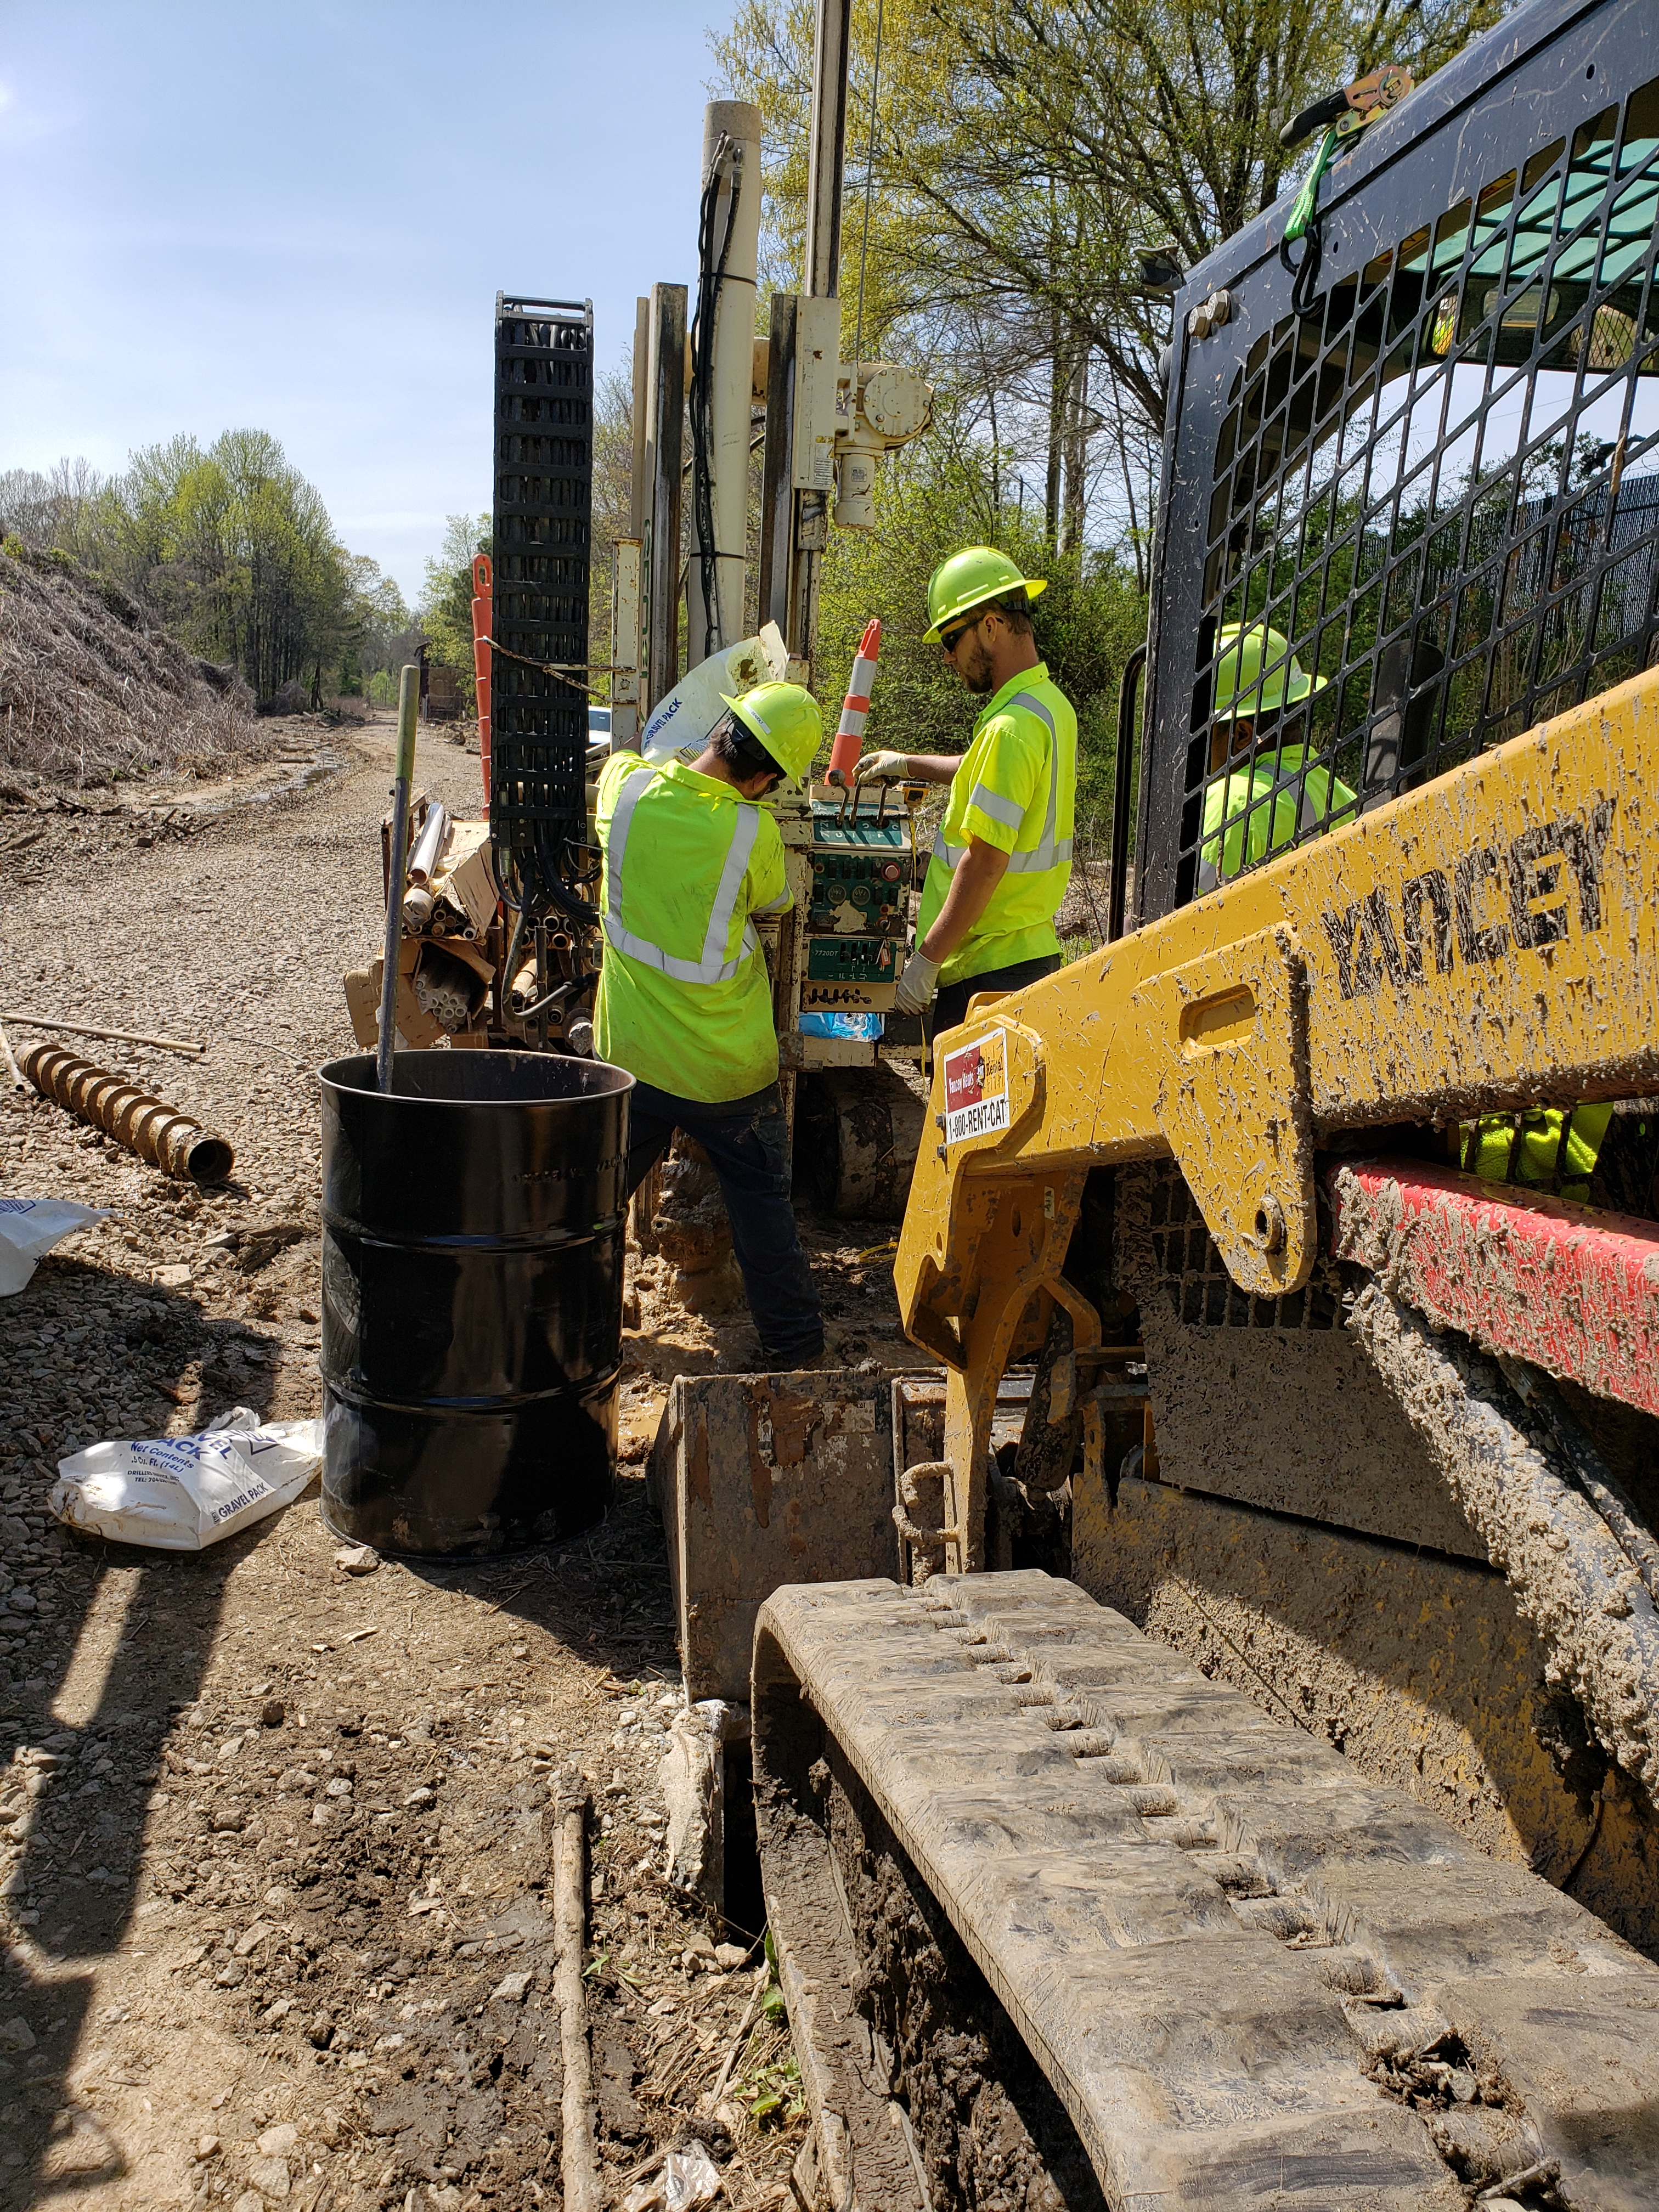
2017 Assessment Grant-CSX Rail/Church Line
Phase II

Slide 16
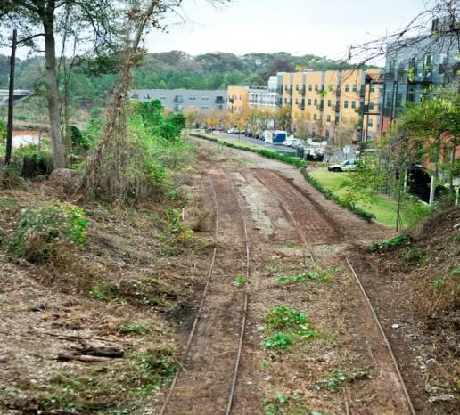
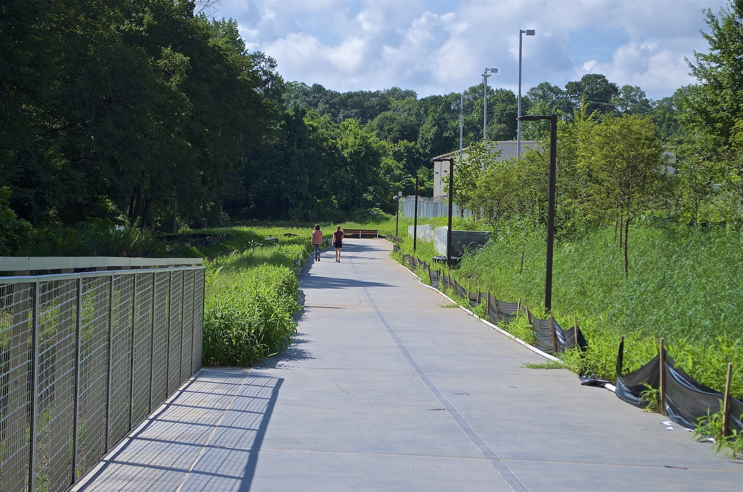
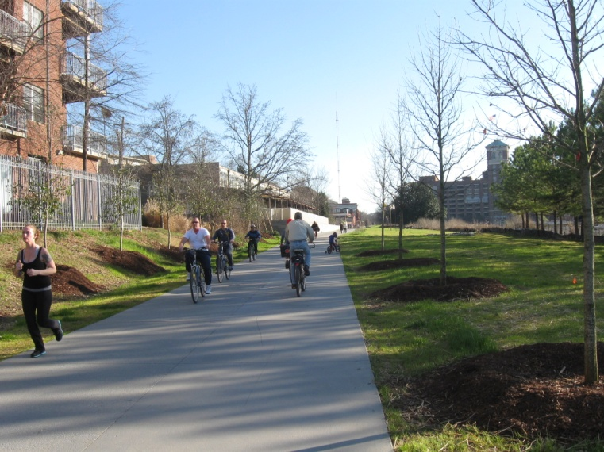
BRLF: BeltLine Eastside and Westside Trail
Phase II & BRLF Loans

Slide 17
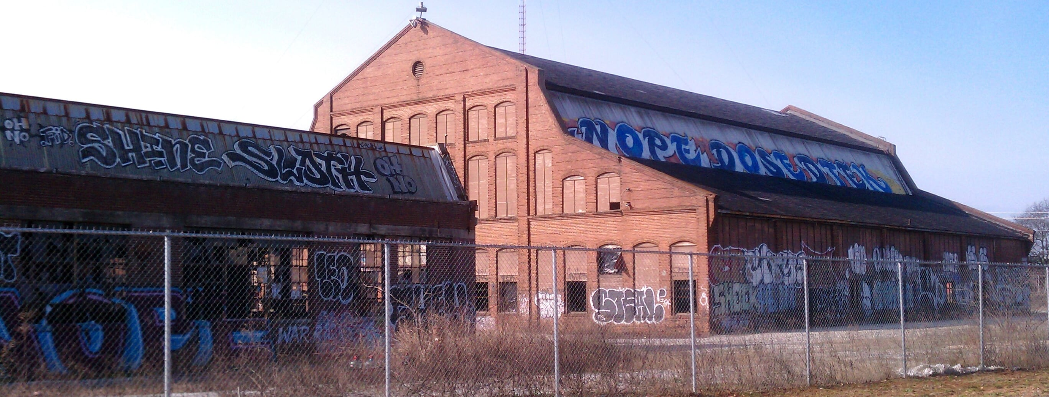
Assessment and BRLF: PULLMAN YARD
Cleanup Planning
Lead and Asbestos Abatement

Slide 18
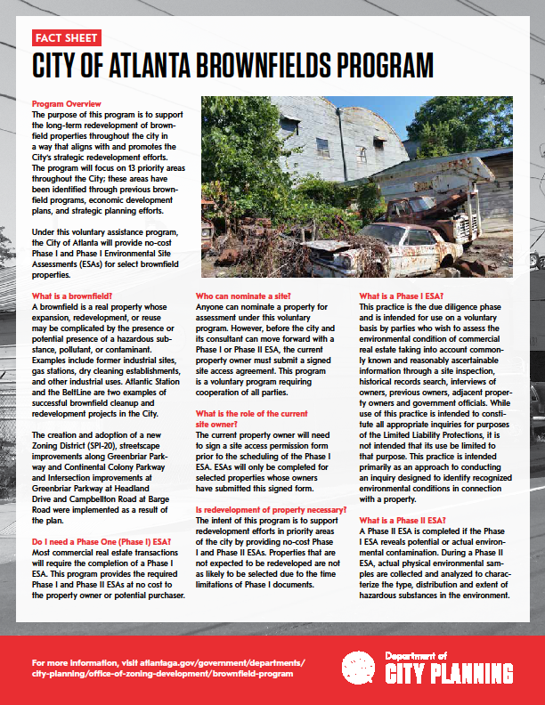
More Information-
Visit
www.atlantaga.gov/brownfields
Fact Sheet
Application
Story Map
https://coaplangis.maps.arcgis.com/apps/MapTour/index.html?appid=6bfaf54dbe854f2482a3582a2bc3a897
Contact:
Jessica Lavandier
jlavandier@atlantaga.gov

