Slide 1
Taking A Closer Look at PFAS Health Risk Implications
Presenter: Shanna Alexander MS, MPH, DABT

Slide 2
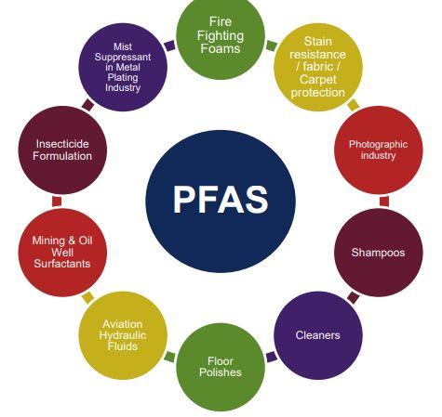
overview
Toxicological Effects
Variation in Standards
Root Cause of Uncertainty
Challenges and Novel Approaches
Credit: AUS Dept. of Health
Notes:
Most people are likely to have background levels of PFOS, PFOA and PFHxS in their blood. Class of about 3500 chemical compounds. Bioaccumulative in animals and humans, biopersistent, loves water and can travel long distances. So ingestion is the primary route of exposure (house dust, food packaging, our diet, or drinking water)
- Seeing PFOS levels as high as 300,000 in MI in surface water

Slide 3
Systemic toxicity effects
Cardiovascular effects/Blood (hypertension in pregnancy)
Digestive effects (ulcerative colitis)
Reproductive (low fertility, low infant birth weights, preeclampsia due to hypertension)
Liver effects (high blood cholesterol, elevated bilirubin levels)
Endocrine disruption (thyroid disease)
Increased risk of cancer (PFOA; testicular, liver, and kidney)
Immune response effects (asthma, low vaccination response)
Developmental effects (low birth weights; largest body of animal studies)
Notes:
Hematological effects? Research to date suggests that exposure to PFAS may pose a number of potential health risks. Similar effects observed in animal studies.
We know there are over 3000 PFAS, they’re ubiquitous in the environment (food packaging, house dust and drinking water), bioaccumulative, and biopersistent
Binds to proteins (loves cell membrane surfaces and highly perfused tissues); low affinity to fats
PFOS and PFOA do not metabolize well in animals and humans.
The Air Force filed a suit seeking relief in the U.S. District Court of New Mexico, calling the state standard ‘arbitrary, capricious, an abuse of discretion, and not supported by substantial evidence.’

Slide 4
VULNERABLE “at risk” populations
Pregnant women (developing fetuses) – crosses placenta
Women of reproductive age
Babies and young children (detectable levels in breast milk)
People with suppressed immune systems
Notes:
Josh McNaughton (child affected by the Wolverine site in utero) tested at 4 years old at 47000 ppt.
Male rats show higher levels than females

Slide 5
limited toxicity data
PFAS | Chronic Oral RfD (mg/kg-day) / Critical Effect | Source
PFOS | 0.00002 (developmental effects; reduced growth) | PPRTV
PFOA | 0.00002 (developmental effects; early puberty in male mice) | PPRTV
GenX (HFPO) | 0.00008; NOAEL = 3 mg/kg-d (liver toxicity in male mice) vs 30 mg/kg-d for female mice | Draft PPRTV
PFBS | 0.01 (thyroid and kidney effects) | Draft PPRTV
PFHxA | 0.25 (bench dose modeling of renal papillary necrosis; chronic female rat bioassay) | Luz, Anderson, et al. (2018)
Notes:
- Higher the RfDo the less toxic the compound so GENX is less toxic that PFOS and PFOA; characterizing the uncertainty is an issue. EPA guidelines looks at whether the appropriate endpoints are being studied.
- Shorter the chain the less bioaccumulative and toxic the compound.
Toxicity is only one piece of information public health officials look at. Other factors like exposure must also be considered.
combination of PFOA, PFOS, PFHxS, PFHpA, and PFNA.

Slide 6
survey question
A former manufacturing plant discharged PFOS to a nearby surface water body that resulted in contamination of groundwater downstream. PFOS was detected between 50 to 65 ppt in several private drinking water wells in a residential neighborhood. What action(s) should ensue?

Slide 7
And the answer is…
It depends…
How is “action” being defined and is it legally enforceable?
What state or region did the release occur?
What is the comparison criteria and is it a health screening or advisory level or an action level?

Slide 8
Variation in drinking water guidelines
Region/State (Framework) | PFOA (ppt) | PFOS (ppt)
Canada | 200 | 600
Australia (health advisory) | 560 | 70 (PFOS and PFHxS)
ATSDR | 21 | 14
Michigan (screening; 4/19) | 9 | 8
Vermont (health advisory) | 20 (5 PFAS) | 20 (5 PFAS)
New Jersey | 14 | 13
Alaska (action levels) | 70 (6 PFAS) | 70 (6 PFAS)
Minnesota (screening) | 35 | 15 (4/19 update)
New York (proposed MCL) | 10 (PFOS/PFOA) | 10 (PFOS/PFOA)
California (notification) | 14 | 13
Notes:
States with numerical PFAS limits. These are precautionary measures as wait for EPA to promulgate MCLs. PFAS is an emerging global issue; lots of legislative activity but slow on the science front. Will all boil down to the science… the chemists and the toxicologists/risk communicators. Is there a risk and at what level? We need numbers backed by sound science and not just based on policy and fear mongering.
ATSDR recommends contacting your state and local authority. “Coincidentally”, EPA makes plan in same week to establish MCLs. Cooperative partnership?
MI:
PFOA: 9-ppt
PFOS: 8-ppt
PFNA: 9-ppt
PFHxS: 84-ppt
PFBS: 1,000-ppt

Slide 9
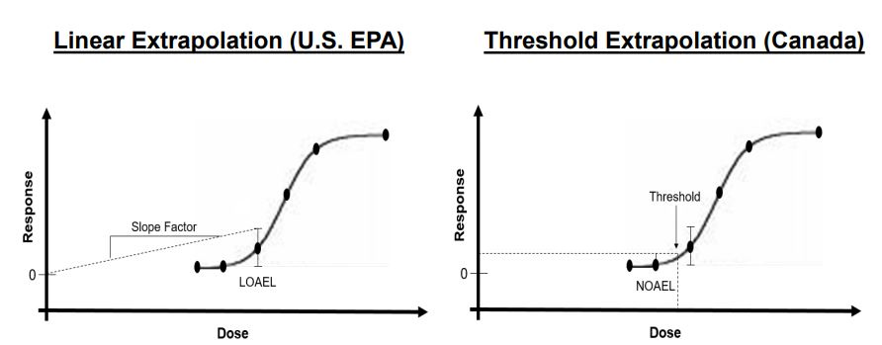
Dose-response relationship
Notes:
US Linear No threshold dose relationship theory and model vs Canada’s threshold dose approach.
Problem with the US ancient low dose approach is that at the low dose you often get imprecise data and conflicting results. The theory itself implies proportionality
between dose and cancer risk

Slide 10
Extrapolation from dose-response modeling
An important step in setting toxicity values is establishing a dose-response relationship (NOAEL vs LOAEL, linear vs non-linear, high dose vs low dose, rat study vs mice study, etc.)
Dose regimen: 300 vs 1,000 mg/kg-d
Wide range of measured effects
Mortality, pathological or functional changes
Agency guidelines for establishing reference dose values using animal bioassays
Was the statistical procedures valid for determining an effect?
Were the appropriate toxicological endpoints chosen for setting the toxicity value?
Notes:
OECD study test methods and assessment

Slide 11
Why so much variability in toxicity?
RfD (ng/kg bwt-day) | USEPA (2016) | ATSDR (2018) | Difference
PFOA | 20 | 3 | 7-fold
PFOS | 20 | 2 | 10-fold
Selection of different critical effect or toxicity endpoint in animal study (ATSDR - immune effects; USEPA – developmental/reproductive)
Use of different uncertainty factors (e.g., large safety margins)
Use of different type of test species (rats vs mice vs monkeys)
Notes:
Based on rat study; rats preferred over smaller rodents; the smaller the rodent the more subjected you are to see increased variability due to technical challenges of dissecting smaller organs
What is the appropriate endpoint? Reduced body weight, liver, heart, lung, or kidney effects, etc.? Or are we seeing other changes that may not be a toxic response such as liver inflammation
Reduced food intake or liver enlargement.

Slide 12
Viable options for Setting Standards
Use of animal toxicology studies alone
CON: Chronic rodent bioassay not possible for universe of PFAS compounds
Use of epidemiological findings
CON: Largest epidemiological study is in West Virginia; but limited compounds
Biomonitoring for body burdens to see if exceed national average
Apply computational approaches – Structure-Activity Relationship Modeling (e.g., TOPKAT)
CON: Broader regulatory acceptance needed and too few compounds studied
Use of epidemiological findings Apply computational approaches – Structure-Activity Relationship Modeling
CON: Broader regulatory acceptance needed and too few compounds studied
Combine toxicological and epidemiological findings and apply scientific weight of evidence
CON: Lack toxicological data
Notes:
CompTox Program and endocrine disruption programs turned 10 this year; but still fighting for broader acceptance in regulatory science

Slide 13
Take-home message
PFAS associated with health effects in just about every body system
No recommended safe blood level for PFAS, but science evolving
Cumulative effects - “Hazard Index” method
Available oral reference dose values for only a few PFAS compounds
Novel approaches to addressing PFAS precursors/varieties
Structure-Activity Relationship modeling, Relative Potency Factor
Still lots of uncertainty in the toxicity. A global scientific concern, BUT…
At what level and at how much of a concern is yet to be determined
Conflicting science and differences in margin of safety (revisit testing guidelines??)
Notes:
Expect to see more legislative activity and lawsuits over health impacts.

Slide 14
Questions?

