Slide 1
Park Pride
Kathryn Johnston Memorial Park

Slide 2
Andrew White, RLA
Director of Park Visioning
Park Pride
Notes:
Thank you for inviting me to share some of the story of KJMP
Name, title, org

Slide 3
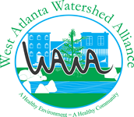
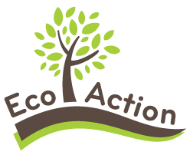
Shared Values – Nonprofit Partners
Delivering new parks and greenspaces through a community-centered process that provides environmental, economic, and social justice outcomes for those that live, work, and play in some of our most vulnerable communities.
Notes:
First I wanted to acknowledge that this project was a collaboration between many different partner organizations
None of this work would have been possible without the contributions of the many great partners we have

Slide 4
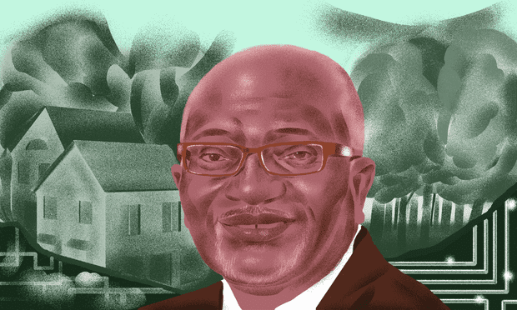
Acknowledgement of Environmental & Racial Injustices
Race is the most significant predictor of a person living near contaminated air, water, or soil.
African Americans are exposed to 1.54 times more fine particulate matter than whites (EPA 2018)
African Americans and other people of color breathe 38 percent more polluted air than whites; people of color are exposed to 46 more nitrogen oxide than whites (Univ of Minnesota 2014)
People of color are overrepresented in populations who live within a one-mile radius (44%) and a three-mile radius (46%) of the nation’s 1,388 Superfund sites. People of color comprise only 37 percent of the U.S. population. (EPA 2014)
Illustration: Richard A Chance
“America is still segregated and so is pollution.”
- Dr. Robert D. Bullard
Rooted in racial discrimination in housing, land use planning, and zoning.
https://drrobertbullard.com/
Notes:
Before I begin talking about the park project, it's important to acknowledge the context of environmental injustices that have been visited on black and brown Americans by white power structures and systems in this country.
I'm going to be talking about some environmental and social issues that are present in many of the neighborhoods we work in, and almost all of these issues can be traced back to intentional discriminatory policies and practices that continue to this day. A presentation on environmental injustice could take the whole rest of the time we have, and candidly I'm a novice when it comes to the larger environmental justice issues in this country. However, I do want to take this opportunity to share the work of Dr. Robert Bollard, who is known as the Father of Environmental Justice. He has been fighting for environmental justice as a civil rights issue for longer than I've been alive, and he has an excellent website where he makes available many resources and studies. But, the key concept I want you guys to hear today is that race is the most significant predictor of a person living near contaminated air, water, or soil, and there are many peer-reviewed studies that back up this claim.

Slide 5
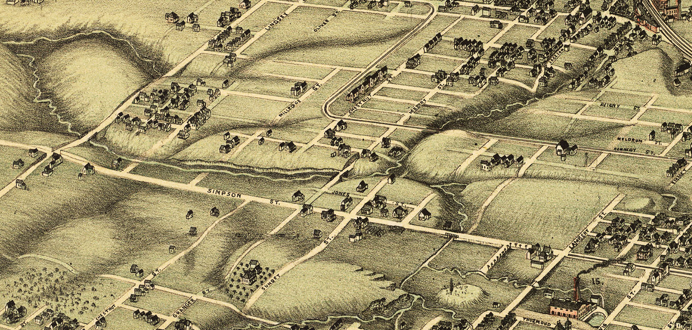
Proctor Creek Headwaters - 1892
Site of Kathryn Johnston
Memorial Park
Notes:
Area in red is KJMP
Historically Proctor Creek flowed through area, but has since been piped into the combined sewer
Once important for fishing, recreation, even baptism

Slide 6
Site of Kathryn Johnston Memorial Park – 1911 and 1978
1911
1978
Notes:
Environmental justice – shows discriminatory land use practices

Slide 7
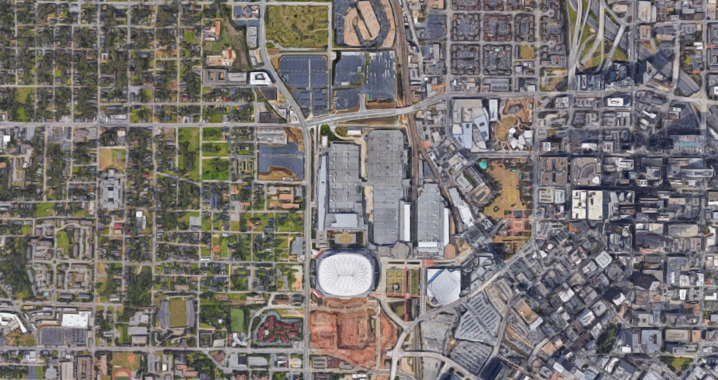
Proctor Creek Headwaters - Today
Notes:
Risk of gentrification & displacement
Highest poverty, vacancy and crime rates
40% foreclosure rate
Average household income $22,474
Natural creek obliterated by development
Severe stormwater flooding
Combined sewer area
29 EPA identified hotspots along the creek
Feeds directly into the Chattahoochee River

Slide 8
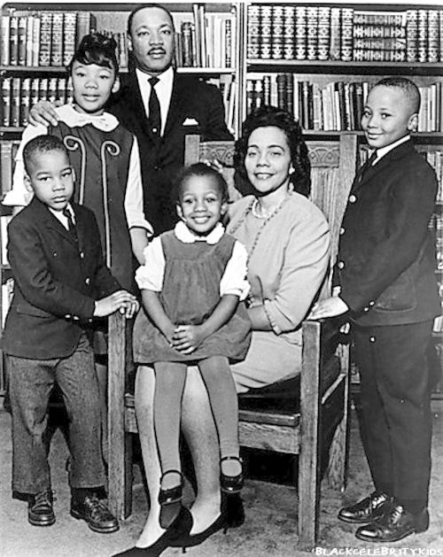
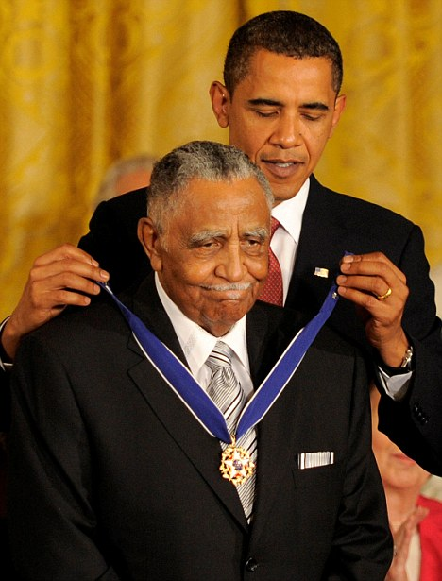
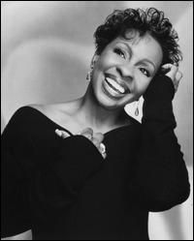
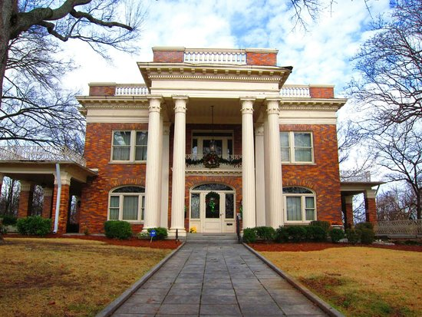
Proctor Creek Headwaters – Cultural and Historic Significance
Notes:
Cultural history of the community

Slide 9
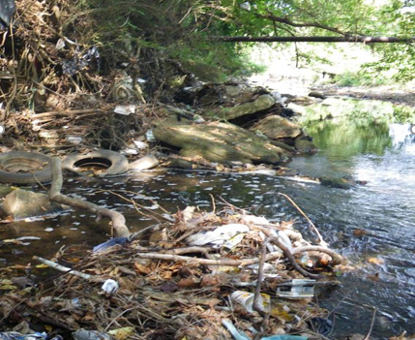
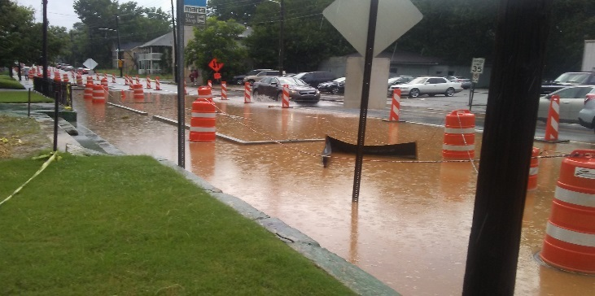
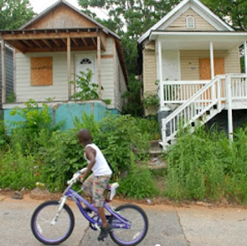
Impacts of Disinvestment and Unjust Policies and Practices
Highest poverty, vacancy & crime rates
40% foreclosure rate
Average household income $22,474
Natural creek obliterated
Severe stormwater flooding
Combined sewer area
29 EPA-identified hotspots along the creek
Notes:
Cultural history of the community

Slide 10
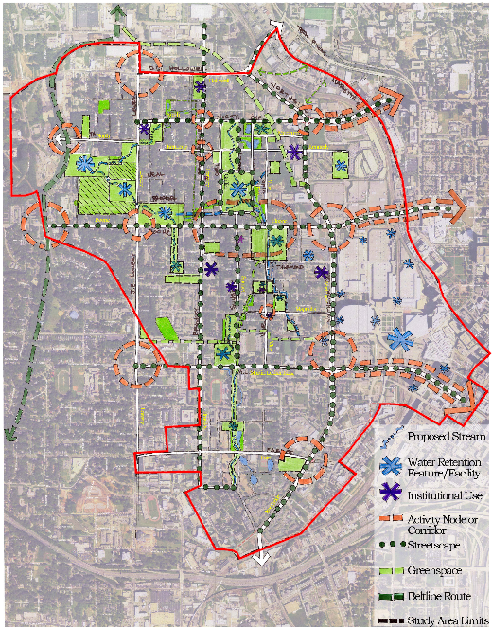
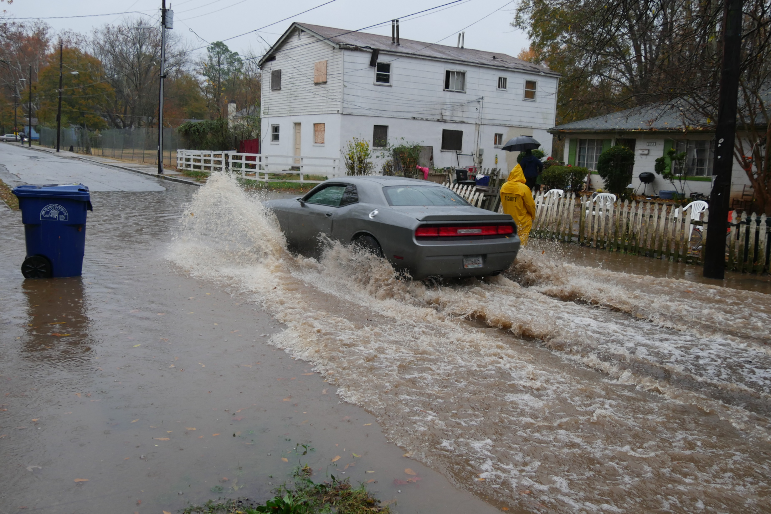
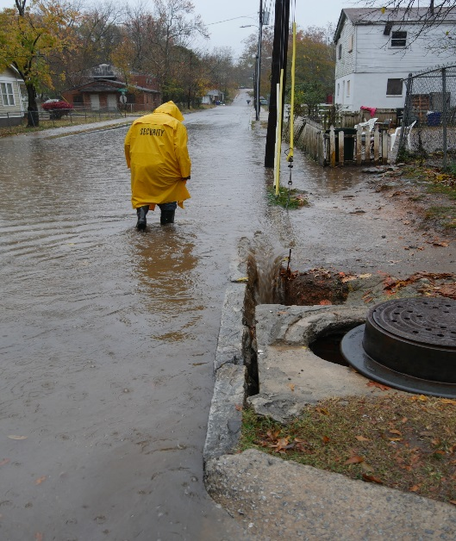
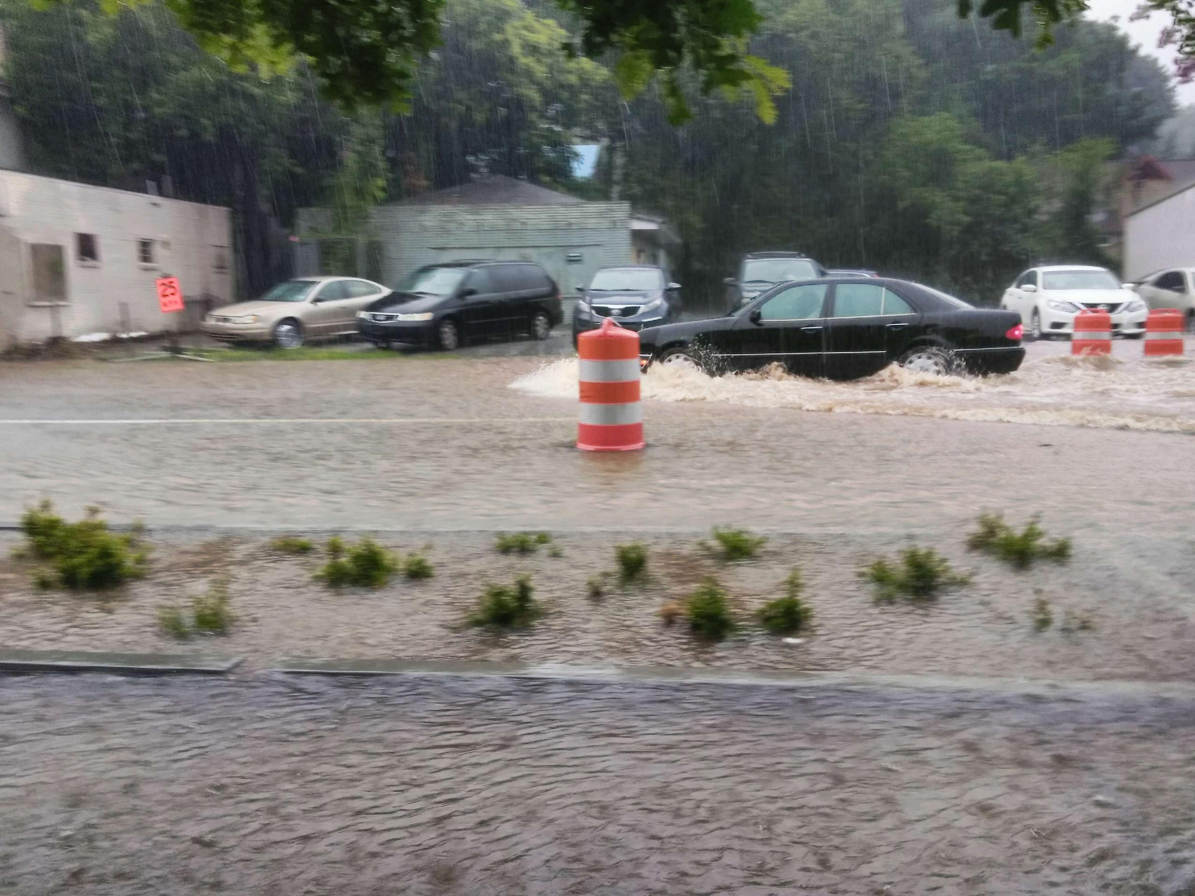
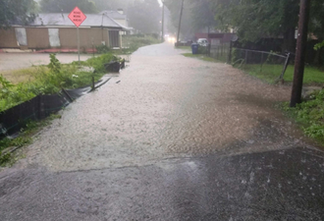
Proctor North Avenue Green Infrastructure Vision Plan – 2010
Notes:
Overview of PNA Study and impacts of flooding on community.
Photos are of streets surrounding KJMP and park property (bottom pic)

Slide 11
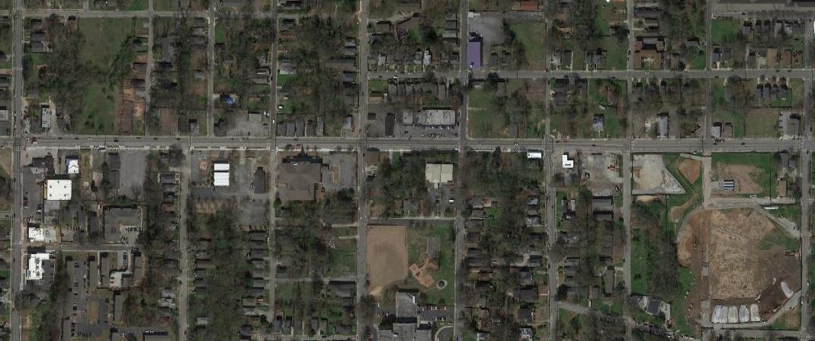
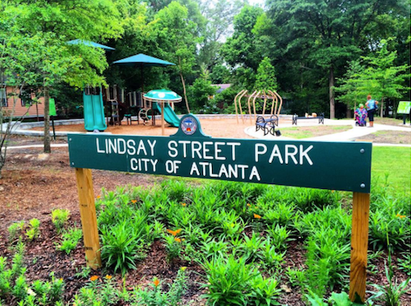
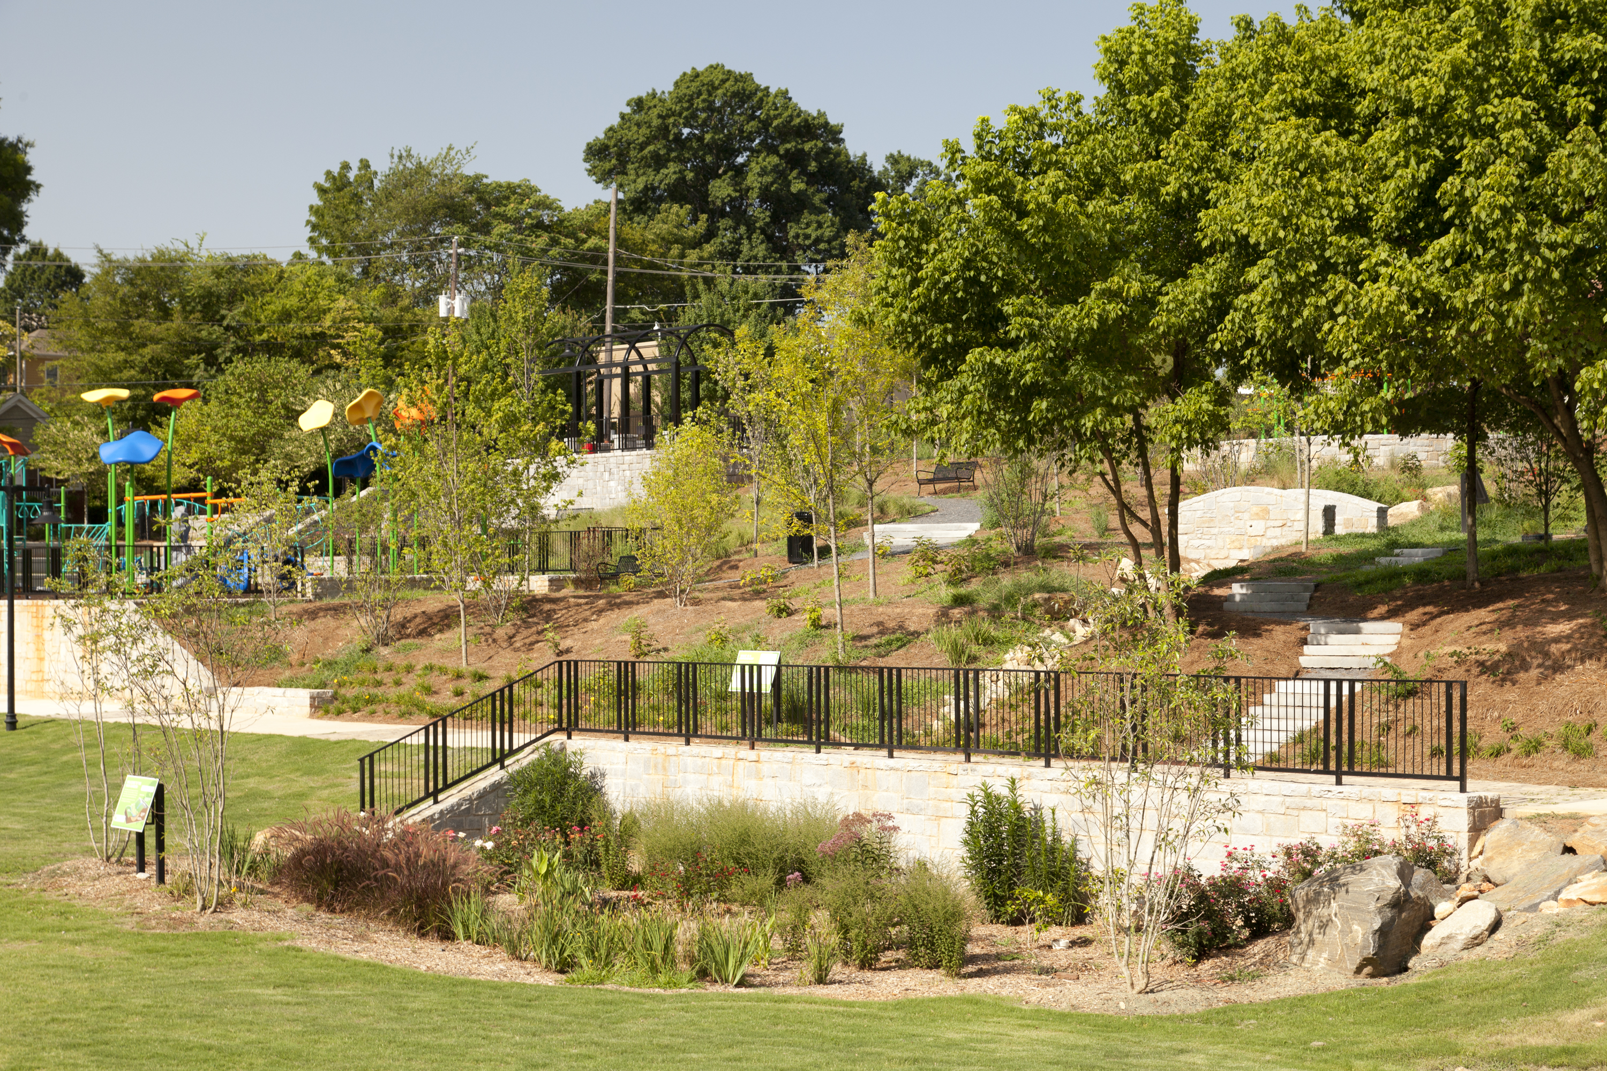
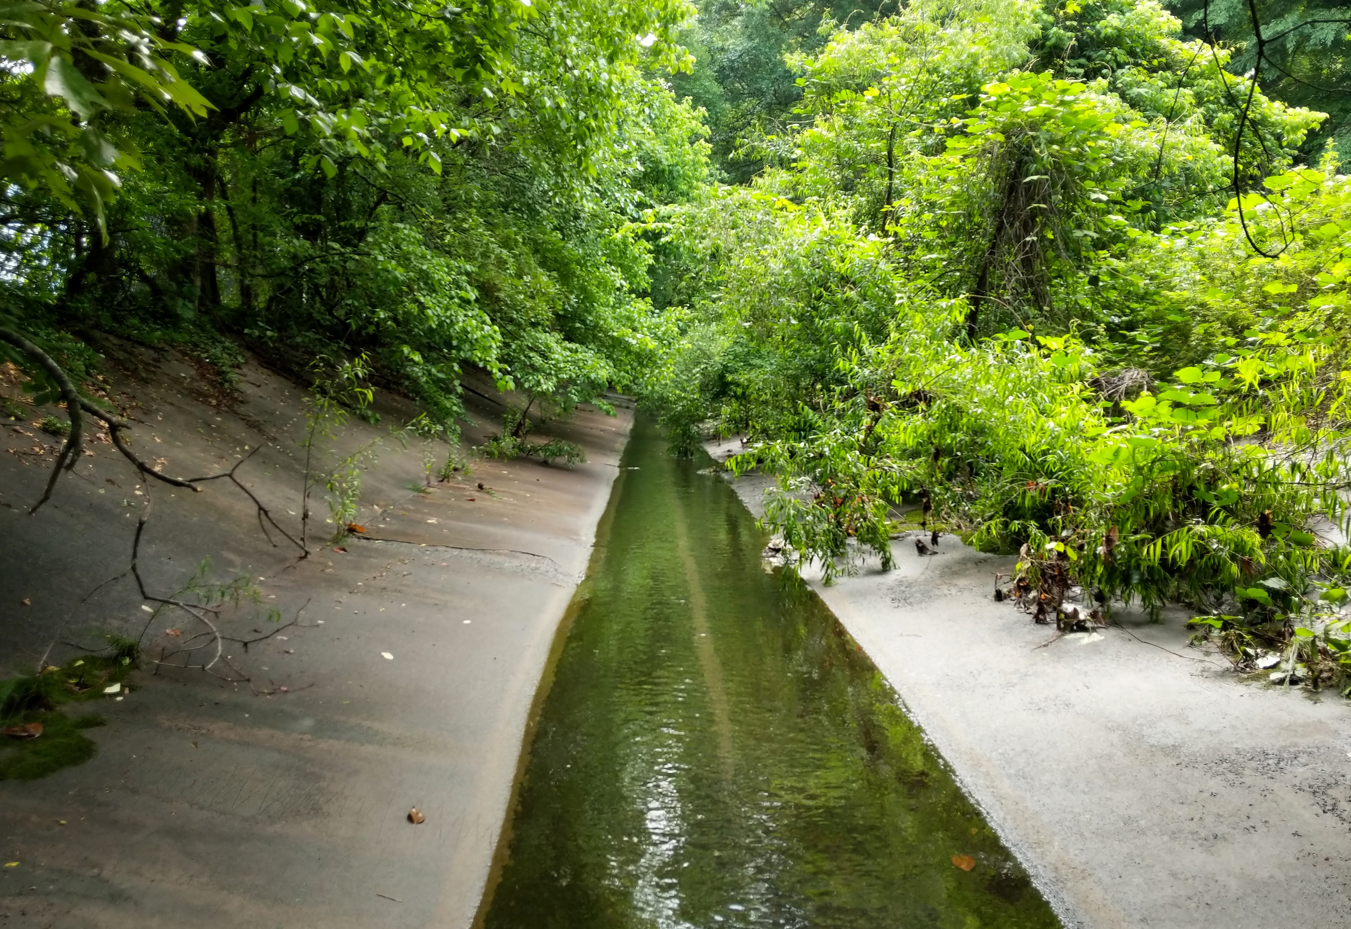
Implementing the PNA Vision
Kathryn Johnston Memorial Park
Boone Blvd Green Street
Rodney Cook Park
Lindsay Street Park
Complete
Vine City Park
Complete
Greensferry Restoration
In Planning
Notes:
Andrew to cover
Multiple GI projects to date throughout the community for real impact
Highlight two previous projects and upcoming restoration at Greensferry, in partnership with City and EIB
1500 feet of concrete channel to be removed, significant restoration and naturalization of a Federally listed urban stream

Slide 12
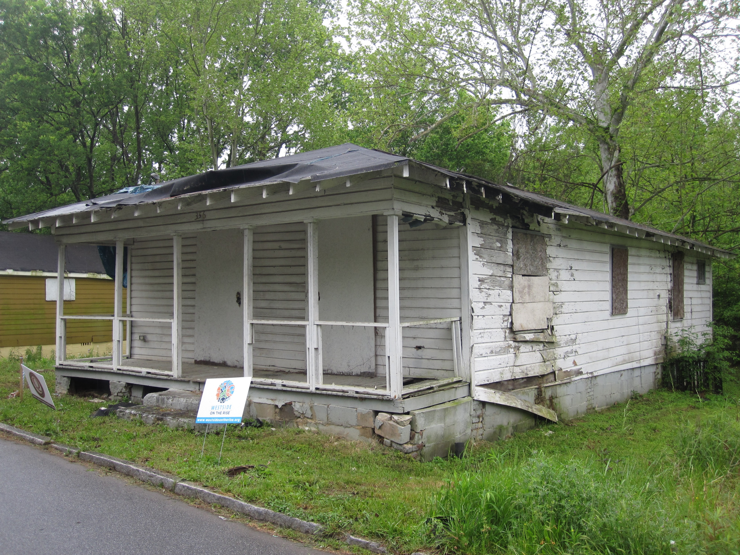
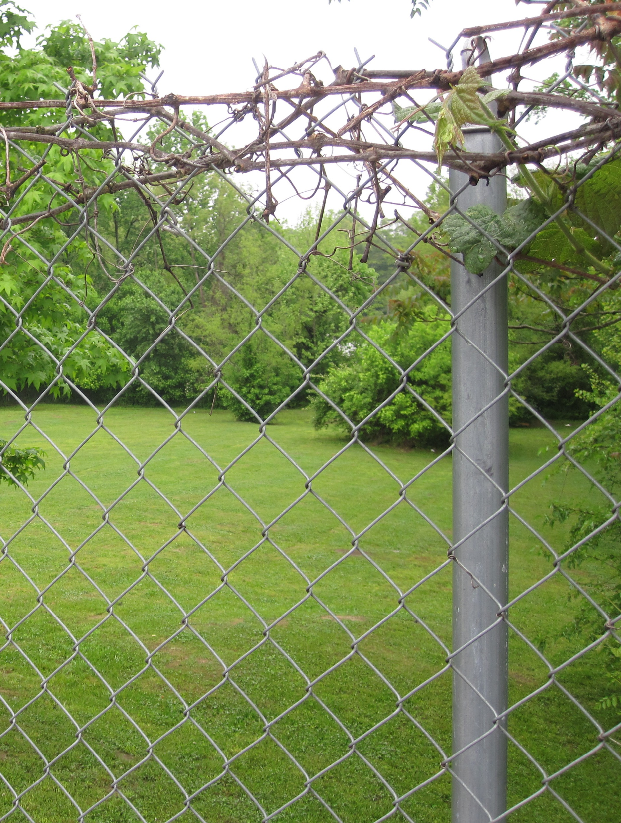
1999-2016 – Blighted and Fenced from Public Access
Notes:
Andrew to cover
Basic overview of park features including openspace, playground, fitness area, seating, and paths.

Slide 13
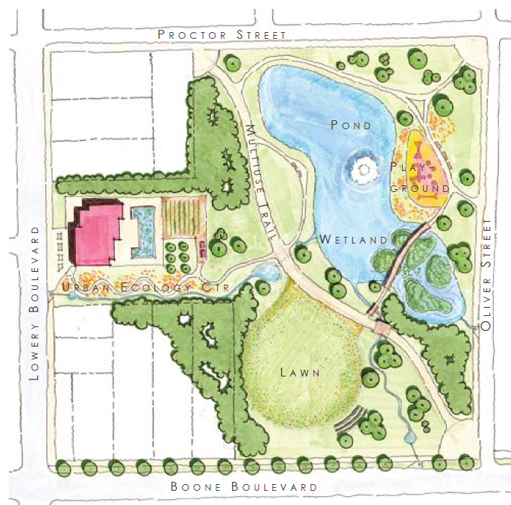
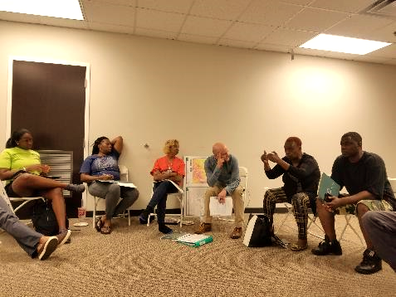
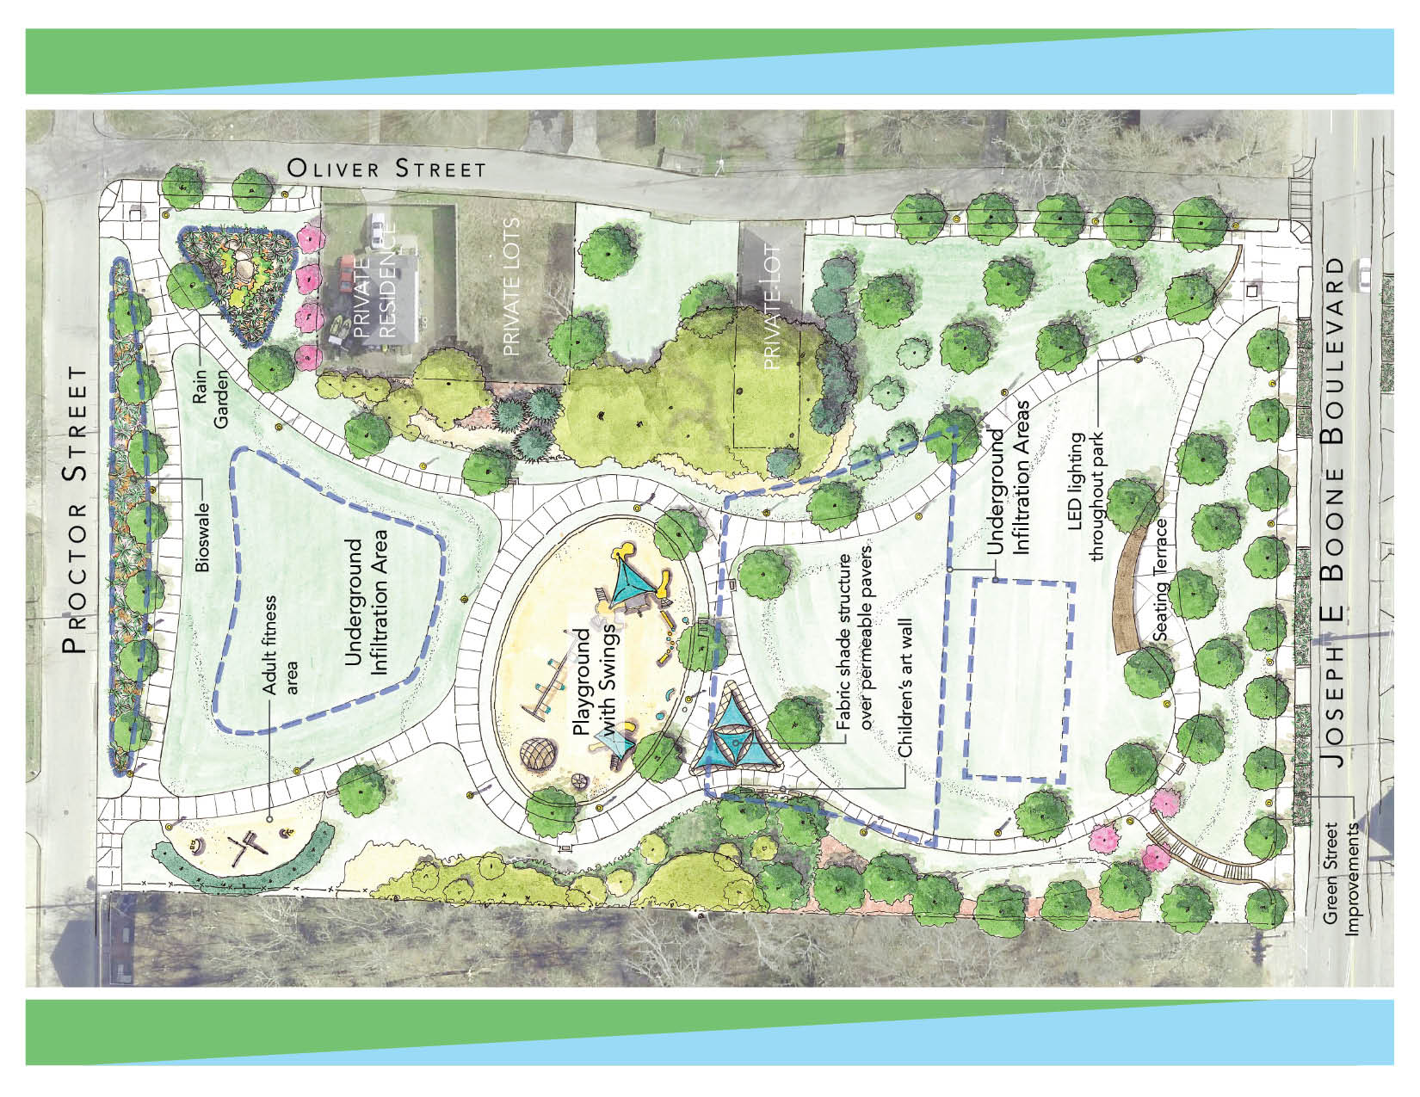
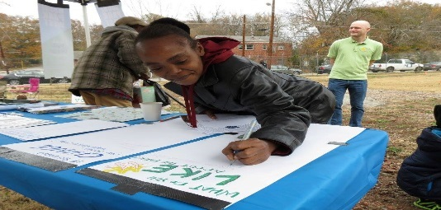
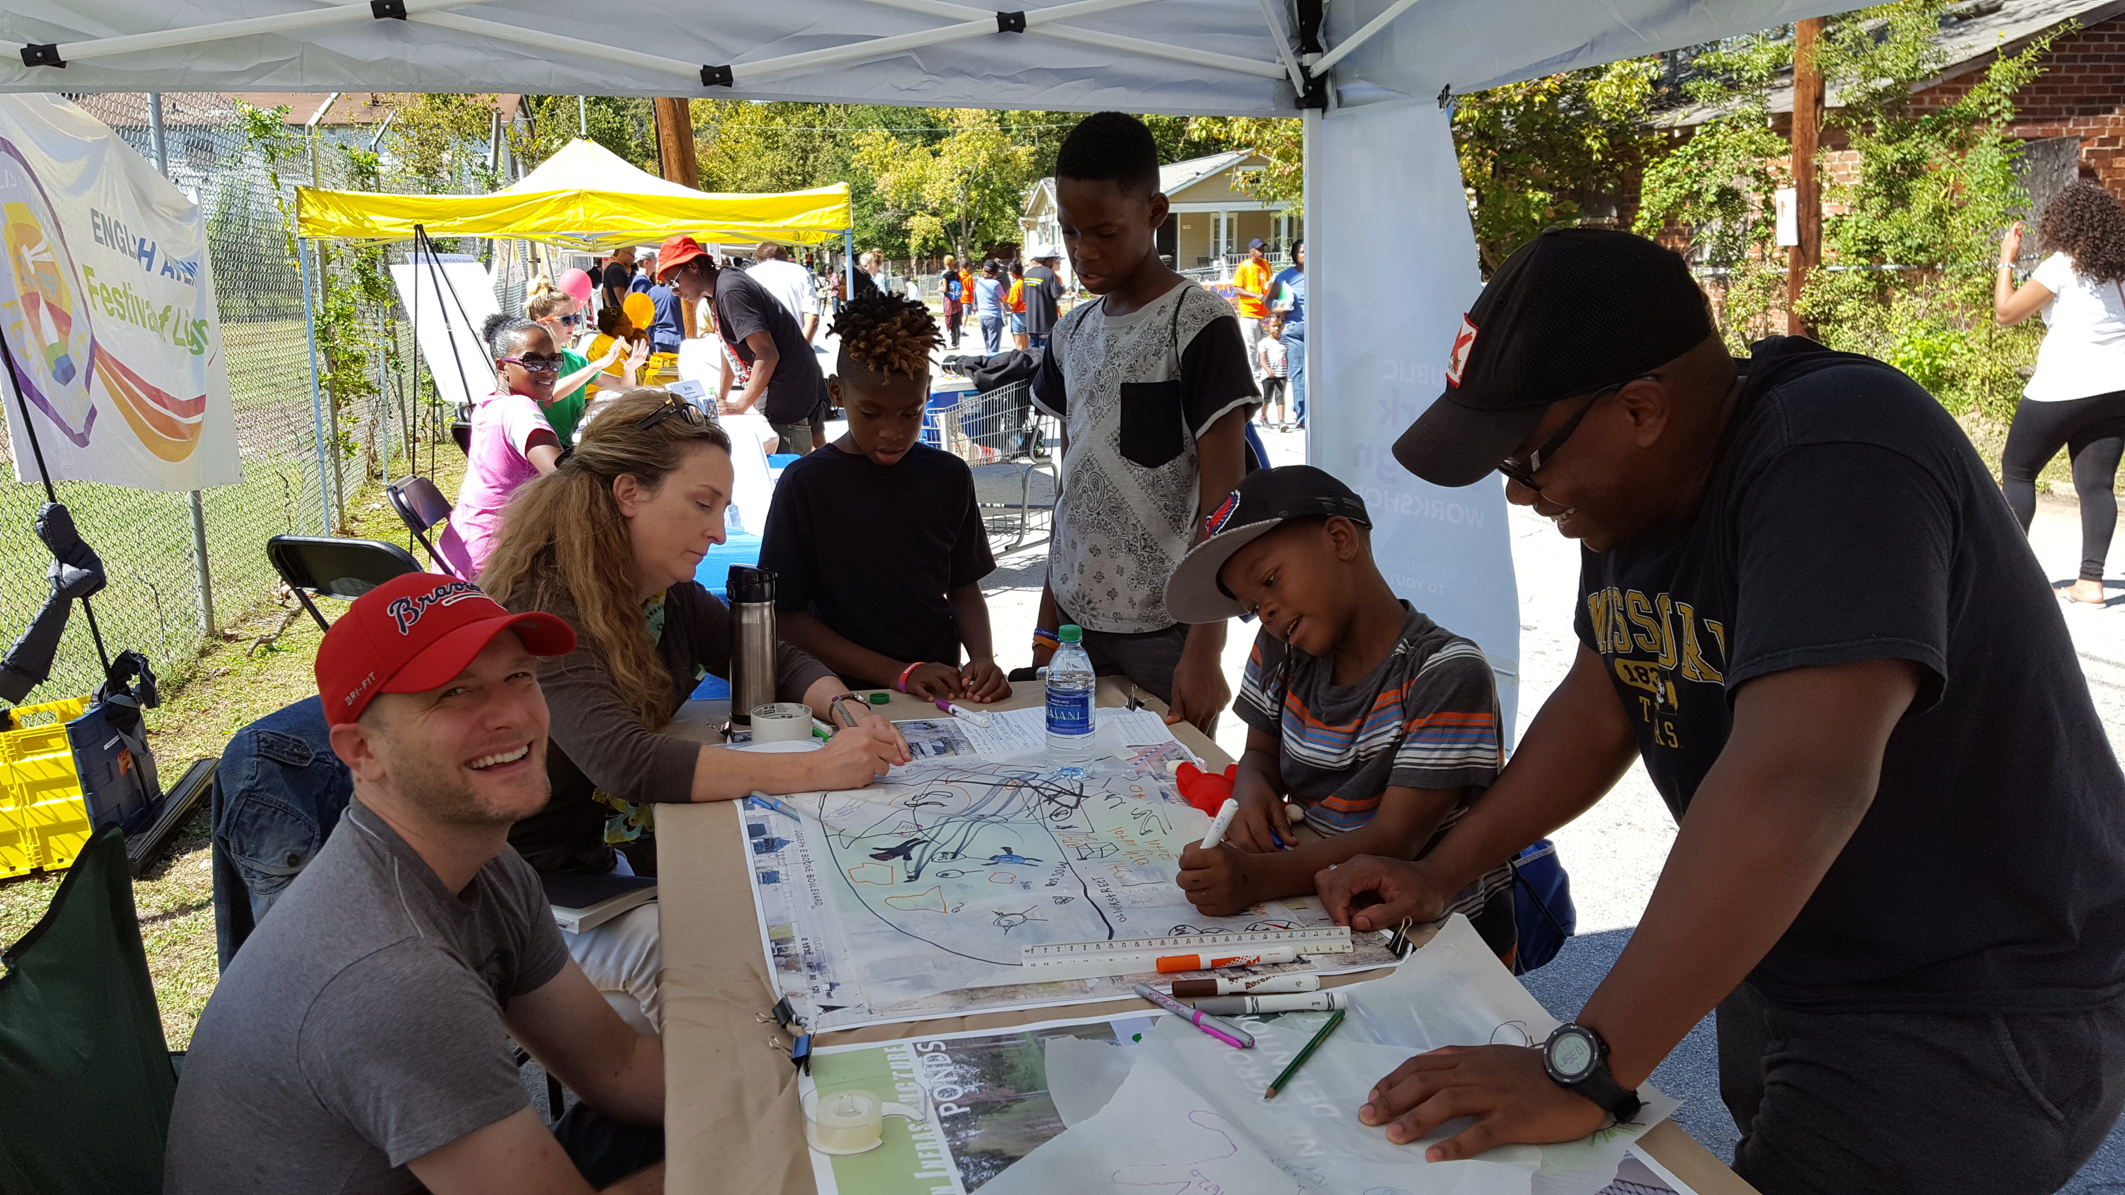
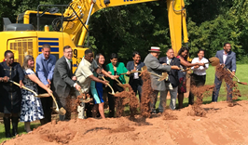
Community Visioning Process
Notes:
Andrew to cover
Overview of process to get to final community vision. Ribbon cutting event with Mayor Bottoms

