Slide 1
Park Pride
Kathryn Johnston Memorial Park

Slide 2
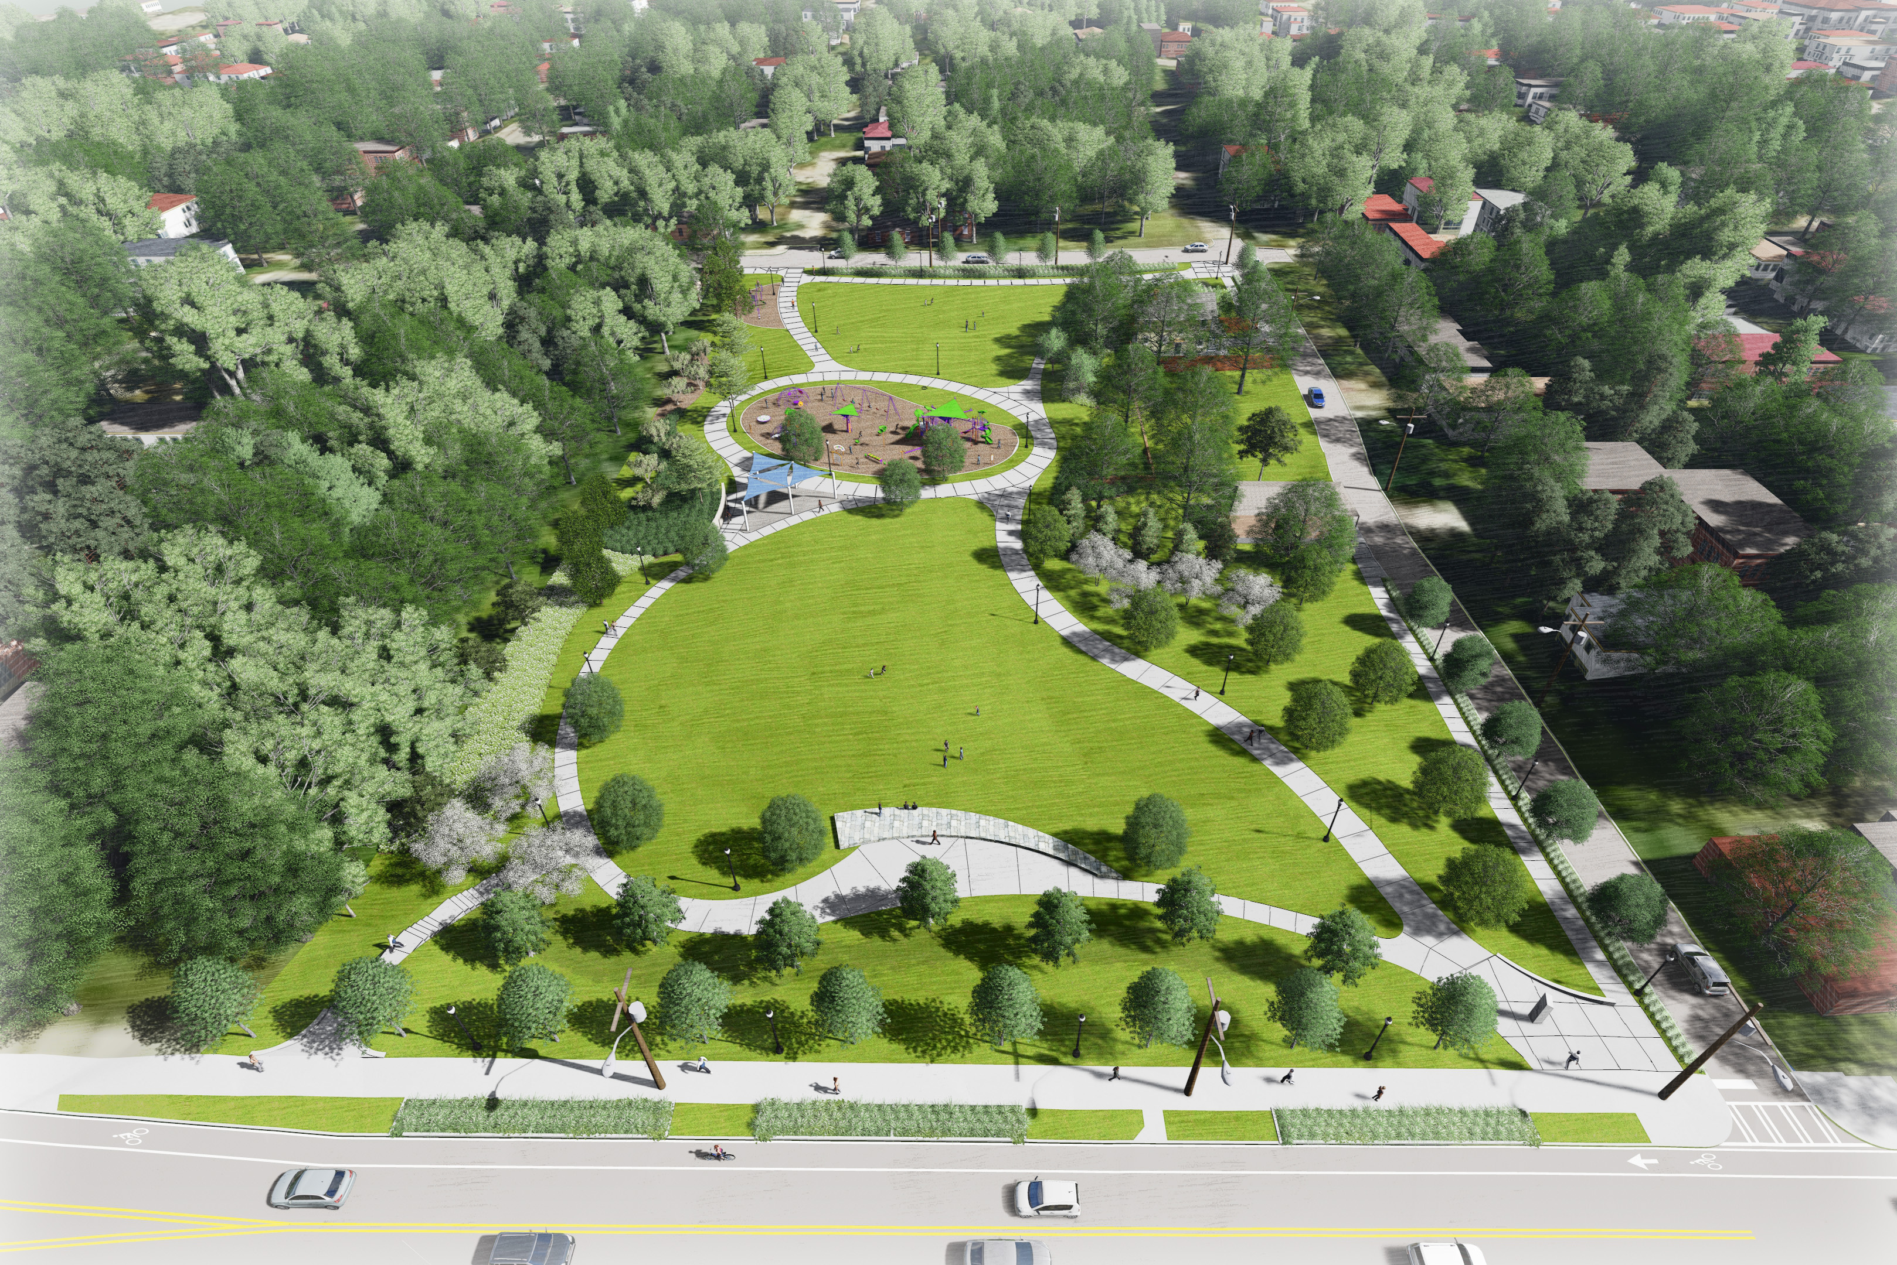
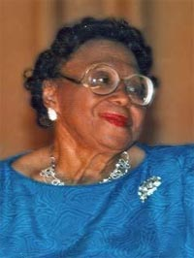
Kathryn Johnston Memorial Park

Slide 3
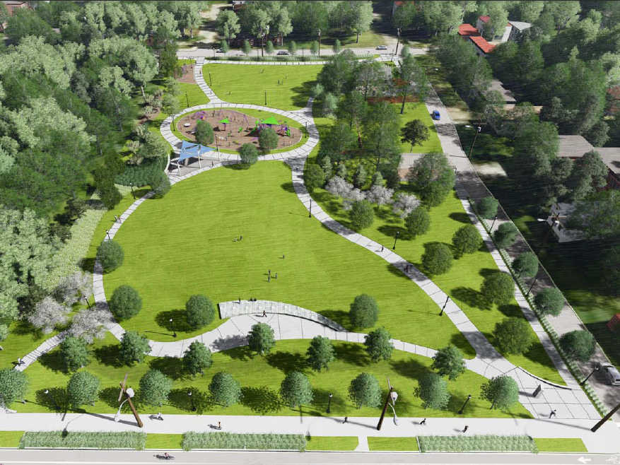
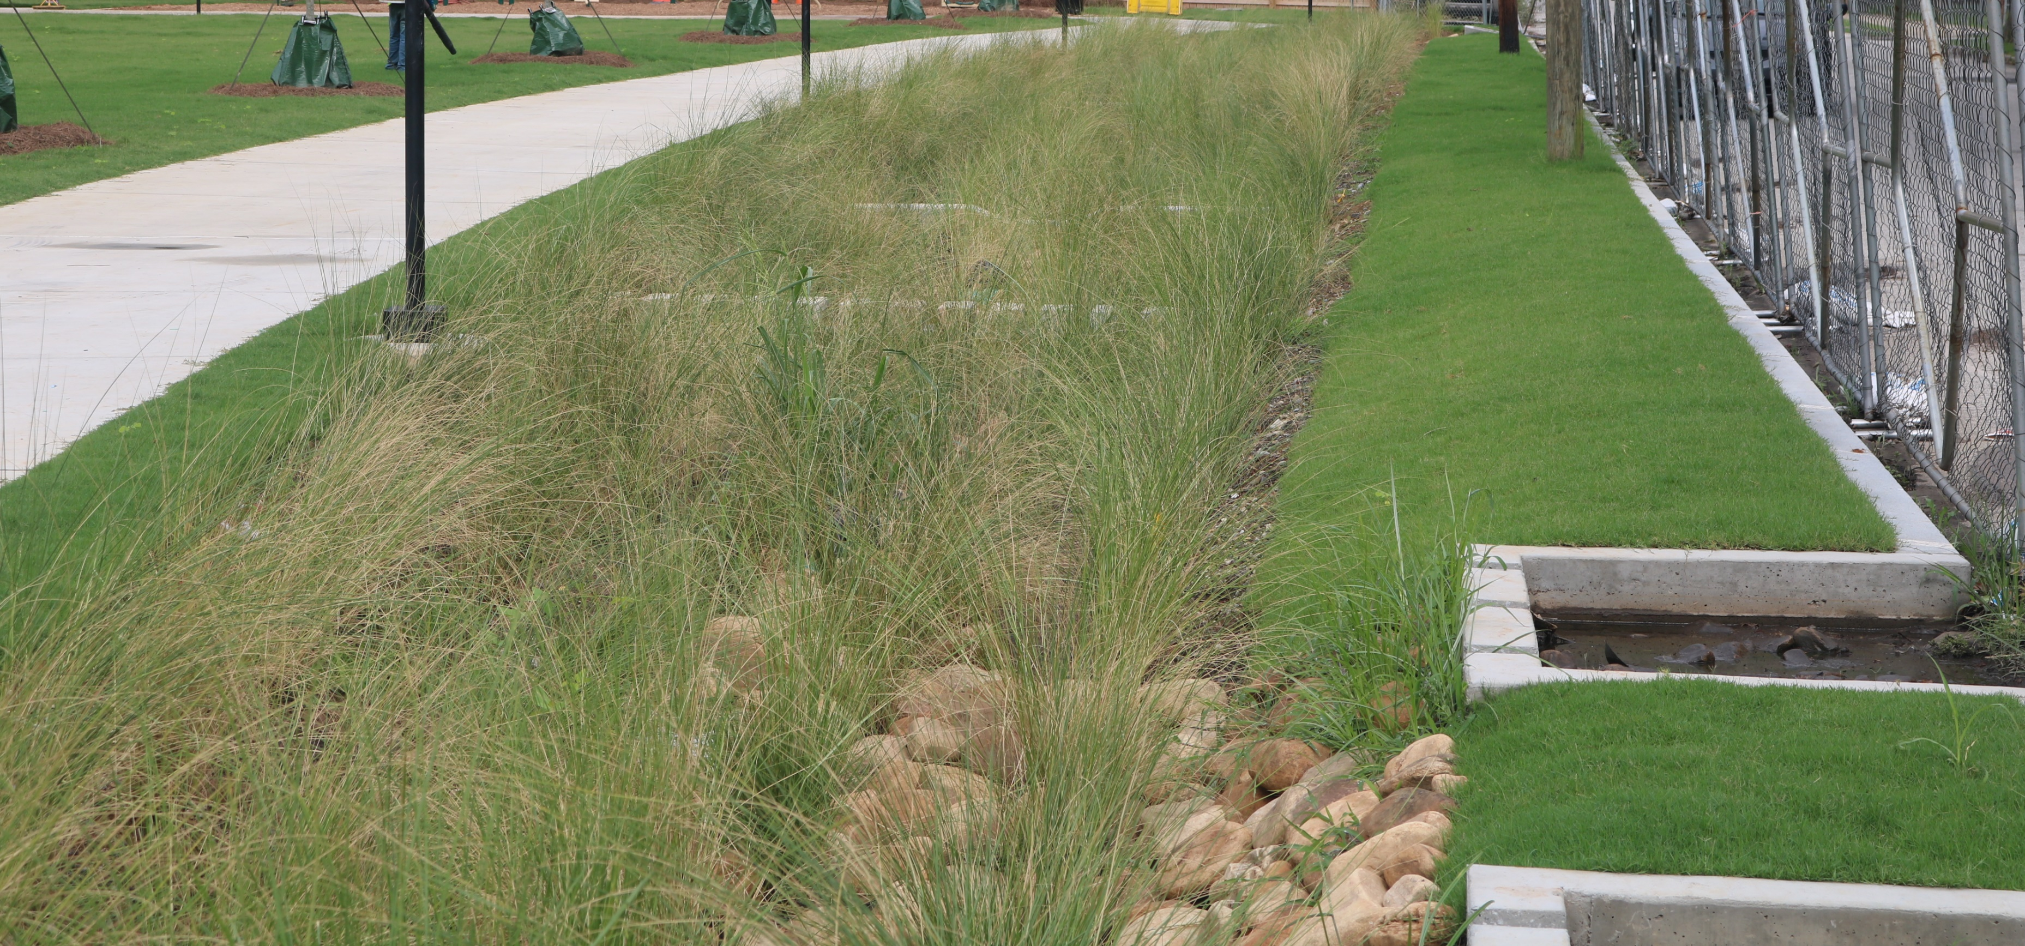
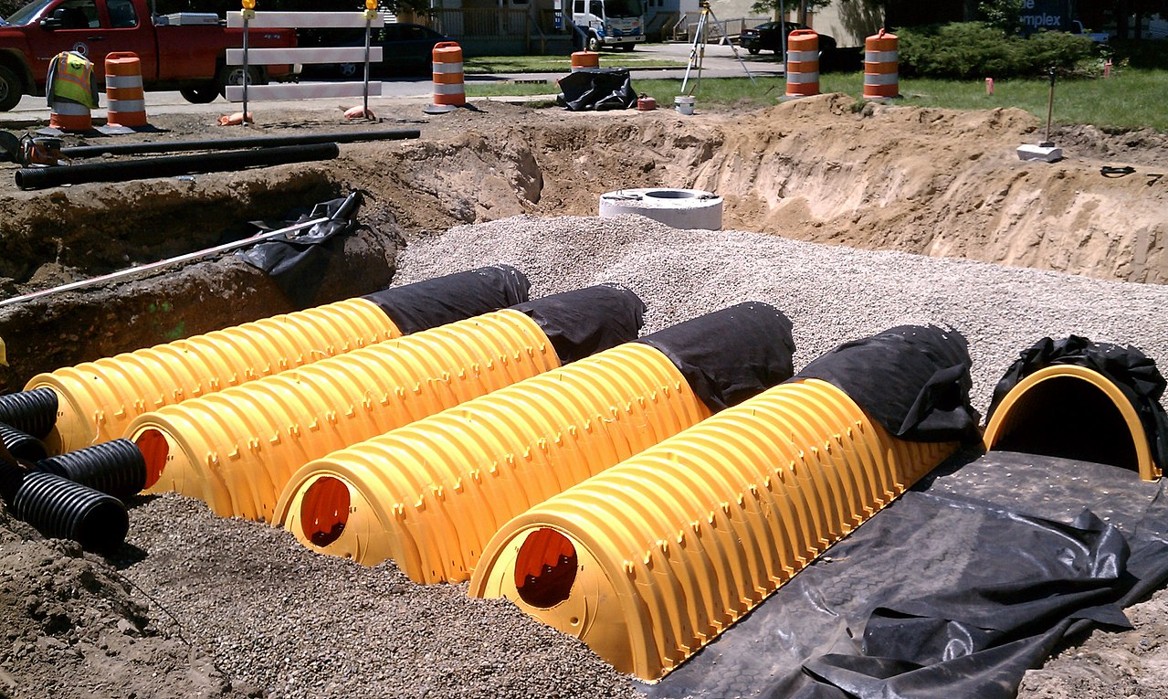
Environmental Benefits
3.5M
Green Infrastructure
gallons of stormwater runoff captured per year
Underground Storage
Notes:
Overview of types of storage being used onsite
3.5 million gallon annual capacity
Provides relief to aging and overburden combined sewer system
Mention community green infrastructure tours that were part of the visioning process
Measured through engineering calculations

Slide 4
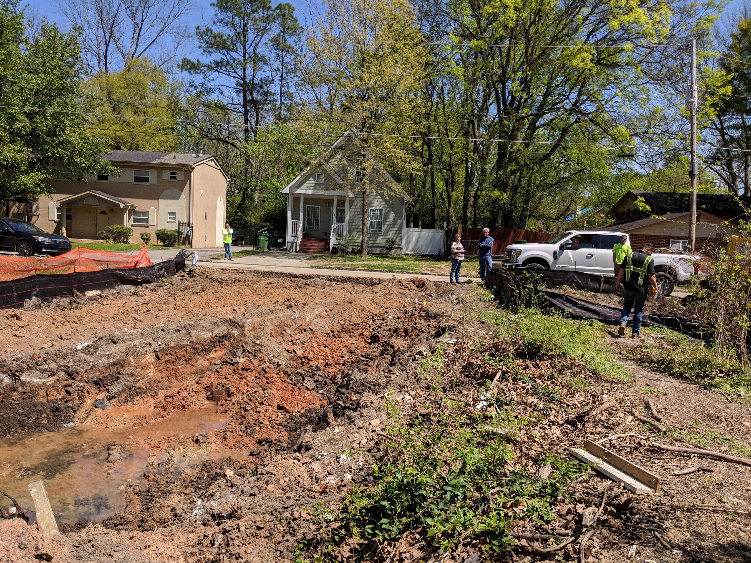
Fun Discoveries
old open sewer canal wall

Slide 5
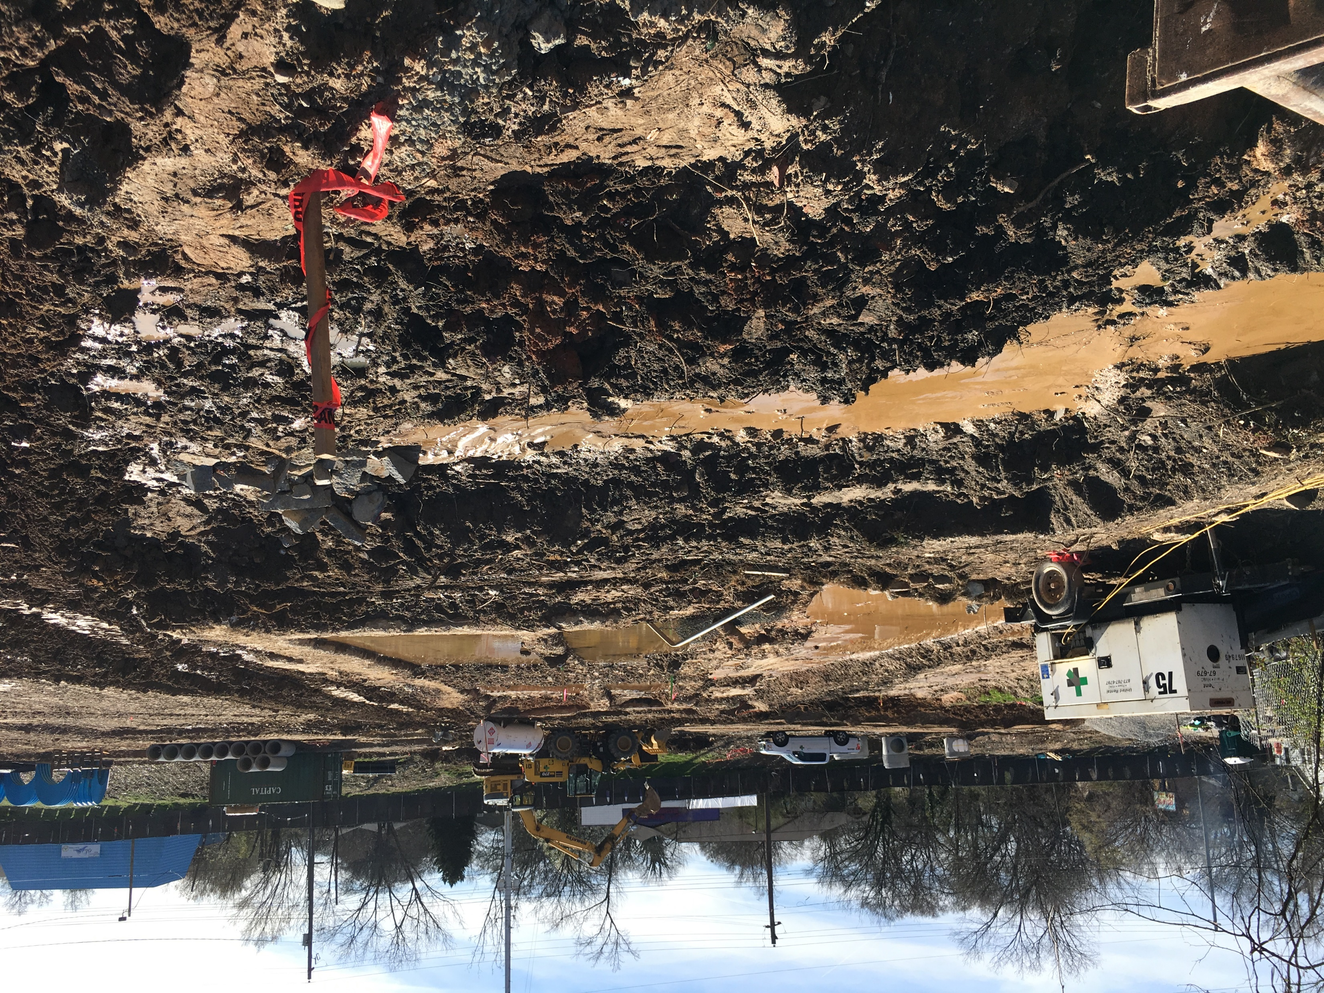
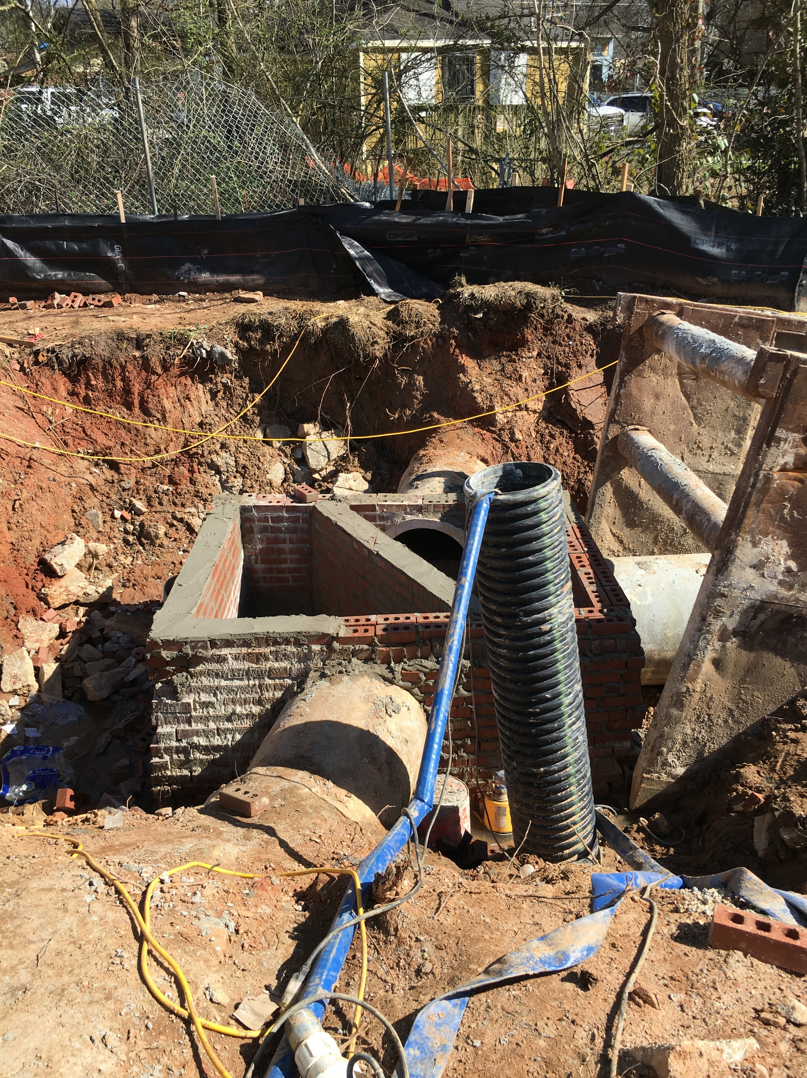
Health Benefits
2
direct openings to combined sewer remediated
old open sewer canal wall
7,190 tons
contaminated soil removed

Slide 6
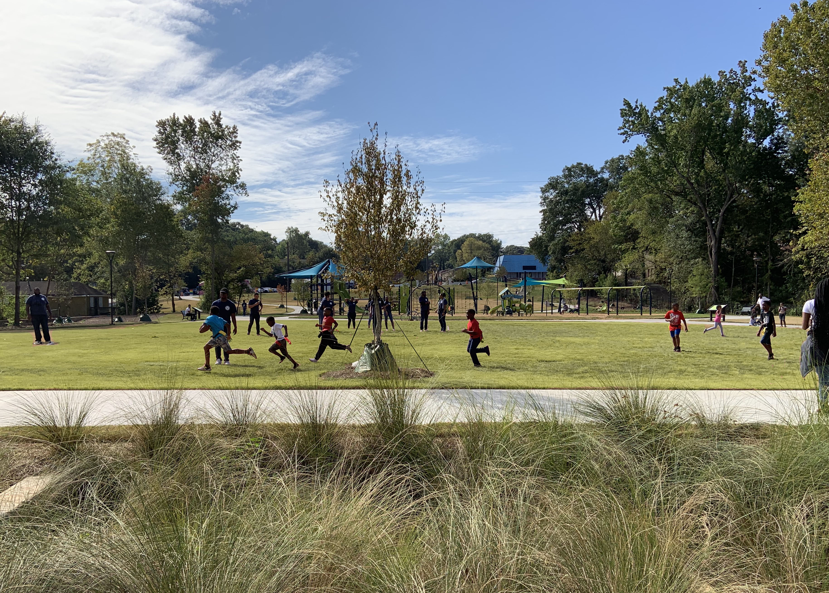
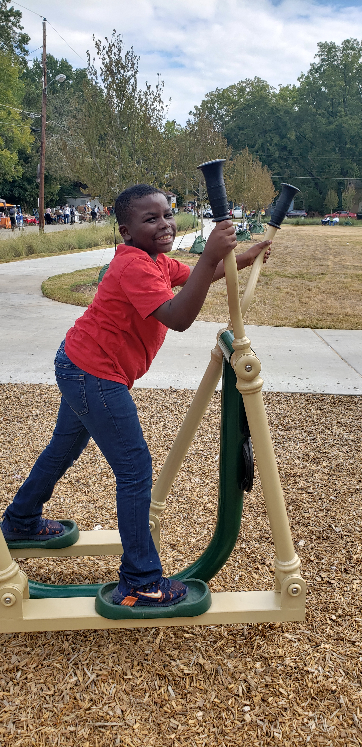
Health Benefits
2
4 acres
direct openings to combined sewer remediated
accessible play space
6
pieces of workout equipment

Slide 7
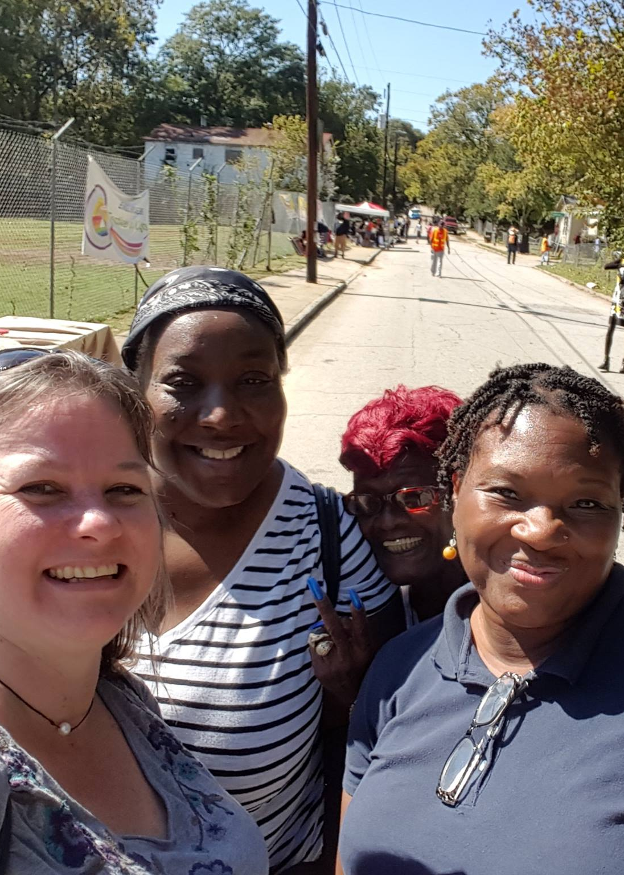
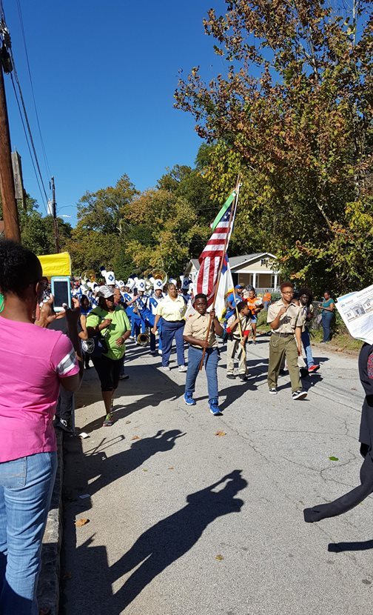
Social Benefits – Festival of Lights
2016

Slide 8
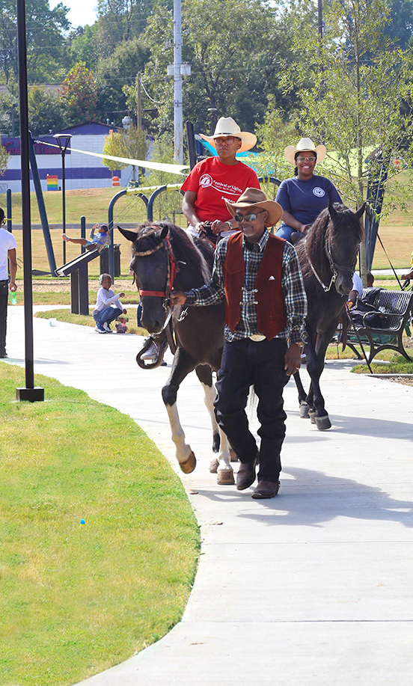
Social Benefits – Festival of Lights
2019

Slide 9
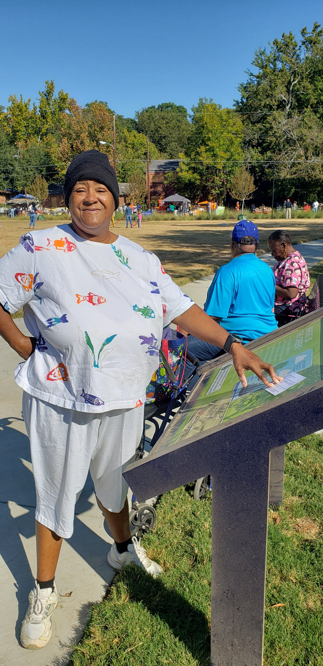
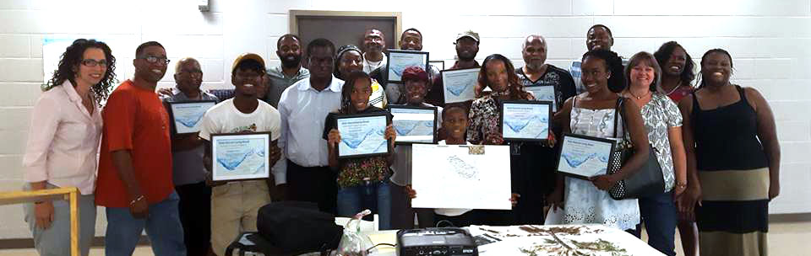
Social Benefits - Education
Ongoing
5
STEM learning
educational signs
AWLN

Slide 10
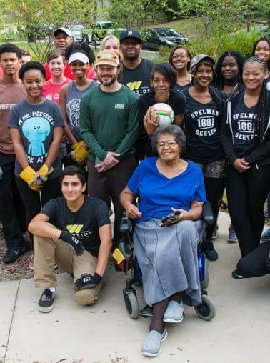
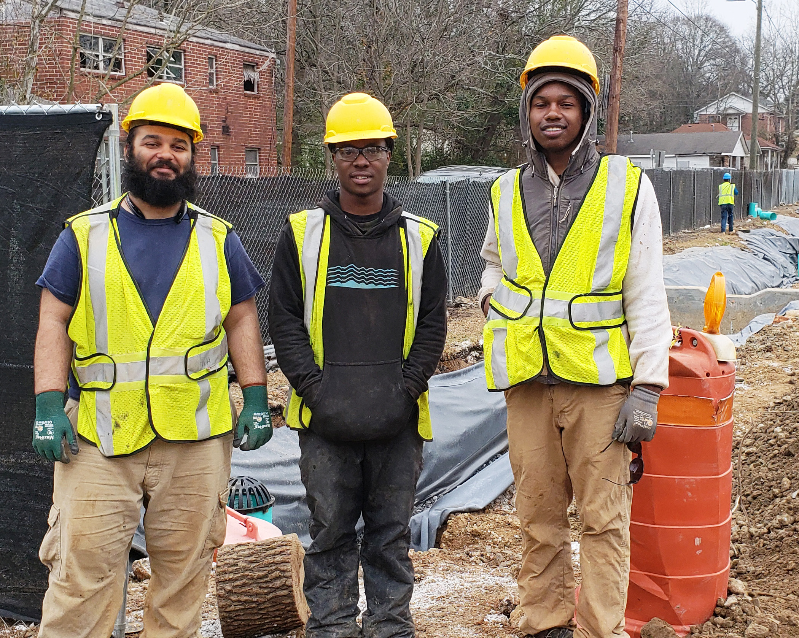
Economic Benefits
$15,800
Park Ambassadors
$60,000
Workforce Training
Notes:
Give overview of variety of community partnerships

Slide 11
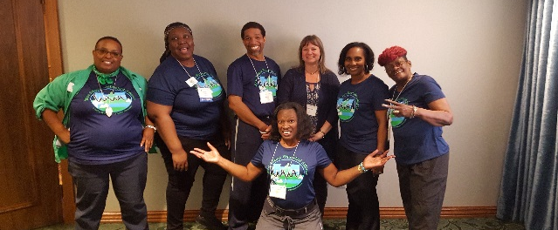
Economic Benefits
over
$125,000
in direct financial support to community-based organizations and businesses
Notes:
Give overview of variety of community partnerships

Slide 12
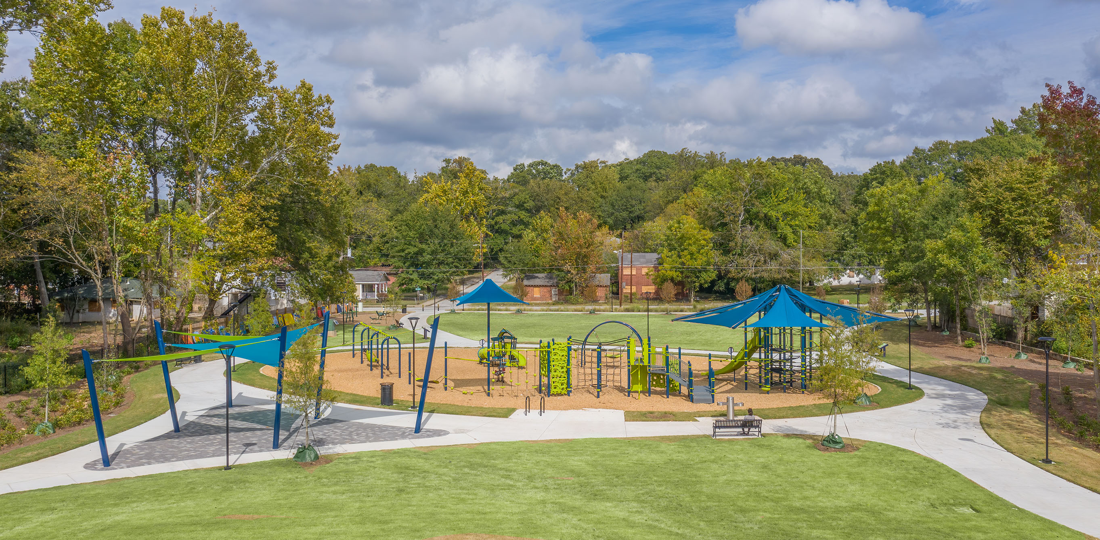
Kathryn Johnston Memorial Park
Notes:
Andrew to cover
Basic overview of park features including openspace, playground, fitness area, seating, and paths.

Slide 13
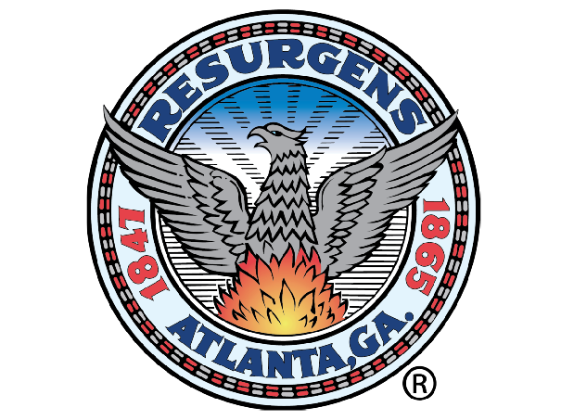
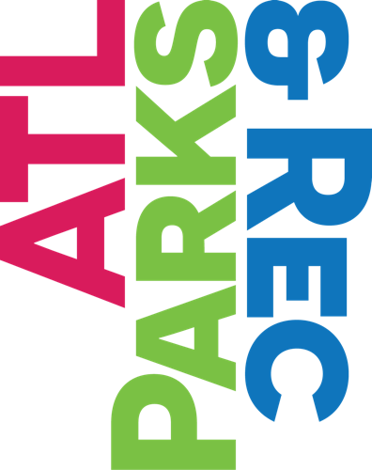
Leveraging Funding Partners– Corporate, Philanthropic, & Public
AEC Trust
The Vasser Woolley Foundation
Dorothy & Charlie Yates Family Fund
Anonymous
David, Helen and Marian Woodward Fund
Notes:
Support from funding partners is critical for success!
Emphasize the importance of corporate support and public-private partnerships.

