Slide 1
The New Administration Environmental Policy and Regulation
Charlie Denton
Barnes & Thornburg
Atlanta

Slide 2
Topics
The Big Picture
Environmental Programs/Policies affected
From Executive Orders
From Executive Actions
Legal and Policy Toolbox
Rulemaking
Executive Orders
Legislation

Slide 3
The Big Picture
Undo what Biden did
Cutting as much of EPA (and state programs) as possible
Mandate not as clear as portrayed
Slim majority in Congress
Litigation is impeding action

Slide 4
Legal and Policy Toolbox
Legislation (including budgets)
Congressional Review Act
Executive Orders
Guidance
Treaties and Accords
Litigation

Slide 5
Trump Environmental Policy
Initial Executive Orders
Repeal IRA
Cancel EJ
Cut enforcement budget
Relax emission limits for air
“Drain the Swamp”
Department of Government Efficiency
Other policies at risk
Almost of the noteworthy policies from the Biden Administration

Slide 6
Infrastructure Legislation- IRA and other grants
IRA funded with 400 Million
35-40% of the act's focus is on reducing greenhouse gas emissions and promoting clean energy
35% is unspent = $49,000,000
EJ Grants
Brownfields Grants

Slide 7
Biden Environmental Justice Policy
EO 13990 “formalize[d] President Biden’s commitment to make environmental justice a part of the mission of every agency by directing federal agencies to develop programs, policies, and activities to address the disproportionate health, environmental, economic, and climate impacts on disadvantaged communities.”

Slide 8
Biden EJ Policy
EO 13985: Inauguration Day: Where the Federal Government has failed to meet that commitment in the past, it must advance environmental justice.
Executive Order 13990: “Protecting Public Health and the Environment and Restoring Science To Tackle the Climate Crisis”
Executive Order 14008: “Tackling the Climate Crisis At Home and Abroad” issued on January 27, 2021.
May 5, 2022 - New Enforcement Strategy Advances President Biden’s Environmental Justice Agenda

Slide 9
EJ Enforcement Policies subject to Reversal or Revision
Strengthening Enforcement in Communities with Environmental Justice Concerns – April 30, 2021
Strengthening Environmental Justice Through Cleanup Enforcement Actions
Using All Appropriate Injunctive Relief Tools in Civil Enforcement Settlements – April 26, 2021
2015 Supplemental Environmental Projects Policy
PFAS Roadmap – October 2021
DOJ Comprehensive Environmental Justice Enforcement Strategy - 5/5/22

Slide 10
Trump Environmental Justice Policy

Slide 11
How to Hurt Environmental Justice
Rescind all EJ EOs
Cut EJ- IRA Spending
Cut grants for brownfields
Cut grants for climate programs

Slide 12
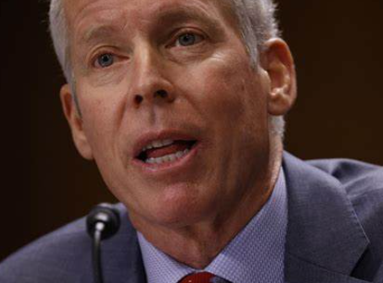
Energy Policy – “All of the Above”

Slide 13
Climate Change
Biden: Repealed/Replaced Trump rules that negatively affect climate (CAA rules!)
Trump still calls it a hoax.
Therefore ….

Slide 14
Paris Climate Accord

Slide 15
Climate Funding from IRA
From the Inflation Reduction Act, $61 billion in climate funding has been awarded for more than 6,100 projects (excluding loans, direct government spending, and tax credits) through September 5, 2024. We estimate that the IRA has just over $33 billion (or 35 percent) in remaining funding, again not including federal spending, loans and tax credits.
This includes 16 programs with more than $500 million in funding not yet awarded to a recipient.

Slide 16
EPA Budget: 80 Pound Gorilla
The Environmental Protection Agency's (EPA) budget for the fiscal year (FY) 2024 is $12.083 billion, which is 19% higher than the FY 2023 budget. The FY 2025 budget is $10.994 billion.

Slide 17
Tax Credits

Slide 18
Elon Musk and DOGGIE

