Slide 1
Impacts of New Administration on Environmental Policy & Regulation
Georgia Brownfield Association
13th Annual Seminar
April 16, 2025

Slide 2
Presentation Overview
1. Introduction
2. Environmental Protection Agency
3. Georgia Redevelopment Examples
4. PFAS Soil and Groundwater
5. Questions and Answers
PFAS = Per- and polyfluoroalkyl substances
Georgia Brownfield Association

Slide 3
Restructure/Streamline EPA to Reflect:
States to Take Leadership Role
Share Resources/Expertise and Recognize States’ Primary Role
Show Accountable Progress
Address Tangible Problems, Using Trackable Metrics
Streamline Process
Eliminate Programs that Do Not Support EPA’s Mission
Healthy, Thriving Communities
Reduce Economic Costs to Local Communities
Compliance Before Enforcement
Foster Cooperative Relationship with Regulated Community
Transparent Science and Regulatory Analysis
Take Public Comment on Studies Supporting Regulatory Analysis
April 21, 2023
Chapter 13

Slide 4
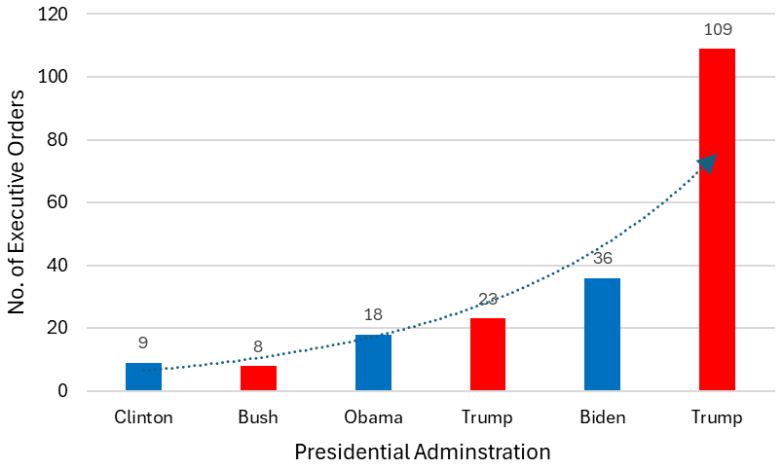
Increasing Number of Executive Orders Example of Higher Rate of Change: Inauguration to March 31st
Red symbol for republican administration, blue symbol for democratic administration

Slide 5
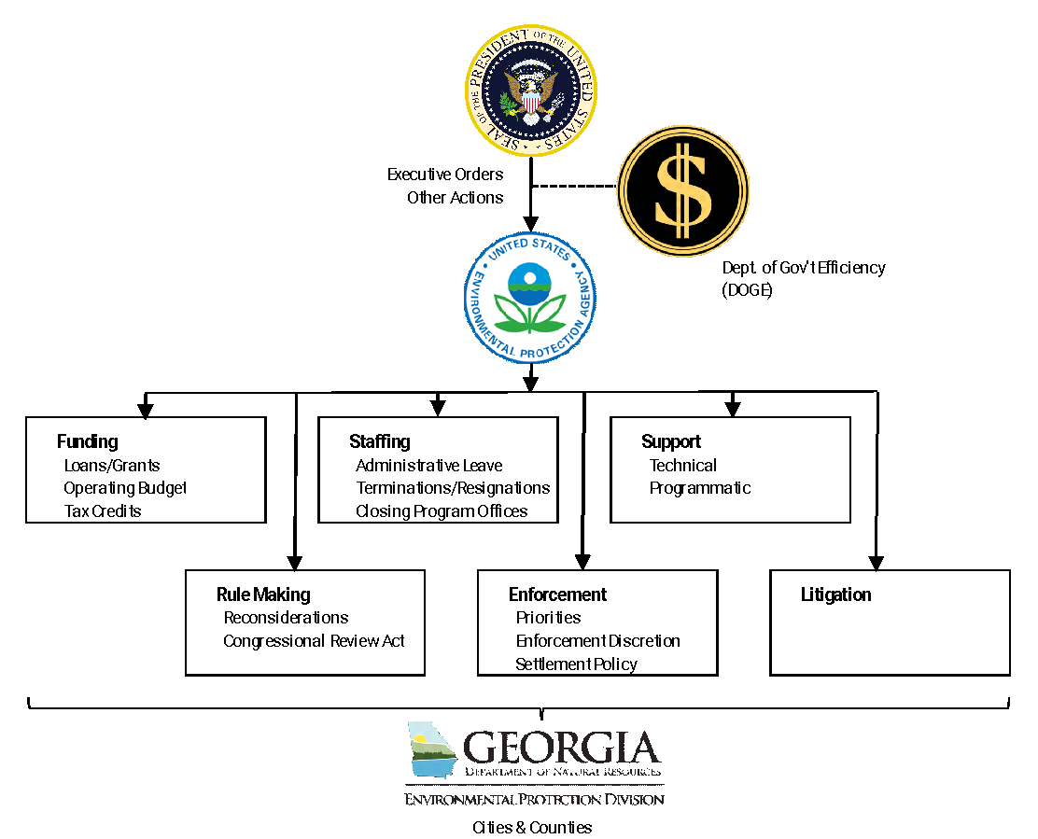
Potential Environmental Changes
Georgia Brownfield Association

Slide 6
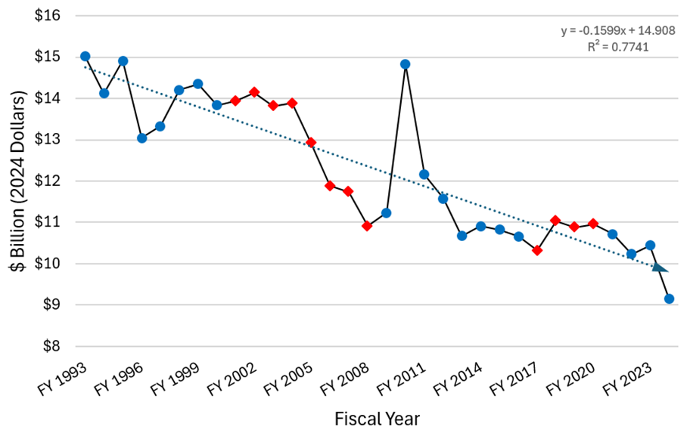
EPA’s Budget Trends
Since FY1993 EPA’s Budget Has Decreased by About $200 Million per Year
Emphasizing Cooperative Federalism & Limiting Federal Government
Transferring Work and Funding to the States
1993
2024
Red symbol for republican administration, blue symbol for democratic administration
Georgia Brownfield Association

Slide 7
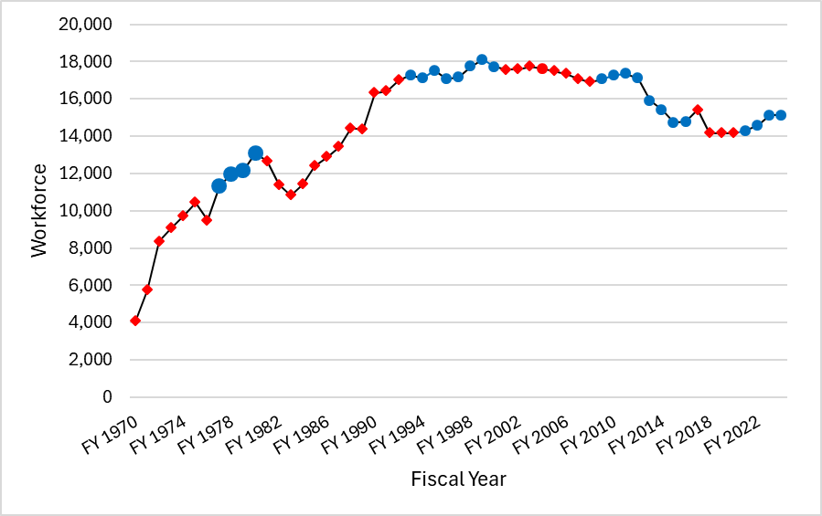
EPA’s Workforce Trends
Since FY1999 EPA’s Workforce Has Decreased by About 155 People/Year
Between FY2012 & FY2015 Workforce Decreased by about 580 People/Year (2,327 Total Staff Reduction)
Recent EPA Staff Changes
Hiring & Grant Freezes
Deferred Resignations
Terminated About 400 Probationary Employees
Shuttered DEI/EJ Offices
About 200 Employees on Leave
Reevaluating Office of Research & Development
About 1,500 Employees
Potential Support Reductions to States and Other Partners
FY1999
FY2024
FY2012-15
Carter Admin.
Red symbol for republican administration, blue symbol for democratic administration
Georgia Brownfield Association

Slide 8
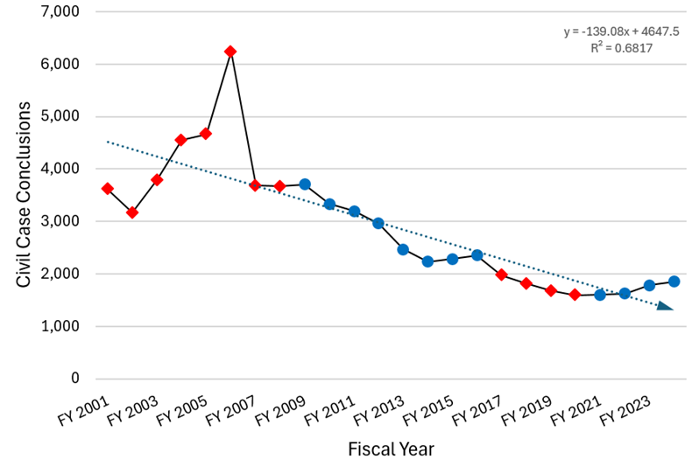
EPA Enforcement Trends and Re-Focusing
March 12th Memo. National Enforcement & Compliance Initiatives
EJ Concerns No Longer Considered
No Energy Production or Power Generation Facility Shutdowns Unless Imminent and Substantial Threat
Senior Mgmt. Approval Before Enforcing Rules Under Reconsideration
March 31st Presidential Exemption from Certain Clean Air Act Requirements
Prior PFAS Enforcement Discretion and Settlement Policy
Red symbol for republican administration, blue symbol for democratic administration
Source: Environmental Integrity Project, 12/4/24

Slide 9
Georgia’s Redevelopment Leadership
Georgia Hazardous Site Reuse and Redevelopment Act
Georgia Brownfield Act
About 775 Cleanups Completed
About 10,000 Acres Reused
About Half Suitable for Unrestricted Reuse
Reshoring Manufacturing Capacity
Governor Kemp’s Goal Making Georgia “E-Mobility” Capital of the World
Currently 82,000 Employees in Clean Tech Industries
Double Next Largest Employer in Georgia

Slide 10
Atlanta Westside Lead Site
2018 Emory Graduate Students Shared Elevated Lead Data in Soil Samples with EPA
Source Industrial Smelting (Slag) Waste
2022 EPA Added Site to Superfund Program
About 600 Properties Remediated
Remove Upper 2-Feet of Soil
Replace with Clean Soil
March 2025 Starting Lindsay Street Park Cleanup

Slide 11
Recent “E-Mobility” Expansions
Rivian EV Manufacturing Plant
Early 2026 Formal Construction Start
7,500 Permanent Jobs, 2,000 Construction Jobs
Produce 400,000 EVs per Year
$6.6 Billion Investment
Hyundai Motor Group Metaplant Expansion
8,500 Jobs
Batteries and 500,000 EV/Hybrids per Year
$12.6 Billion Investment with LG and SK
Project Bunkhouse Data Center
Twelve Buildings, Total 8.7 Million Square Feet
$19 Billion When Finished

Slide 12
Recently Paused Constructions
Aspen Aerogels
Near Statesboro, GA
Manufactures Fire Containment Materials for EVs
250 Jobs
$671 Million Investment for 500,000 Square Foot Facility
Freyr Battery
Near Newnan, GA
Manufactures Battery Storage Systems
700 Jobs
$2.6 Billion Investment

Slide 13
Reconsideration of PFAS Rules
Hazardous Substance Designation under Superfund
April 2024 EPA Designated Certain PFAS as Hazardous Substances
February 2025 Court Granted Stay in Chamber of Commerce’s Challenge to Designation
Rule Remains in Effect During Litigation
Continue Including PFAS in Your Pre-Purchase All Appropriate Inquiries (AAI)
Maximum Contaminant Levels (MCLs) for Drinking Water
April 2024 EPA Issued MCLs for Certain PFAS
February 2025 Court Granted Stay in American Water Works Association’s Challenge to the MCLs
Original Compliance Date for Public Water Supply Systems is 2029

Slide 14
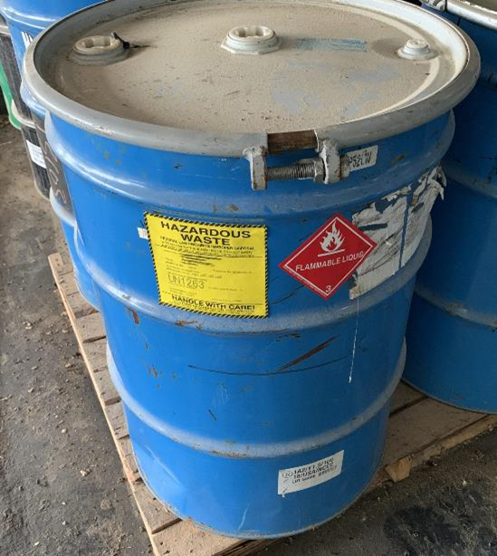
Waste Management of PFAS
In January 2024 EPA Proposed to Regulate Certain PFAS as Hazardous Constituents
Could Trigger Additional Site Investigations and Cleanups
Potential Future Regulated as Hazard Waste
On- and Off-Site Water and Solids Management Issues
Would Trigger Additional Compliance Obligations

Slide 15
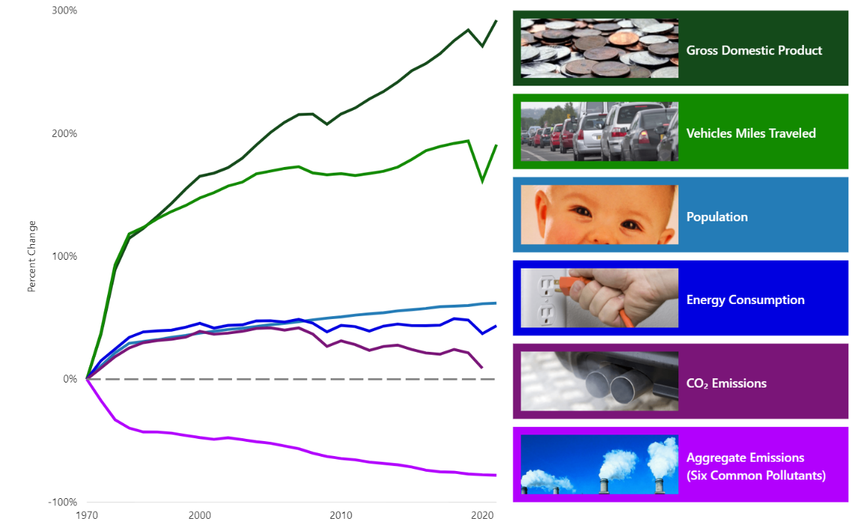
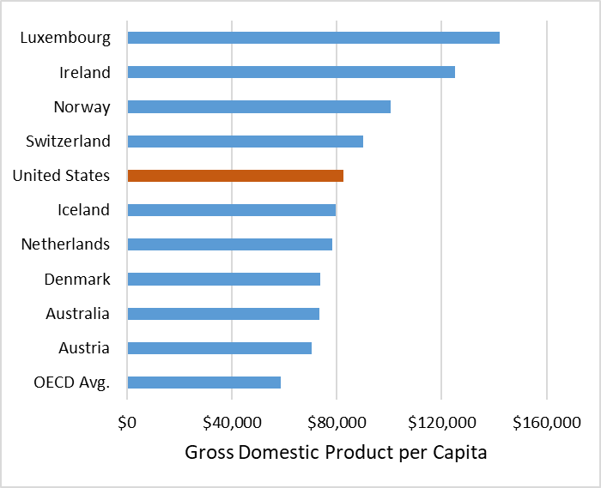
Economic Growth/Environmental Improvements
Source: https://gispub.epa.gov/air/trendsreport/2022/#growth
Source: Organisation for Economic Co-operation and Development (OECD)
Notes:
Economic growth in the US does not appear to have been slowed by environmental improvements.
US is one of the richest counties (based on GDP/capita)in the world when compared to its peer-counties – those developed countries with high-income economies with a very high Human Development Index [i.e., the 38 Organization for Economic Co-operation and Development (OECD) countries]. See bar chart, 2023 data.
Since 1970, the growth rate of the US economy is about 1.5-time higher when compared to the average OECD country.

Slide 16
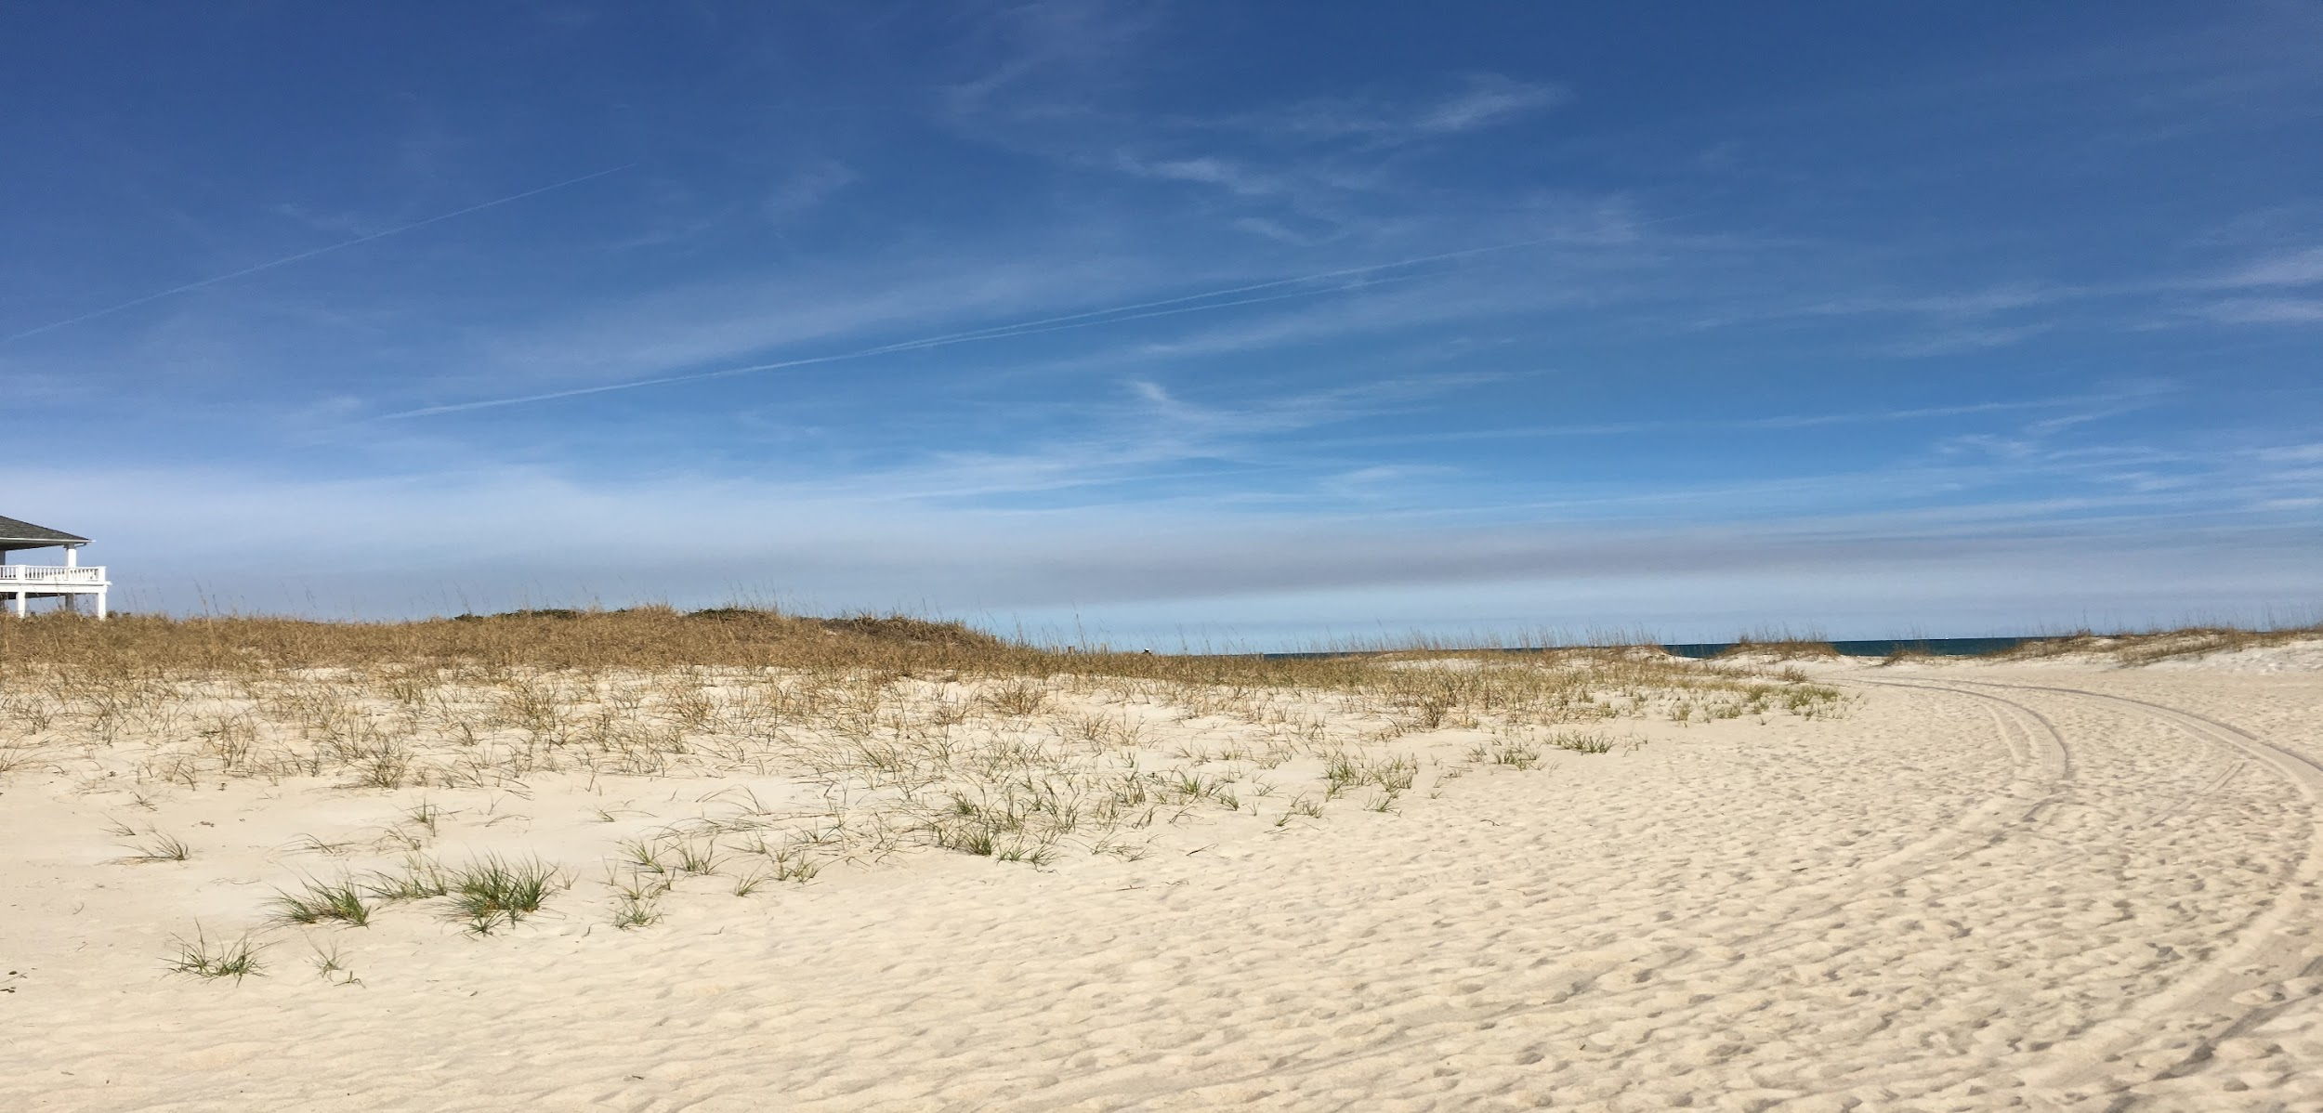
New Administration Impacts: Environmental Policy & Regulation
Your Questions & Comments
Richard Glaze
Partner, Barnes & Thornburg
(404) 431-4350
rglaze@btlaw.com
Stephen Ellingson
Vice President, Shannon & Wilson
(678) 512-9688
sbe@shanwil.com
File: GBA Admin Transit Ellingson 2025-04-16.ppt
Georgia Brownfield Association

