Slide 1
U.S. EPA Brownfields Update
Georgia Brownfield Association Seminar
April 16, 2025
Presented by:
David Hayes, EPA Brownfields Project Manager
EPA Region 4

Slide 2
EPA Region 4 Organizational Updates
Office of the Regional Administrator
  Regional Administrator: Kevin J. McOmber, P.E.
  Deputy Regional Administrator: Jeaneanne Gettle
  Chief of Staff: Leland Frost

Slide 3
EPA Region 4 Organizational Updates
Land, Chemicals and Redevelopment Division
Heather Ceron, Acting Director
Gracy R. Danois, Acting Deputy Director
Redevelopment and Chemicals Branch
Sara Janovitz, Acting Manager
Brownfields & Redevelopment Section
Vacant,
Acting Manager
PCB & Sustainability Section
Barbara Alfano,
Manager
RCRA Programs and Cleanup Branch
Dee Rodgers-Smith, Manager
RCRA Programs & Permitting Section
Kelly Adams,
Manager
RCRA Corrective Action Section
David Egetter, Manager
UST & Data Management Section
Nancy McKee Perez, Manager
Chemical Safety Section
Vacant, Acting Manager

Slide 4
EPA Region 4 Organizational Updates
Brownfields and Redevelopment Section
Sara Janovitz – Section Manager
Janet Brinson
Aditi Chakravarty
Jayvion Crawl
Austin Gilly
David Hayes
Alyssa Kuhn
Sid Patel
Olga Perry
Nichole Rodgers
Pepa Sassin
Matthew Simone
Freddie Wilson

Slide 5
EPA Region 4 Organizational Updates
Notable Retirements and Departures
César A. Zapata (Office of the Regional Administrator)
Camilla Warren (Brownfields Program)
Derek Street (Brownfields Program)
Terri Crosby-Vega (PCB Coordinator)

Slide 6
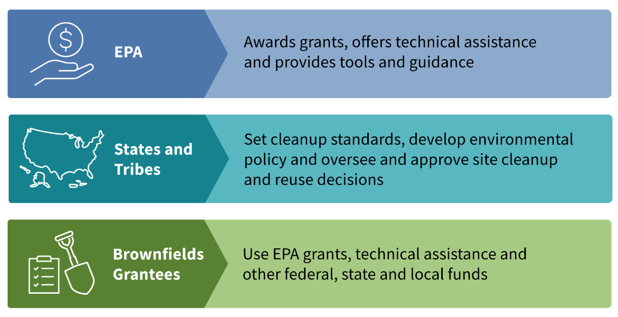
Roles for Brownfields Activities

Slide 7
EPA Brownfields Grants
Assessment Grants provide funding for brownfield inventories, planning, environmental assessments, and community outreach.
  Community-wide Assessment Grants – up to $500,000
  Assessment Coalition Grants – up to $1.2 million
  Community-wide Assessment Grants for States and Tribes – up to $2 million
Cleanup Grants provide funding to carry out cleanup activities at eligible brownfield sites owned by the applicant. Up to $500,000, $2 million, or $4 million.
Multipurpose (MP) Grants provide funding to conduct a range of eligible assessment and cleanup activities at one or more brownfield sites in a target area. Up to $1 million.
Revolving Loan Fund (RLF) Grants provide funding to capitalize loans that are used to clean up brownfield sites. Up to $1 million.
Job Training (JT) Grants provide environmental training for residents impacted by brownfield sites in their communities. Up to $500,000.
State and Tribal Response Program Grants provide non-competitive funding to establish or enhance State and Tribal Brownfields response programs.
Note: All grants listed are competitive except for State and Tribal Response Program Grants. Grant amounts listed are examples based on recent grant solicitations and are subject to change.

Slide 8
EPA Brownfields Assistance
Targeted Brownfields Assessments (TBA)
  Site assessment work (e.g., Phase I Environmental Site Assessment (ESA), Phase II ESA) conducted by EPA contractors at eligible Brownfield properties on behalf of eligible entities
  TBA applications are accepted anytime throughout the year
  David Hayes, Region 4 Coordinator: hayes.david@epa.gov
Land Revitalization Technical Assistance
  Helps communities identify possibilities for reusing a contaminated, or potentially contaminated site
  Site reuse assessments, revitalization planning, funding / financing analysis, etc.
  Nichole Rodgers, Region 4 Coordinator: rodgers.nichole@epa.gov
Technical Assistance to Brownfields Communities (TAB)
  TAB providers (grantees) for each EPA region
  Provides free technical assistance to communities and stakeholders to help address their brownfield sites, and to increase their understanding and involvement in brownfields cleanup, revitalization and reuse
  Region 4 TAB provider:
    New Jersey Institute of Technology (NJIT): www.njit.edu/tab/

Slide 9
FY25 State and Tribal Response Program Grant Allocations (Section 128a)
Funding to establish or enhance state and tribal environmental response programs
FY25 funding allocations not announced yet
  For Region 4, FY25 requests from all 8 States and 4 Tribes
Nationally for previous year (FY24), $46.25M in regular appropriations and $57.9M in Bipartisan Infrastructure Law (BIL) funding to award
Previous year FY24 Allocation for Georgia: $1.26M
  Regular appropriations: $720,000
  BIL funding: $544,500

Slide 10
Multipurpose, Assessment, Revolving Loan Fund, and Cleanup Grants: Awards in Georgia for 2021 – 2024
Grant Recipient Name | Grant Type | Announcement Year (FY) | Special Funding Type | Total Grant Funding
Albany, City of | Assessment | 2021 |  | $ 300,000
Bainbridge and Decatur County Development Authority | Assessment | 2021 |  | $ 300,000
College Park Business and Industrial Development Authority | Multipurpose | 2021 |  | $ 800,000
College Park, City of | Assessment, Cleanup | 2021 |  | $ 695,000
Albany, City of | RLF Supplemental | 2021 |  | $ 480,850
Georgia Mountains Regional Commission | Assessment | 2022 |  | $ 500,000
Rome Floyd County Development Authority | Assessment | 2022 |  | $ 500,000
Savannah, City of | Assessment | 2022 | BIL | $ 500,000
Social Circle Downtown Development Authority | Assessment | 2022 |  | $ 400,000
Southwest Georgia Regional Commission | Assessment | 2022 |  | $ 485,000
Walker County | Assessment | 2022 |  | $ 500,000
Atlanta, City of | RLF Supplemental | 2022 | BIL | $ 3,900,000
Decide DeKalb | RLF Supplemental | 2022 | BIL | $ 2,500,000
Adrian, City of | Assessment | 2023 |  | $ 500,000
Atlanta, City of | Cleanup | 2023 | BIL | $ 2,000,000
Perry, City of | Cleanup | 2023 | BIL | $ 500,000
Savannah, City of | Revolving Loan Fund | 2023 | BIL | $ 1,000,000
Columbus Consolidated Government | Multipurpose | 2024 | BIL | $ 1,000,000
Middle Georgia Regional Commission | Assessment | 2024 |  | $ 1,500,000
Rome Floyd County Development Authority | Cleanup | 2024 | BIL | $ 2,000,000
Warner Robins, City of | Multipurpose | 2024 | BIL | $ 1,000,000
Total: $21,360,850

Slide 11
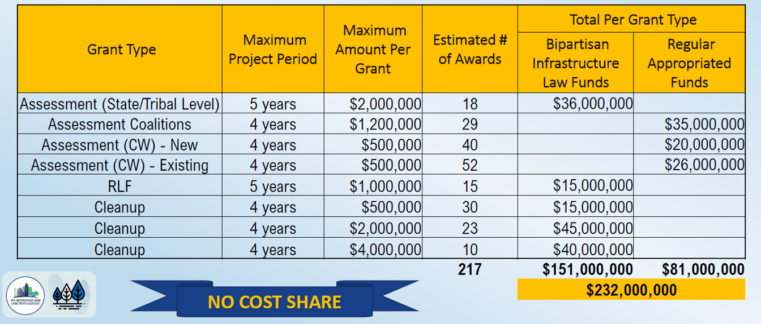
FY25 Brownfields Assessment, Cleanup, and Revolving Loan Fund Grant Offerings

Slide 12
FY25 Brownfields Assessment, Cleanup, and Revolving Loan Fund Grants
Expected Timeframe
September – November 2024: Applications Open
November 2024 – April 2025: EPA Review and Selection
May 2025: Selections Announced
May – July 2025: EPA works with selected applicants to complete pre-award documents and funding recommendations
August – September 2025: Grants Awarded

Slide 13
Questions / Contact
David Hayes
EPA Brownfields Project Manager
hayes.david@epa.gov
404-562-8071

