Slide 1
Brownsville Pointe Development 105 McDonough Blvd SE, Atlanta, GA
FCSMINISTRIES.ORG
2025

Slide 2
OUR MISSION
FCS partners with under-resourced neighborhoods to provide that promotes flourishing communities and God’s Shalom.
innovative and holistic development
FCSMINISTRIES.ORG
Notes:
However, We CAN think Innovatively and holistically

Slide 3
OUR APPROACH
We reweave the fabric of neighborhood so that they become places of opportunity, access, and belonging.
FCSMINISTRIES.ORG

Slide 4
WHAT WE DO…

Slide 5
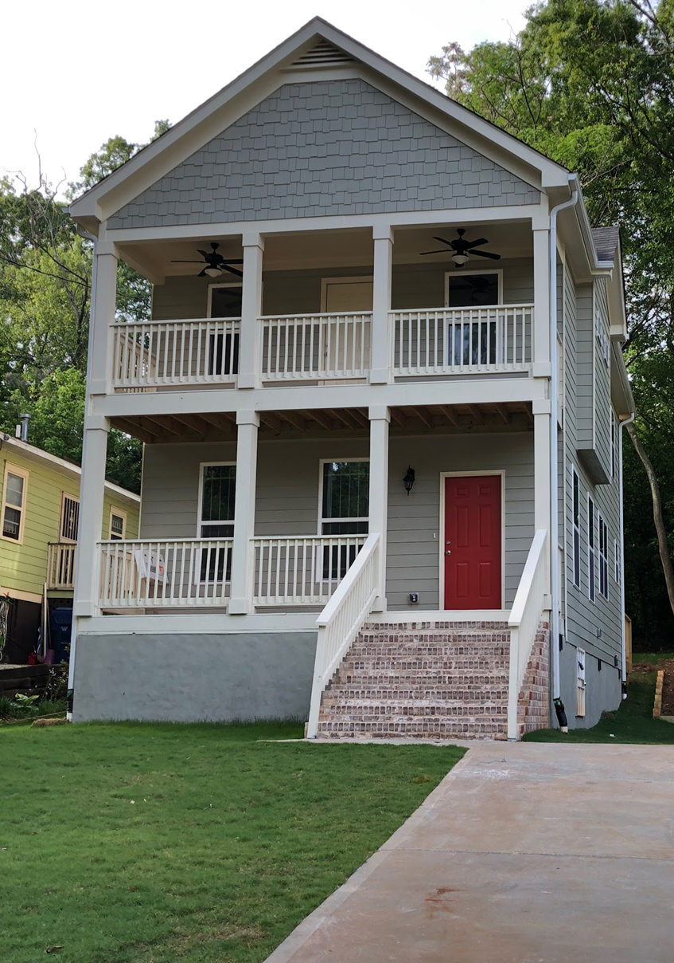
FCS History in Historic South Atlanta
Focused, intentional development has led to the following impacts:
Homeownership rates have moved from 10% in 2000 to over 60% in 2020.
One third of the neighborhood is owned by families with AMI below 80%.
FCS has constructed or rehabilitated over 200 single family homes.
Maintain a 32-Unit Single-Family Rental Portfolio
Development of Haven at South Atlanta, an 84-unit LIHTC development in partnership with Pennrose. Grand Opening was in spring 2023.
Carver Market Grocery Store & Community Grounds Café

Slide 6
OUR IMPACT
Renewed Social Cohesion
Improved Holistic Health and Vitality
Greater Racial Equity
Strengthened Economic Mobility
FCSMINISTRIES.ORG

Slide 7
THE VISION
Main Street Corridor
FCSMINISTRIES.ORG

Slide 8
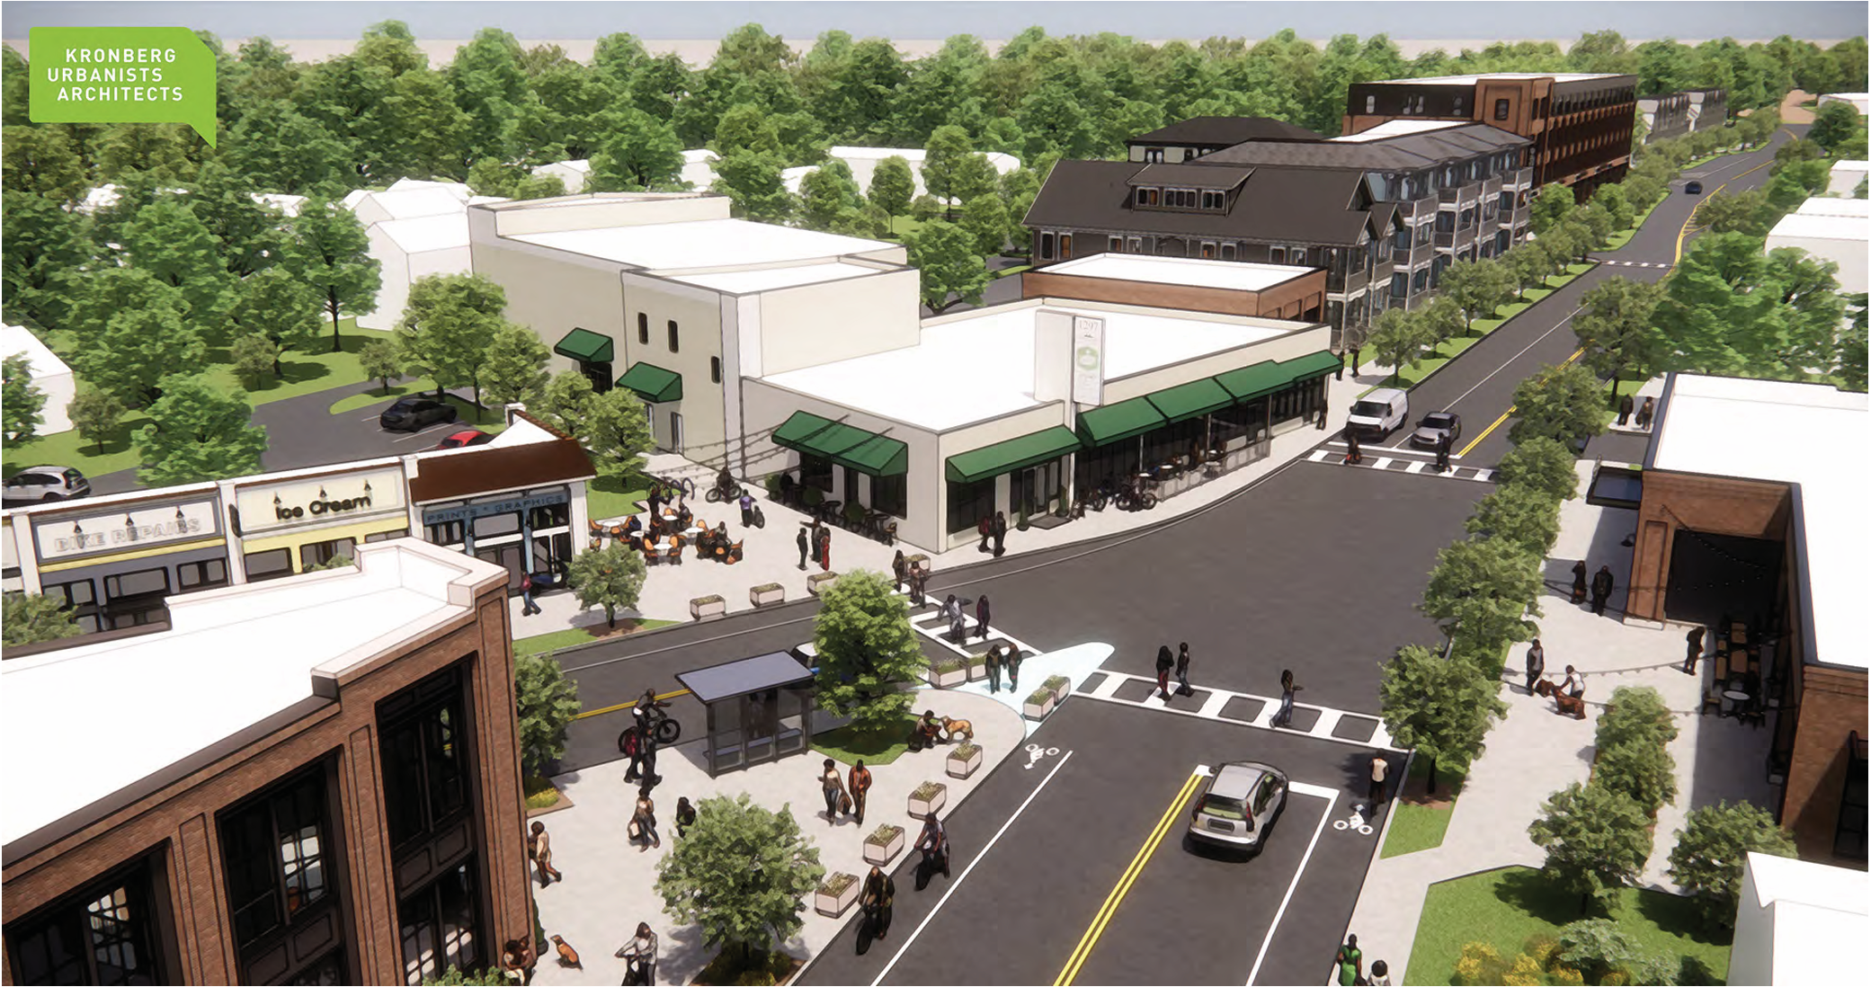
The Vision – Main Street Corridor

Slide 9
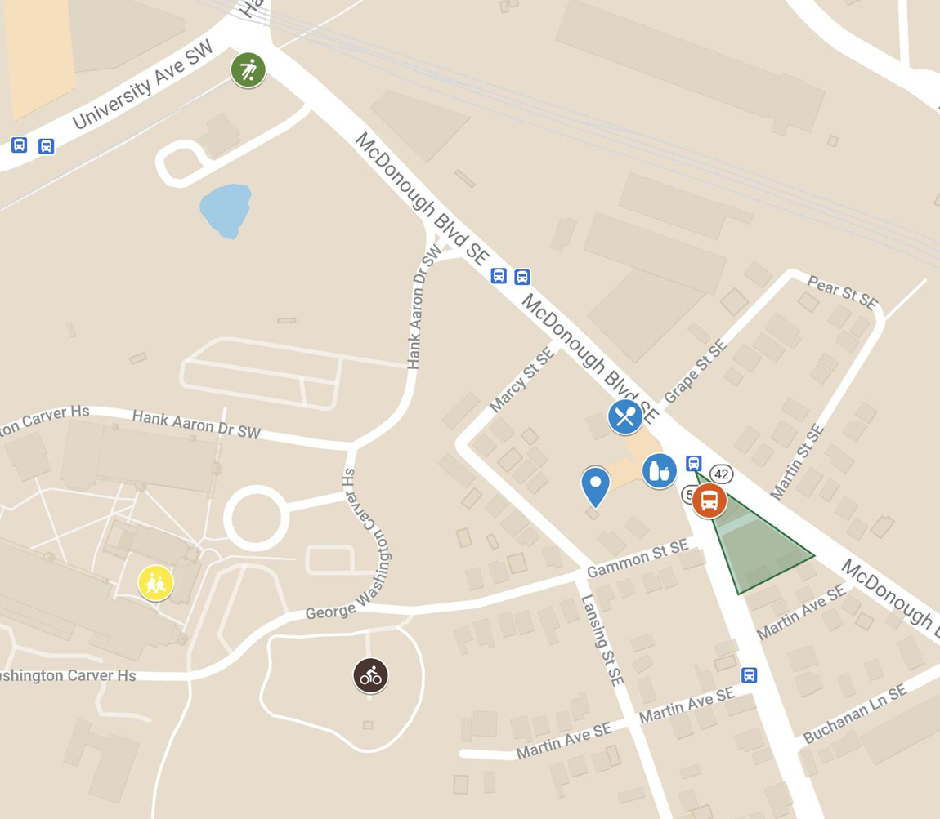
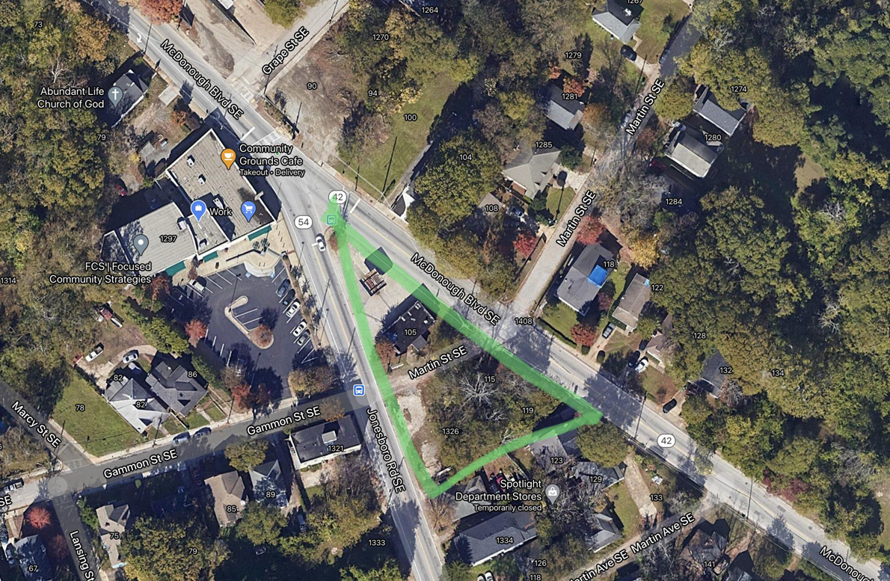
105 McDonough Proximity & Location
105 McDonough is strategically located at the intersection of McDonough Boulevard and and Jonesboro Road at the entrance of Historic South Atlanta.
Carver Market .01 mile
Community Grounds .01 mile
BeltLine Southside Trail .3 mile
Carver High School .3 mile
Slater Elementary .3 mile

Slide 10
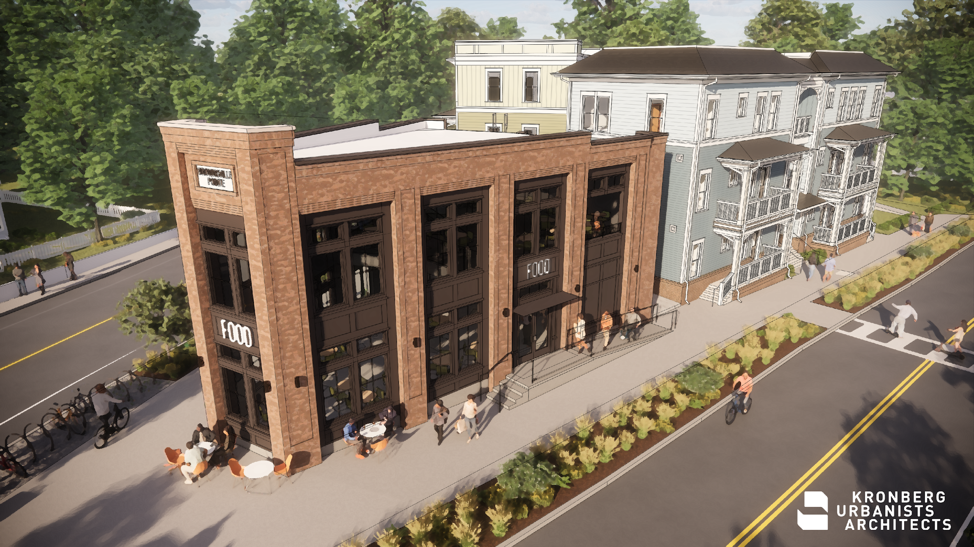
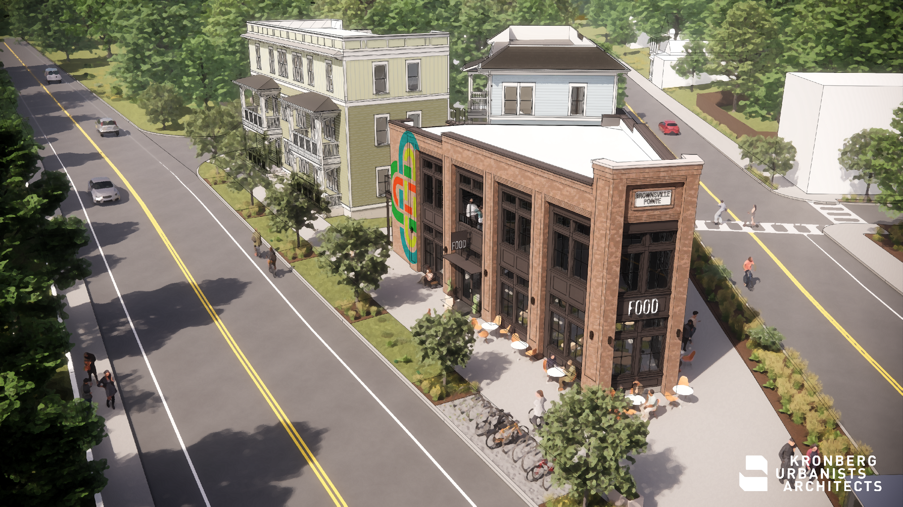
Brownsville Pointe Development

Slide 11
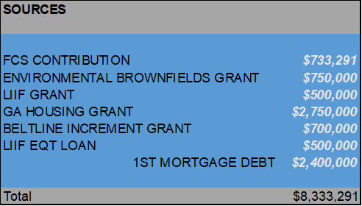
Brownsville Pointe by the numbers
Brownsville Pointe Development (“BPD”), a 15,090 square foot mixed use project located in Historic South Atlanta at the corner of McDonough Blvd and Jonesboro Rd within the Beltline Tax Allocation District. The development project includes three buildings: Two garden style multi-family buildings (13,300 SF) comprised of 18 units with 12 units restricted for 60% AMI or below a commercial restaurant building (1,790 SF). The project has sourced 4 grants to contribute funding for the project.
The restaurant building will be attainable retail with
rents 10-20% below market to a start-up or small business owner.

Slide 12
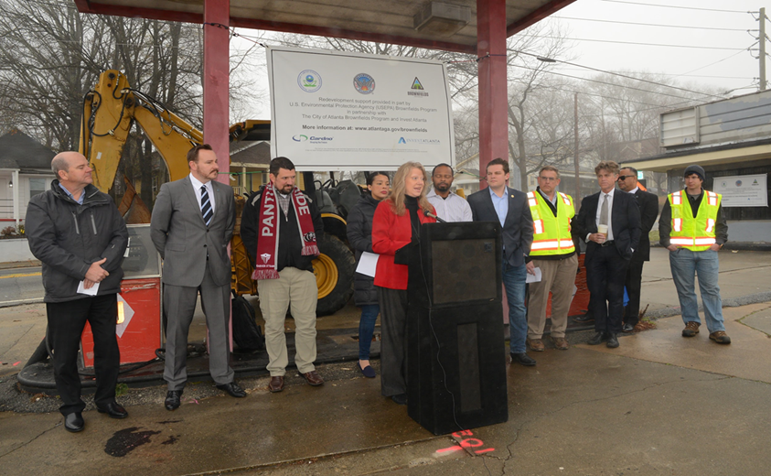
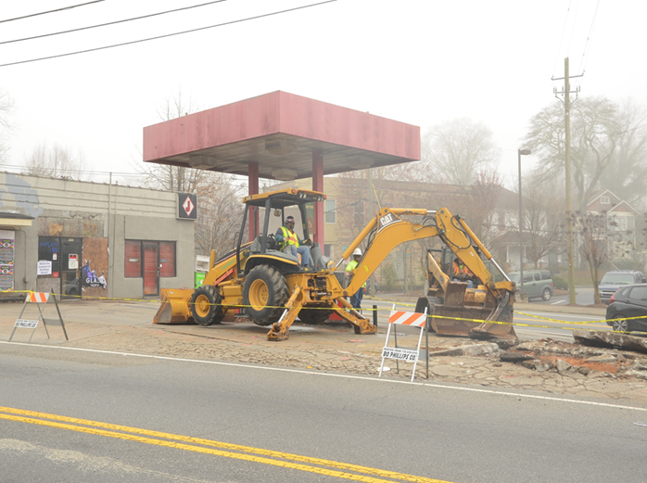
Brownsville Pointe Development- Environmental
Site was accepted into the Georgia Brownfields Program in 2018
Remediation of a leaking UST- Underground Storage Tank was performed in partnership with City of Atlanta and Invest Atlanta
Unfortunately, not all of the contaminated soils were removed at that time.
FCS is currently performing a soil excavation approximately 20 feet deep to remove and replace any contaminated soils located on the site.
This work is anticipated to be completed in May 2025.
FCS is able to do this remediation work because of the City of Atlanta’s Brownfield Revolving Loan Fund through a $750k Grant made to FCS.

Slide 13
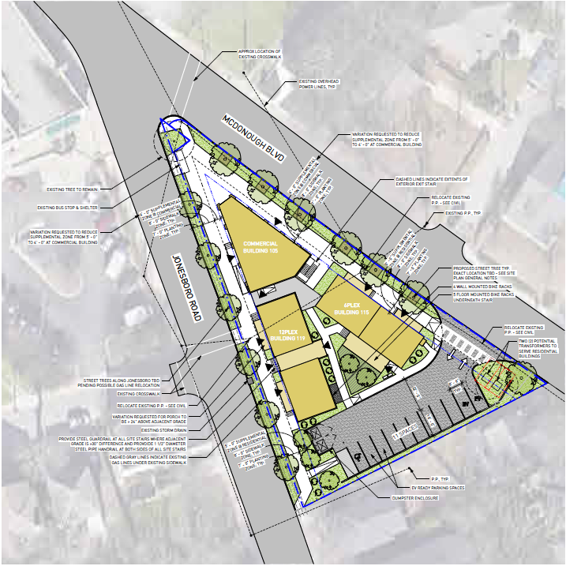
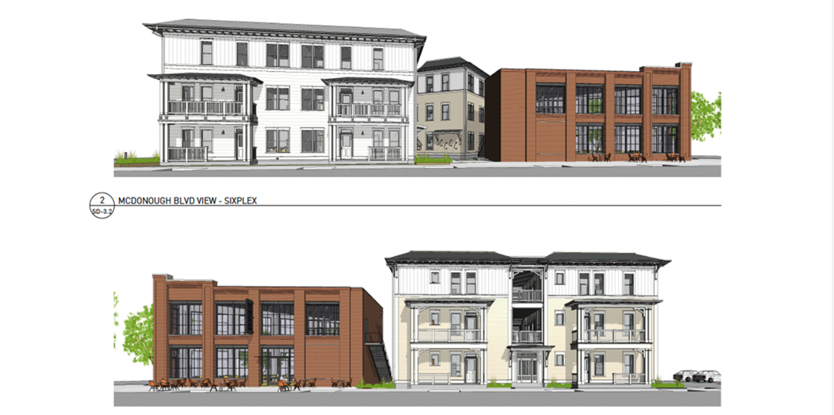
Brownsville Pointe Development

