Slide 1
Crystal Springs Mill - Chickamauga, GA

Slide 2
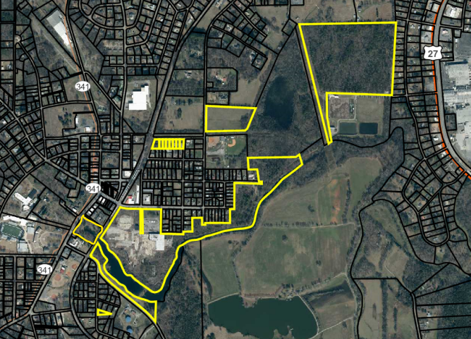
Crystal Springs Mill - Chickamauga, GA

Slide 3
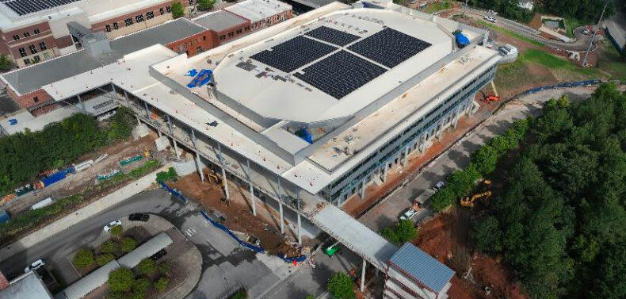

Slide 4
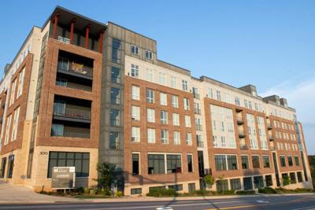

Slide 5
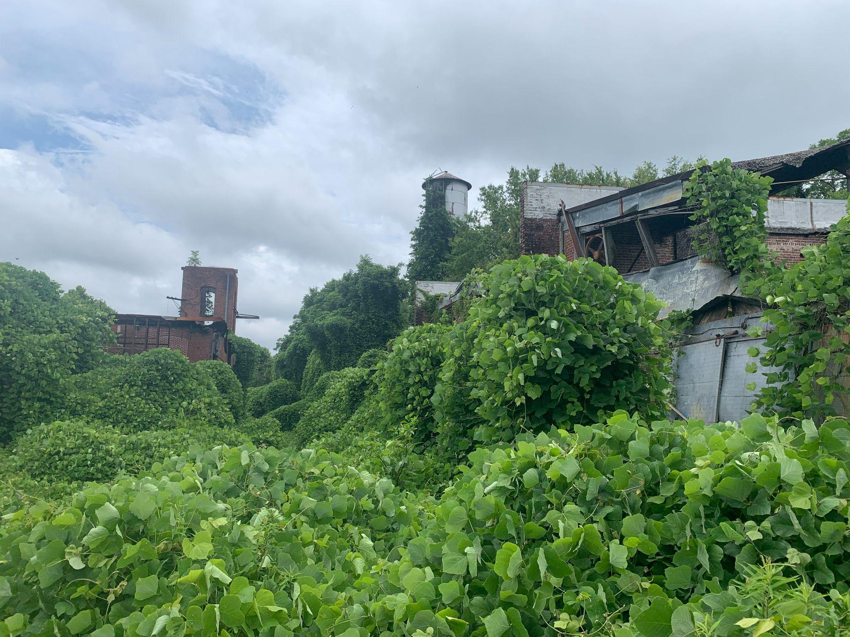

Slide 6
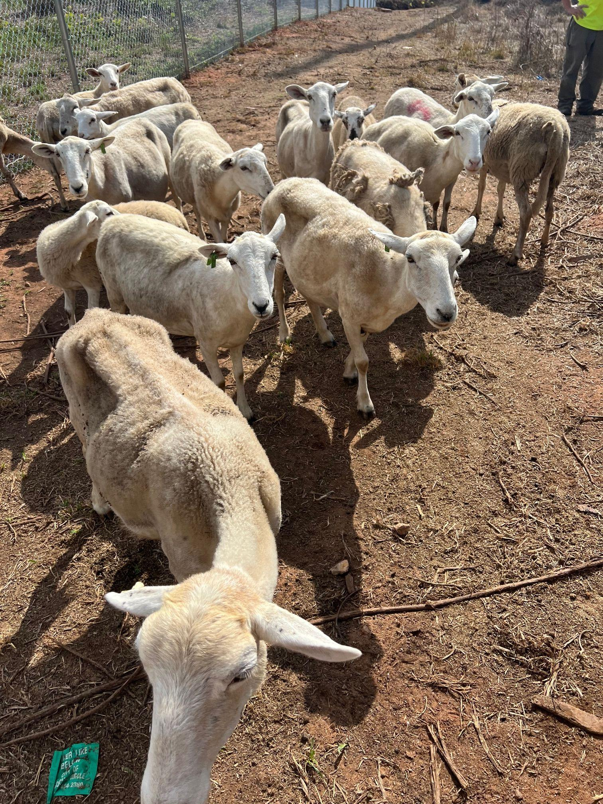

Slide 7
