Slide 1
GBA Seminar
April 16, 2025
We Bought What? RFCDA’s EPA-Funded
Accelerated Assessment of a 132-Acre Property

Slide 2
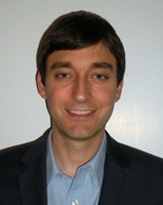
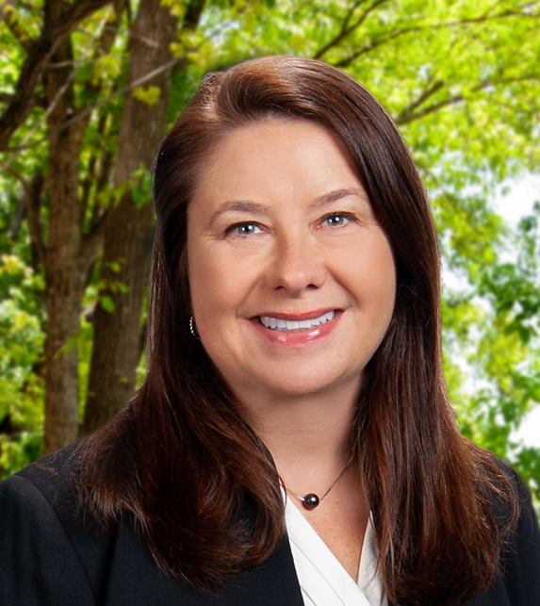
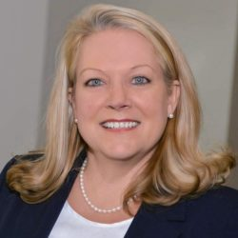
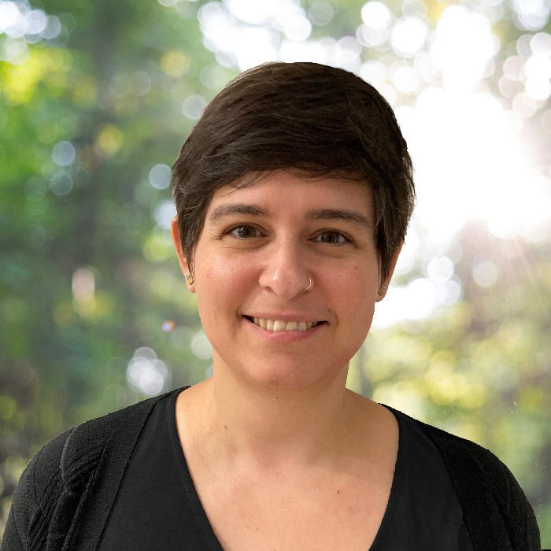
RFCDA Panel
David Hayes
Brownfields Project Manager
US EPA Region 4
Jessica Turner, PG
Senior Project Manager
GEI Consultants, Inc.
Missy Kendrick, EDFP, IOM
President
Rome Floyd County Development Authority
Stefanie Gugolz, PG
Project Geologist
GEI Consultants, Inc.

Slide 3
Battey Business Complex
Former Northwest Georgia Regional Hospital operated 1944 - 2011
RFCDA acquired property in February 2022
Approximately 132.5 acres, 66 vacant structures (including 24 houses)
EPA Assessment Activities in 2023-2024
Phase II ESA
ACM and LBP Survey of structures
Community engagement
Remediation planning
Redevelopment planning

Slide 4
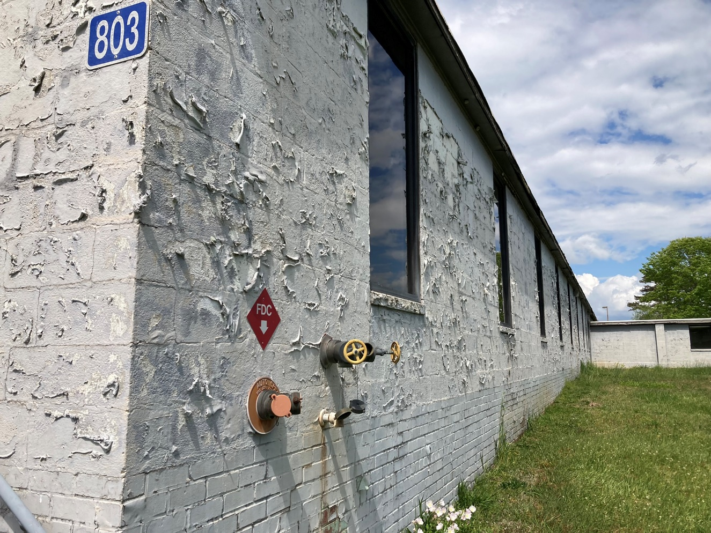
Battey Structures

Slide 5
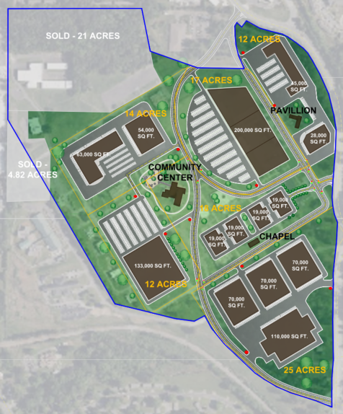
Redevelopment Potential
Industrial complex for new businesses and job creation
Re-use of three existing buildings:
Community Center
Chapel
Pavilion

Slide 6
Documenting Site History
RFCDA partnered with a video production agency for filming
Funded in part by a grant from the Rome Area Heritage Foundation
Captures previously untold stories from former hospital staff, patients, and community

