Slide 1
Using Geographic Information Systems to Rapidly Identify and Quantify Past and Present Sources of Potential Environmental Contamination
Georgia Brownfield Association
Data Valuation Session
Michael Wild, P.E.
ERM NewFields
April 16, 2025
Notes:
My name is Michael Wild and
I am with ERM NewFields which is an international environmental consulting firm.
I am also a professional Environmental Engineer here in Atlanta since 1987 (officially a dinosaur I guess).
I work primarily with the legal community to quantify and clarify environmental contamination and risks.
If you ask anyone that knows me, they will tell you that I love looking at data and Geographic Information Systems or GIS is favorite vehicle to see it.
Advances and expansions in available, online environmental data through GIS makes my life easy. These advances should make your lives easier too.

Slide 2
Why Dig for Data?
GIS is an excellent tool to consolidate and analyze data associated with your brownfield site
Your site, however, is not constrained by a predefined boundary
With respect to contamination, the past doesn’t stay in the past
Notes:
GIS is an excellent tool to consolidate all your data associated a potential brownfield site
It is important to know that your site and realized or potential contamination on it is not constrained by a pre-defined boundary or fence line.
Offsite sources from air, surface water or groundwater do not respect theses boundaries - so you should always look beyond your site for other contamination sources.
Also, with respect to contamination, what happened in the past at or near your site, especially for heavy metals like lead, arsenic and cadmium that accumulate and don’t break down, the line between past and present disappears.

Slide 3
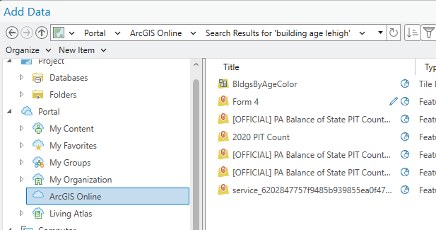
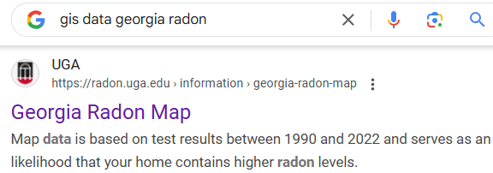
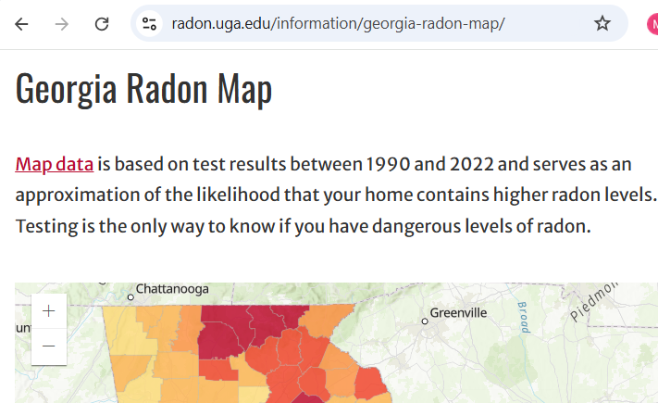
How Do I Dig for GIS Data?
Search and Add Directly via ArcGIS Online
Google It!
GIS Data / County or State name / Stuff You Want
Notes:
So – how do I, a curious person with a need to know, start digging for GIS data?
If you are starting from scratch and have access to GIS software such as Esri’s ArcGIS Pro or ArcMap, I would:
Start searching and adding content via ArcGIS Online which is Esri’s cloud-based web GIS platform
In this example I am using ArcGIS online to search for GIS data of building age in the county of my site.
Another way is to just Google it
I like to use the words GIS data, the county or state my site is in and the stuff that I am interested in
For this example, I typed in GIS Georgia and Radon which points me towards a map and table from the university of Georgia. This website provides Radon concentration ranges by county. A few extra steps to get these data into my GIS but not so difficult that I skip it.
If you didn’t know it, Radon is a real problem here in Georgia, at the case study site I showed earlier, and in my own house, unfortunately.

Slide 4
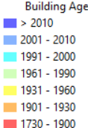
Best Online Data Servers: EPA, USGS, County, State,...
Notes:
So I have done these compilations many times already and have put together some of my favorite sites, which I have saved in a group of online sources. Most are from federal government sources like the EPA and the united states geological survey or USGS.
In this map you can see that our brownfield site is surrounded by homes built in the early 1900’s, hazardous waste and air pollution sites, water dischargers, mining operations and underground storage tanks. Clicking on each of these dots or polygons shows the underlying data or links to additional information.

Slide 5
Dead Links – What Should I Do?
If Possible, Download Now
If Not, Find an Archive
Or an Alternative
Notes:
You may have also noticed that at the top of my favorite online data sources are some dead or missing links from the CDC and EPA’s EJ (environmental justice) screening tool. For GIS users, this is the dreaded red exclamation marks
Due to new policy shifts, significant amounts of data and fully developed Web tools are disappearing from federal Web sites. This trend is likely to continue for various kinds of scientific and demographic data that are targeted by current policies, but ALL federal data sources are vulnerable to instability due to large cuts in information technology.
SO - If there are useful dataset, download what you can immediately.
Public Environmental Data Partners is an excellent resource for archived datasets or archived versions of disappeared data tools.

Slide 6
Health Indices/Other Data? Check your County or State
Notes:
In addition to the site I mentioned, I also suggest going to sources that may be available from your site’s state or county. This excellent series of environmental datasets and health indices comes from the Pennsylvania department of health.
How did I find it you may ask?
I looked.

Slide 7
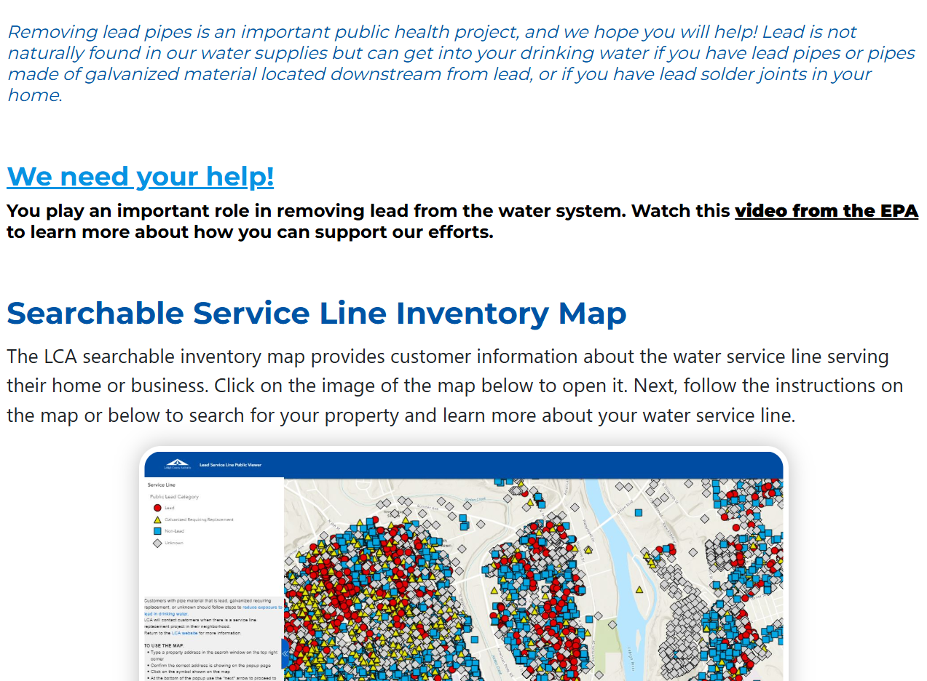
Lead-Based Paint and Lead in Drinking Water
From County Water Authority
Lead paint in older homes is still considered to be one of the most widespread sources of lead exposure (CDC).
In older homes still containing lead pipes or lead solder in the plumbing system, lead can enter drinking water through corrosion of the home’s plumbing materials.
Notes:
Earlier I talked about the age of homes as being an important data source,
That’s because, prior to the 1970s, lead-based paint was widely used in the US and the older the home, the higher the concentration of lead and potential lead contamination.
According the CDC lead paint is one of the most widespread sources of lead exposure.
The prior administration issued a rule requiring drinking water systems across the country to identify and replace lead pipes within 10 years.
In my opinion, this is a significant problem that has been overlooked for years in homes, schools and other properties.
Some water systems are more GIS savvy than others, but this information should be out there for you to find in a GIS ready or near ready format
You just need to look.

Slide 8
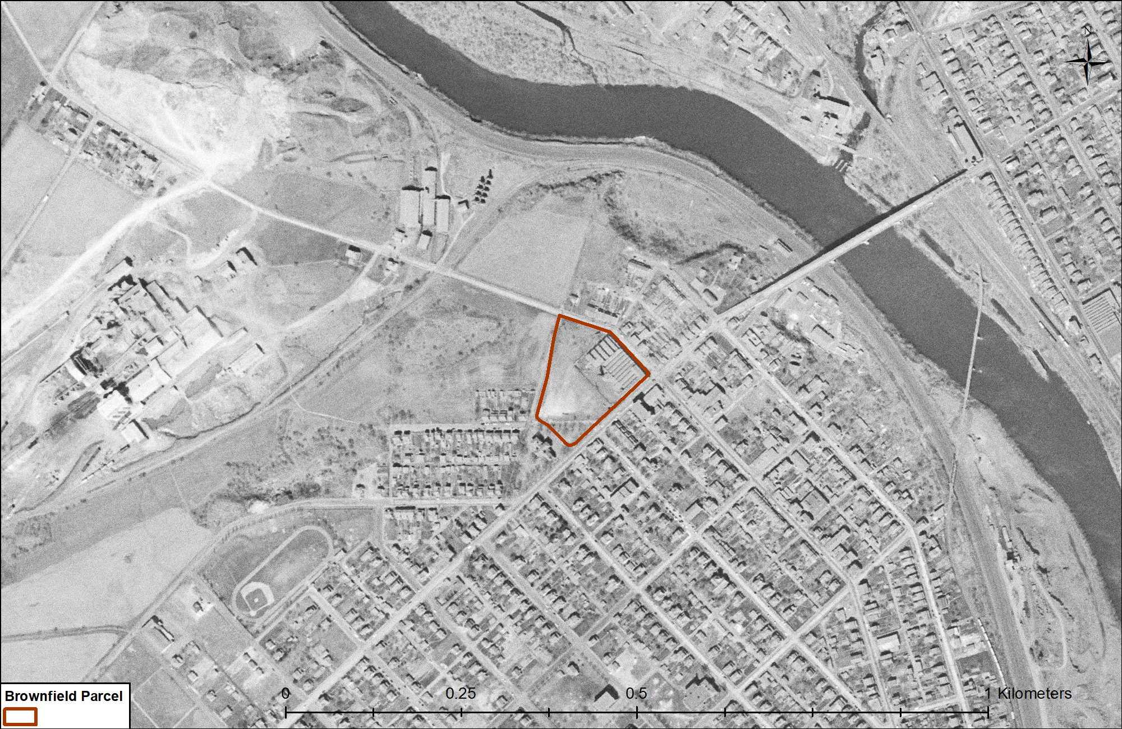
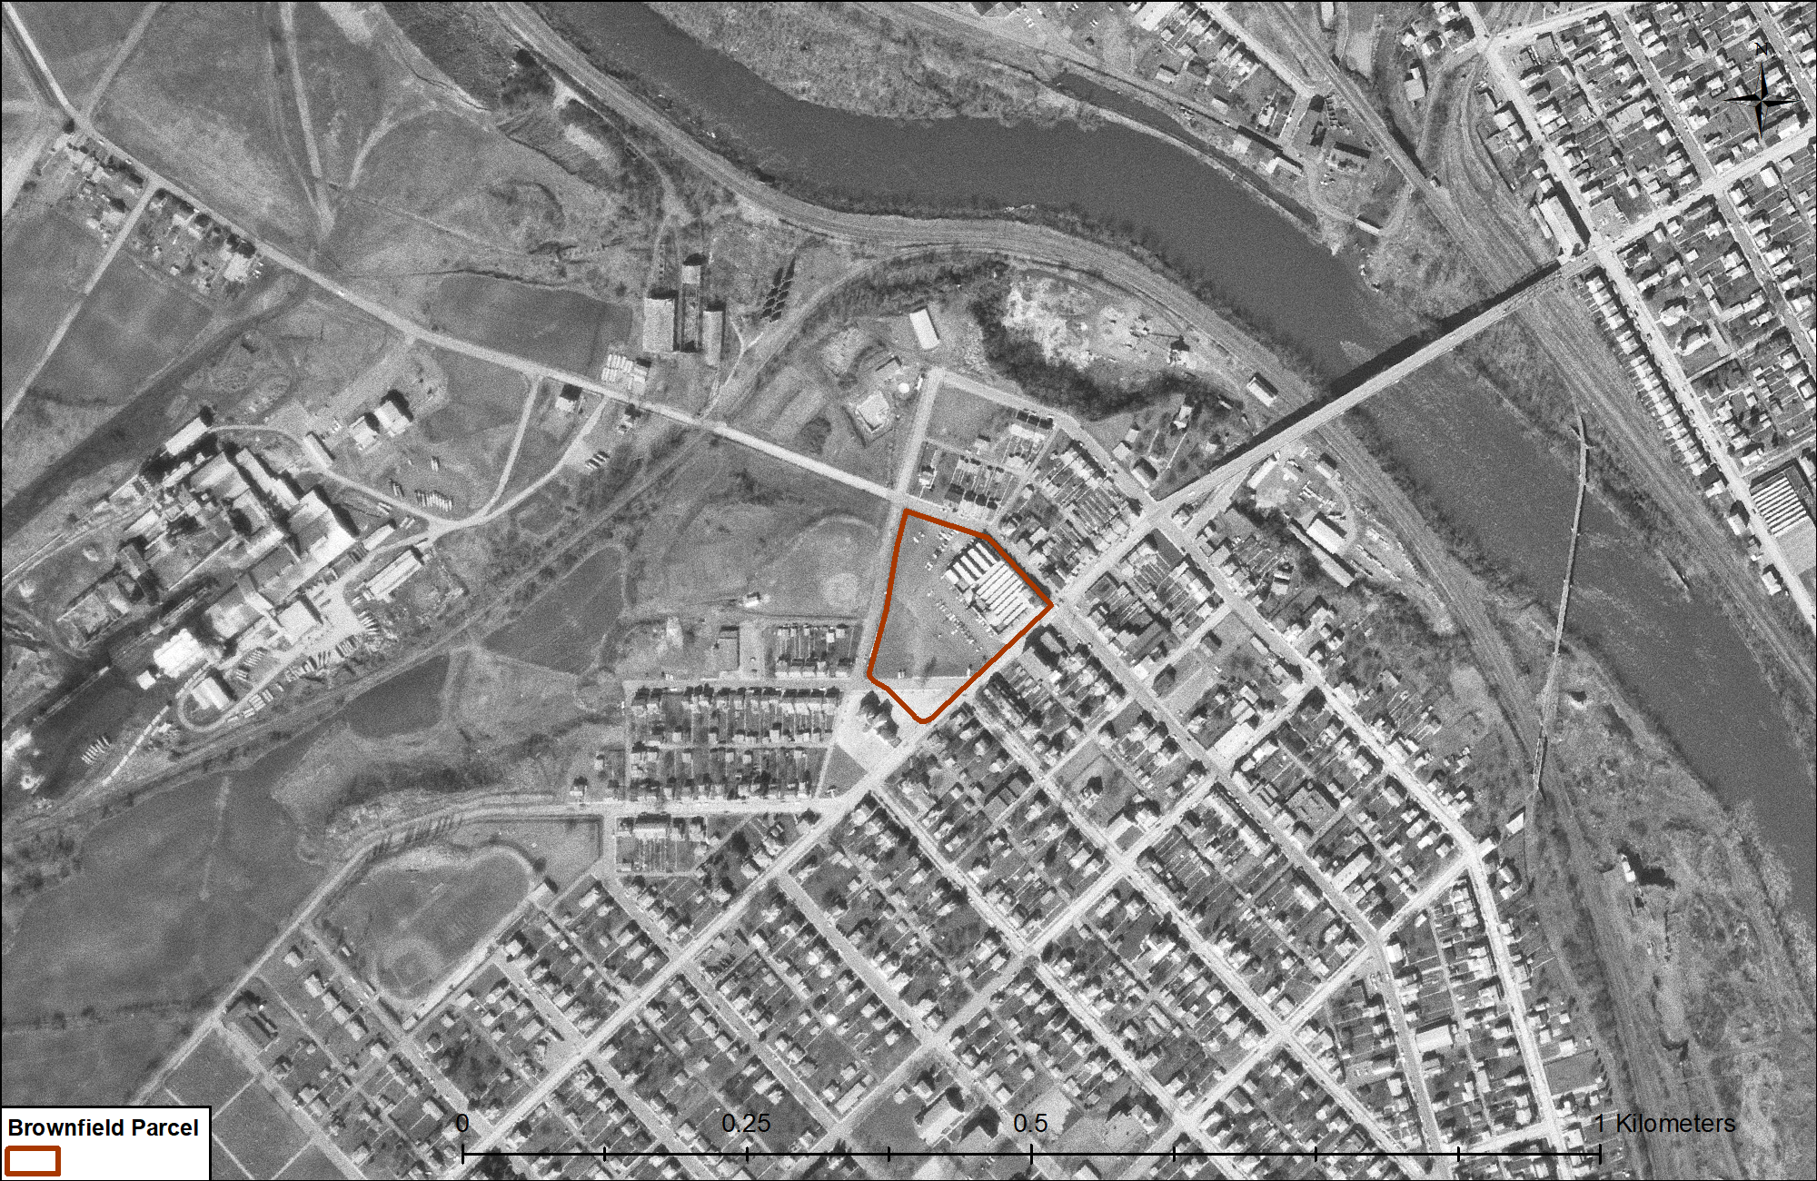
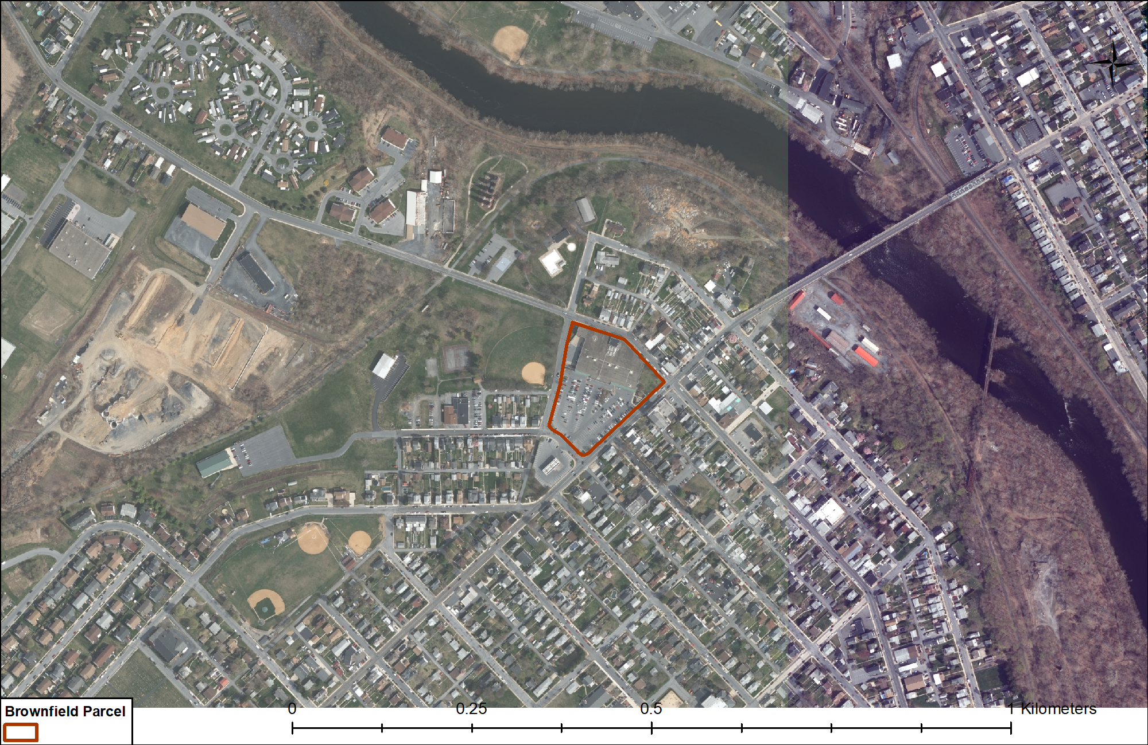
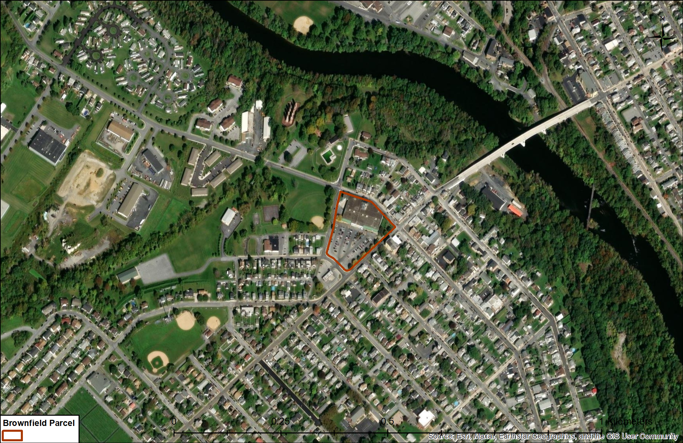
Historic Aerials: earthexplorer.usgs.gov
1955
1972
2015
2023
Notes:
Other commonly overlooked data sources are historical aerial photos which should be required reading for environmental engineers and scientists.
The usgs has a great and free site for historical aerials. Just download the aerials that overlay your site and register them into your GIS.
Here you can see how my site and the surrounding area has changed over time.

Slide 9
Historic Aerials: earthexplorer.usgs.gov
1955
1972
2015
2023
Notes:
This slide shows the aerials I compiled next to each other.
You can see from this perspective how the area and this site changed over time. It wasn’t aways a Giant foods surrounded by residential properties and greenspace when it was developed in 2012.
Property records from the County tell me that the area adjacent to my site was an 80-year-old cement plant with its own quarries – one of which is very apparent in the 1955 and 1972 aerials. By 2015 you can seen these areas start to be redeveloped and or filled in.

Slide 10
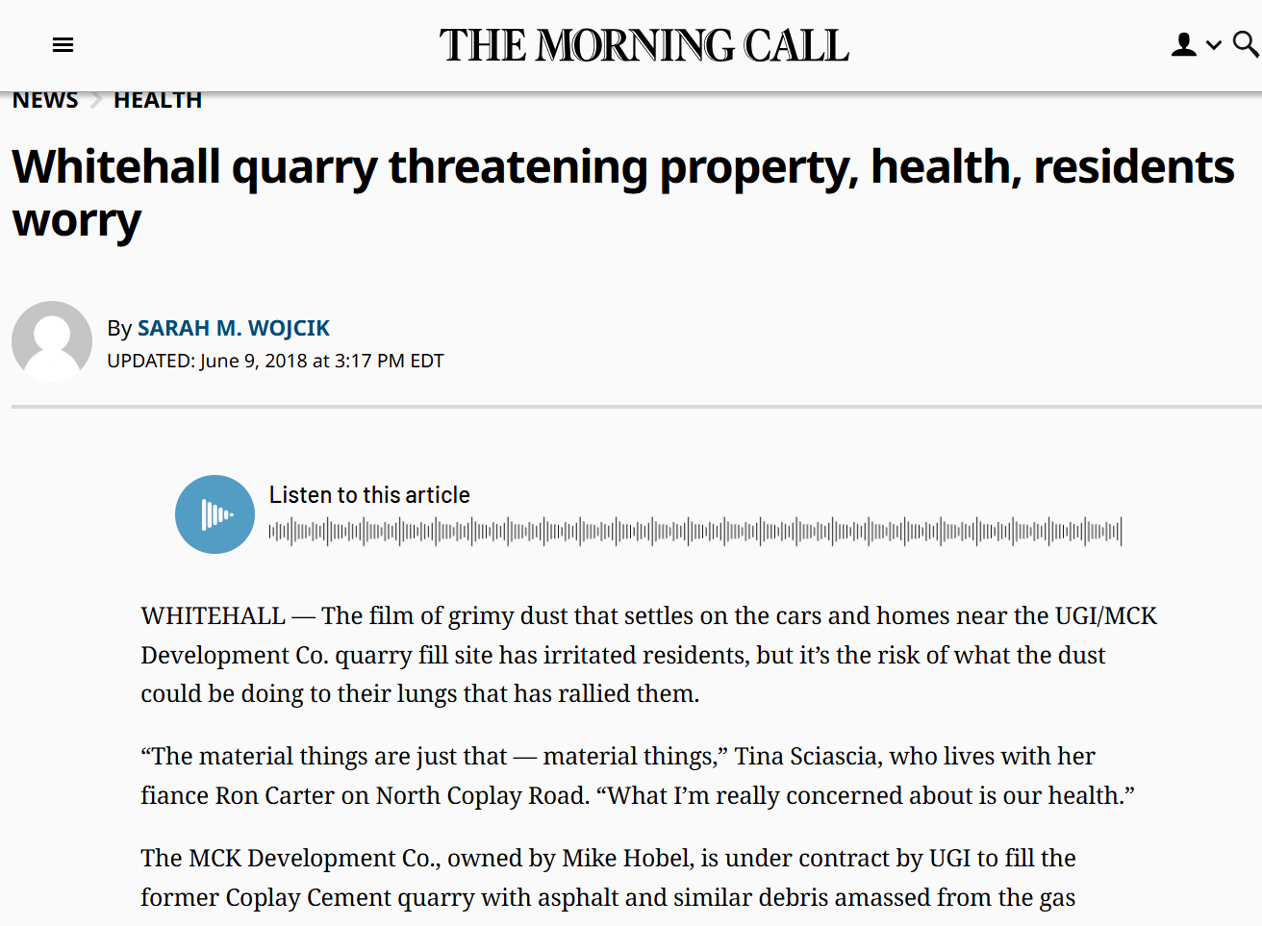
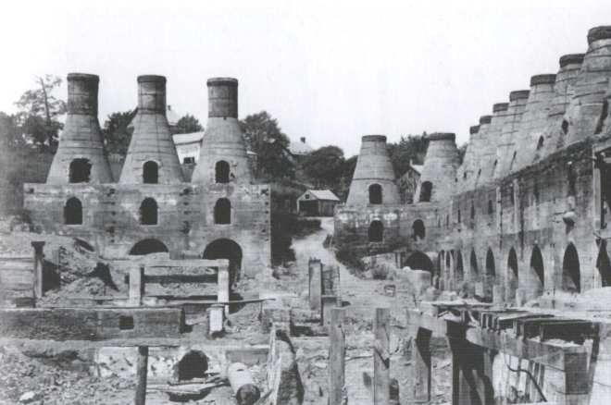
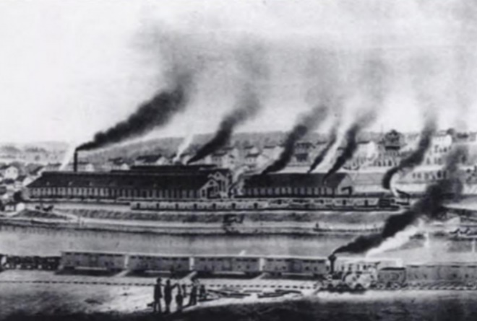
Don’t Forget Other History
Coplay Cement Mill
Lehigh Train Car Manufacturing
Notes:
And a big shout out to my researchers out there. Not everything needs to be GIS-mappable to understand your site and its surroundings. Newspapers and historical societies are great sources of information.
This news story, for example talks about the grimy dust from redevelopment work at a former limestone quarry and cement plant. Cement plants are well-known sources of heavy metals that don’t break down but accumulate over the years.

Slide 11
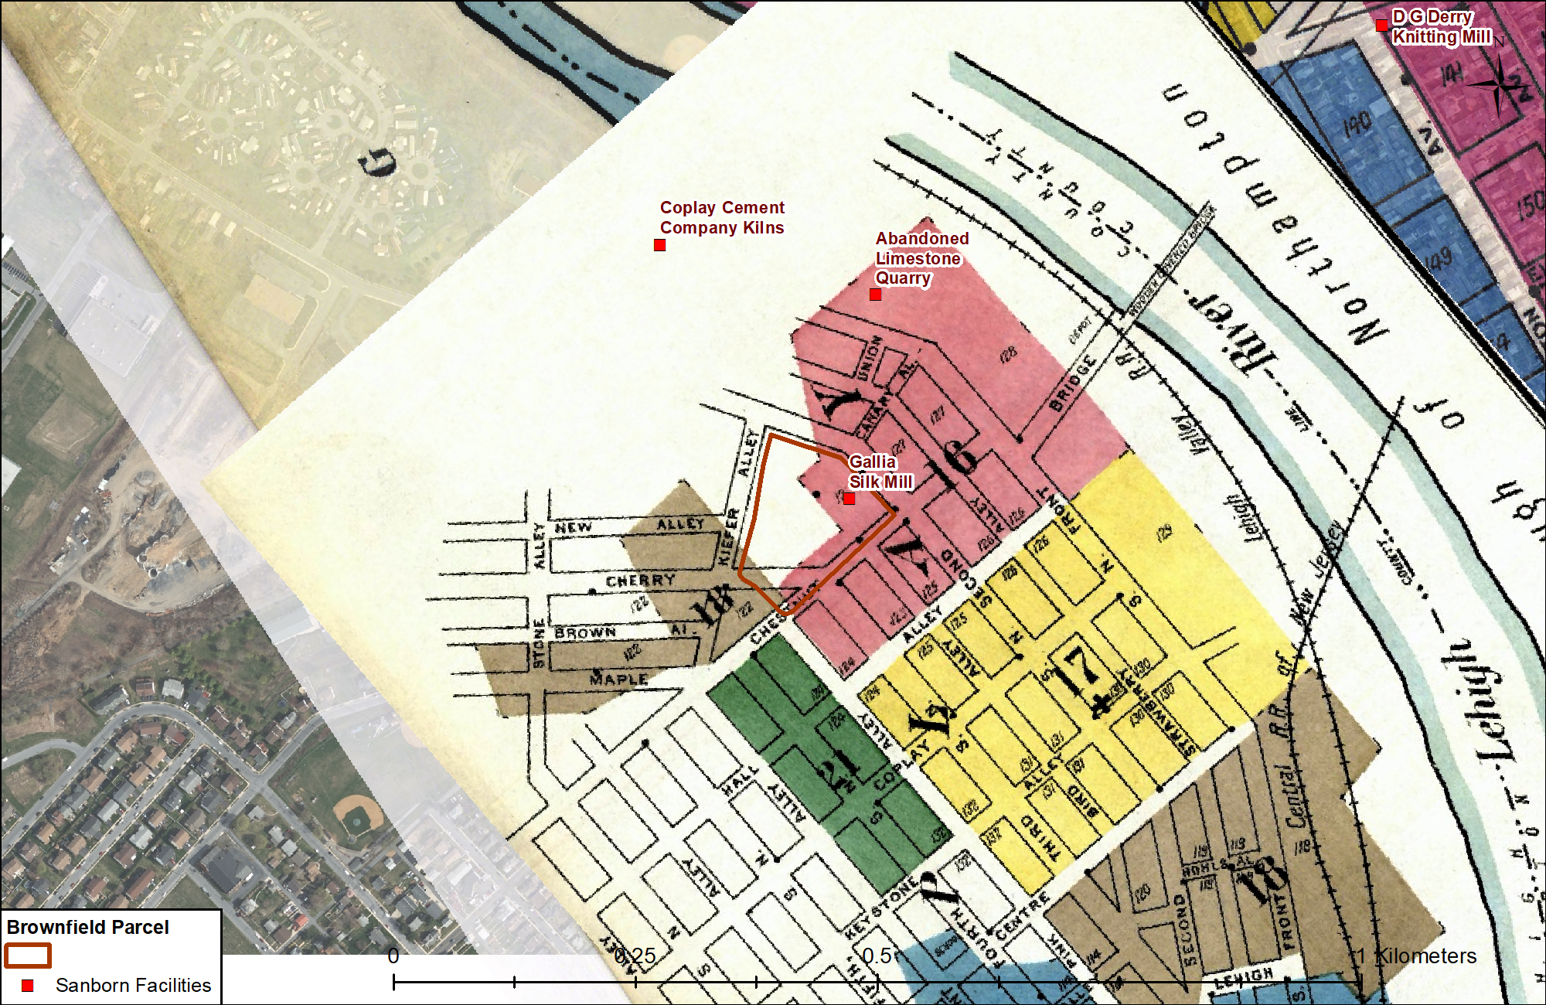
Sanborn Maps: State Repositories or Library of Congress
Notes:
Finally – who doesn’t love the really old stuff? Dinosaurs like me, that’s who.
Sanborn maps are excellent sources of former industries whose contamination may also, and likely is, still around. My brownfield property was formerly the Gallia Silk Mill. Silk mills and other textile industries are known sources of heavy metals, dyes, organic solvents and other processing chemicals. The next speaker, Emmie Chen will talk about ways to fingerprint and distinguish different sources of contamination. I am here to simply say, there are current and historical contamination sources all around and at my brownfield site I might not had know existed if I hadn’t bothered to look, click and compile.

Slide 12
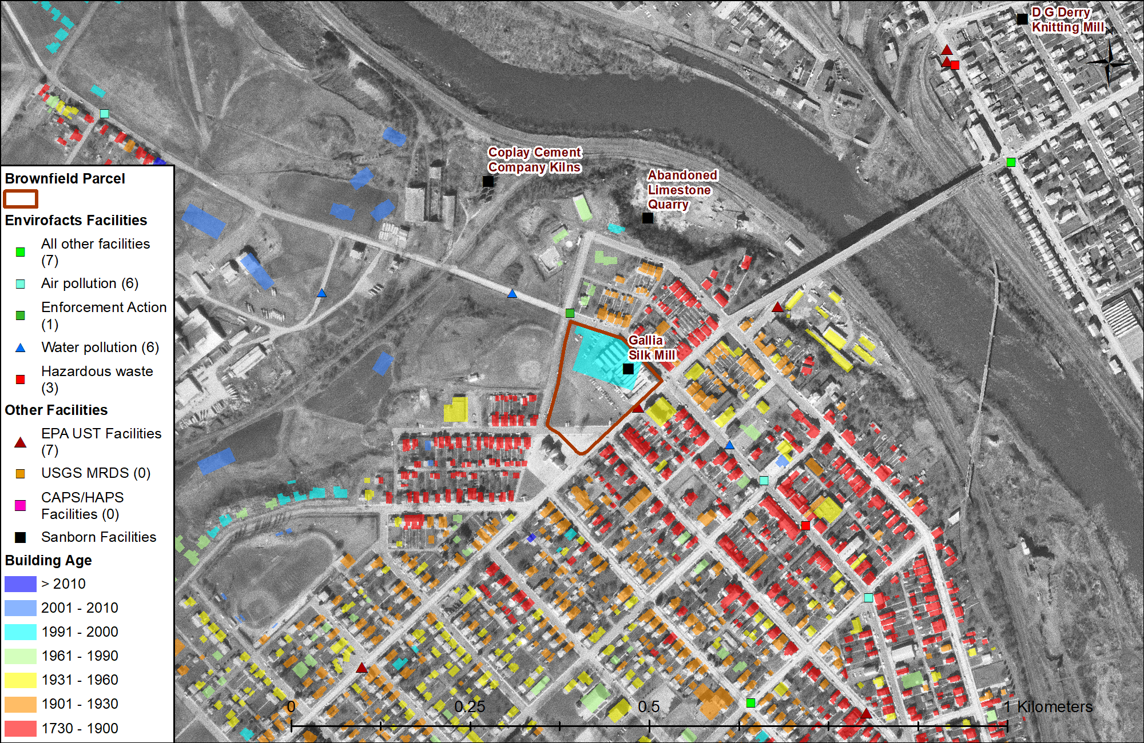
Everything Everywhere All at Once
EPA Facilities
TRI Data
USTs
USGS Mines
State Facilities
Radon Surveys
Building Age
Health Indices
Historic Aerials
Sanborn Maps
Old News
Download!
Notes:
So - Everything Everywhere All at Once isn’t just my favorite movie, it is my favorite way of understanding my site and informing my client.
Data sources like EPA facilities, Toxic release inventory data, USTs, lead based paint, historical aerials and Sanborn maps – these are some of my favorite things.
And, just in case, even though I love Real-time, updated GIS data from trusted sources,
download yourself copies of the data you compiled. Because you never know when that information can disappear from your map or become temporarily unavailable.
I guarantee you that, for environmental contamination, just because it is flushed from the tubes of the internet, doesn’t mean it disappears off your site

