Slide 1
Applications of Environmental Forensics AT SITES WITH LEGACY AND EMERGING CONTAMINANTS
APRIL 16, 2025

Slide 2
Introduction to Environmental Forensics
Establish Nexus
Develop a defensible factual basis of liability and establish contaminant link
Identify Parties
Identify financially viable responsible parties (RPs)
Large or Small Sites
Inform Site Investigation Inform site investigation and remediation strategies
Support Legal Strategy
Inform legal strategy regarding asset purchase or divestiture, cost allocation, liability defense, cost recovery, etc.
Many Contaminants
Identify Sources
Identify sources of contamination and, where possible, the proportion of contamination contributed by each source
Multiple Legal Frameworks

Slide 3
Multiple Lines of Evidence (LOE) Approach to Forensics
Site History Forensics
Concentration and Spatial Distribution
Multiple lines
of evidence that
tell a cohesive,
defensible, and compelling story
about the sources
of COCs
Contaminant Transport Pathway Analysis
Modeling
Fingerprinting Analysis

Slide 4
Case Studies
Case Study 1:
PFAS Forensics at a Groundwater Site
Case Study 2:
Petroleum Age Dating at an Underground Storage Tank Site

Slide 5
Case Study 1:
PFAS Forensics at a Groundwater Site

Slide 6
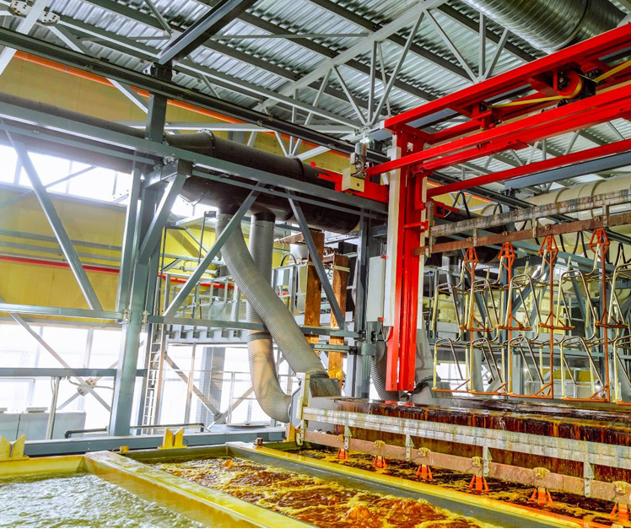
Case Study 1 Background
The Case: A former chrome plating facility wanted to understand if they may be responsible for PFAS contamination detected in a nearby town’s groundwater
MPCA, 2022

Slide 7
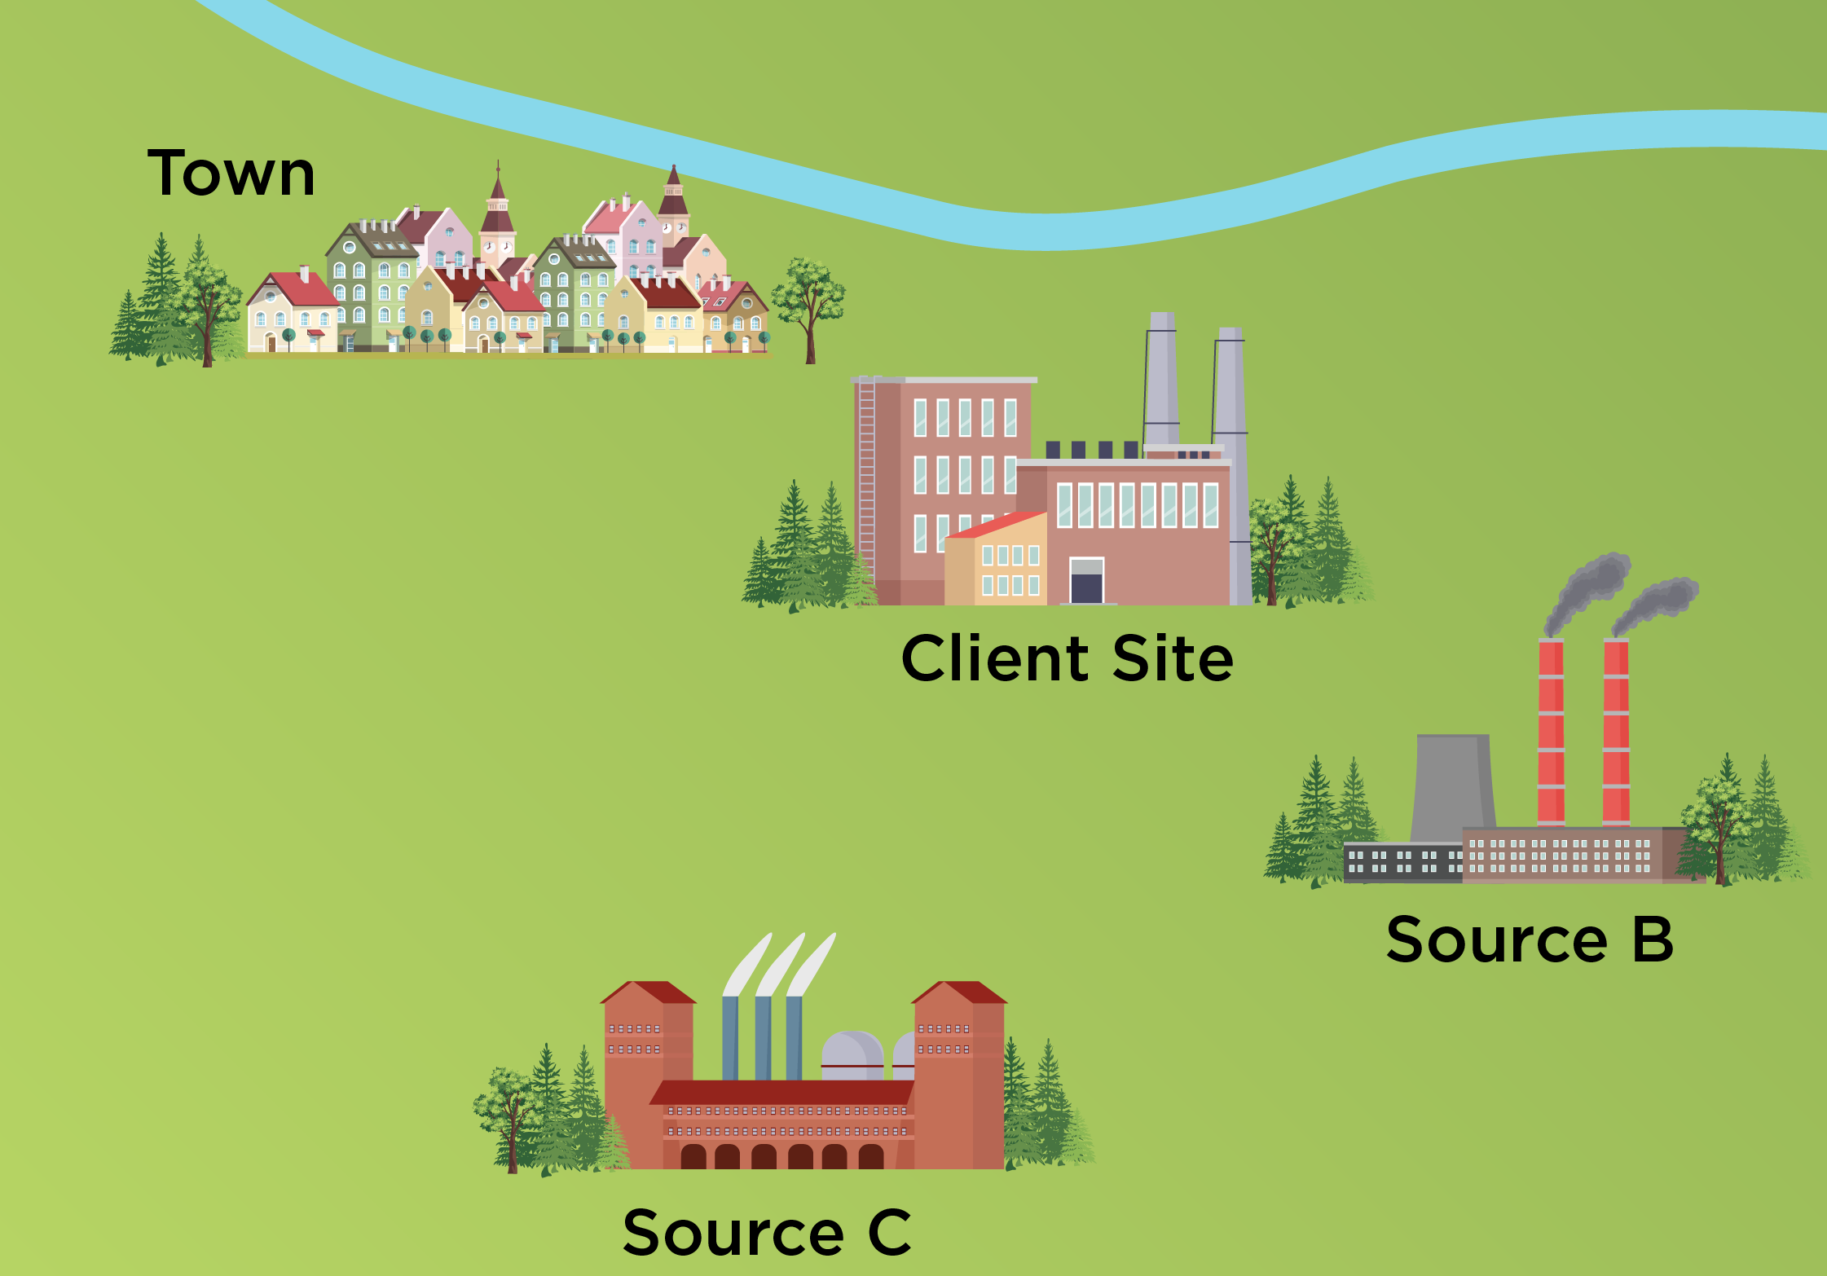
Which PFAS Source Impacted the Town’s Groundwater?
PFAS groundwater data from each of the three sources was compared to the PFAS groundwater data from the Town
Historical research identified two other potential PFAS sources proximate to the Town

Slide 8
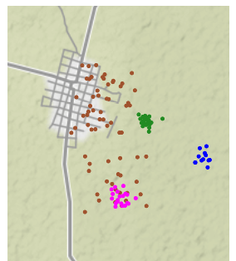
Statistical Evaluation of PFAS Datasets
Principal Component Analysis (PCA)
A statistical technique used to project multi-dimensional data onto two
or three dimensions for visualization and possible source identification
Client’s
Site
Source
B
Source
C
Town Samples
Client Site Samples
Source B Samples
Source C Samples

Slide 9
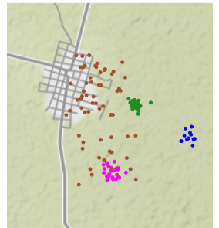
Groundwater Flow Patterns Support the Conclusion That Source C is the PFAS Contributor to the Town’s Groundwater
PFAS compounds are soluble and travel with groundwater in the subsurface
Analysis of groundwater flow patterns revealed that groundwater beneath Source C flows directly under the town, while groundwater at the Client’s site and Source B flows toward the river downgradient of the town
Local GW Flow Direction
Client’s
Site
Source
B
Source
C

Slide 10
Multiple LOEs Indicated That an Alternate Source was Responsible for PFAS Contamination in the Town’s Groundwater
Historical research identified two additional potential PFAS sources proximate to the town
PFAS groundwater data from each of the three sites was compared to the town’s PFAS groundwater data using a robust statistical tool
An evaluation of the fate and transport of PFAS in groundwater in the area supported the conclusion that another source released the PFAS found in the town’s groundwater

Slide 11
Case Study 2:
Petroleum Age Dating at an Underground Storage Tank Site

Slide 12
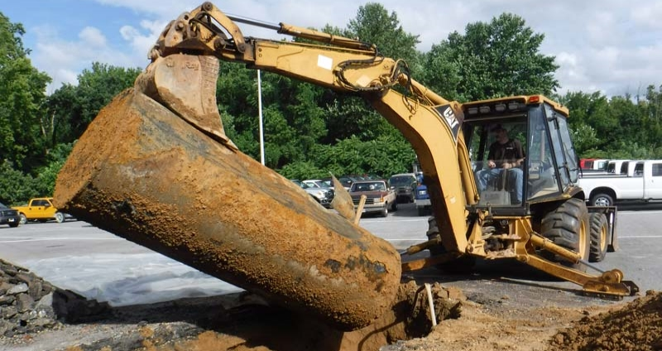
Case Study 2 Background
The Case: A property owner sued its former fuel distributor for diesel contamination of soil and groundwater discovered in the 2010s
The client was contractually obligated to operate and maintain the underground fuel distribution system while the contract was in effect, but the contract expired in the 1980s
The date of release is of paramount importance, as releases following contract expiration are not the client’s responsibility
Source: https://www.greentraxinc.com/what-makes-my-underground-storage-tank-ust-commercial-vs-residential/

Slide 13
What Happens Over Time After Petroleum is Released to the Environment?
Refined petroleum products contain thousands of unique compounds
Each of these compounds weather at a different rate in the environment
If the starting composition is known, one can estimate the age of a petroleum release by assessing the relative abundance of “fast weathering” and “slow weathering” compounds
Abundant “fast weathering” compounds = fresh release
Depleted “fast weathering” compounds = older release
Petroleum weathering over time
Source: https://www.shine.cn/news/metro/2007222712/

Slide 14
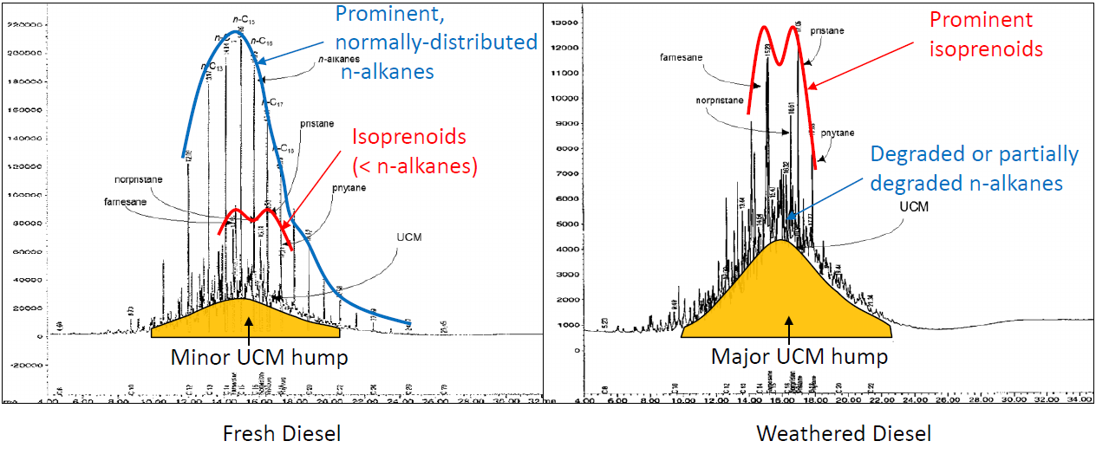
Lab Chromatogram Evaluation for Release Dating

Slide 15
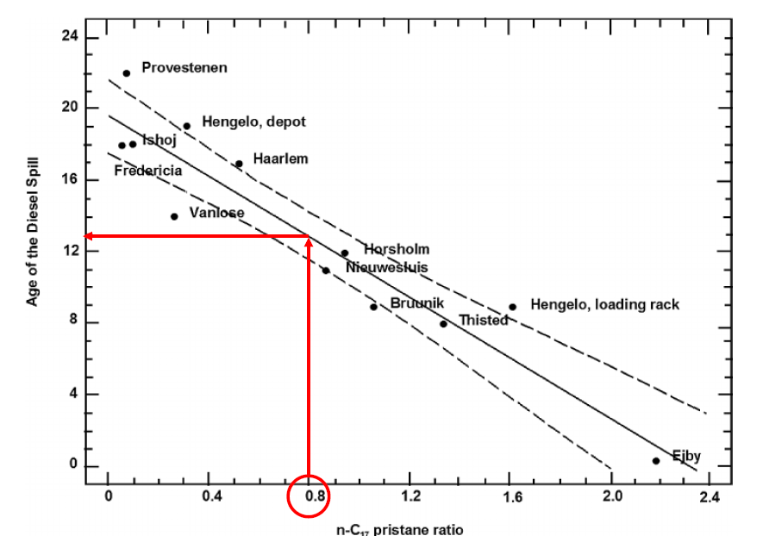
Quantitative Release Dating Using Ratios
Sample No. | N-C17 to Pristane Ratio | Age of Diesel Spill | Probable Release Date (samples collected in 2020)
1 | 0.80 | 13 years | ca. 2007
2 | 0.91 | 12 years | ca. 2008
3 | 1.15 | 10 years | ca. 2010
4 | 0.68 | 14 years | ca. 2006
Source: Christensen and Larsen, 1993.

Slide 16
Multiple LOEs Indicated That the Client Was Not Responsible for the Diesel Contamination, as It Was Released Post-1980
Chromatogram patterns alongside quantitative aging estimates support a modern petroleum release
Client was not liable for environmental damages after their 1980 contract expiration

Slide 17
Conclusions
A multiple LOE approach for environmental forensics can provide attorneys and their clients with defensible technical arguments in support of mediation & litigation proceedings under various regulatory frameworks
Forensic tools can be applied at a wide variety of sites impacted by a diverse suite of environmental contaminants (including both legacy and emerging contaminants)

Slide 18
Questions?
Emmie Chen, P.E.
echen@geosyntec.com

