Slide 1
Inaugural Darahyl Dennis Scholarship
April 16, 2025
Presented With the Support of:

Slide 2
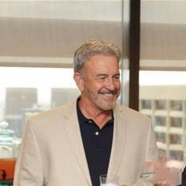
Darahyl Dennis
Inaugural GBA President and visionary
34 years at Georgia Power in environmental field
Columbus State University graduate
Passionate advocate for environment
Beloved husband, father, friend

Slide 3
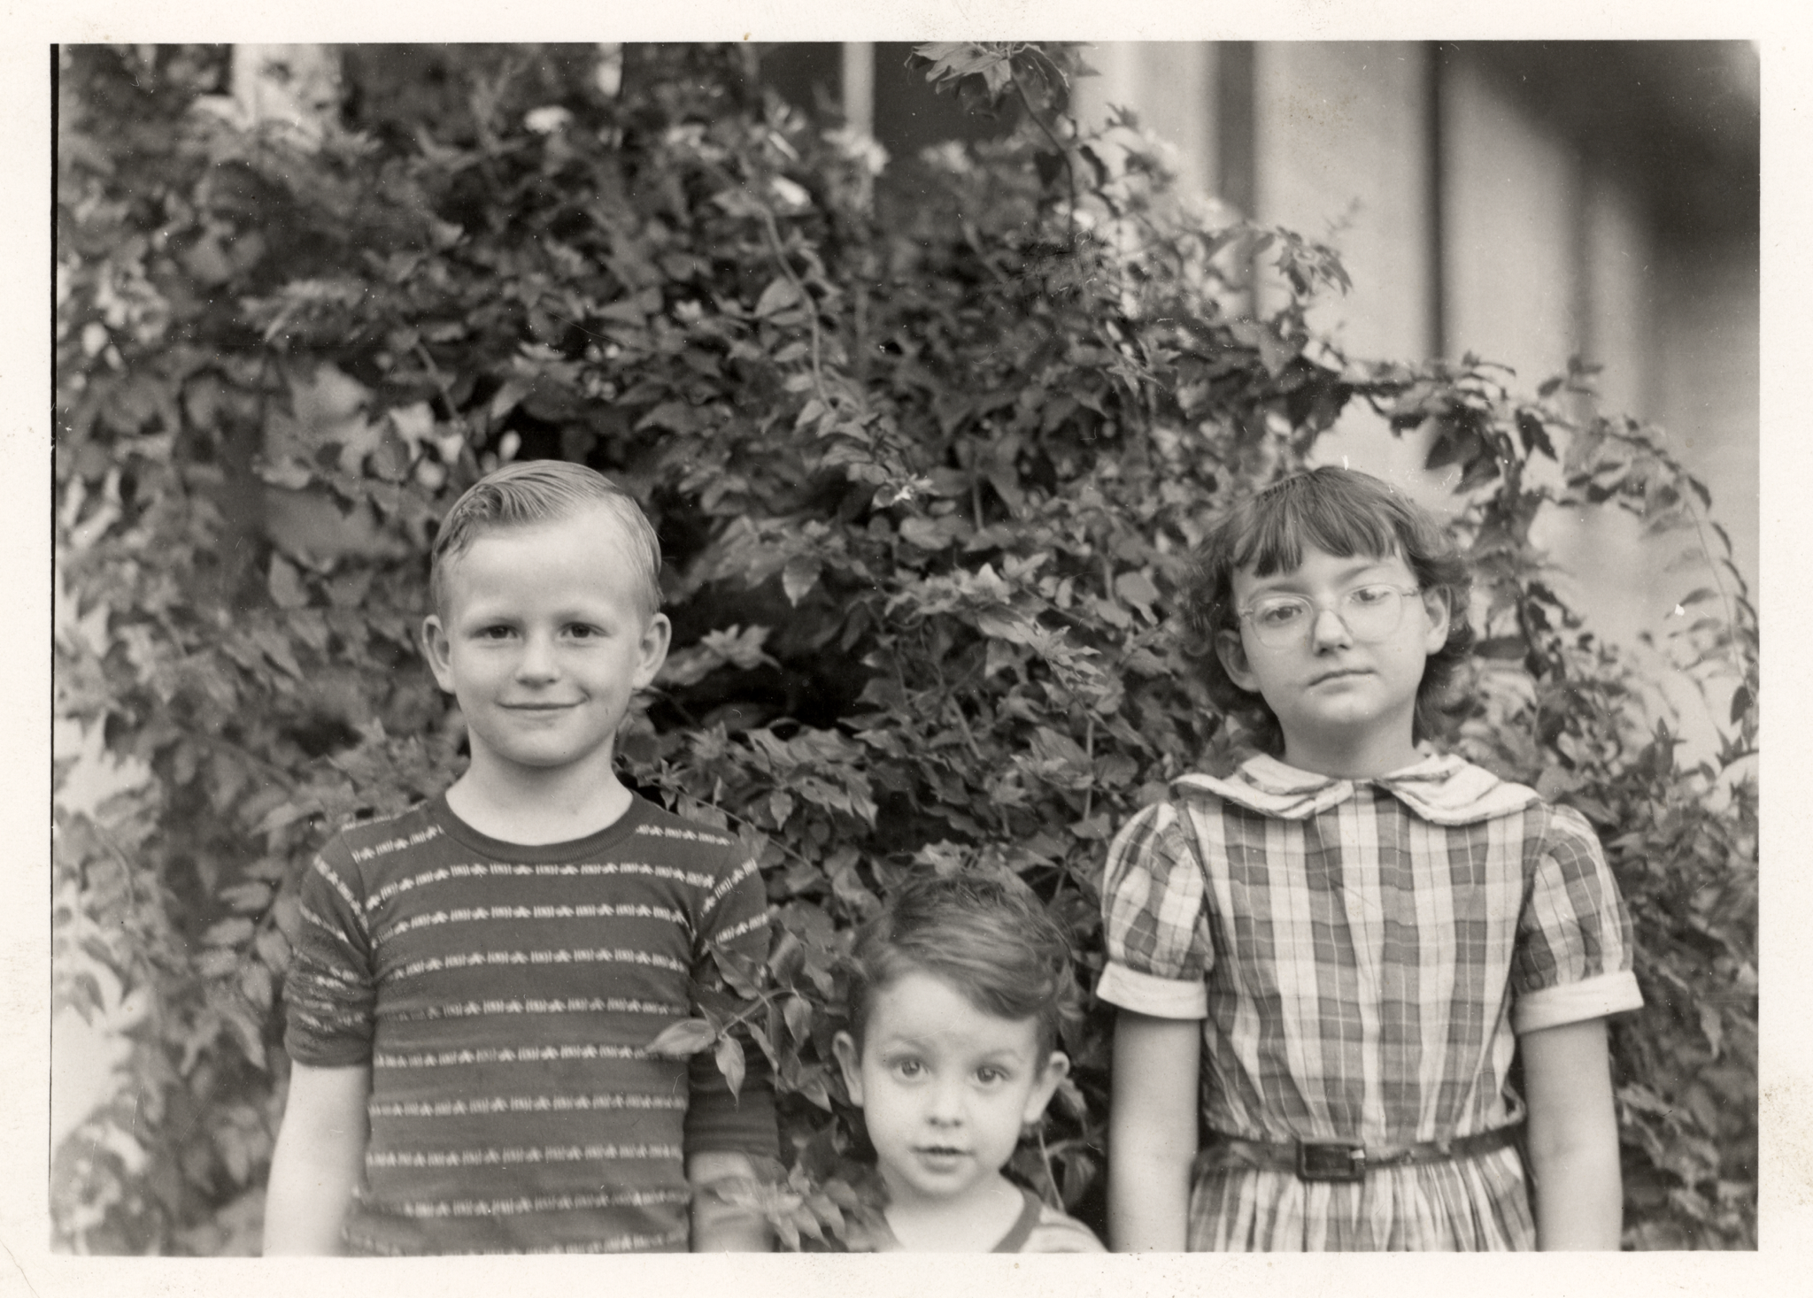

Slide 4
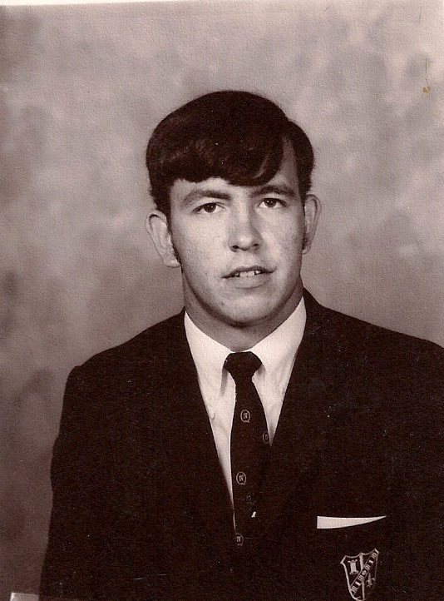
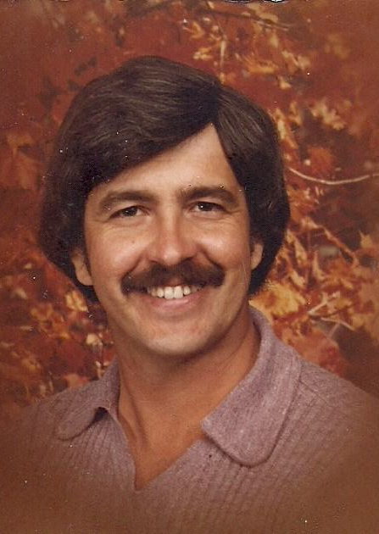
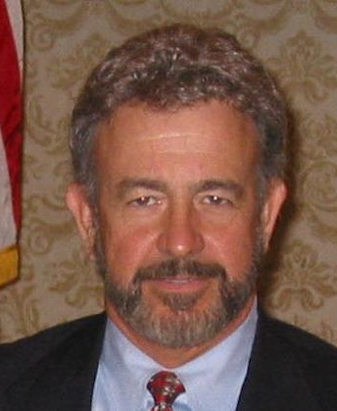

Slide 5
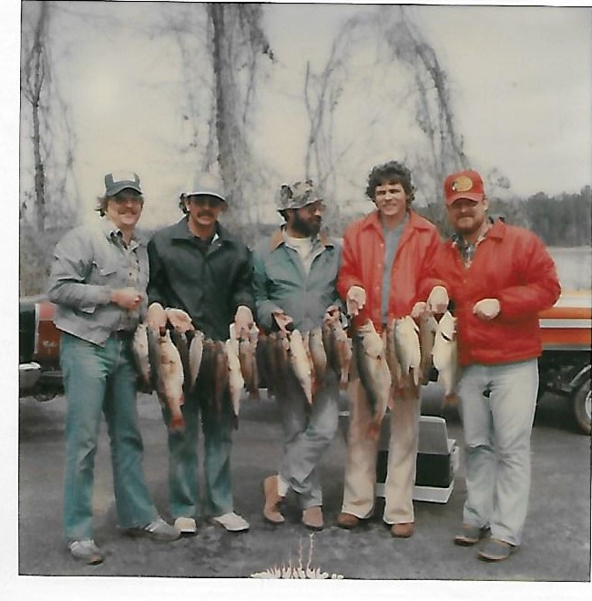

Slide 6
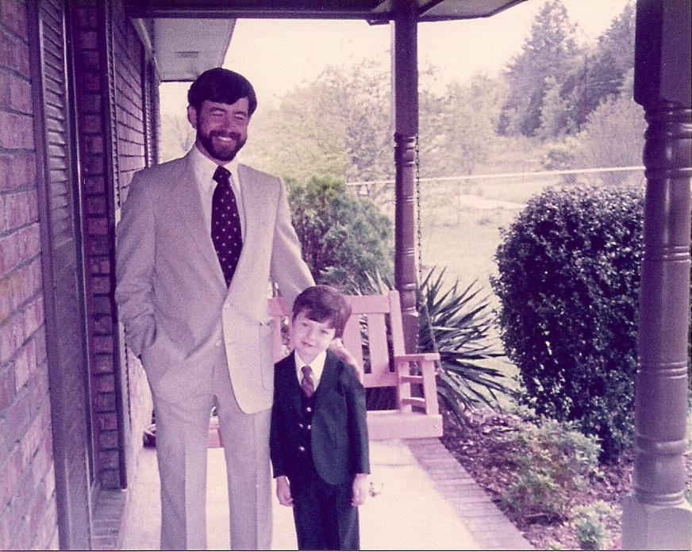

Slide 7
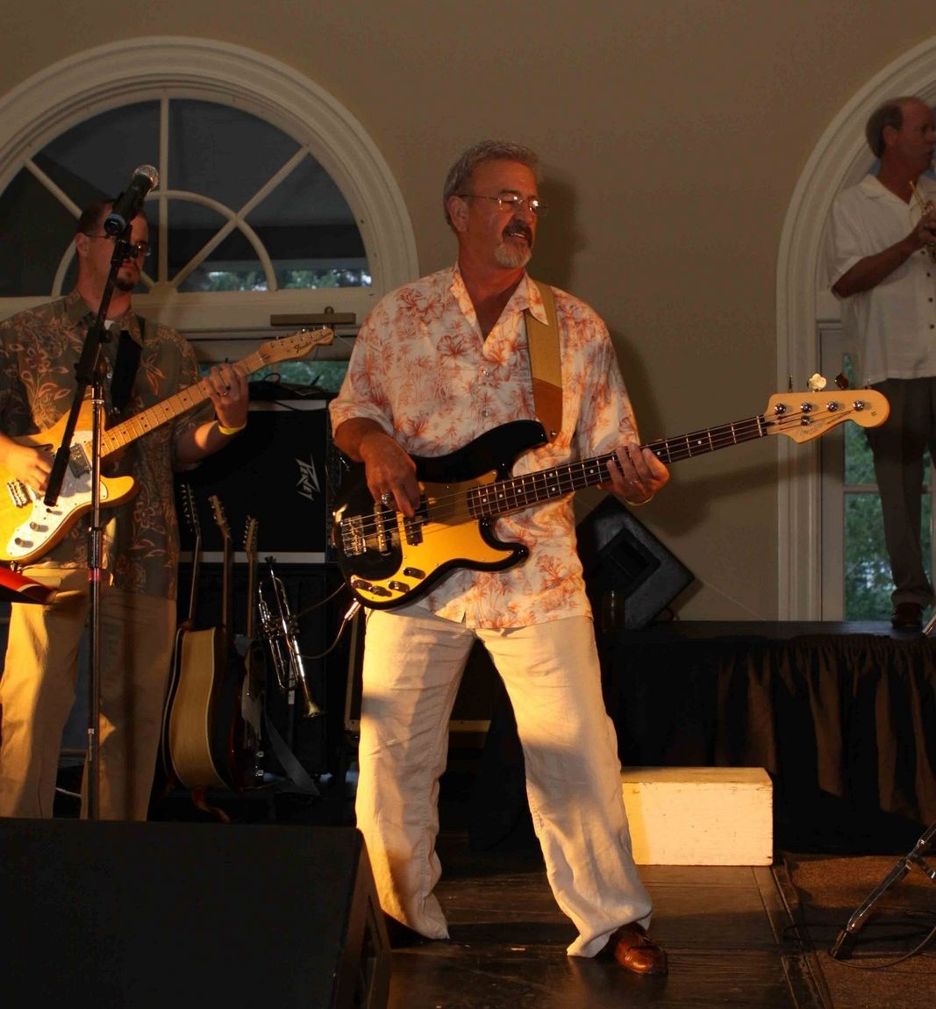

Slide 8
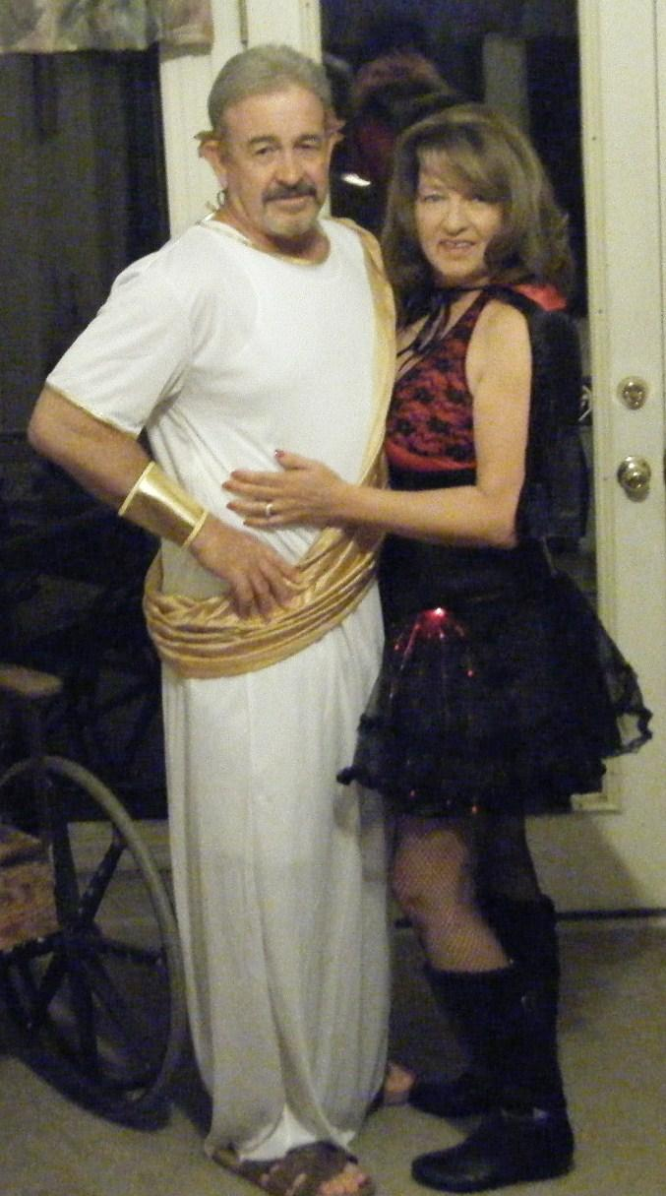
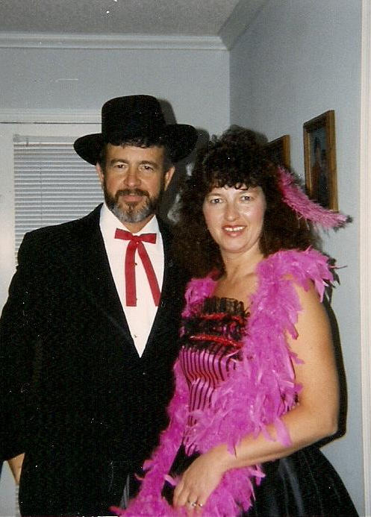
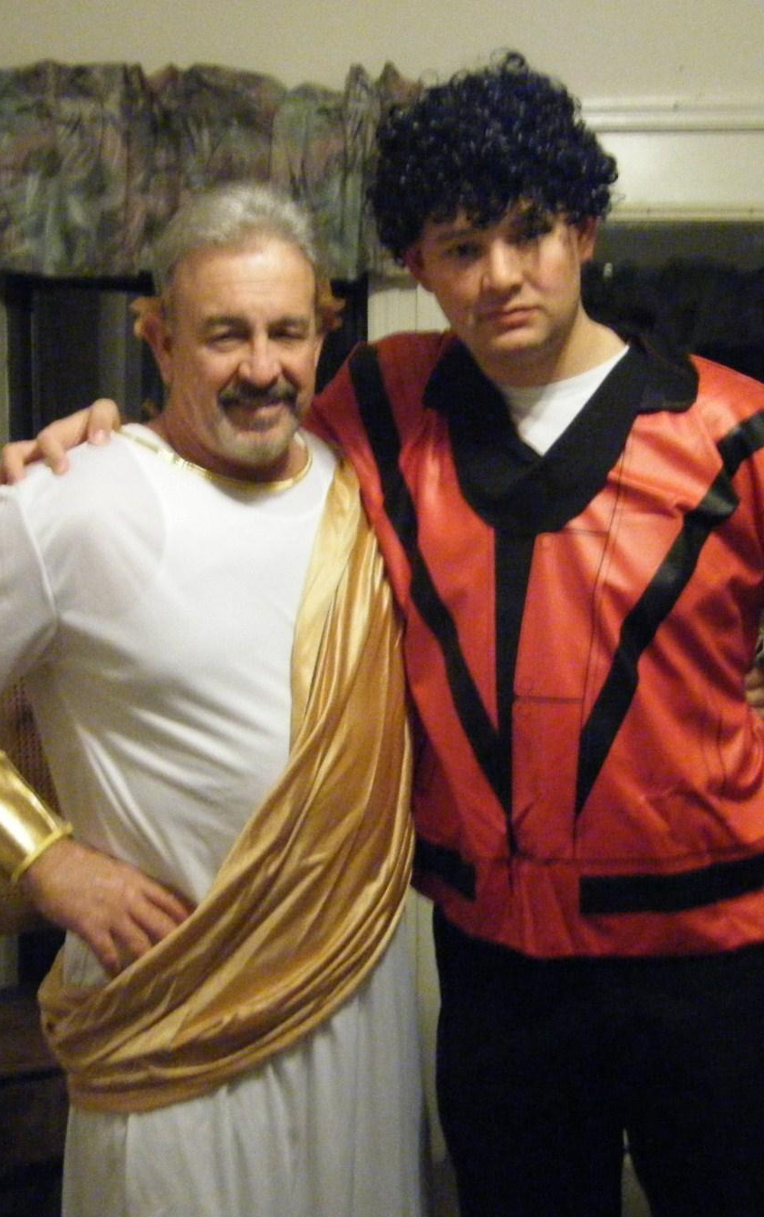

Slide 9
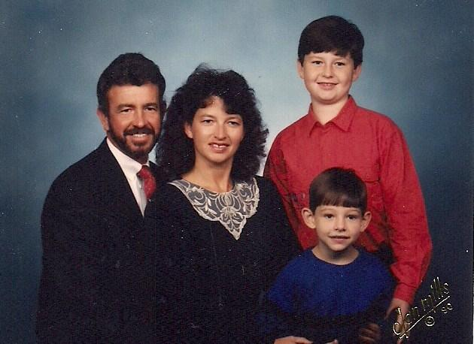

Slide 10
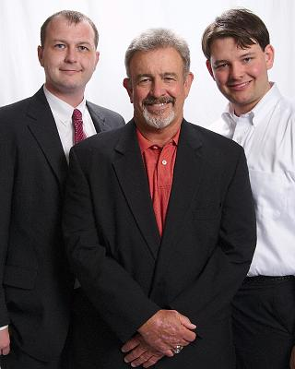

Slide 11
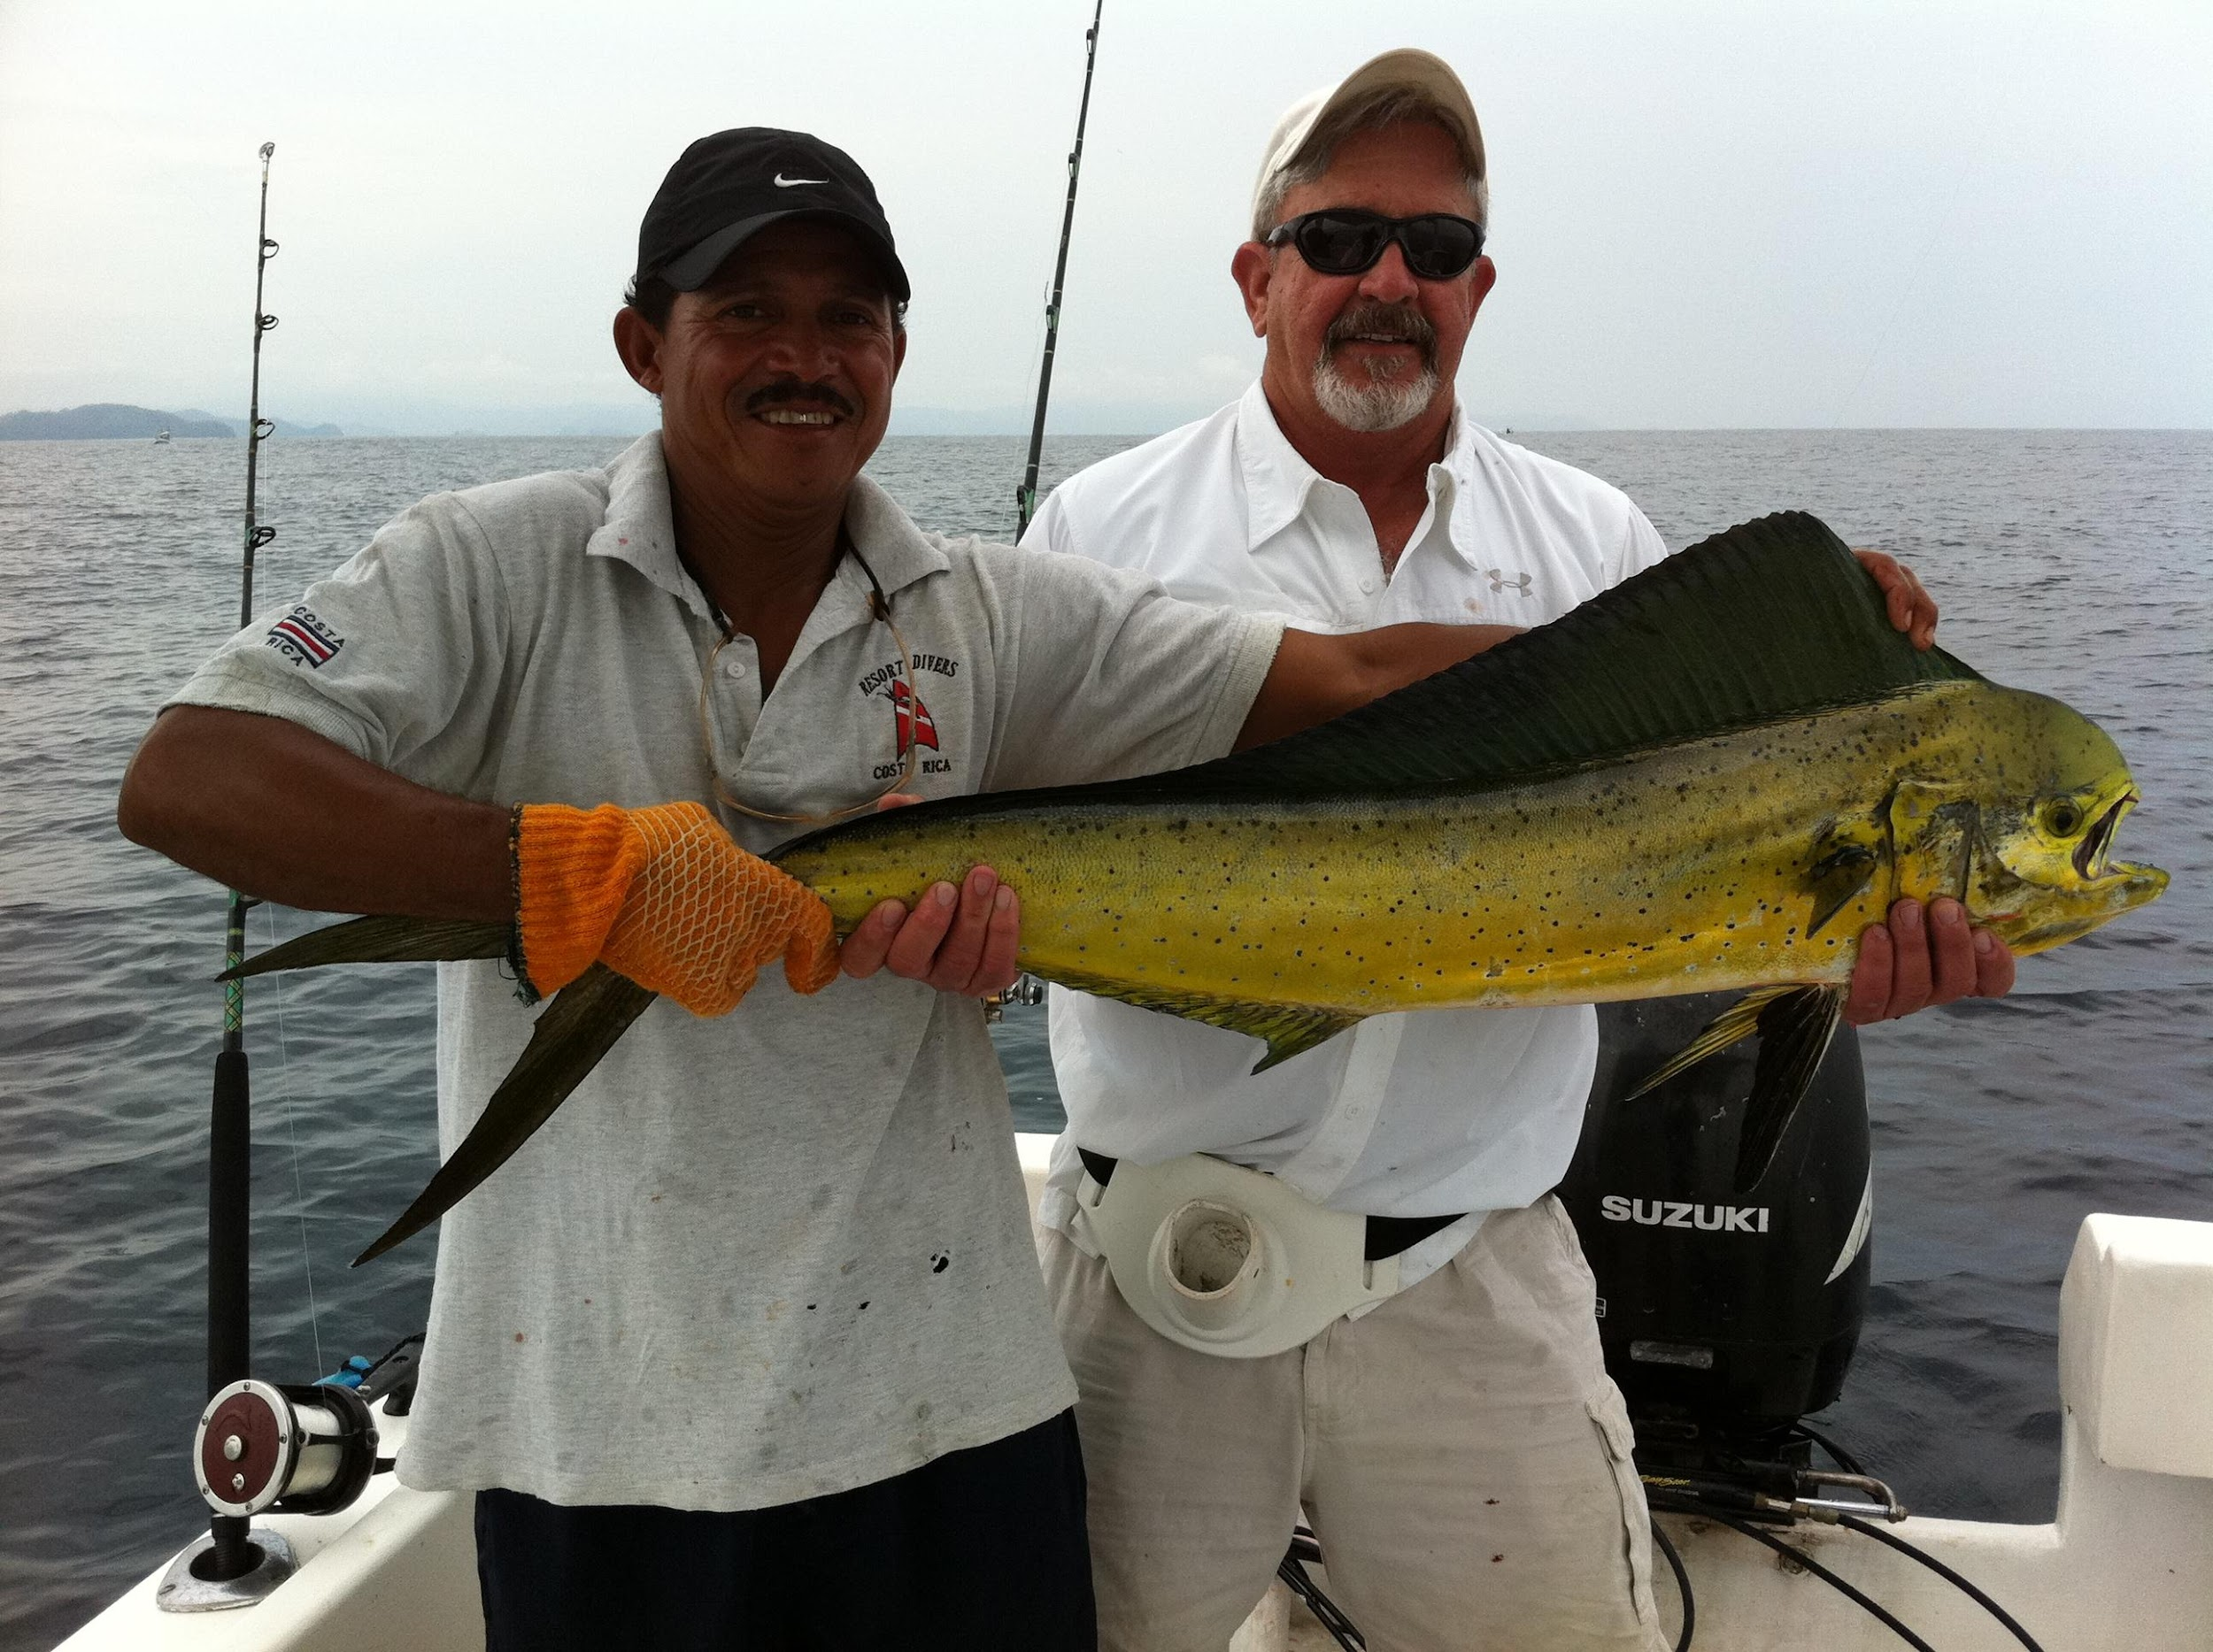

Slide 12
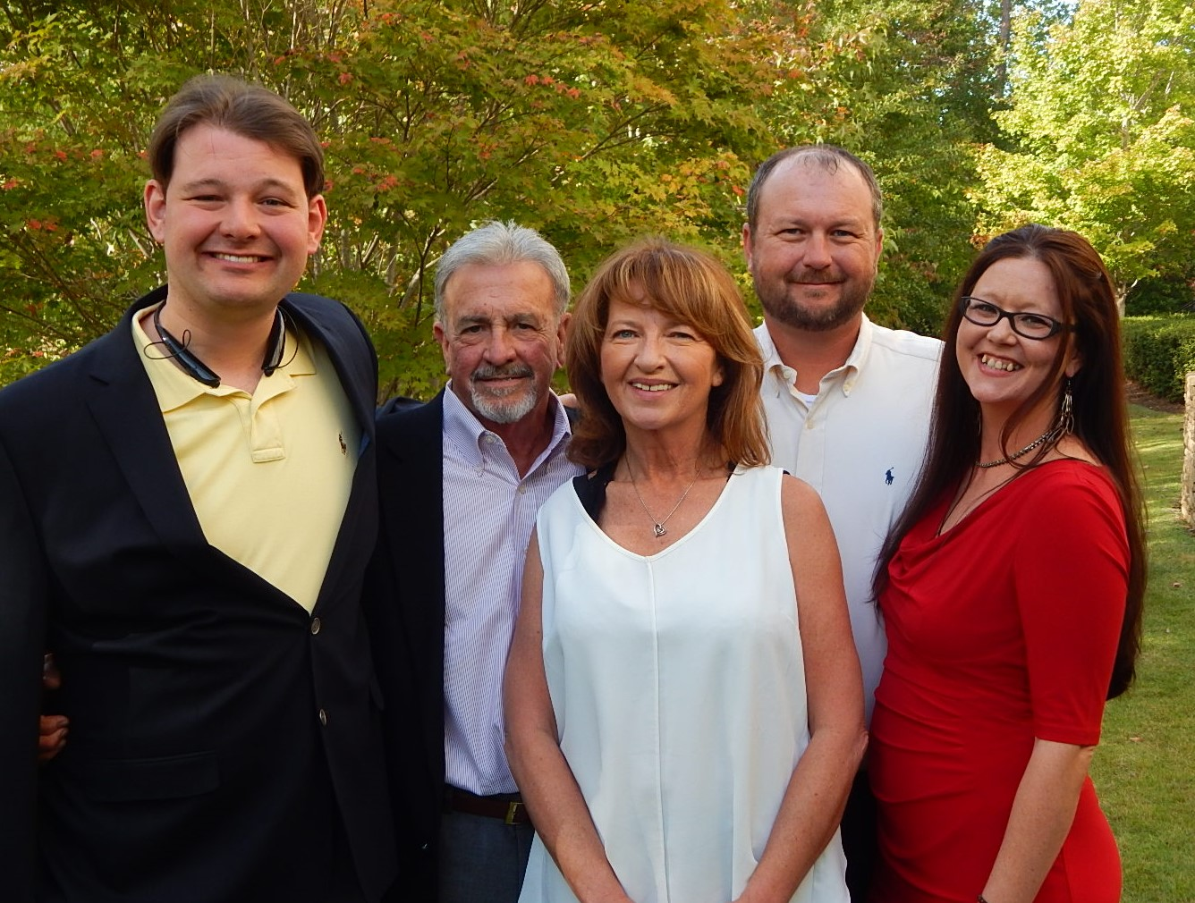

Slide 14
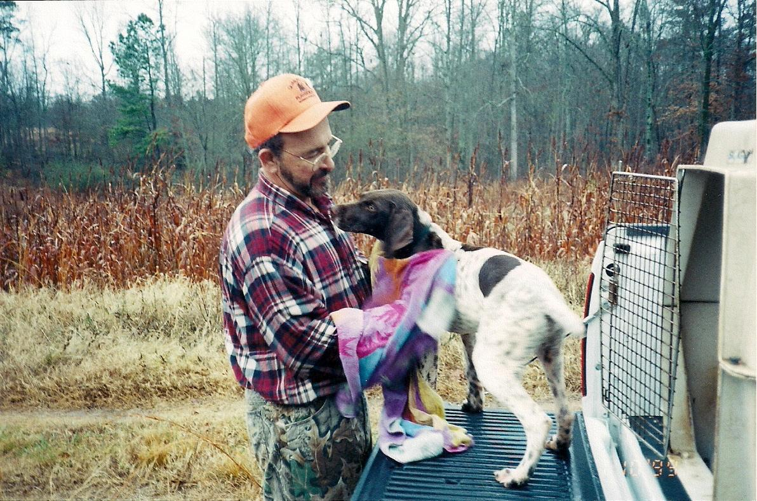

Slide 15
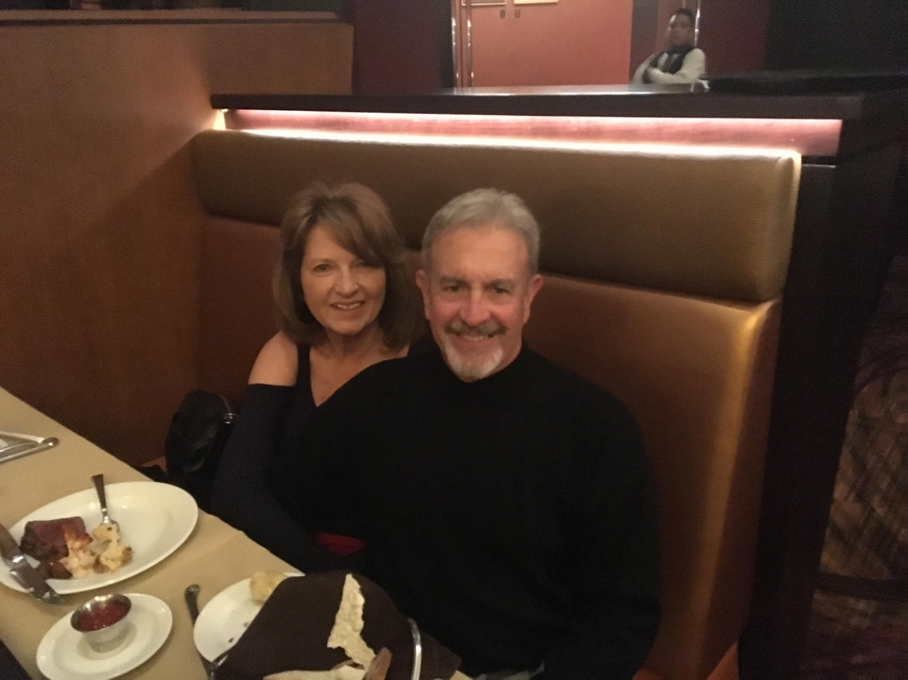

Slide 16
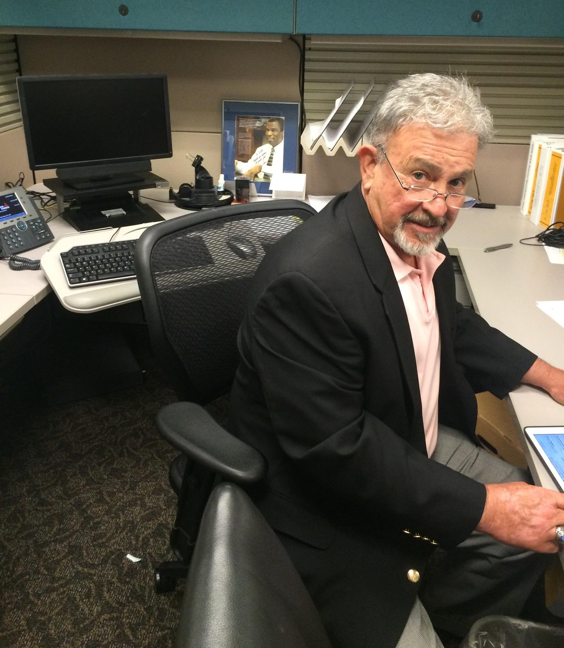

Slide 17
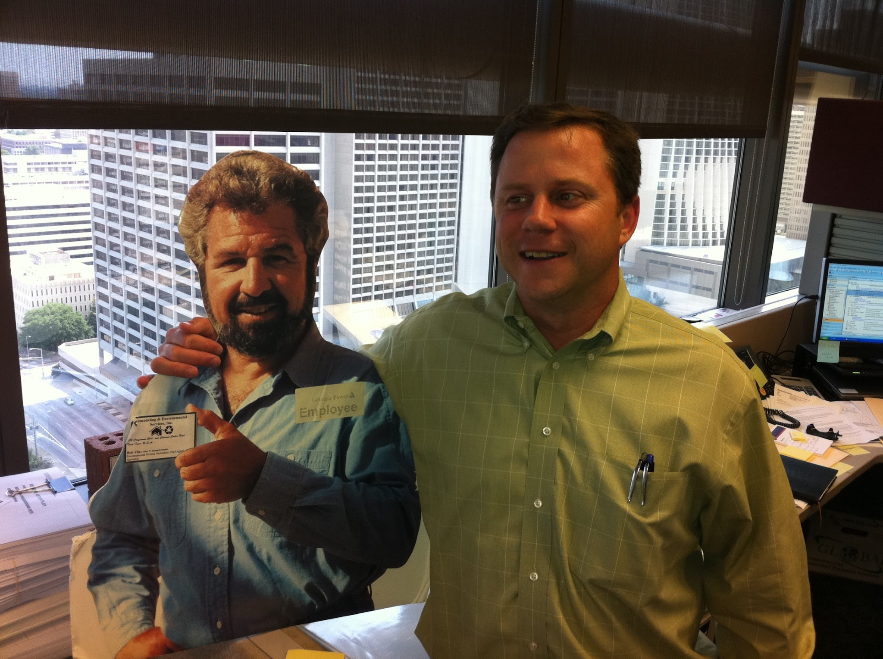

Slide 18
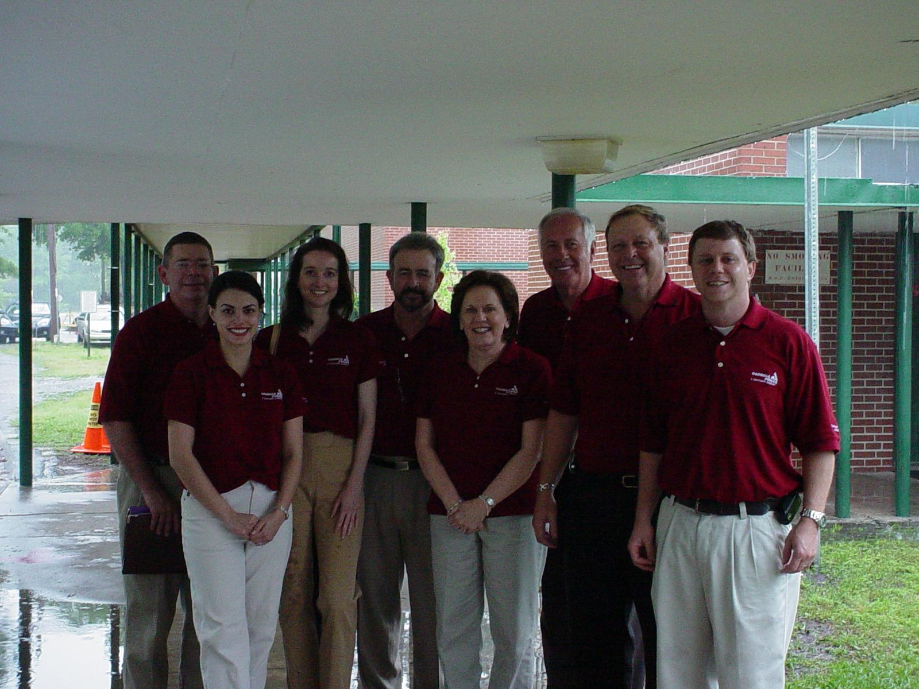

Slide 19
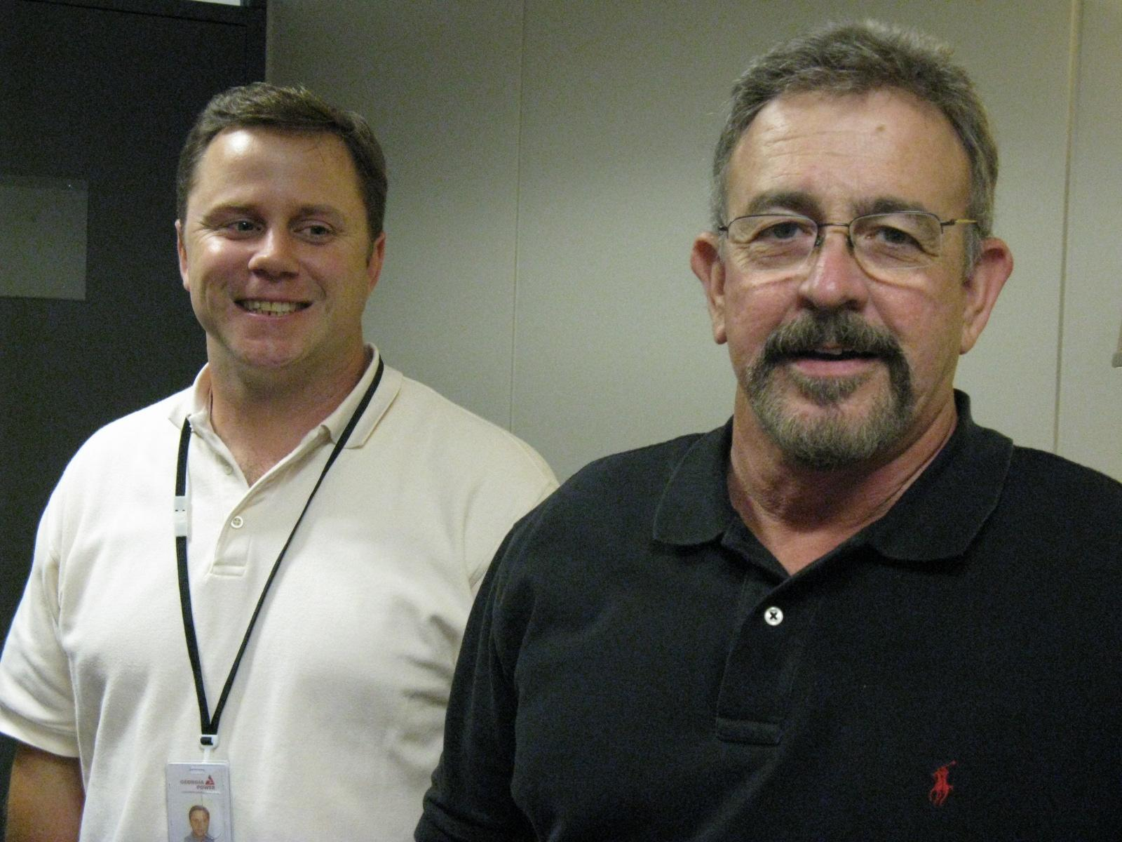

Slide 20
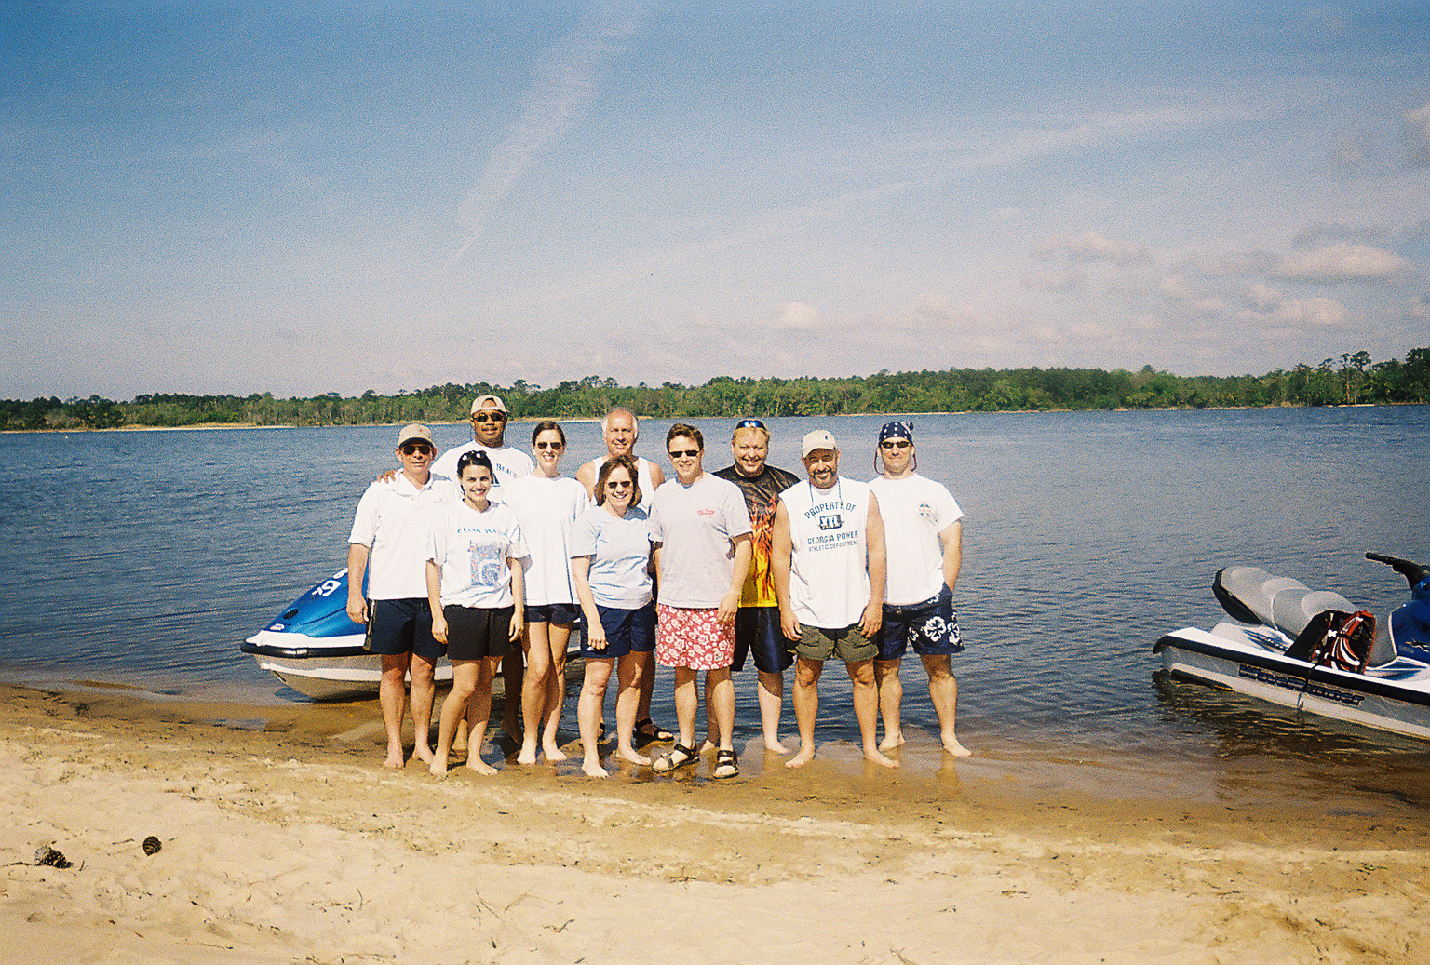

Slide 21
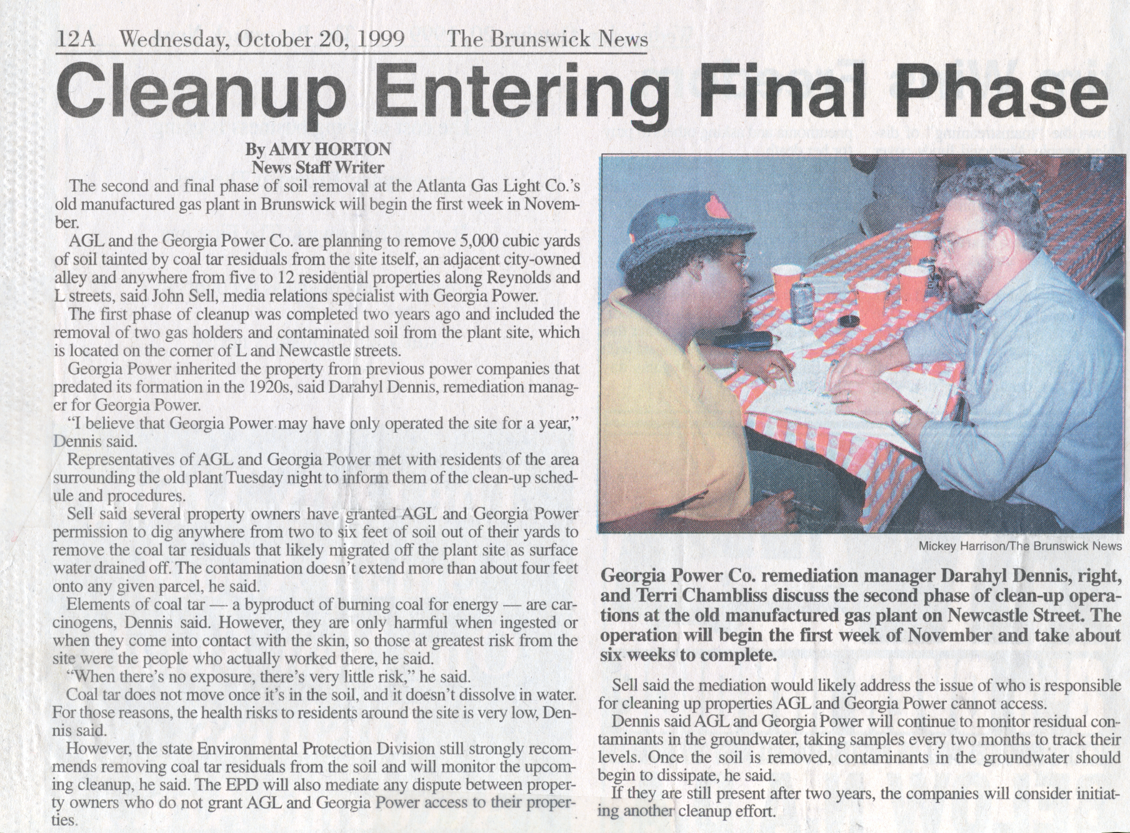

Slide 23
Inaugural Darahyl Dennis Scholarship Presentation
More than one dozen excellent applications
Scholarships award criteria:
Academic performance
Environmental field involvement
Involvement in underserved communities
Commitment to environmental career
Alma mater
Extra curricular activities

Slide 24
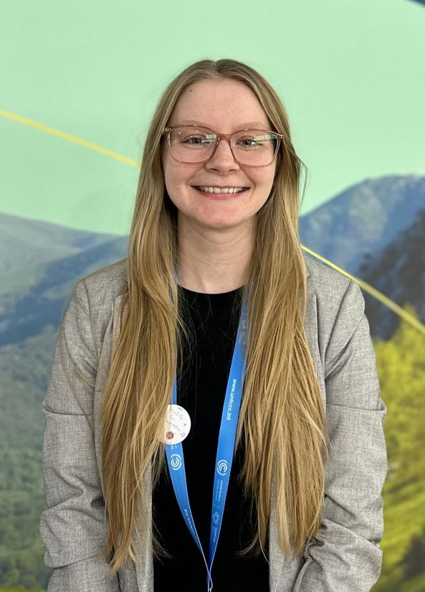
Dana Kahn Emory University Graduate Student
4.0 Environmental Science and Music major
Graduating 2025
Since eighth grade, Dana has wanted to study climate change and make a meaningful impact on our Earth and society. After graduation aspires to pursue a career as an environmental scientist or sustainability specialist who helps businesses and governments reach their environmental objectives, comply to environmental policies, and conserve Earth’s resources.
As a master’s student, Dana studies the biogeochemical methane cycle and create digital maps based on a long-term research forest called Howland Research Forest in Maine.
Also works with the Emory Center for Digital Scholarship as a geospatial assistant, helping develop the digital Georgia Coast Atlas, where we explore the geographical, ecological, and historical dimensions of Georgia’s coast.
Recently completed her second fellowship, a 7-month environmental justice training with the Partnership for Southern Equity (PSE) as a Just Energy Academy member.

Slide 25
Shelley Le Columbus State Student
4.0 Biology major
Graduating 2025
Interested in protecting and restoring impaired ecosystems within the Columbus, GA and Phenix City, AL regions.
Actively involved with research that uses microbiological techniques and molecular methods to identify sources of E. coli contamination in the waterways surrounding the Chattahoochee River to differentiate between human and animal origin of contamination. This research aims to develop remediation strategies to improve the water quality and protect public health.

Slide 26
Congratulations Dana and Shelley!

