Slide 1
For the WIN! Managing Environmental Risk in Transactions
Presented to: Georgia Brownfields Association
April 16, 2025

Slide 2
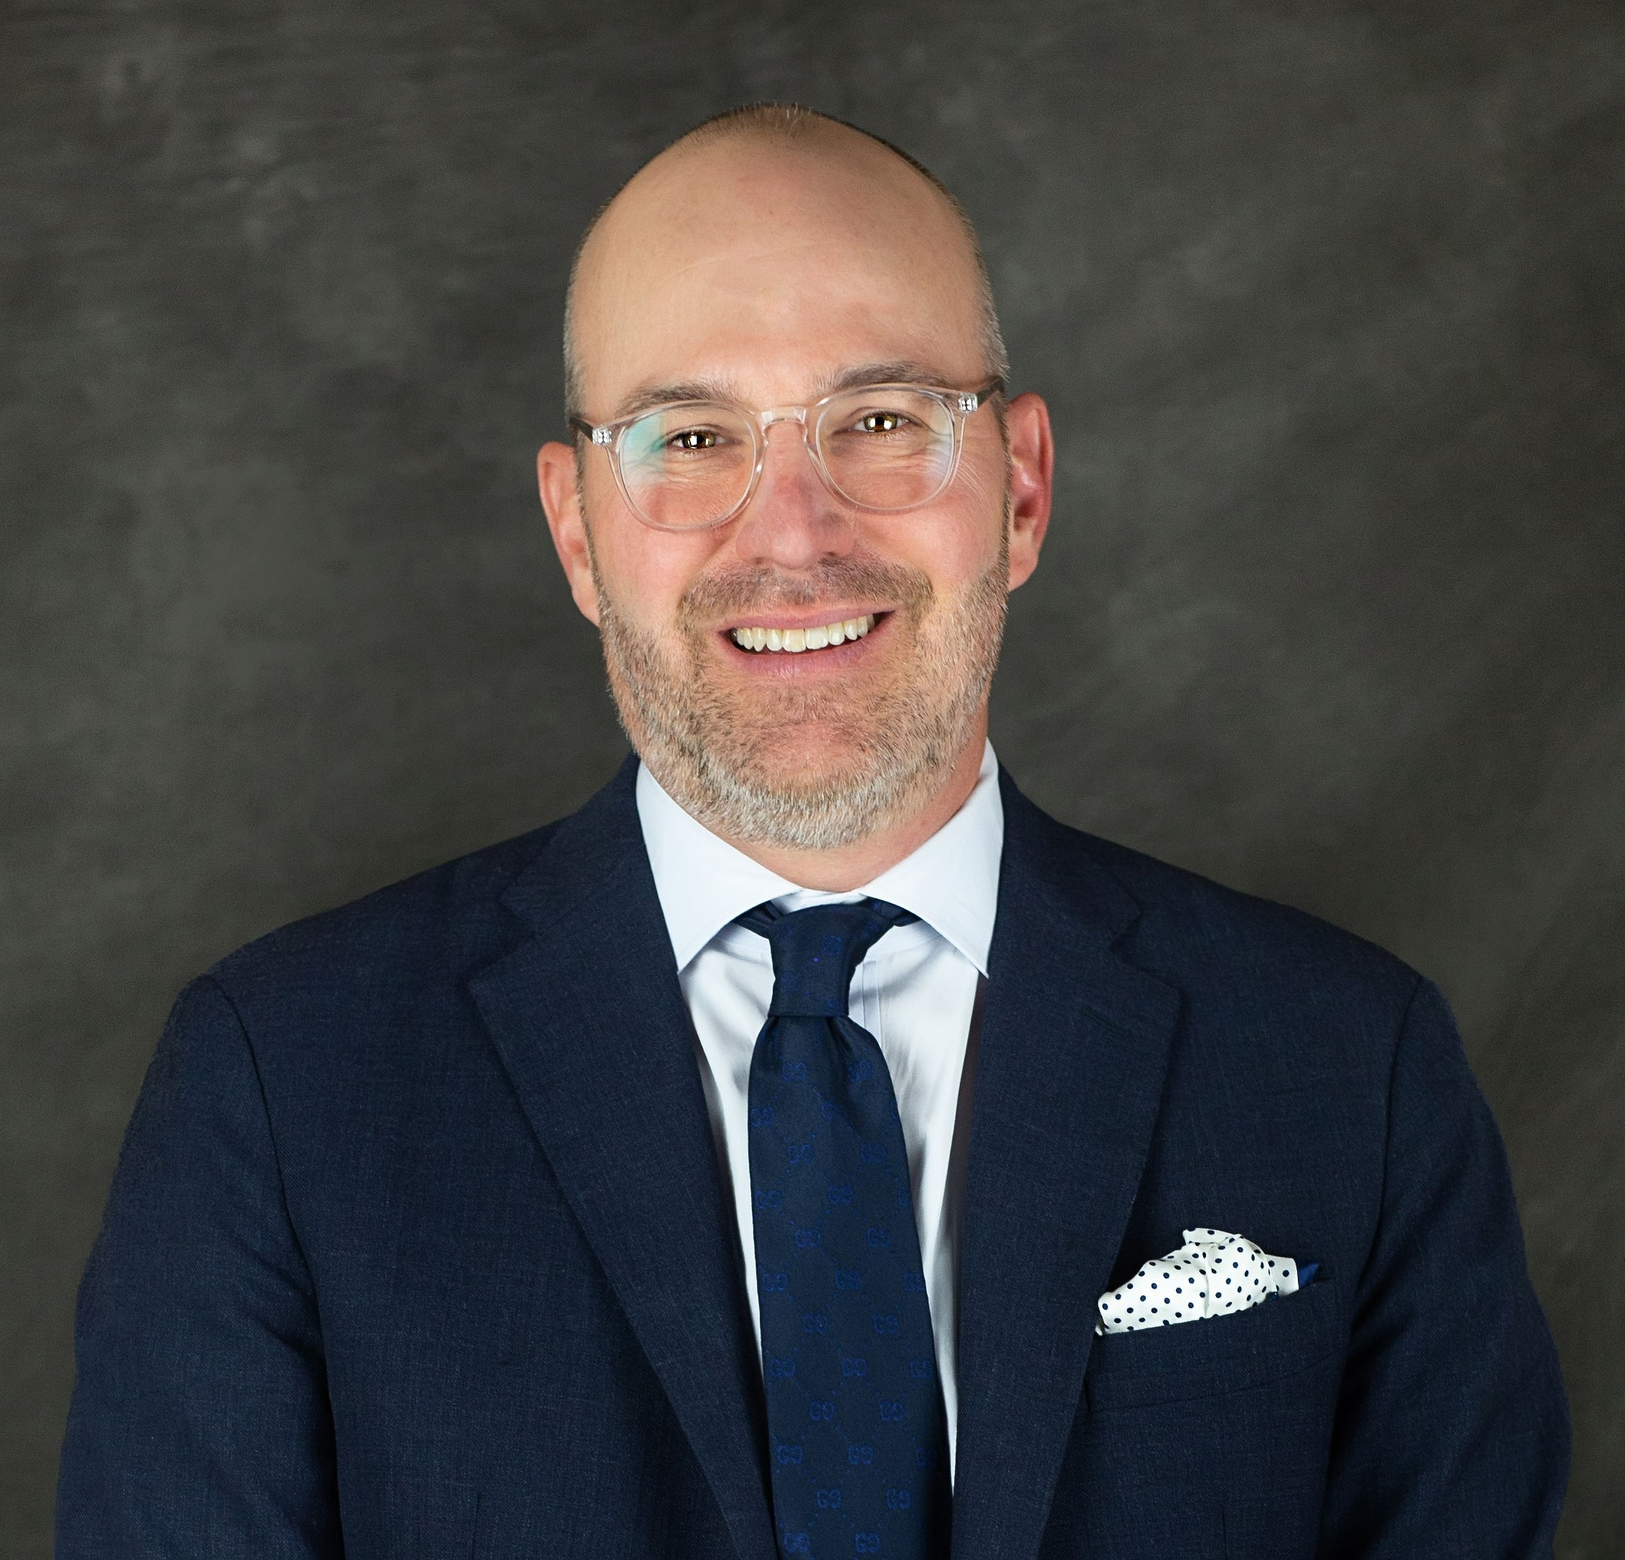
Presenters
Bill Nellen, MS, MBA Executive Vice President Alliant Insurance Services, Inc. Atlanta, GA Years of Environmental Risk Experience: 30+ years

Slide 3
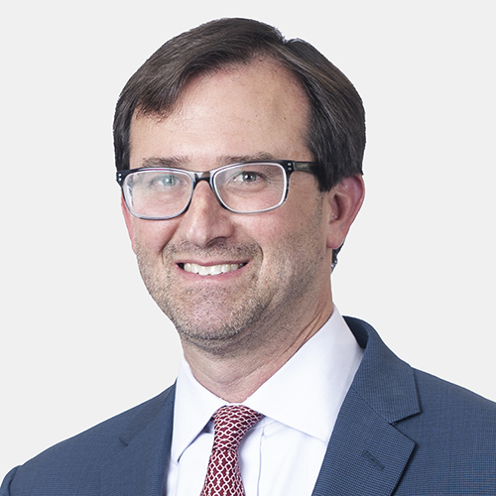
Presenters
Jason S. Lichtstein, Esq. Office Managing Partner Akerman LLP Atlanta, GA Years of Environmental Experience: 20+ years

Slide 4
PLL Coverage Available / Key Concepts
Third Party Claims for Bodily Injury and Property Damage
Pre-Existing (Historical) and New (Operational) Conditions
On-Site Clean-Up of Pollution Conditions
Off-Site Clean-Up of Pollution Conditions
Business Interruption / Loss of Rents
Transportation (Loading / Unloading)
Non-Owned Disposal Sites
Legal Defense Expenses
Policy Limits – Typically range from $5MM - $50MM
Self Insured Retentions (SIR)– Typically start at $50K
Policy Term – Typically 5-10 years

Slide 5
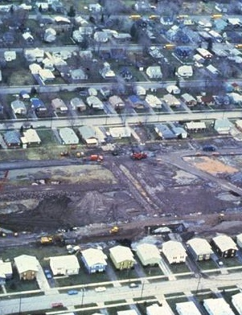
PLL Top 10
Known v. Unknown
Pre-Existing versus New
Retroactive Date?
Additional Insured v. Named Insured
Disclosed Documents
Schedule of Insured Contracts
Defense Outside Limits
Insured Property Definition
Illicit Abandonment
CPL?

Slide 6
When is insurance typically utilized to manage environmental risk during Brownfields Projects?
Certain Contaminants Often Expressly Excluded
PFAS, PFOA, GenX and Other Emerging Contaminants
10 Year (Pre-Existing Conditions) / 5 Year (New Conditions) Split
Return of Secured Creditor Policies
Coverage is Always Limited Under Any Policy:
Subject to Limitations, Conditions, Exclusions and Definitions
Can Be Used to Supplement Indemnities and Escrows

Slide 7
Environmental Legal & Transactional Issues
Important to Advise Clients (for Clients to Hear & Evaluate the Options)
Works to Mitigate Worst-Case Scenarios
Helps Set the Edge/Outer Boundary for Environmental Risk & Liability
Provides Transactional & Deal Flexibilities
Deal & Transactional Narrative Development for Teams/Players Involved
Helpful to Mitigate Potential Third-Party & Natural Resource Damage Exposure, Even Without Direct Cleanup Coverage for Known Impacts
Citizen Suit & Climate/Disaster Coverage Considerations
Can Reduce Lender Environmental Risk

Slide 8
Environmental Legal & Transactional Issues
Key Nuances to Watch:
Identify, Fully Schedule & Confirm List of Disclosed Environmental Reports & Documents
Confirm Complete List of Named Insureds & Additional Insureds
Nuances Re: Description of Complex Covered Site(s)
Obtaining Quotes & Coverages for Some Specialized Industries Can Be Difficult
Even if Federal Environmental Regulatory & Enforcement Focus May Ease, State Focus May Not & Citizen Suit & Third-Party Environmental Risk Remains

Slide 9
Discussion & Questions

