Slide 2
Land Protection Branch Organization
Chuck Mueller Chief
Risk Assessment
Amy Potter Risk Assessment
Sarah Visser Assistant Chief
NPL Unit
William Cook Solid Waste Management
Lena Sasson Recovered Materials and Abatement
Jay Kemberling Underground Storage Tanks
Jim McNamara Hazardous Waste Corrective Action
Jamie Lancaster Hazardous Waste Management
Jason Metzger Response and Remediation
MSW & Industrial Landfills
Waste Reduction
Inspections and Enforcement
RCRA Remediation
RCRA Permitted Facilities
HSI and Abandoned Sites
Environmental Monitoring
Scrap Tire Compliance
Private Party Cleanups
HW Generators
HSRA Remediation
Surface Mining
Lead and Asbestos
EPD Managed Cleanups
DOD Facilities
Voluntary Remediation and Brownfields

Slide 3
Response and Remediation program
Jason Metzger Program Manager
HSRA
HWTF
VRPA
GBA
GIS Spec
Legal Affairs Coordinator
David Brownlee Response Development 1
Kevin Collins Response Development 2
Henry Candela Abandoned Sites
Kevin Seaway Voluntary Remediation
Shannon Ridley Brownfield
Release Notifications
HSRA Remediation
Abandoned Site Reviews
VRP Remediation
Grant / Fund Management
Brownfield Policy
HSRA Remediation
Inactive Site Review / Enforcement
EPD Contractor Cleanups
VRP Fund Management
Stephanie Horwitz Team Lead
Adam Hanley Team Lead
Local Gov’t Reimbursement
Training / Emerging Contaminants
Manage HWTF Contract
Brownfield Remediation

Slide 4
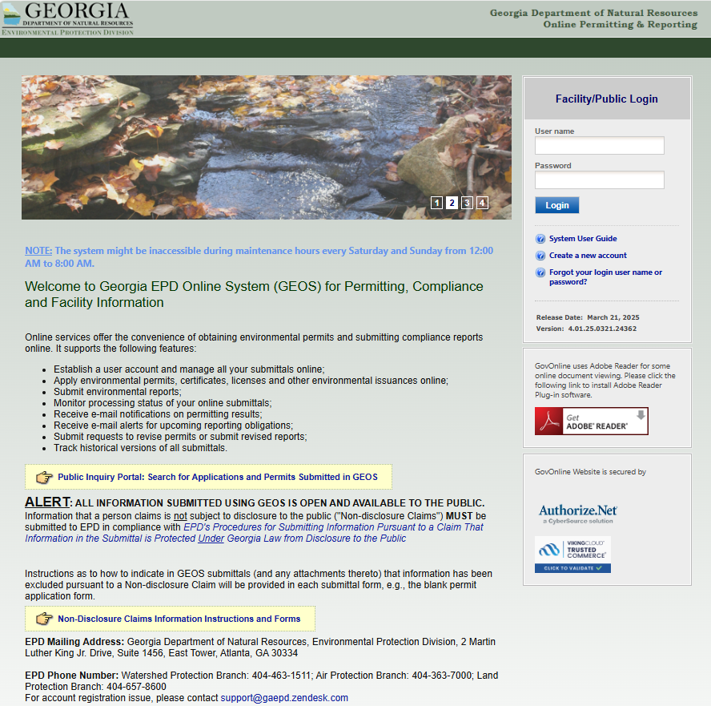
GENERAL LPB Update
Record Review Appointments
Available M-F
Hazardous Waste, Brownfields, VRP
**Balcony level**
Towers.FileReview@dnr.ga.gov
UST, Lead and Asbestos, Solid Waste
Tradeport.FileReview@dnr.ga.gov
Digital Transition – enhancements

Slide 5
Solid Waste Trust Fund
Funded by $1 Fee on each new replacement tire sold in Georgia
Funds appropriated to EPD for the following Authorized Uses:
Scrap Tire Management and Abatement
Waste Reduction, Grants, and Litter Education
Abandoned Landfill Closure
Fund Administration
https://epd.georgia.gov/about-us/land-protection-branch/recovered-materials-and-abatement/recovered-materials/solid-waste

Slide 6
Solid Waste Trust Fund Grant Program
Local government entities, public authorities, agencies, commissions, or institutions are eligible to apply and receive funding.
Two competitive grant tracks; Application period opens annually in August:
Recycling and Waste Diversion Grant Program - Funds projects that reduce solid waste, recover valuable materials, support manufacturing, and encourage innovation. Awarded $3.2M in FY25.
Tire Products Grant - Funds the direct costs of incorporating tire-derived products (TDP) into projects that would otherwise use new or virgin materials, or for research to support innovative uses for TDP. Awarded $1.7M in FY25.
One non-competitive grant track open year-round:
Local Government Scrap Tire Abatement Reimbursement - Reimburses local governments for recycling tires abated in their communities. Awarded $1M to date in FY25.
For details on how to apply visit our website: https://epd.georgia.gov/about-us/land-protection-branch/recovered-materials-and-abatement/recovered-materials/solid-waste-0

Slide 7
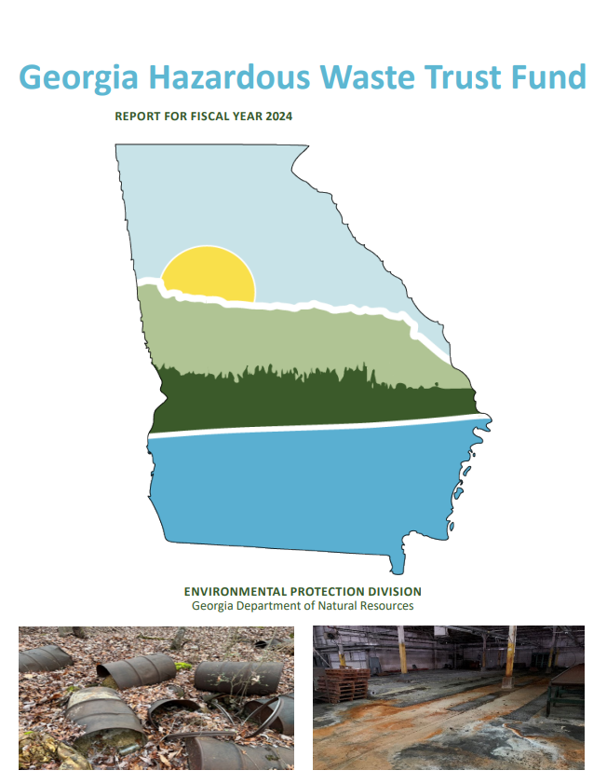
Hazardous waste trust fund
Solid Waste tipping fees, Generator fees, Penalties
Reimburse local government leaking landfill costs
Abandoned site cleanups
Program Ops / Oversight
HWTF Annual Report
https://epd.georgia.gov/hazardous-waste-trust-fund

Slide 8
OTHER Key ITEMs In Land Protection
Twin Pines Mining Permit Application
Received 77,000+ comments on the draft permit applications – drafting response to comments
Waiting on submittal of financial assurance
Coal Combustion Residuals (CCR) disposal permits
Worked closely with EPA Region IV on 2 CCR Permits
Issued Wansley AP-1 in March 2025
Draft permit for McDonough AP-2,3/4 released for 60-day public comment period
Virtual public meeting scheduled for April 29th
Public comment period ends on May 30th
14 (including major mod) CCR permit applications under review – expect less EPA oversight
https://epd.georgia.gov/twin-pines
https://epd.georgia.gov/ccr-permits

Slide 9
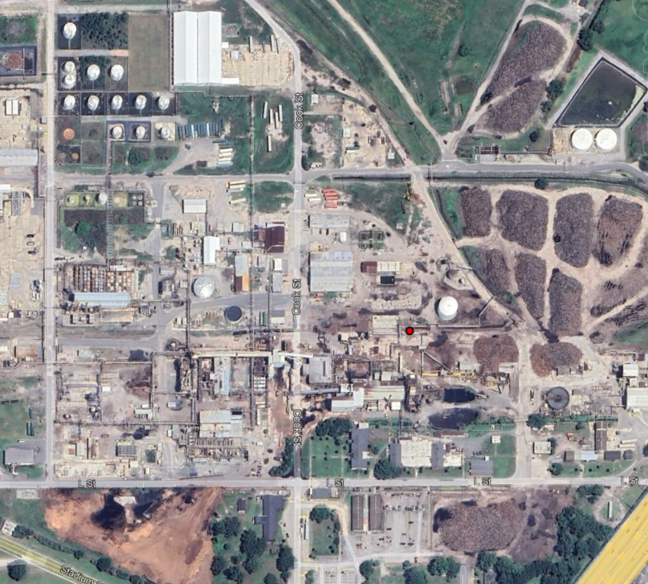
OTHER Key ITEMs (cont’d)
Westside Lead NPL Site
Brunswick Area
RCRA Part B Closure/Termination

Slide 10
LPB Technical guidance
Vapor Intrusion Guidance Update
EPD and Technical Advisory Committee tweaked the existing guidance.
Majority of revisions are in a new Attachment A
Checklist of recommended items to include in a VI Report. ​
Internal review of draft complete
Goal is to finalize by end of Q2 2025​
Georgia Risk Assessment Guidance Update
Draft document sent back to Technical Advisory Committee end of March
Goal is to be ready for public comment by the end of May/early June. ​
ECO guidance and chemical specific issues are items most relevant to RRP

Slide 11
Hazardous site inventory
FY25 Notifications – 60 (est.)
FY25 Listings – 3 (est.)
FY25 Delistings – 10 (est.)
Total Listed approx. 456 (est.)

Slide 13
Unit structure / staffing
Shannon Ridley Brownfield Coordinator
Stephanie Horwitz Team Lead
Adam Hanley Team Lead
Maryam Ghavamian Database Administrator
Lucas Budny Geologist
Farrell Barber Jr. Engineer
Todd Harbage Engineer
Marion Plemons Geologist
Nikki Haborak Geologist
Kent Pierce Engineer
John Salvino Geologist
Jessica Yates Geologist
Qian (Quinn) Wang Engineer

Slide 14
Status of brownfield projects
1489 Total Applications
Over 760 Cleanups Completed
Over 660 Active Projects

Slide 15
Brownfield applications received b y year

Slide 16
Brownfield application types

Slide 17
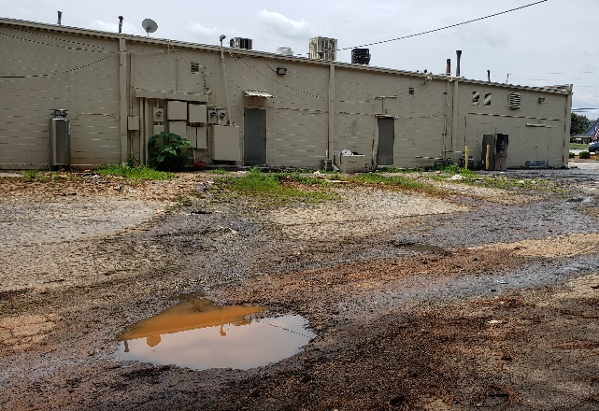
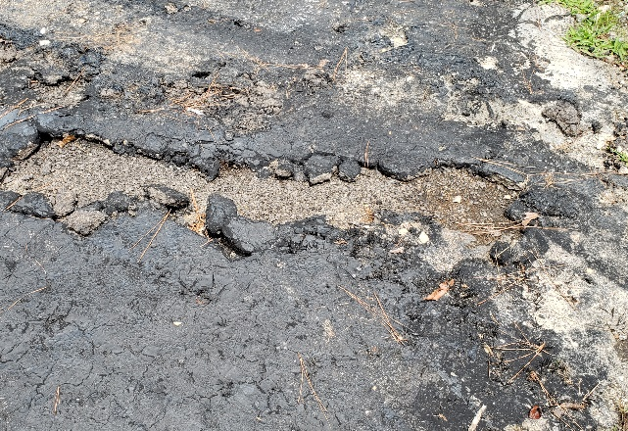
Non-compliant brownfields
Includes both HSI and non-HSI Brownfield properties
Compliance challenges:
Schedule
Use/misuse
Unresponsive to EPD
Change in ownership

Slide 18
NEXT STEPS
EPD is evaluating compliance schedules for all properties.
Failure to implement an approved CAP within the specified timeframe may result in loss of liability protections (§12-8-207(b)(4)).
Initial schedule in CAP - 3 years.
Timely response to comments including discussion of assessment/corrective action for generic CAPs (60 days)
Schedule extensions may require:
Justification/proof of CAP implementation
Milestone schedule
Proof of financial assurance (HSI brownfields)

Slide 19
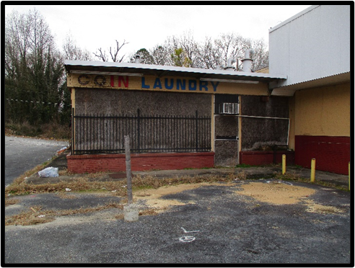
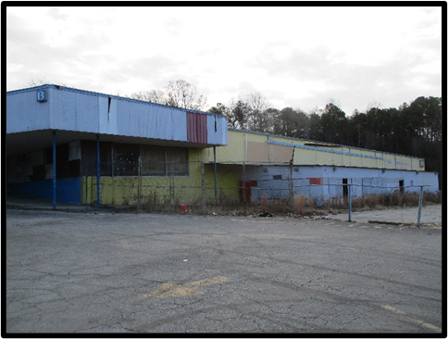
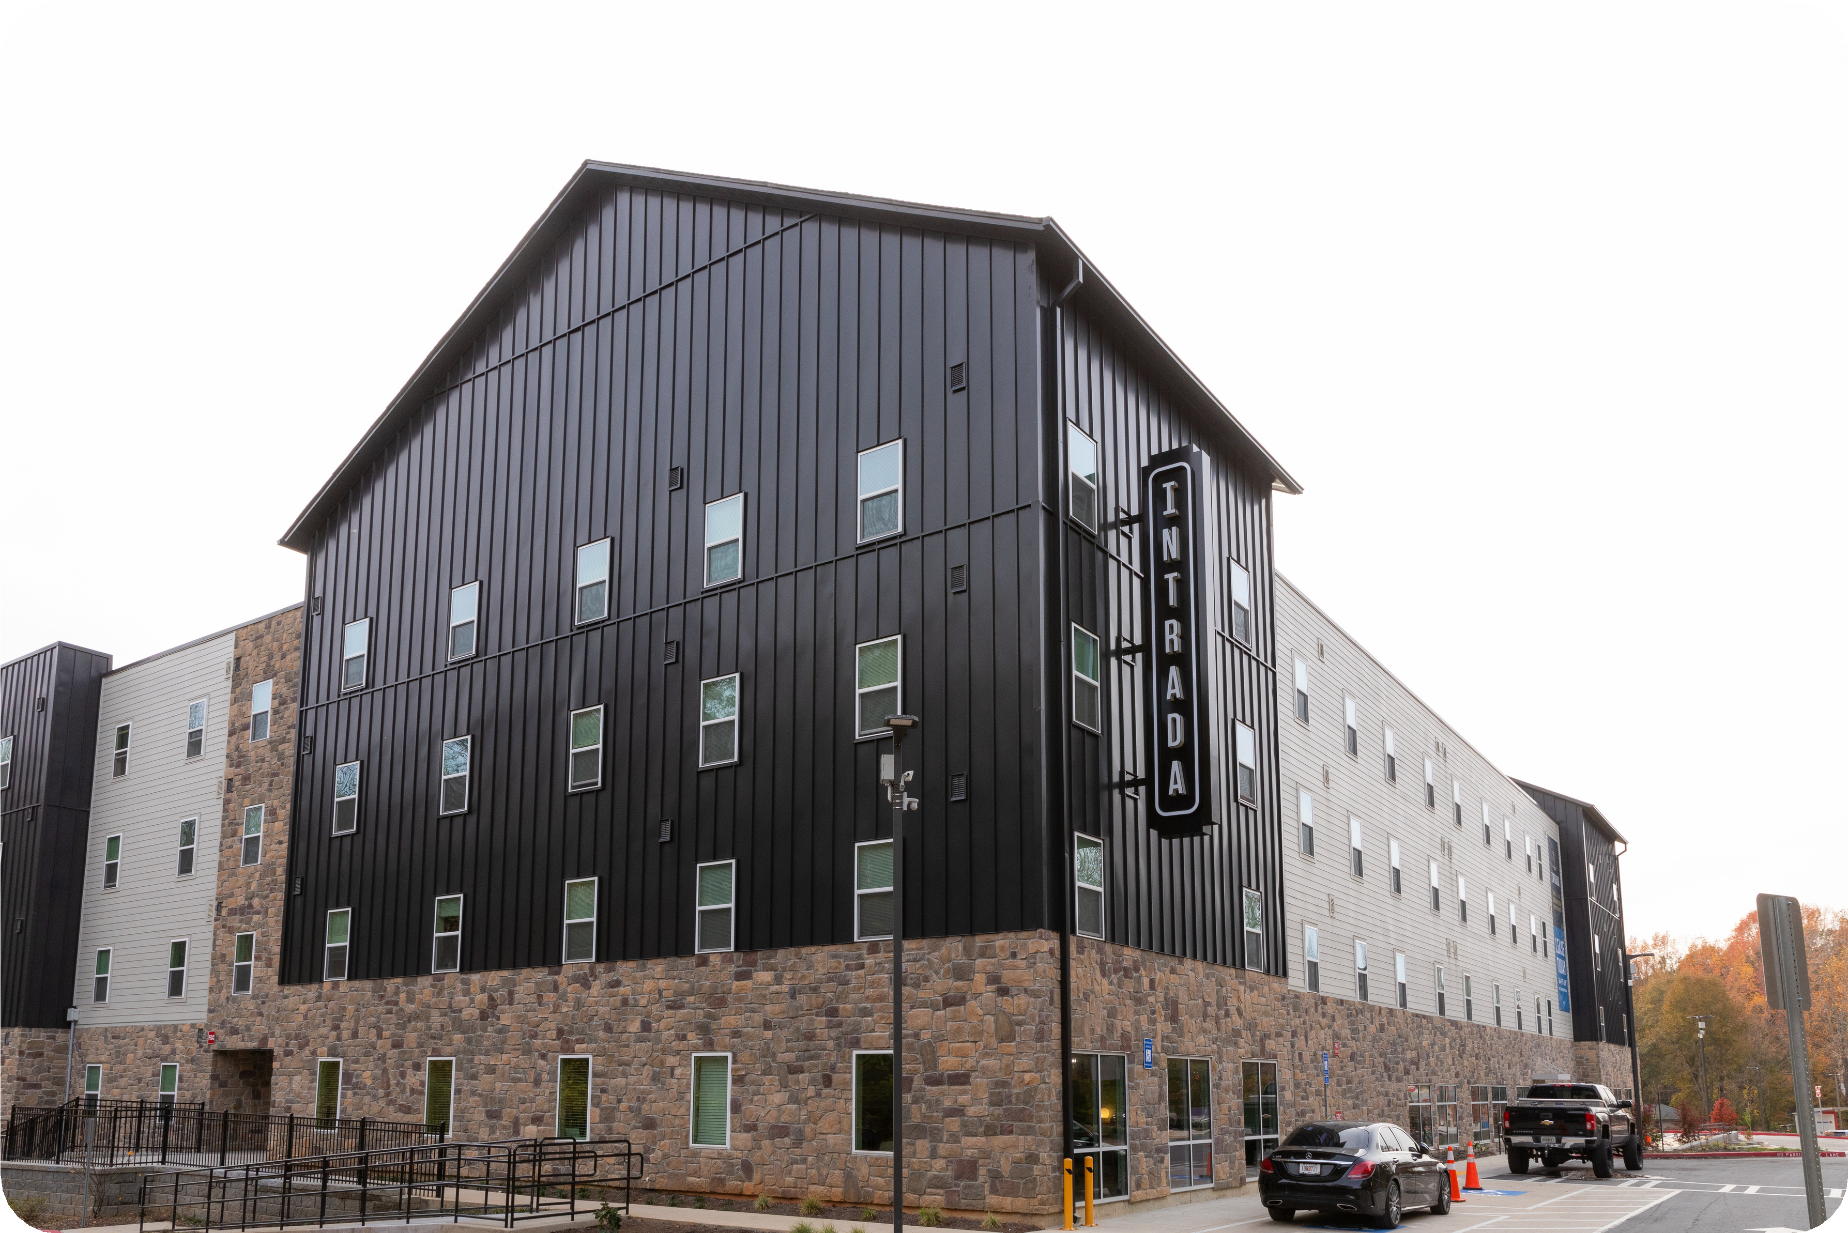
PRIORITIZATION OF WORK
Current Work Priorities
Brownfield Applications (CAPs or CSRs)
CAP Amendments
Cost Certifications
CSRs for approved CAPs / CSR Backlog
Approximate Review Times
2 to 4 weeks – Brownfield Applications (CAPs)
6 to 12 months - CSRs for approved CAPs
2 to 3 months (Comfort Letters) – CSRs for approved CAPs

Slide 20
Historic funding levels

Slide 21
Thank You! Questions?
Contact Information:
Adam.Hanley1@dnr.ga.gov 470-251-8102
Stephanie.Horwitz@dnr.ga.gov 470-527-2777

