Slide 1
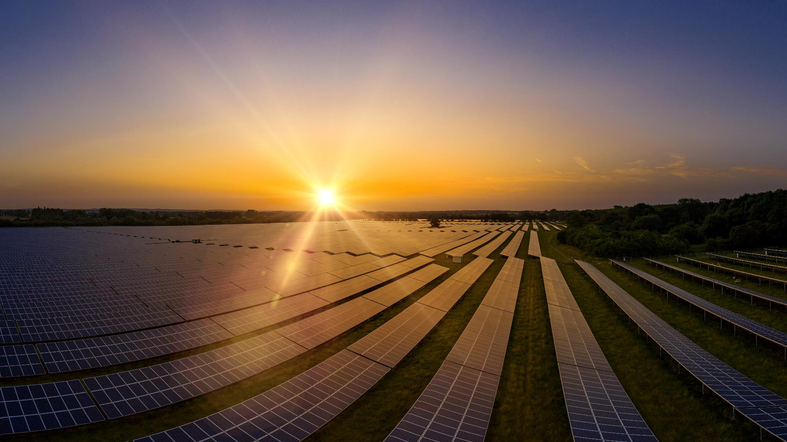
Beneficial Reuse of Brownfields
Georgia Brownfields Conference
April 16, 2025
Presented by:
Douglas Latulippe
Neil Campbell
SCS Engineers

Slide 2
Innovative Development of Brownfield Sites
Financial
Feasibility - Net Metering
Technical Assessment
Solar Feasibility
Grid
Access
Emission Offsets
Regulatory/ Environmental
Next Steps

Slide 6
Solar Power on Brownfields
Steady revenue, potential growth, fixed cost
Net metering to off-set power purchase cost
Diversified power – no power outages
Sustainable solar panels; last for 25 – 35 years
Possibly reduce post-closure costs of brownfield
Positive green public relations
No air emissions from solar
Creates local jobs
Limited brownfield data
Potential environmental liability
Permit requirements
Uneven surface, requiring regrading
Stormwater adjustments due to solar panels
Maintenance
Higher construction costs (vs. greenfield site)

Slide 7
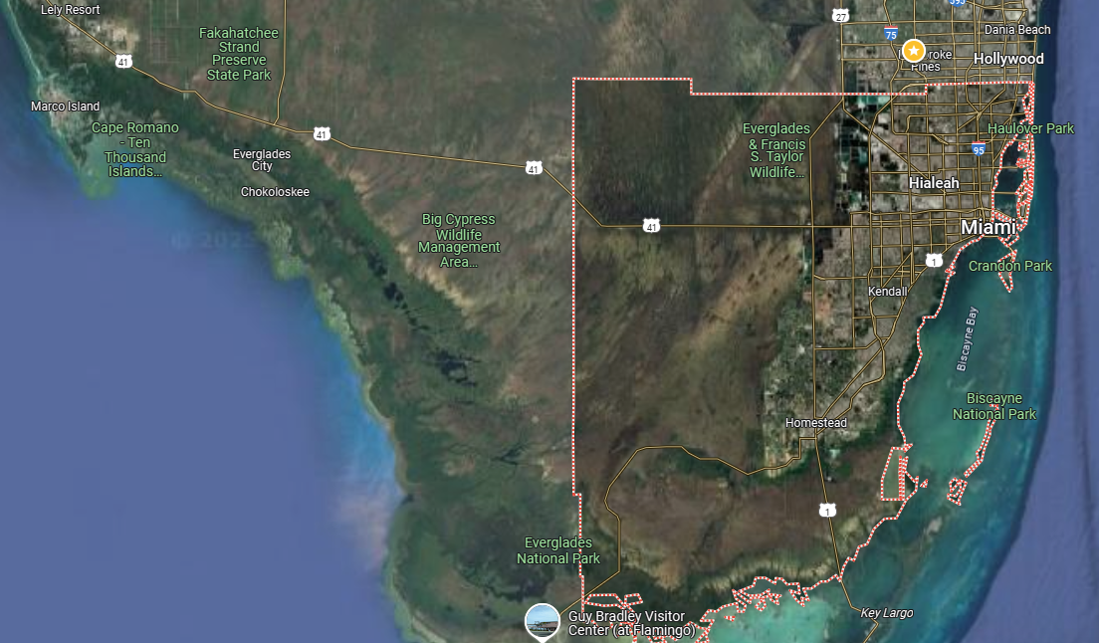
1.4 Million People
Between Two
National Parks

Slide 8
500-Acre Logistics Center Built on a Former C&D Debris Landfill
Remedial Action Plan and Water Use Permitting
Design and Permitting of Class I Industrial Deep Injection Well
Design/Build/Operate 2 MGD Groundwater Extraction System and Pump Station
Landfill Gas Survey, Design O&M of Gas Management Systems and for Warehouses
Regulatory Liaison
Civil Design and Construction Management

Slide 9
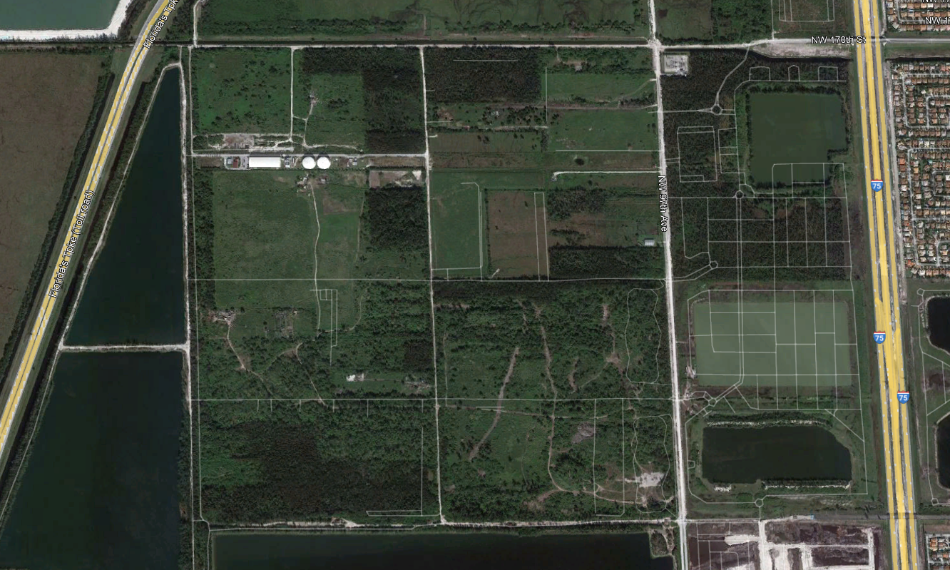

Slide 11
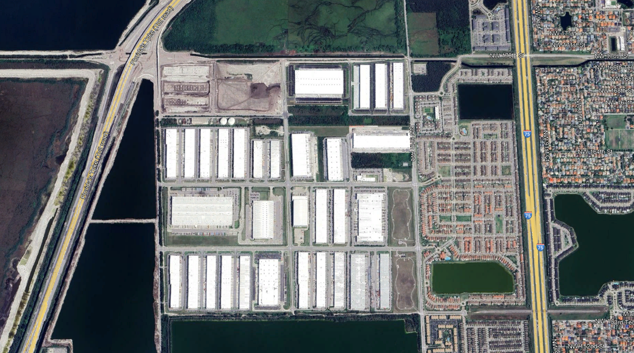

Slide 13
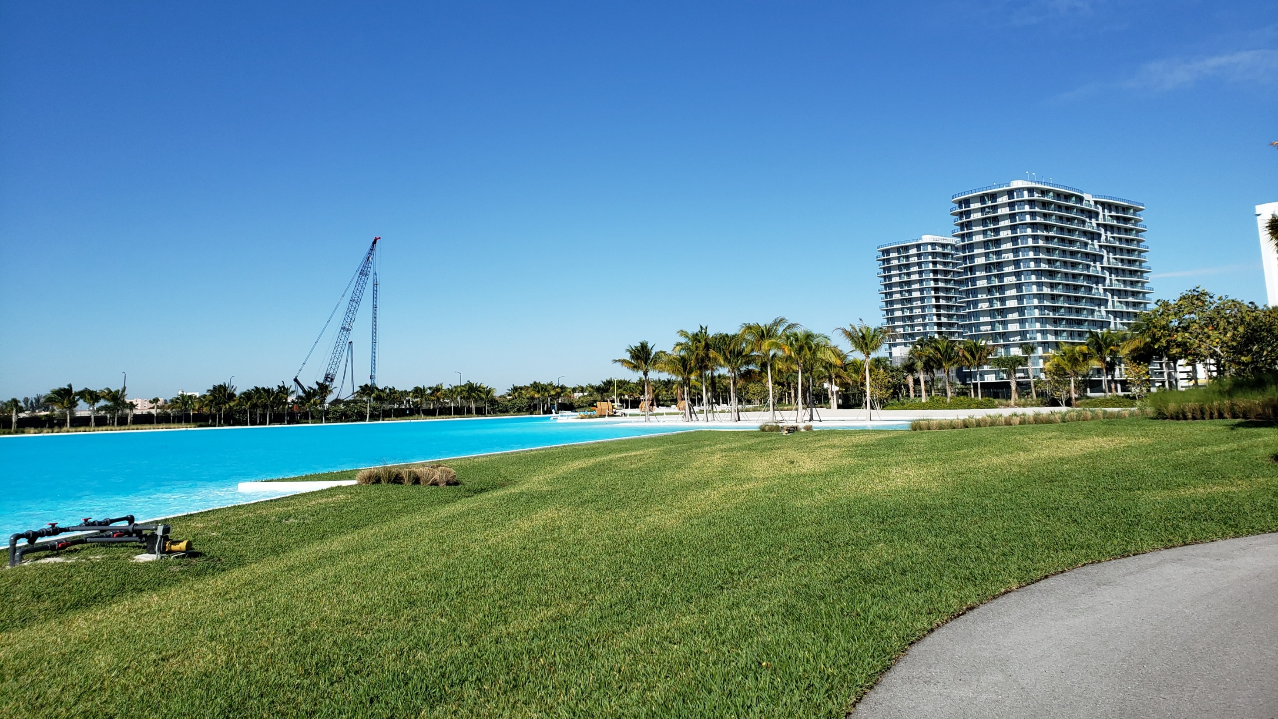
200-Acre Mixed-Use Development on a Former Class I Landfill
Groundwater Assessment and Remediation
Class I Injection Well
Combustible Gas Management
Landfill Closure and Design
Permitting
Stormwater Management

Slide 14
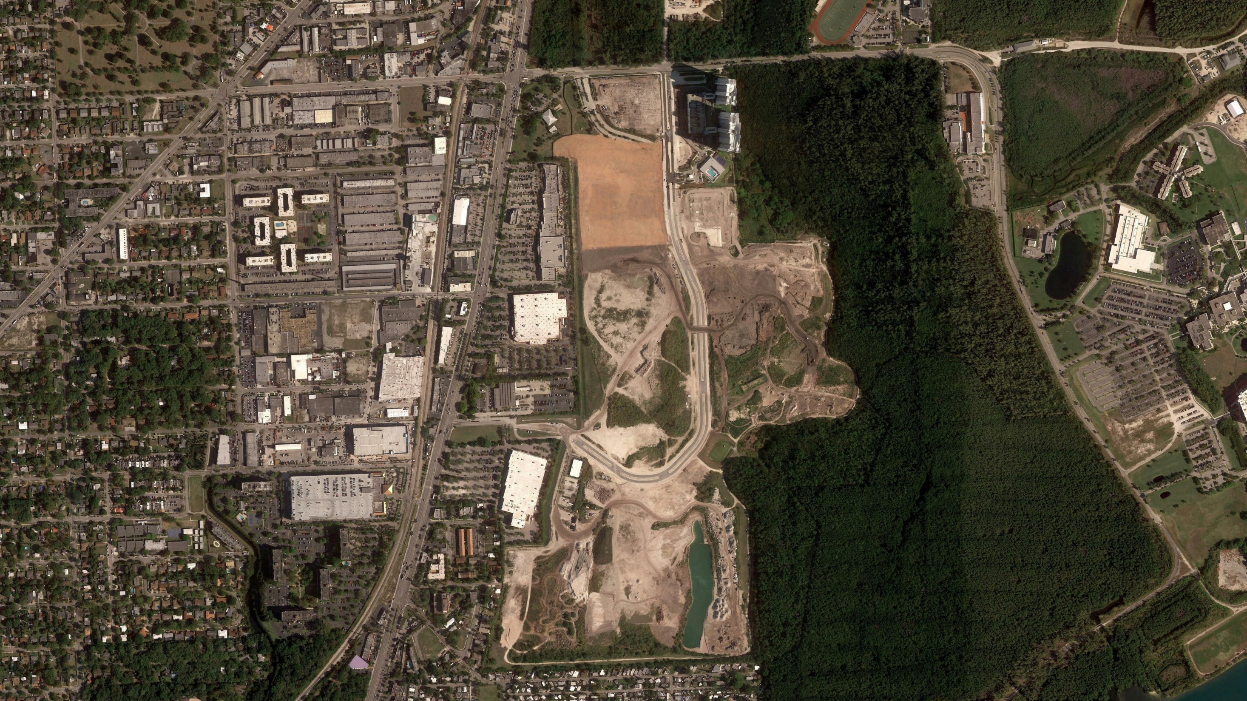

Slide 15
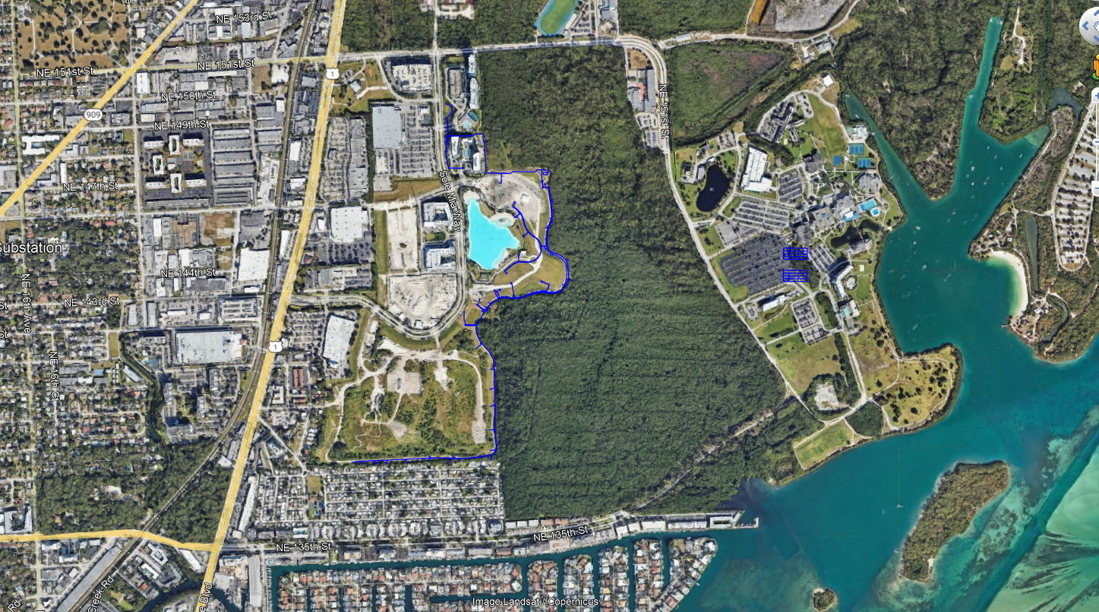

Slide 16
THANK YOU!
Doug Latulippe dlatulippe@scsengineers.com
Neil Campbell ncampbell@scsengineers.com
Deep Well Injections
Solar

