Slide 1
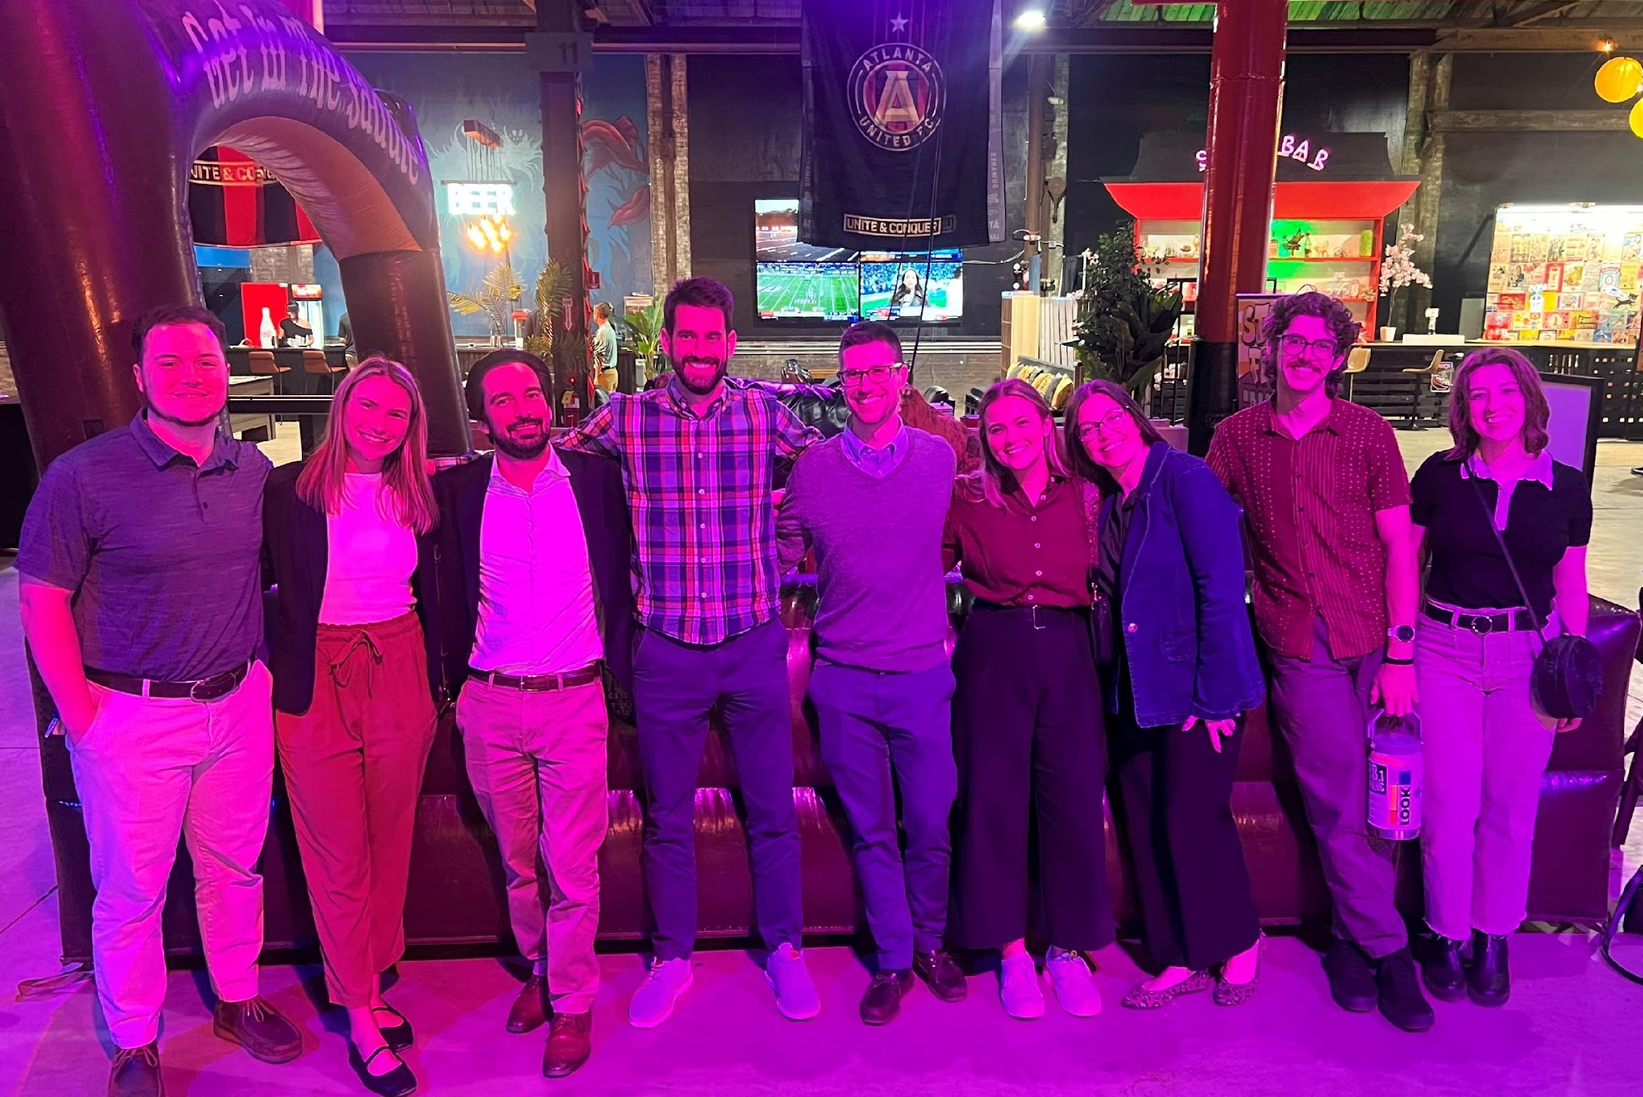
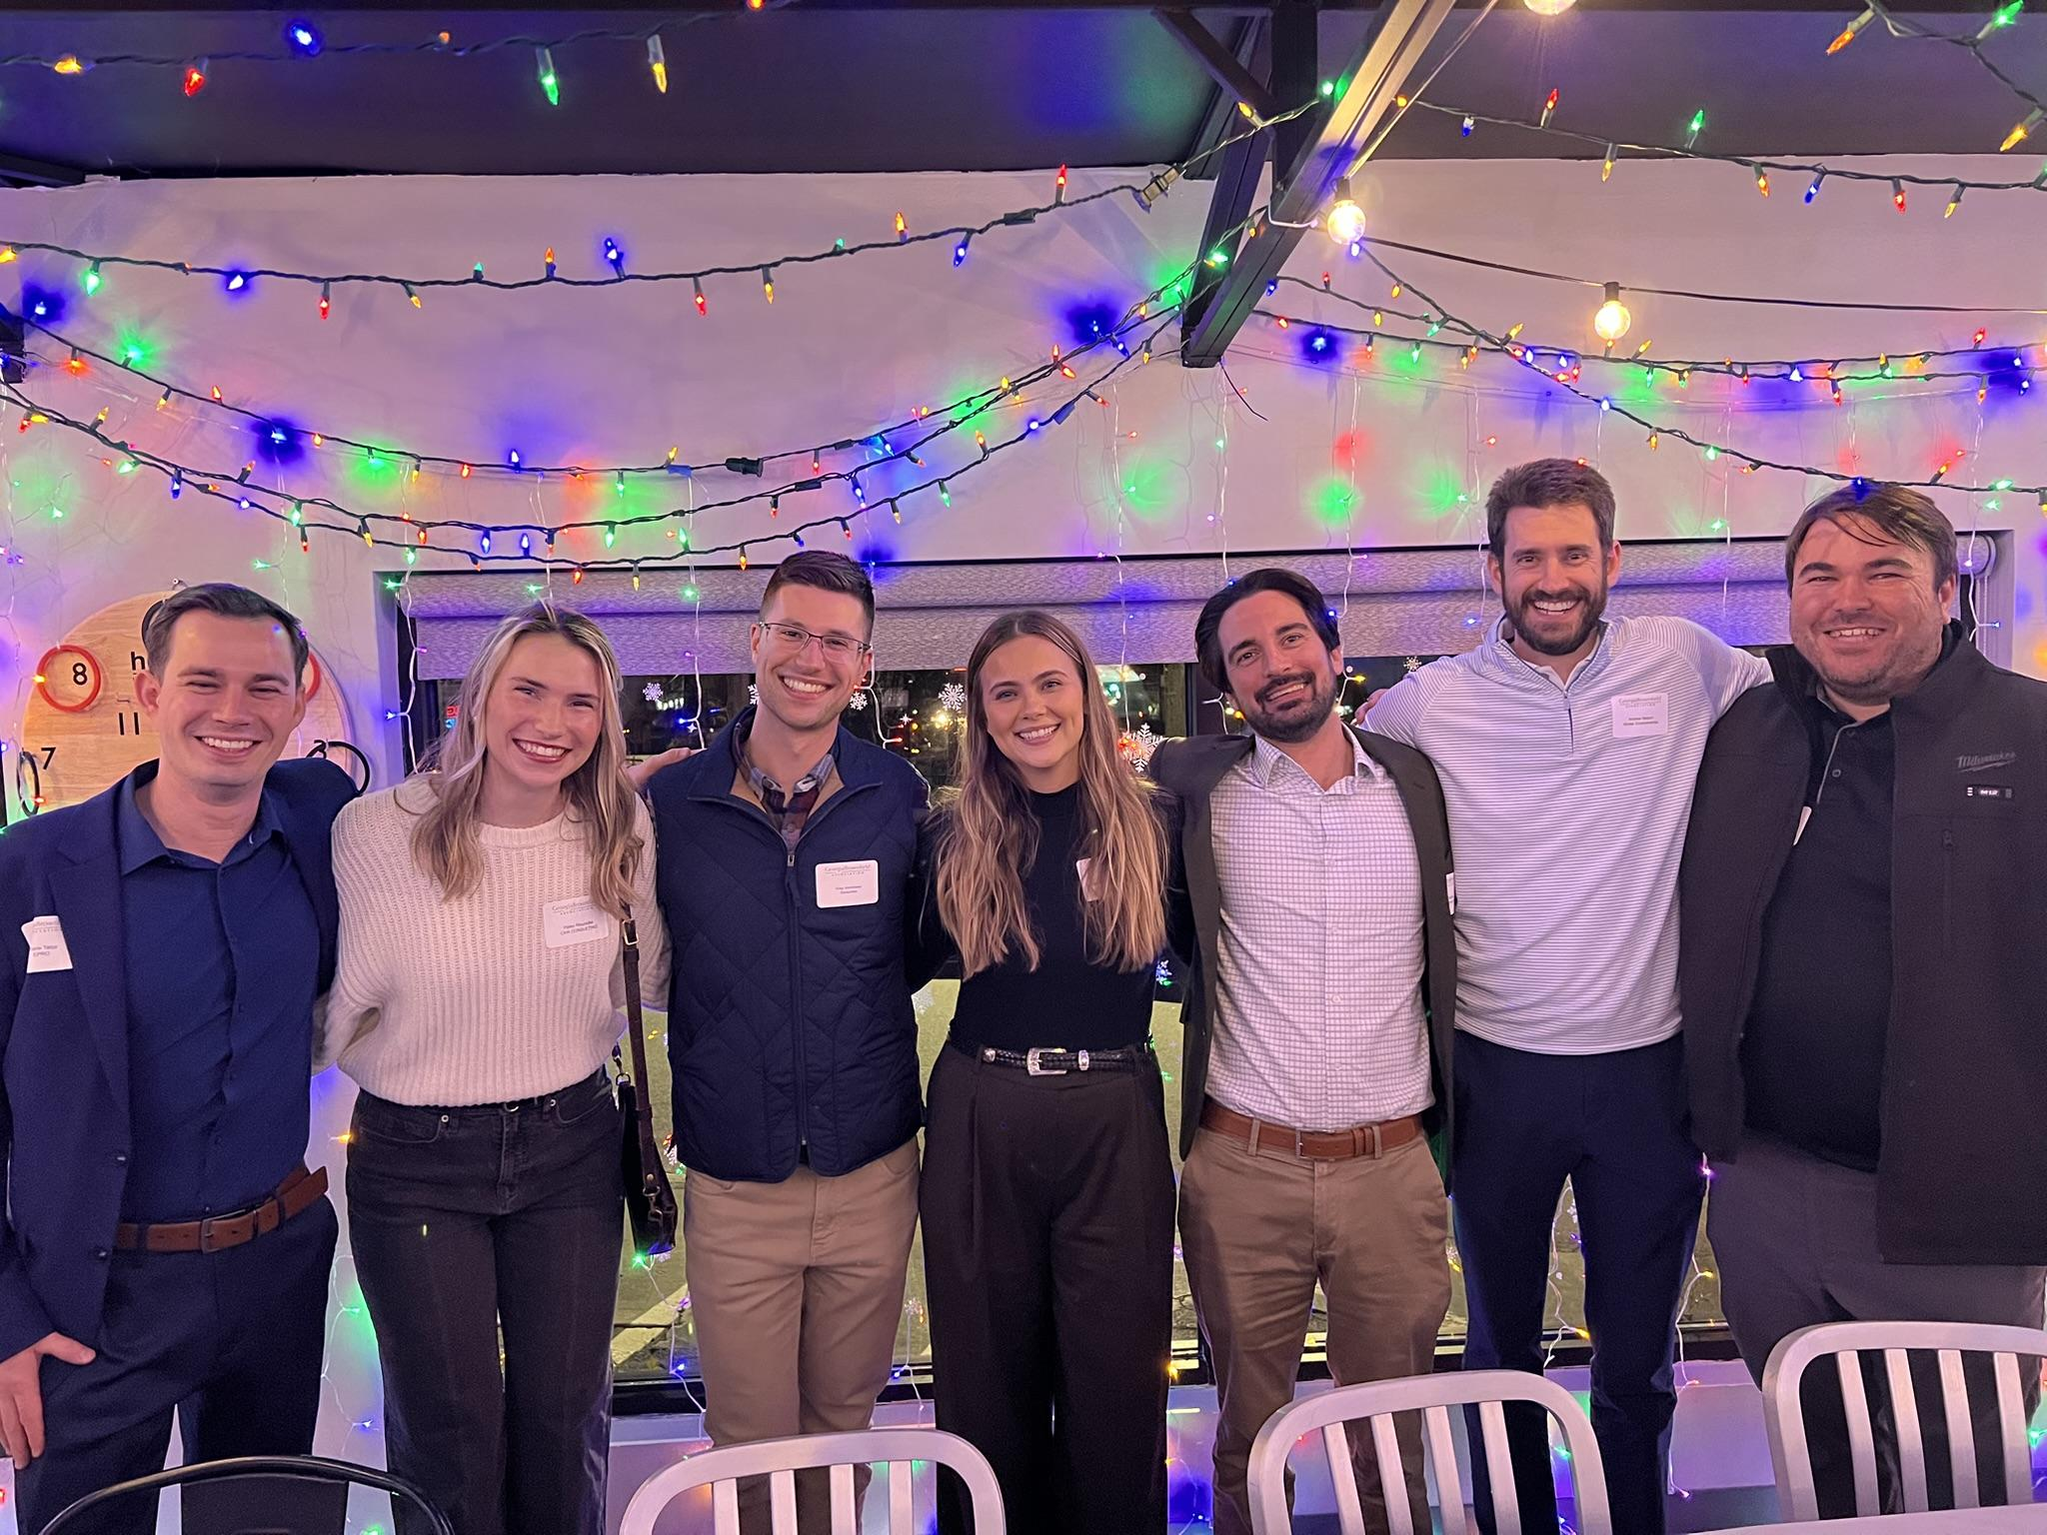
Young Professionals Committee
About Us
2024 Recap
2025 Preview

Slide 2
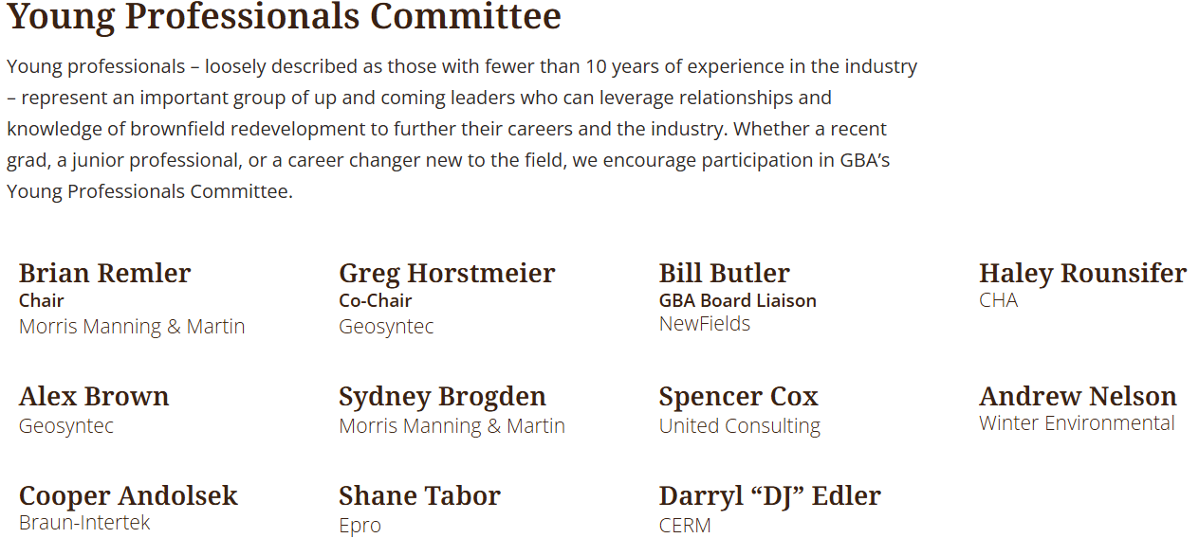
Brad Edwards
United Consulting
Stefanie Gugolz
GEI Consultants
Rosco Peters
ERM
Braun Intertec

Slide 3
GBA YPC Steering Committee: 2025
Chair
Brian Remler
Co-Chair
Greg Horstmeier
Event Coordination & Programming
Brian
Rosco, DJ, Brad
Recruitment
Shane
Sydney
Secretary
Sydney
Cooper
Marketing / Sponsorship
Andrew
Shane
Volunteering
Cooper
Haley
Stefanie
Student Outreach
Haley
Spencer
Stefanie
Reach Out / Coord. Sponsors (cold / warm calls)
Draft Emails for GBA
Prepare Meeting Minutes
Reach Out / Coord. Events
Liaising with GBA
Outreach to University Students / Faculty
Research & Reach Out
Circulate Minutes
Take Photos and Post to LinkedIn
Venue & Logistics Coord.
LinkedIn / Plug YPC
Create / Circulate Surveys
Coord. on-campus and student involvement
Coord. w/ other professional orgs

Slide 4
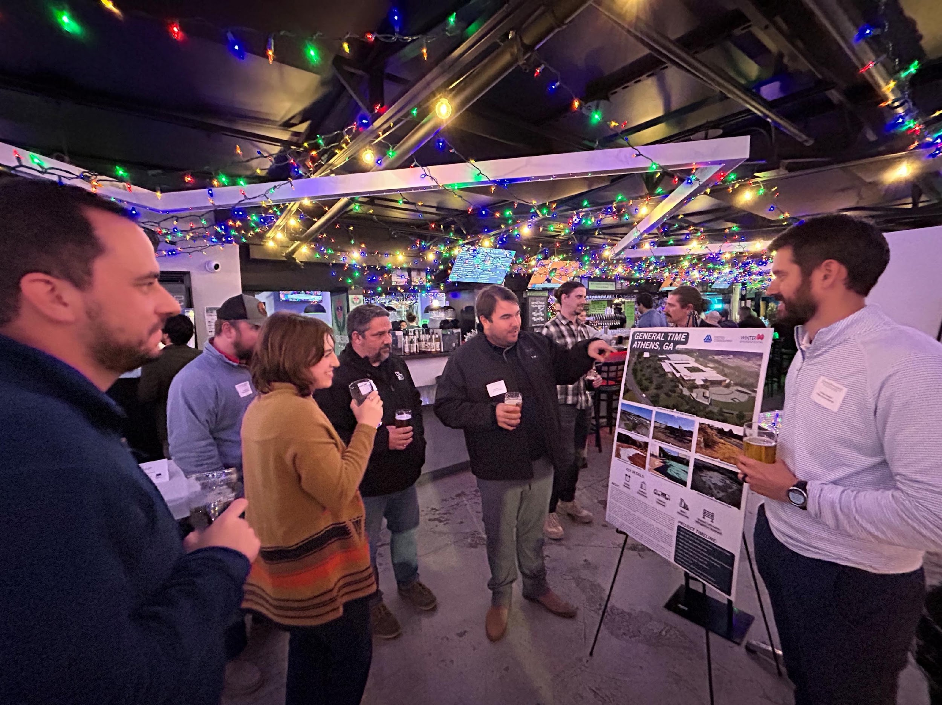
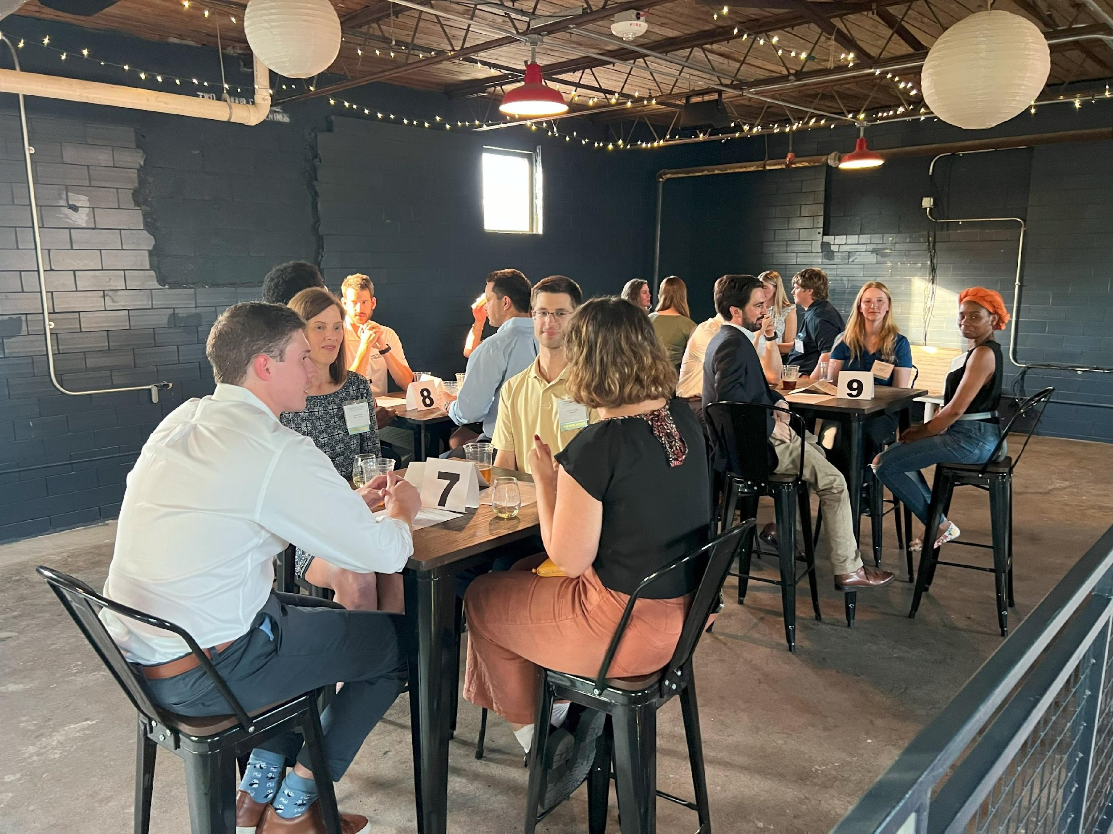
YPC Events
Lower-stakes networking
Educational opportunities
Public speaking & leadership opportunities
Volunteering
Student Outreach

Slide 5
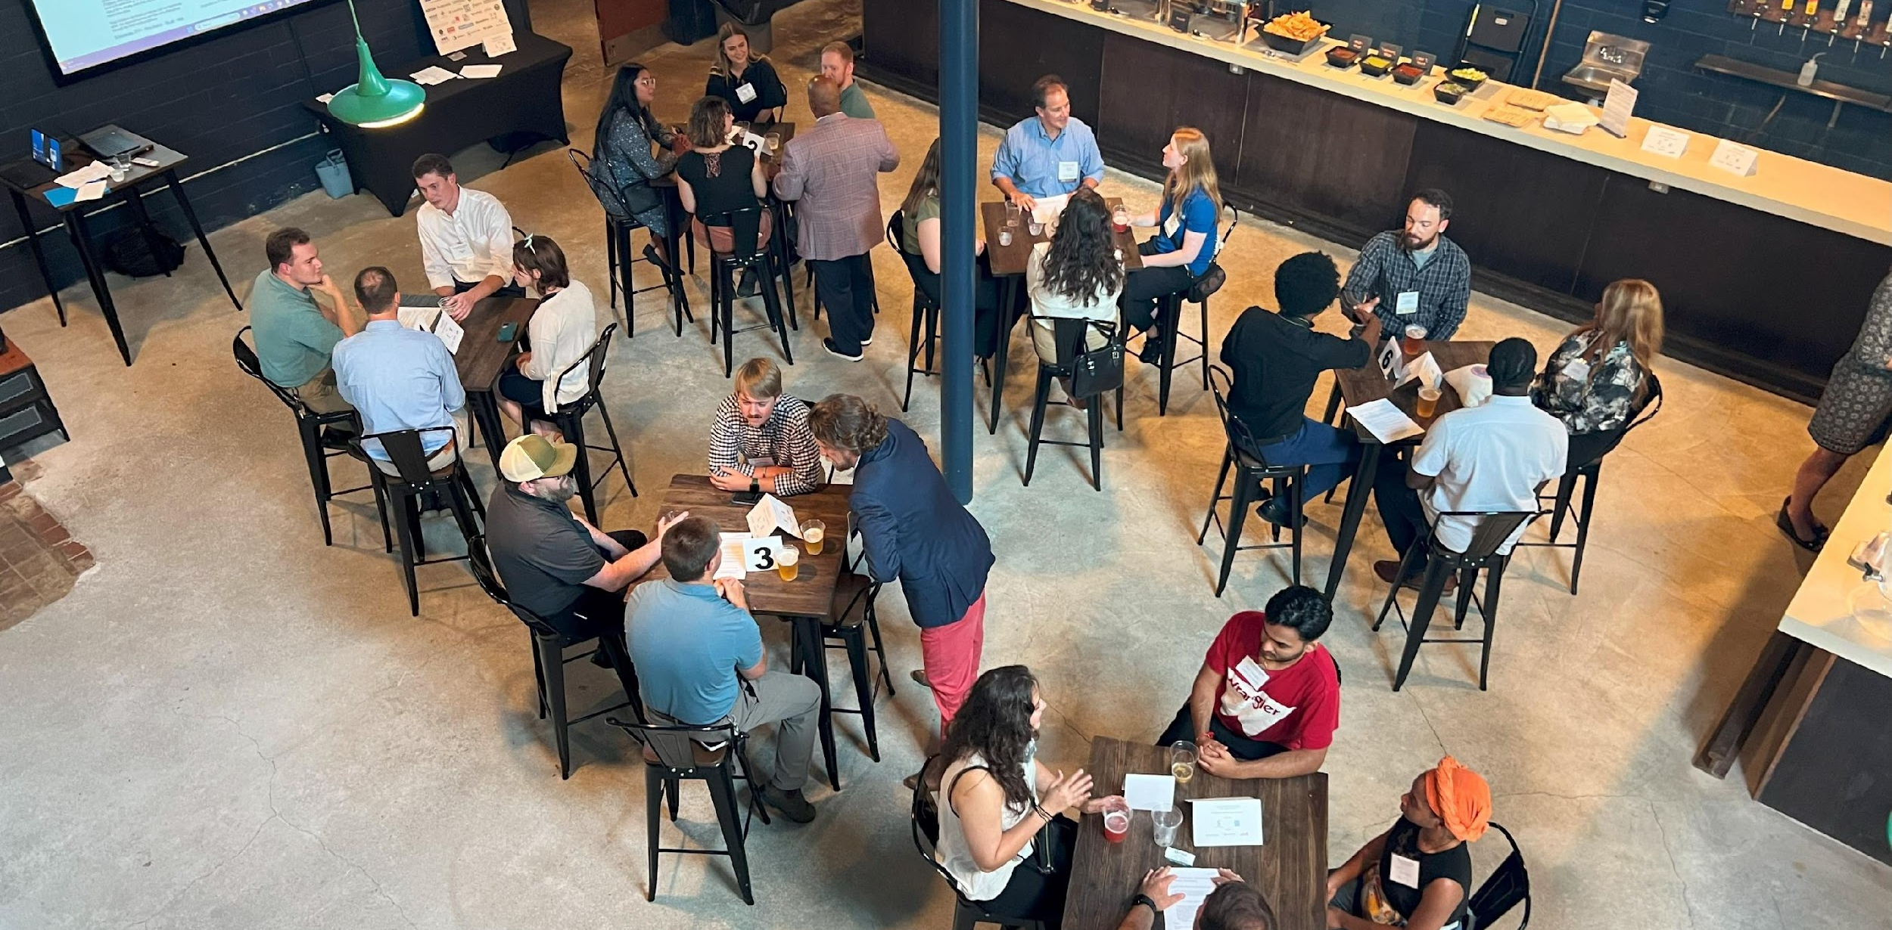
YPC Kickoff: Speed-Networking
August 2024

Slide 6
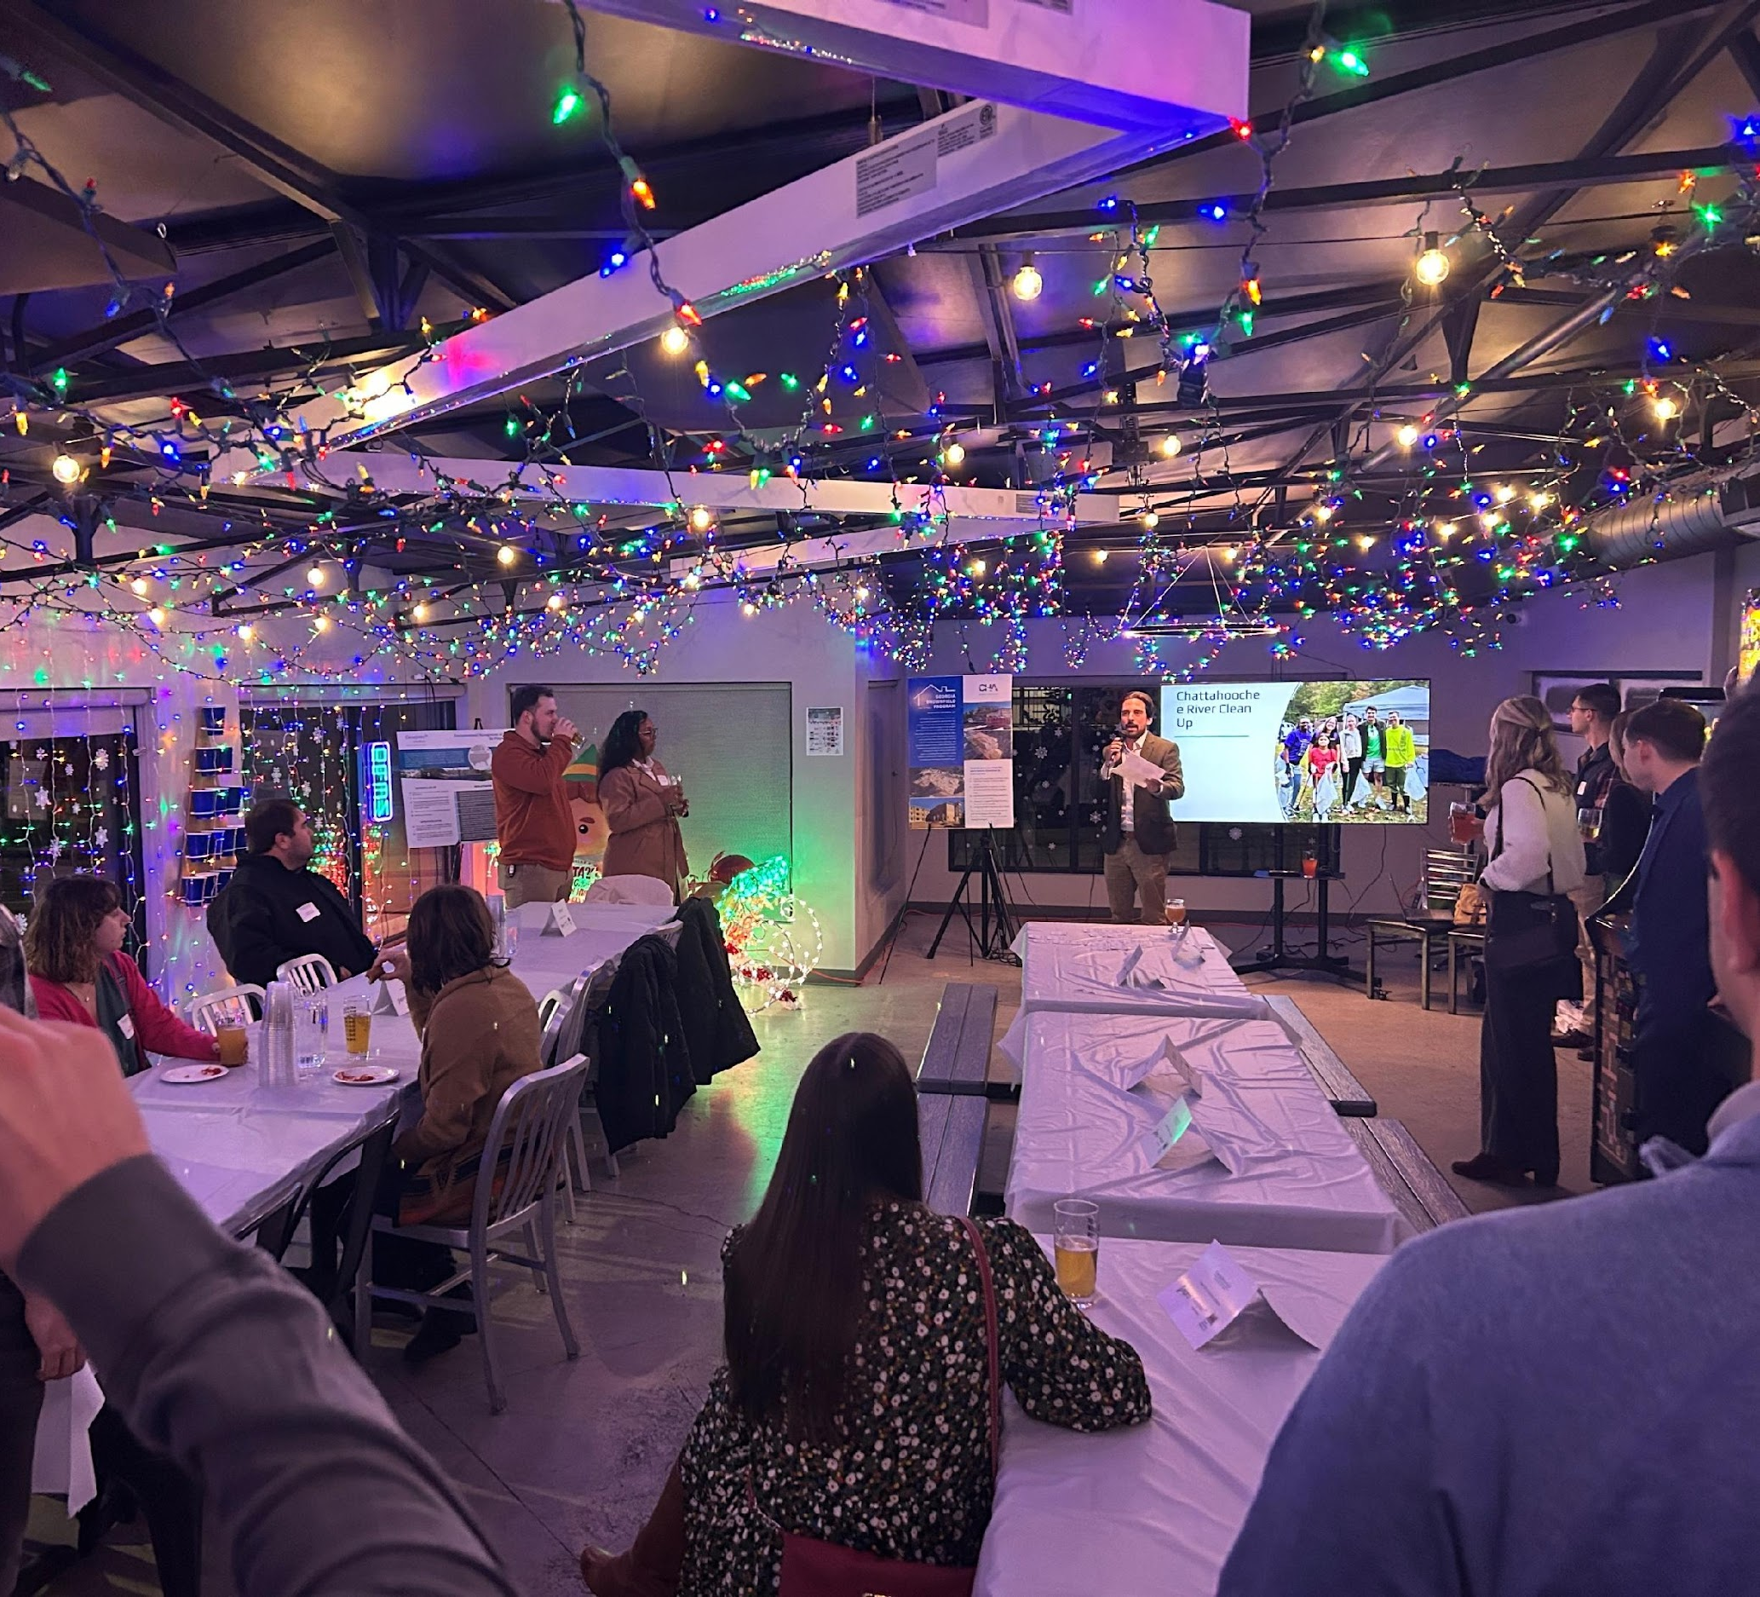
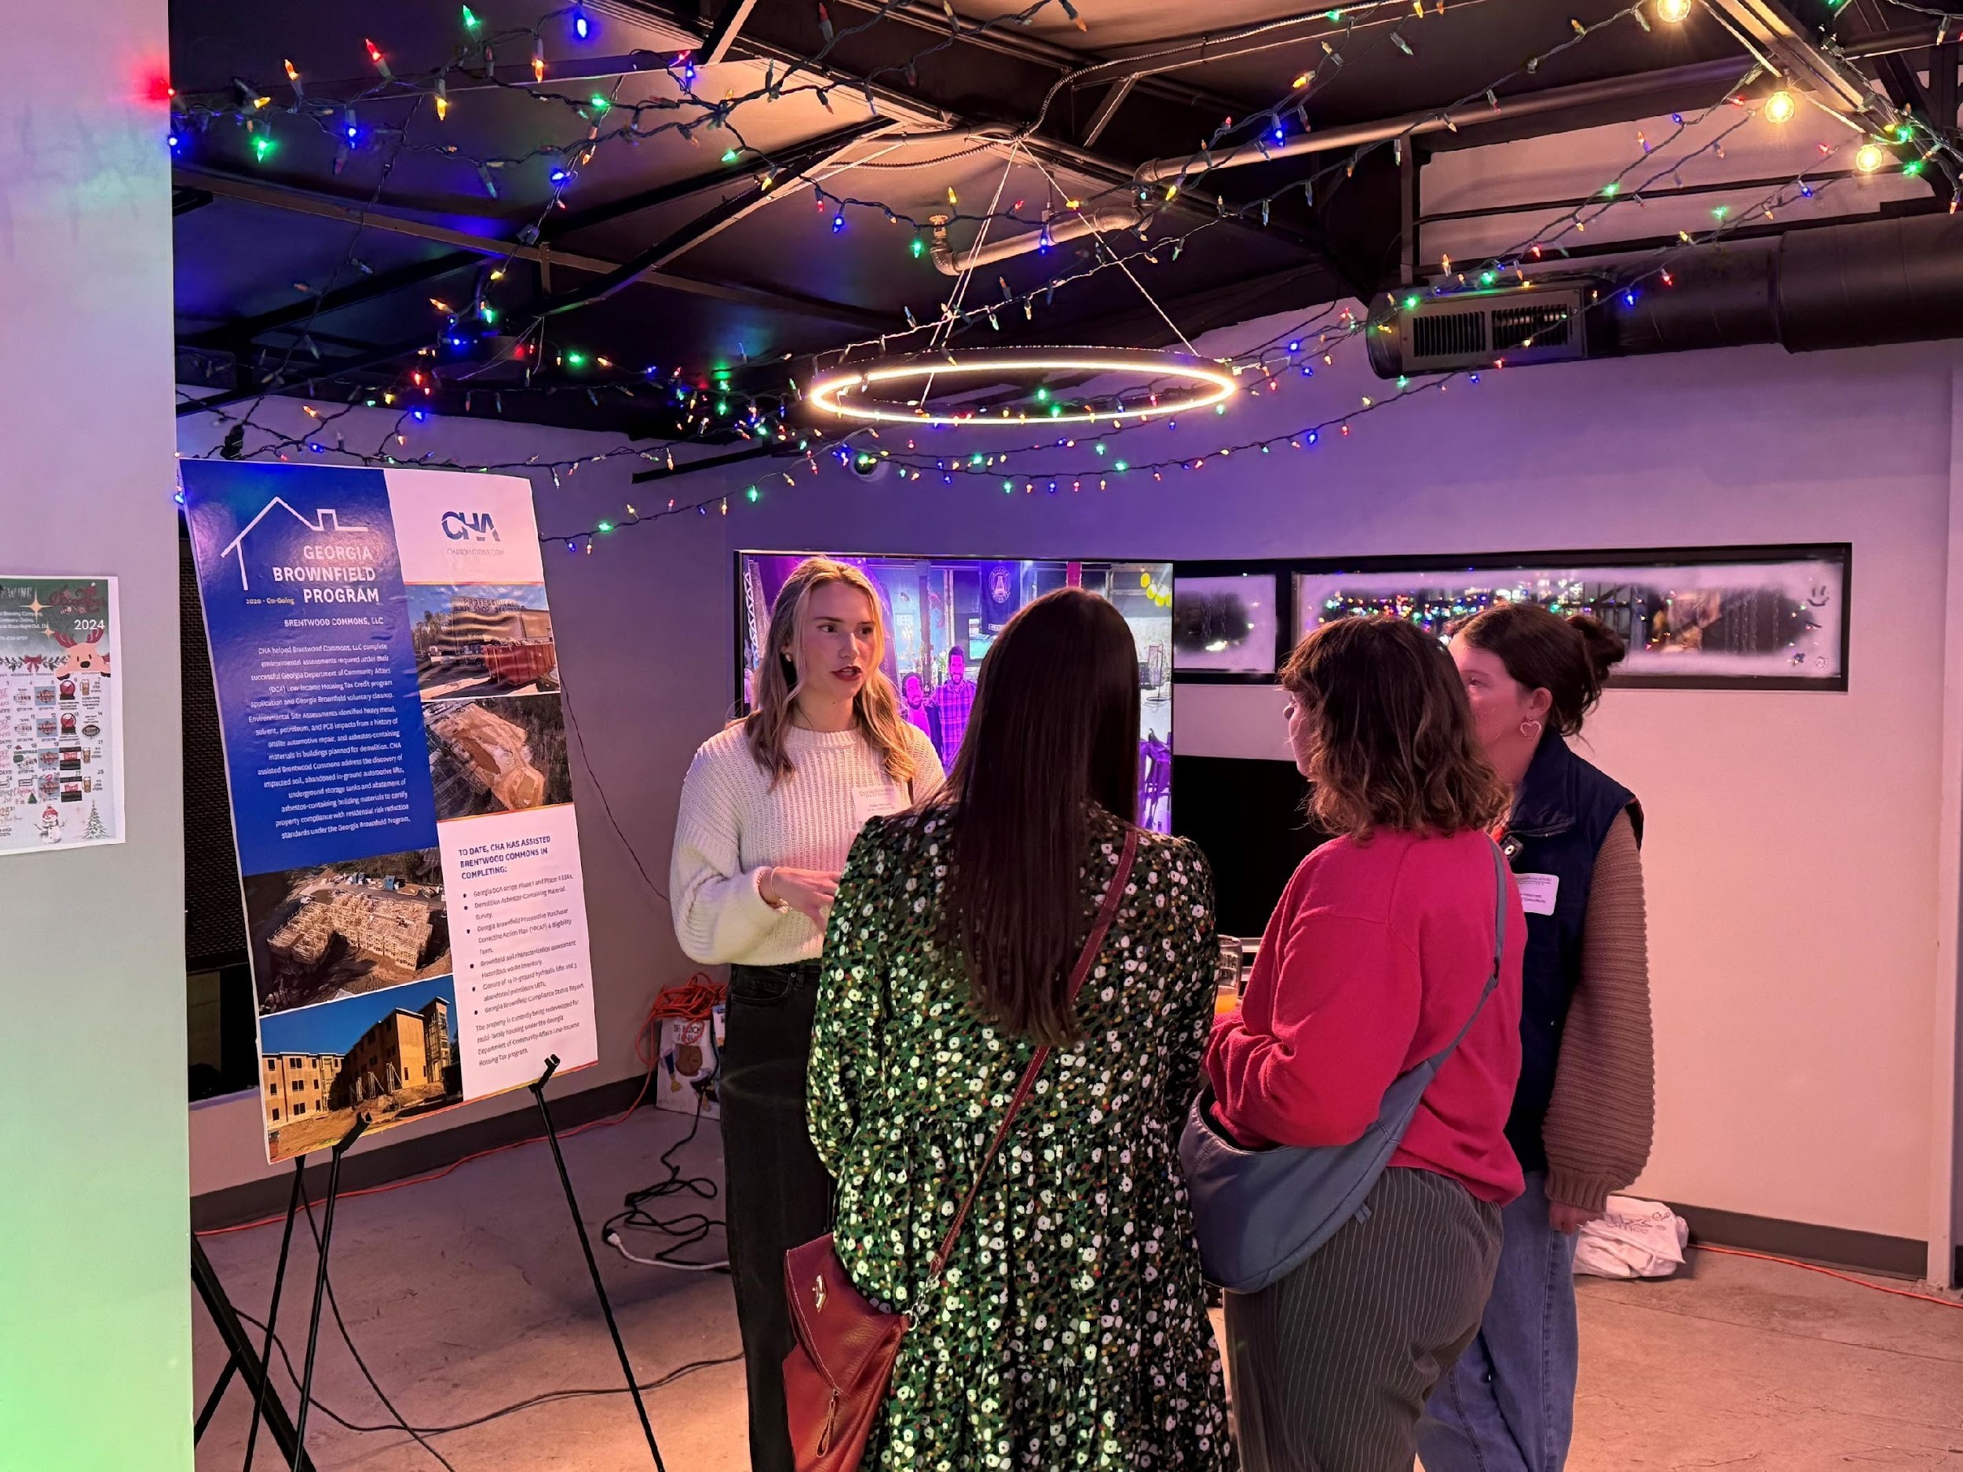
YPC Holiday Happy Hour & Poster Session
December 2024

Slide 7
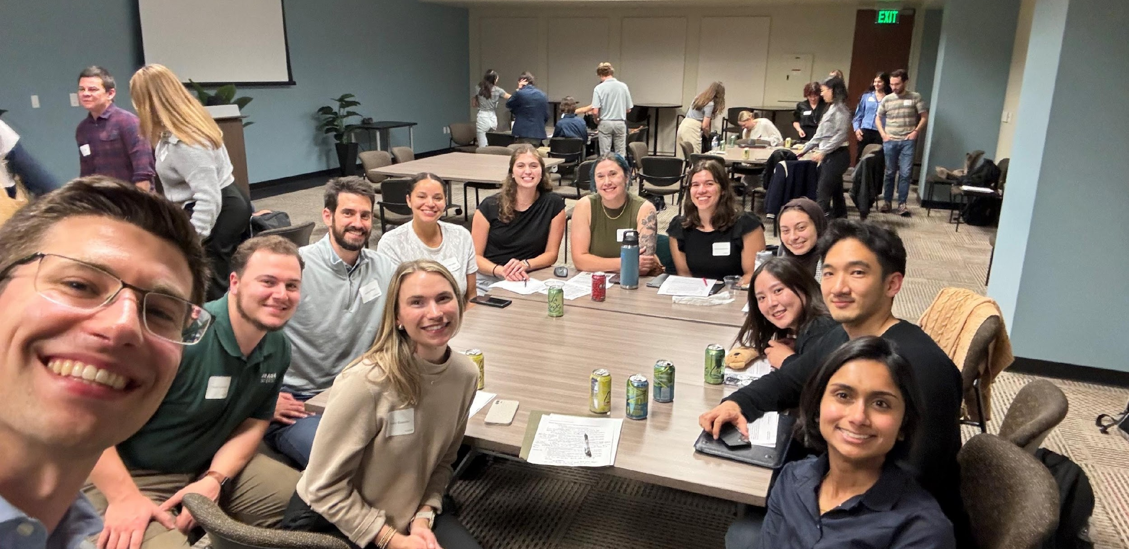
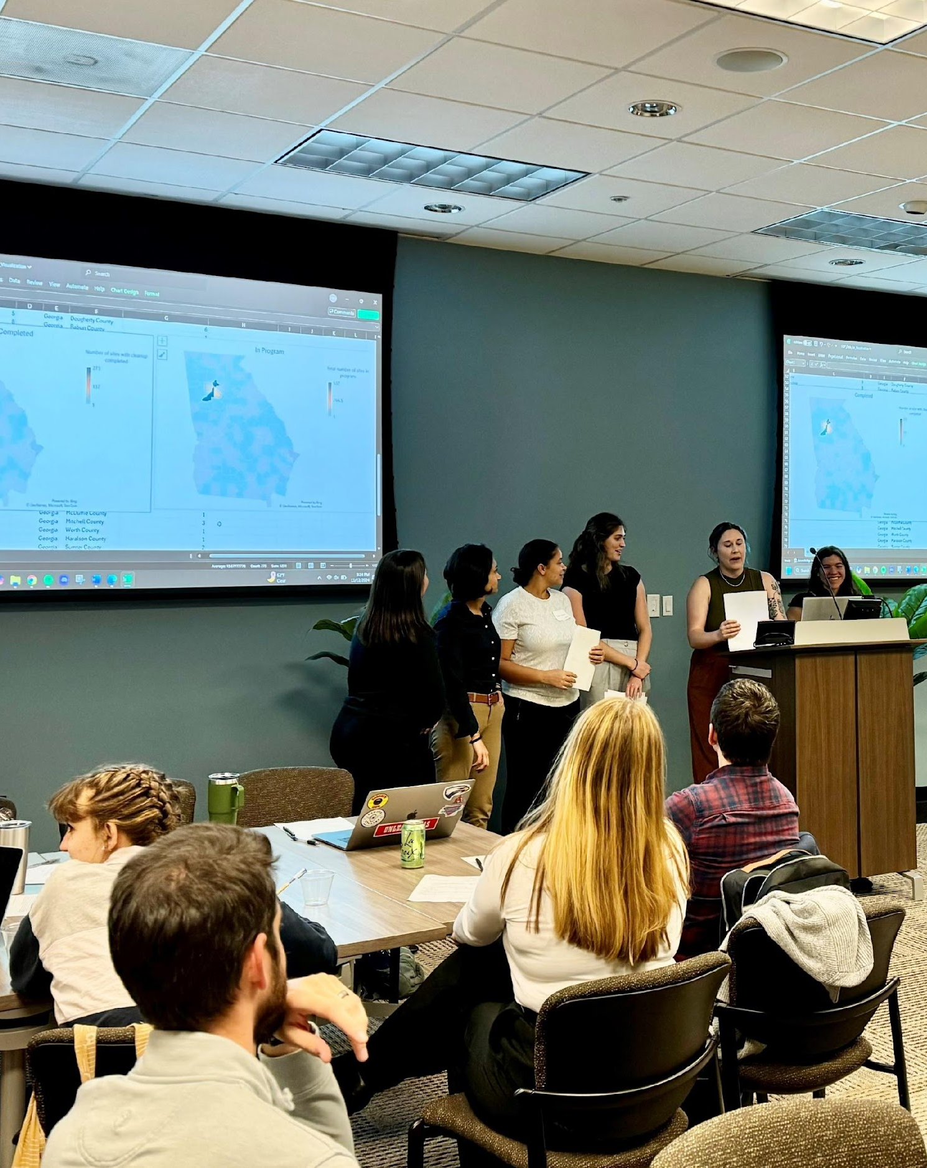
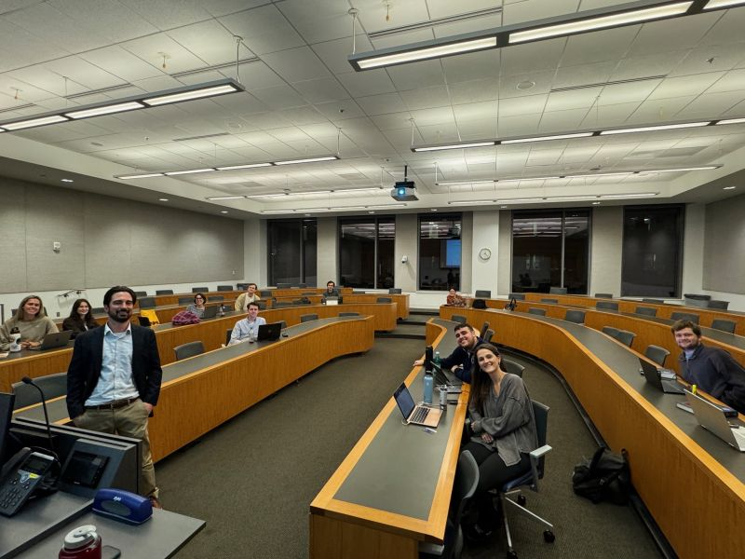
Student Outreach
Georgia State Law
(Oct. 2024)
Georgia Tech Sustainability Problem Solving Night (Nov. 2024)

Slide 8
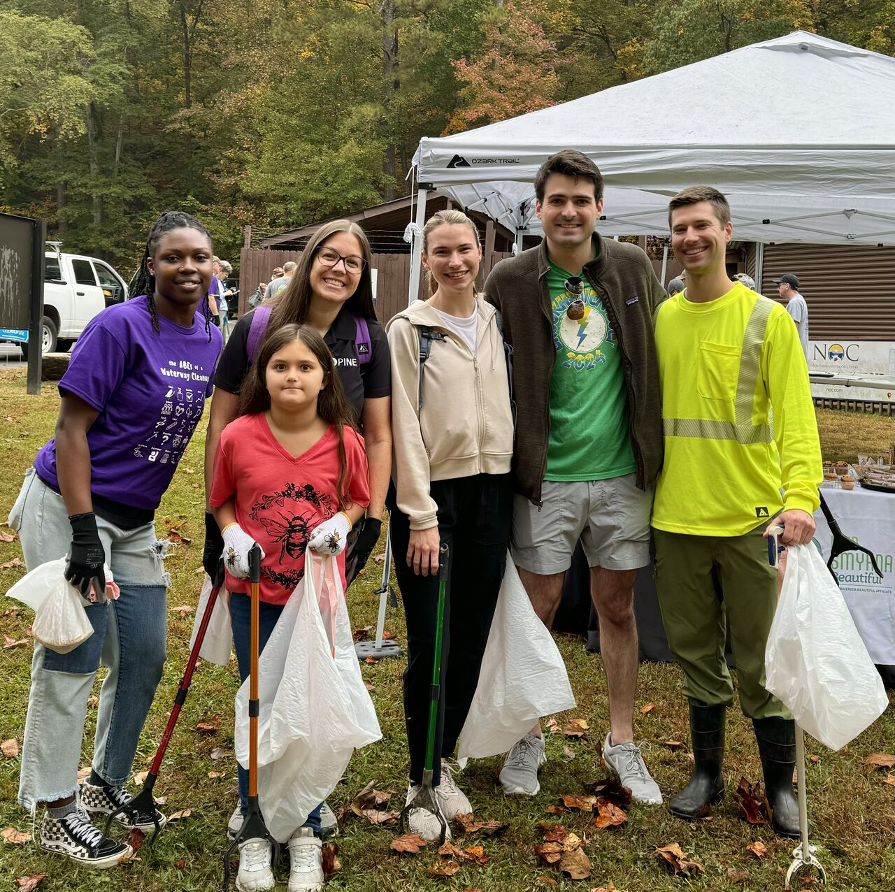
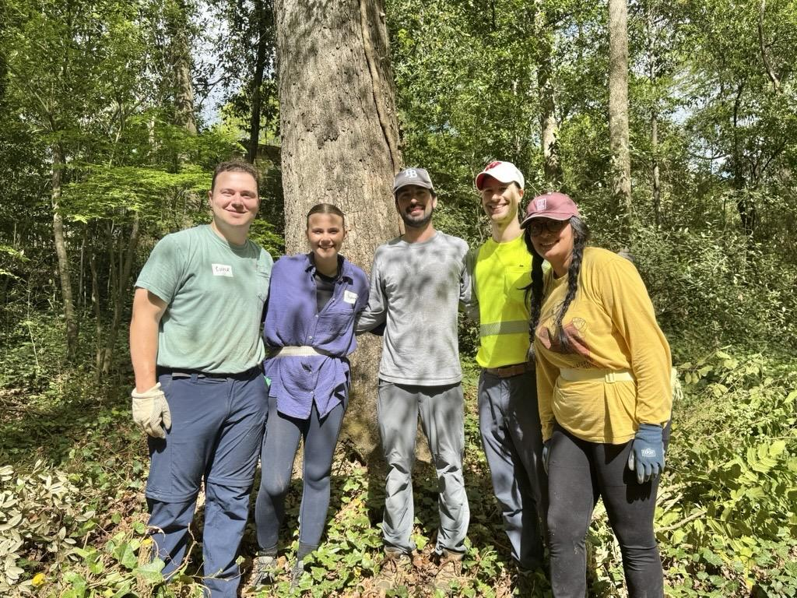
Volunteering Events
Chattahoochee River Clean Up
Rivers Alive, Nov. 2024
Frazer Forest Restoration
Trees Atlanta, April 2025

Slide 9
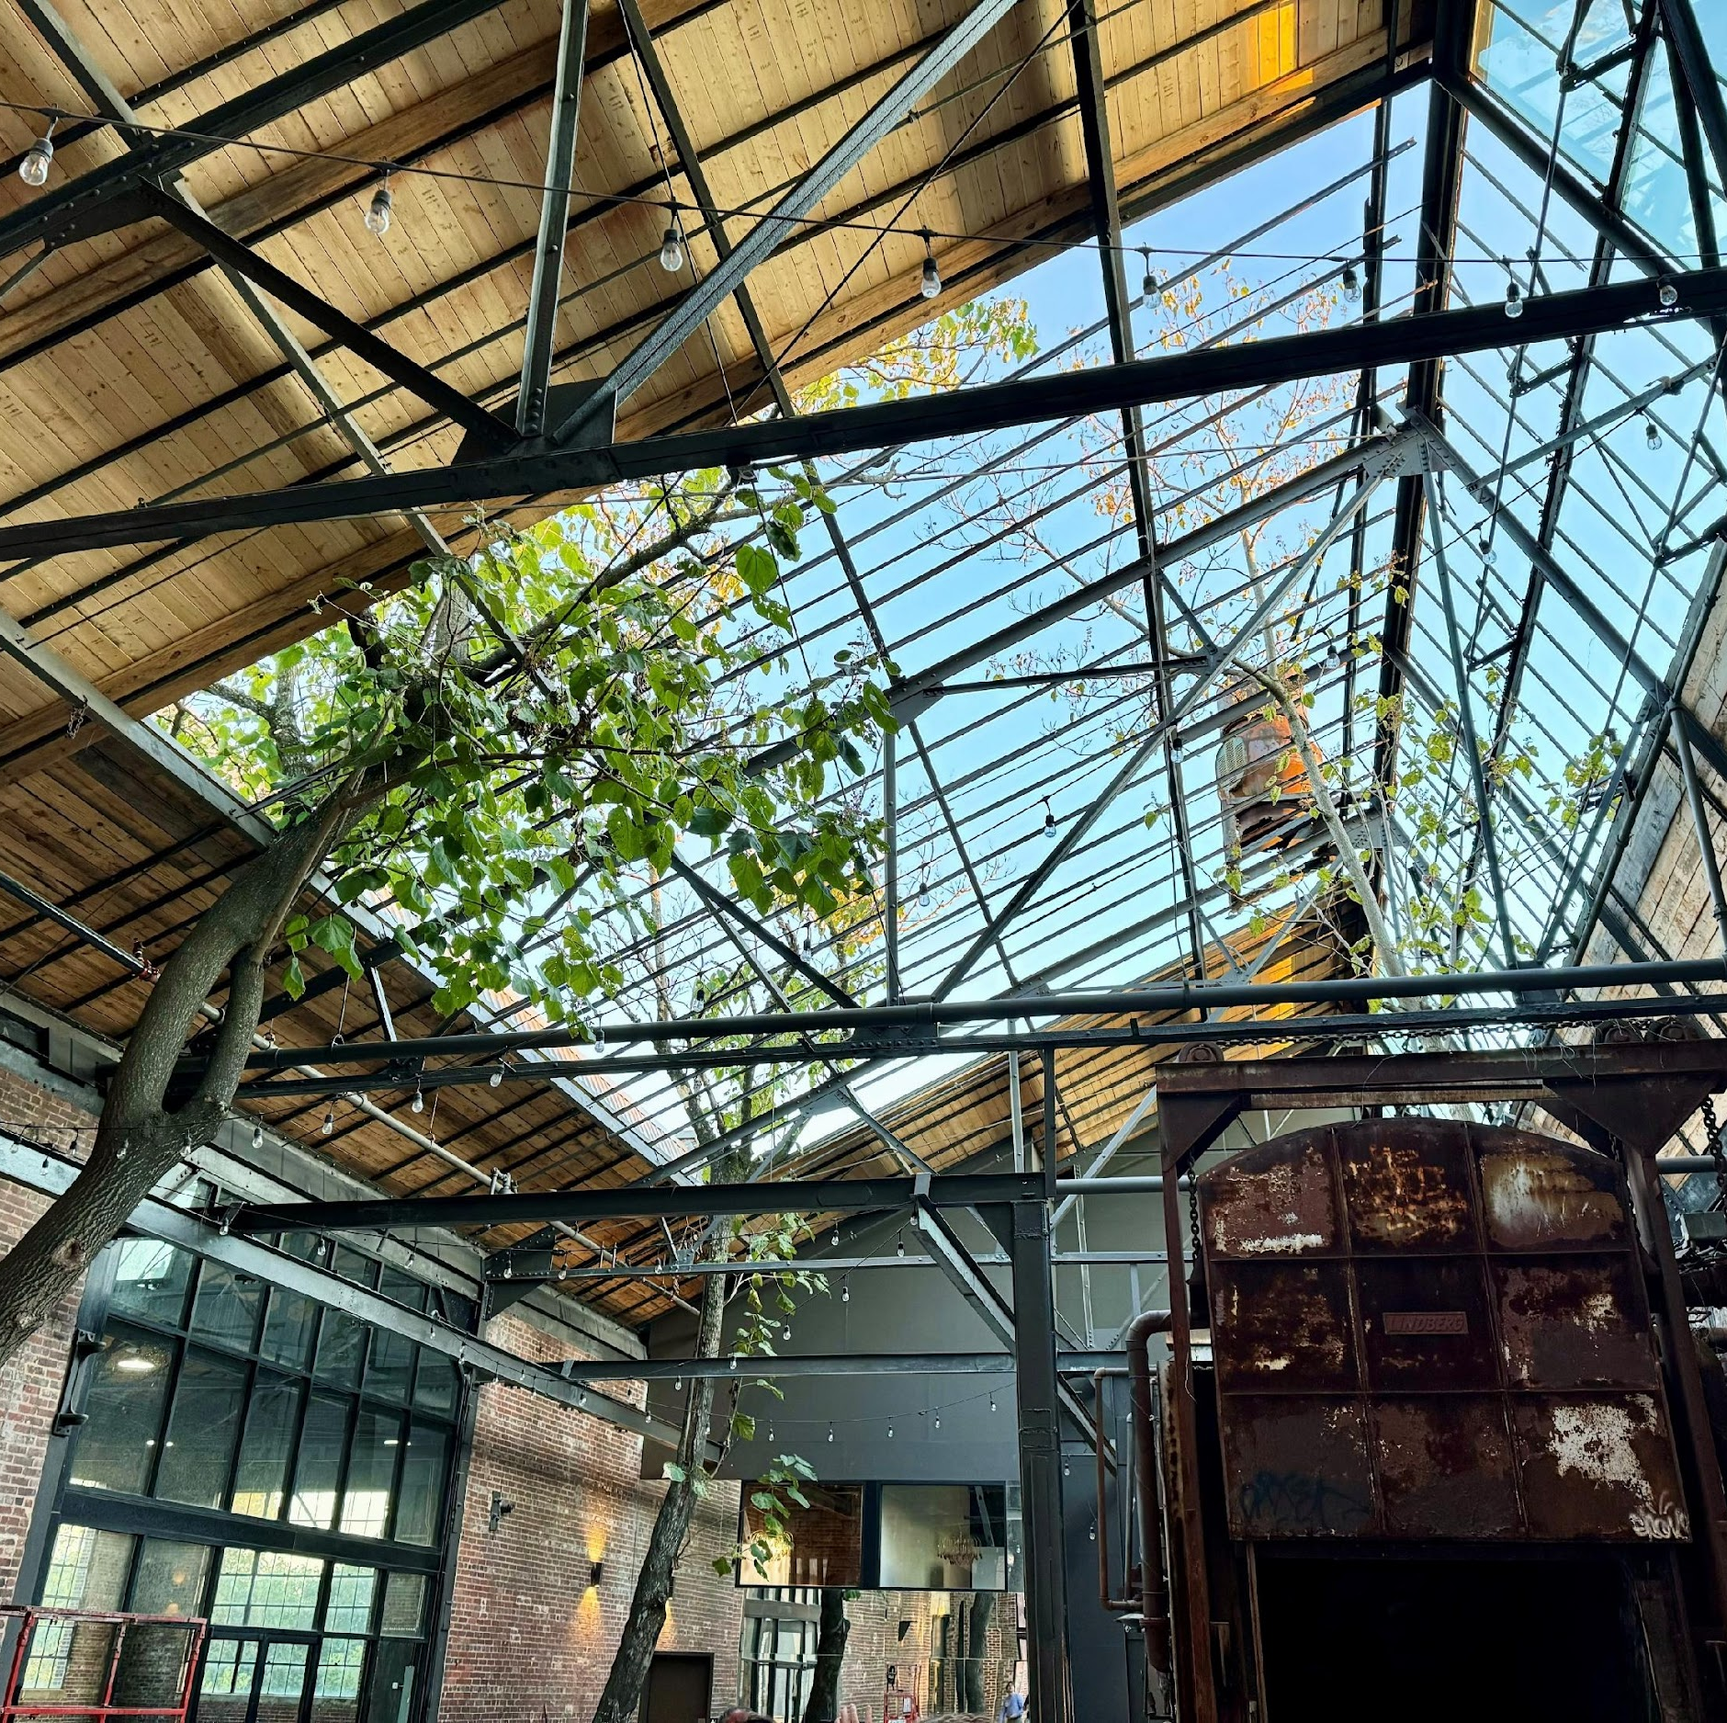
2025 Preview
Virtual Lunch & Learns
Speed Networking
Activity (e.g., Top Golf)
Potential Field Trip
Holiday Happy Hour
Student Outreach
Volunteering Opportunities

Slide 10
