Slide 1
PFAS IN Georgia’s brownfields – navigating the regulatory blind spot
Georgia Brownfield Association
Spring Seminar
Presented by: Kimberley Hale, Shannon Ridley & Len Diprima
April 16, 2025
Disclaimer: This presentation is for educational purposes only. Opinions or points of view expressed in this presentation represent the view of the presenter. Nothing in this presentation constitutes legal advice.

Slide 2

Road Map
Brief Background on PFAS issues in due diligence
EPA’s “Hit List” and Enforcement Policy
Georgia’s Brownfield Regulatory Gap
Assessing Options – Brownfield Hypothetical
The Looming Vapor Issue

Slide 3
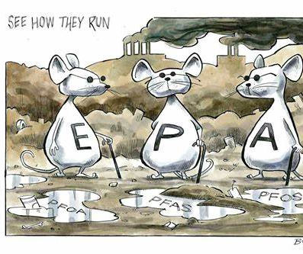
PFAS in Due Diligence
On April 10, 2024 (effective June 25, 2024), EPA established National Primary Drinking Water Standards for 6 PFAS chemicals.
On April 19, 2024 (effective July 8, 2024), EPA designated two of the thousands of PFAS chemicals as hazardous substances; PFOA and PFOS must now be considered in a Phase I assessment.
Other PFAS chemicals are considered emergent contaminants and should also be evaluated.
  What this means for Georgia properties and related transactions?
  PFAS may be identified in Phase I as a REC.

Slide 4
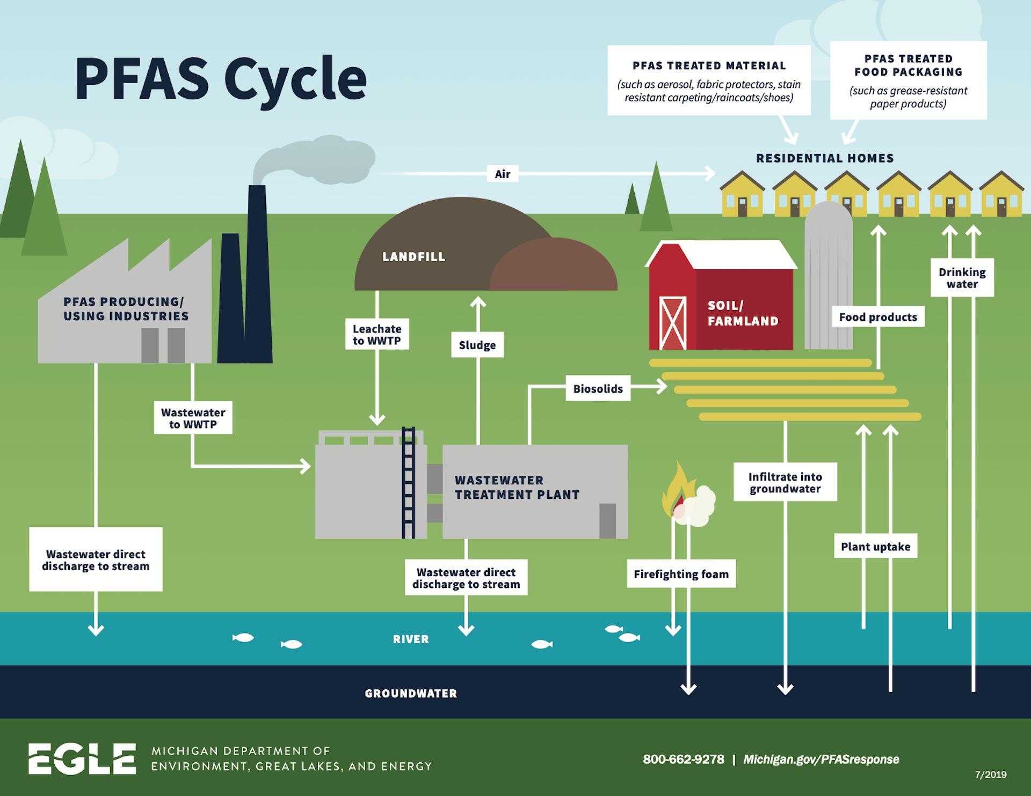

EPA’s List of Suspect PFAS Operations
Manufacture of PFAS
AFFF (fire-fighting foam used at airports, military bases, and fire departments)
Textile manufacturers (carpets, clothing, outdoor gear)
Paper and packaging
Metal Plating and Electroplating
Wastewater Treatment Plants
Landfills
Fire Training Areas
Agricultural operations
Dry cleaners
Etc., etc.

Slide 5

EPA’s PFAS Enforcement Discretion Policy
April 19, 2024
Based on equitable factors, EPA does not intend to pursue the following for PFAS response actions or costs under CERCLA:
Community Water Systems and POTWs
Municipal Separate Storm Sewer Systems
Publicly Owned or Operated Municipal Solid Waste Landfills
Publicly Owned Airports or Fire Departments
Farms that Apply Biosolids to Land
EPA will focus on those entities that manufacture PFAS or used PFAS as part of an industrial process or was actively involved in the use, storage, treatment, transport, or disposal of PFAS.

Slide 6
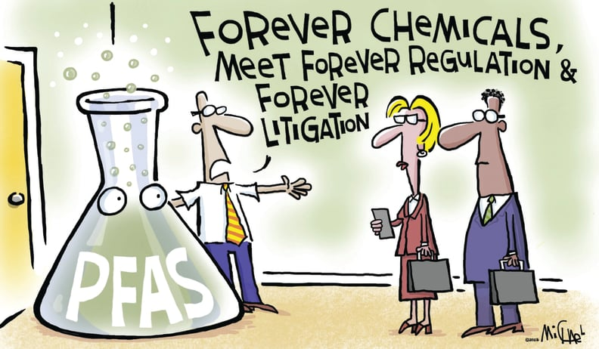
Georgia’s Current Regulation of PFAS
PFAS is not a listed hazardous substance under Georgia’s HSRA
There is no standard for PFAS under current Georgia rules and no risk levels
What does that mean for Brownfield applicants?
  LOL will NOT cover PFAS and so there is no liability protection under the Brownfield Program if PFAS is identified onsite.

Slide 7


The Discussion Hypothetical #1
Facts: Property was previously used for agricultural purposes, and it is likely that biosolids were applied during its history. Owner now wants to sell Property as area has evolved and they have been offered top dollar. Potential Buyer’s Phase I report identifies the historical agricultural use as a potential source of PFAS, a REC. Buyer intends to build multi-family units onsite and demands access to perform a Phase II investigation for all contaminants including PFAS.
What should the Owner do?
If owner allows Buyer to perform Phase II…
Buyer’s Phase II investigation confirms PFAS in groundwater, as well as arsenic and petroleum contaminants in soil. The levels of arsenic and petroleum are above relevant screening standards, but below residential Type 1 cleanup standards. The PFAS levels are above the designated EPA drinking water standards. Buyer wants to take the Property through Georgia’s Brownfield Program but is concerned about the PFAS levels. Is there a source of PFAS in soil?

Slide 8



The Discussion Hypothetical #2
Facts: Property was previously used for industrial drycleaning purposes in downtown area, and the facility partially burned 20 years ago. Drycleaning and firefighting likely impacted the property with PFAS. Owner now wants to sell Property as area has evolved into mixed-use developments and they have been offered top dollar. Potential Buyer’s Phase I report identifies the historical drycleaning use and fire suppression as a potential source of PFAS, a REC. Buyer intends to build mixed-use onsite that will extend across the entire block and requires a Phase II investigation for all contaminants including PFAS.
What should the Owner do?
If owner allows Buyer to perform Phase II…
Buyer’s Phase II investigation confirms PFAS in soil and groundwater, as well as chlorinated solvents. The levels of chlorinated solvents are above future use RRS but are located in a different area than the PFAS impacts in soil. The PFAS levels in groundwater are above the designated EPA drinking water standards. Buyer wants to take the Property through Georgia’s Brownfield Program, build a structure that extends sidewalk to sidewalk but is concerned about how to address the PFAS – what standards for soil and estimated costs to consider?

Slide 9
Volatile PFAS: A New Threat?
Georgia Brownfield Association
11th Annual Seminar
April 16, 2025

Slide 10
Presentation Overview
2. “Regular” PFAS
3. New Volatile PFAS
4. Potential Impacts
1. Brief PFAS History
5. Q and A by Panel
PFAS = Per- and polyfluoroalkyl substances

Slide 11
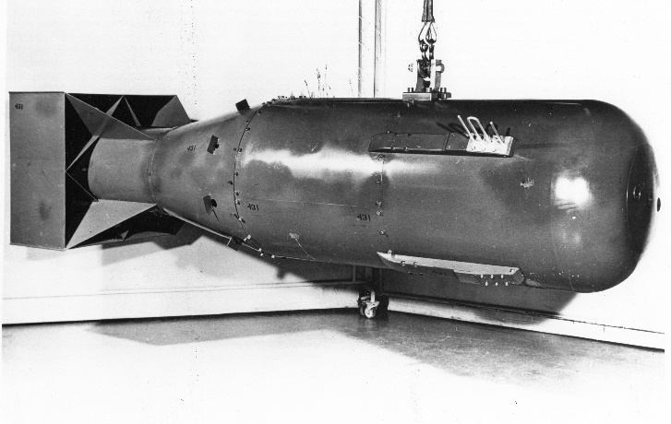

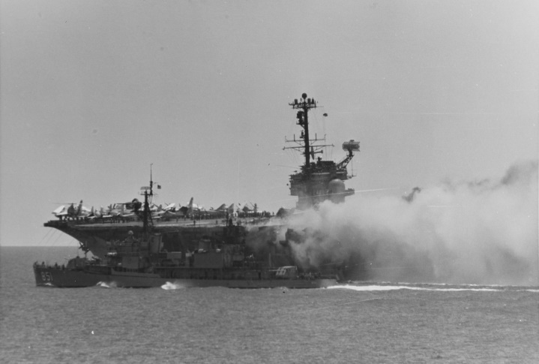
The History of PFAS
1938 Accidentally Discovered
  Researchers Seeking Non-Toxic Refrigerant
1940s - 1950s Entered Consumer Market
  Teflon®, Scotchgard™ etc.
1963 Navy Patents Aqueous Fire Fighting Foam (AFFF)
2009 First Provisional Health Advisory
2024 Federal Drinking Water Standards*
2024 Federal Hazardous Substances Under Superfund Law*
“Regular” PFAS Testing & Remediation
  PFOA, PFOS, etc.
Newer, Volatile PFAS Concerns
Frying Pans 1950s
Little Boy 1945
USS Forrestal 1967
PFOA = Perfluorooctanoic acid & PFOS = Perfluorooctane sulfonate
* = Promulgated federal rules under reconsideration

Slide 12
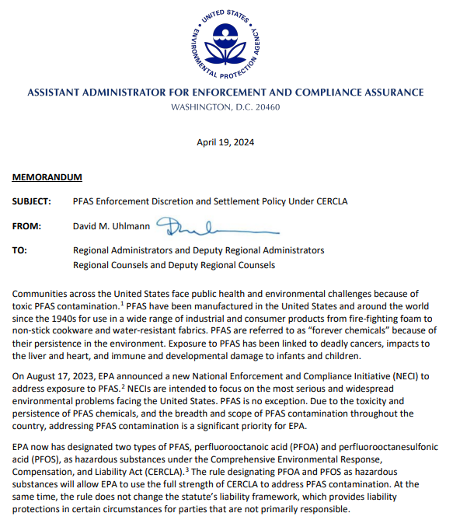
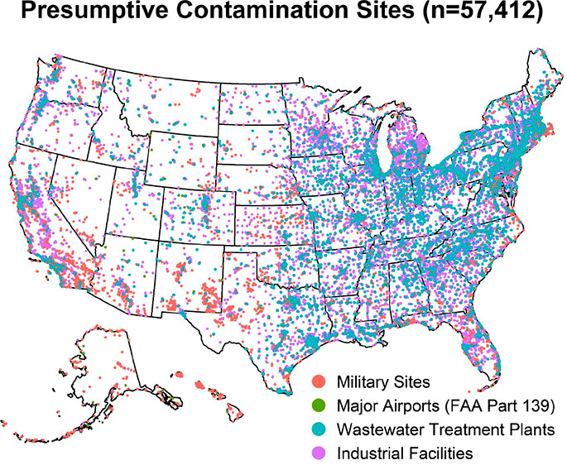

Ubiquitous PFAS & Potential Enforcement Discretion
EPA’s List of 87 Facilities
Potentially Affected by PFAS
Source: Environ. Sci. Technol. Lett. 2022, 9(11): 983-990.
QUESTION: Did We Sample for the Right PFAS?
Parties Potentially Receiving Discretion:
Community water systems & treatment works
Municipal separate storm sewer systems
Municipal solid waste landfills
Airports & local fire departments
Farms where biosolids applied
Source: 89 FR 39,133-39,127, 5/8/24

Slide 13


PFAS Volatility
PFOA
(Perfluorooctanoic Acid)
6:2 FTOH
(6:2 Fluorotelomer Alcohol)
Alcohol
Tail
Tail
Oxygen
Hydrogen
Carbon
Carbon
Florine
Oxygen
Florine
Hydrogen
Carboxyl
Low Vapor Pressure
  0.03 mm Hg
Testing by
  Liquid Chromatography
High Vapor Pressure
  18 mm Hg
Testing by
  Gas Chromatography
Note: EPA threshold is for chemicals with a vapor pressure greater than 1 millimeter of mercury (mm Hg)

Slide 14
Conceptual Site Model for PFAS Occurrence

Slide 15
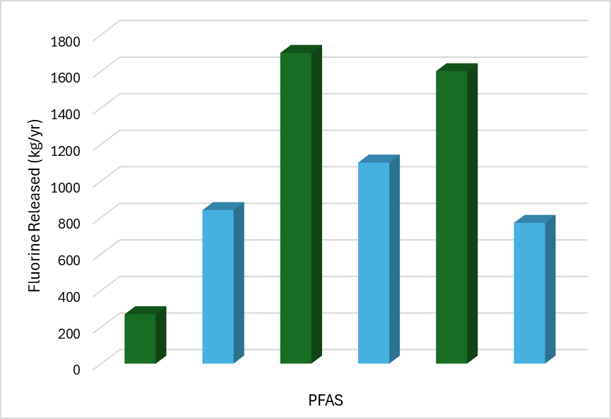
Volatile PFAS Releases from Landfills
Leachate and Volatile PFAs Releases from Landfills
  Volatile PFAS Releases Poorly Understood
  Testing by Liquid and Gas Chromatography
76% of Total Releases are Volatile PFAS
  Volatile Releases Can Exceed Leachate Releases
Passive Venting, Flaring or Energy Recovery
  Only Limited PFAS Destruction
Potential Later Transformation after Release
  FTOH ➔ PFOA, etc.
Volatile PFAS Could be More Toxic Than Other PFAS
Leachate Release
Volatile Release
Landfill 1
Landfill 3
Landfill 3
https://doi.org/10.1021/acs.estlett.4c00364

Slide 16
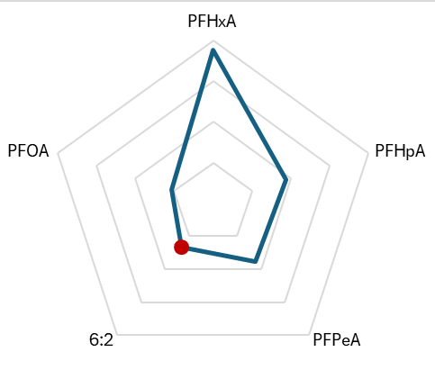
Potential Exposure & Toxicity
Recent Indoor Sampling
(Relative PFAS Concentrations)
Potential Volatile Exposure Pathways
  Ambient/Indoor Air
    Volatile PFAS About 50% of Total Intake
  Vapor Intrusion from Soil or Groundwater
  Incidental Dust Ingestion
  Dermal (Skin) Contact
Potential Volatile Toxicity
  Liver Toxicity
  Increased Breast Cancer Cell Proliferation
  Endocrine (Estrogen) Disruption
  Possible Transformation to Potential Carcinogen
Volatile FTOH

Slide 17





PFAS in Georgia’s Brownfields: Navigating Regulatory Blind Spots & Volatile PFAS
Your Questions & Comments
Kim Hale
Shannon Ridley
Len DiPrima
Steve Ellingson
(404) 812-0841
khale@kmcllaw.com
(470) 604-9456
Shannon.Ridley@dnr.ga.gov
(678) 358-8760
Ldiprima@unitedconsulting.com
(678) 512-9688
sbe@ShanWil.com
File: GBA Vol PFAS Ellingson.ppt

