Slide 1
DAMAR – Case Study Russ Fraze – WSP Gerald Pouncey – Morris, Manning & Martin
RCRA – BrOWNFIELD – RETIREMENT
Georgia Brownfields | April 2025

Slide 2
ENVIRONMENTAl problem

Slide 3
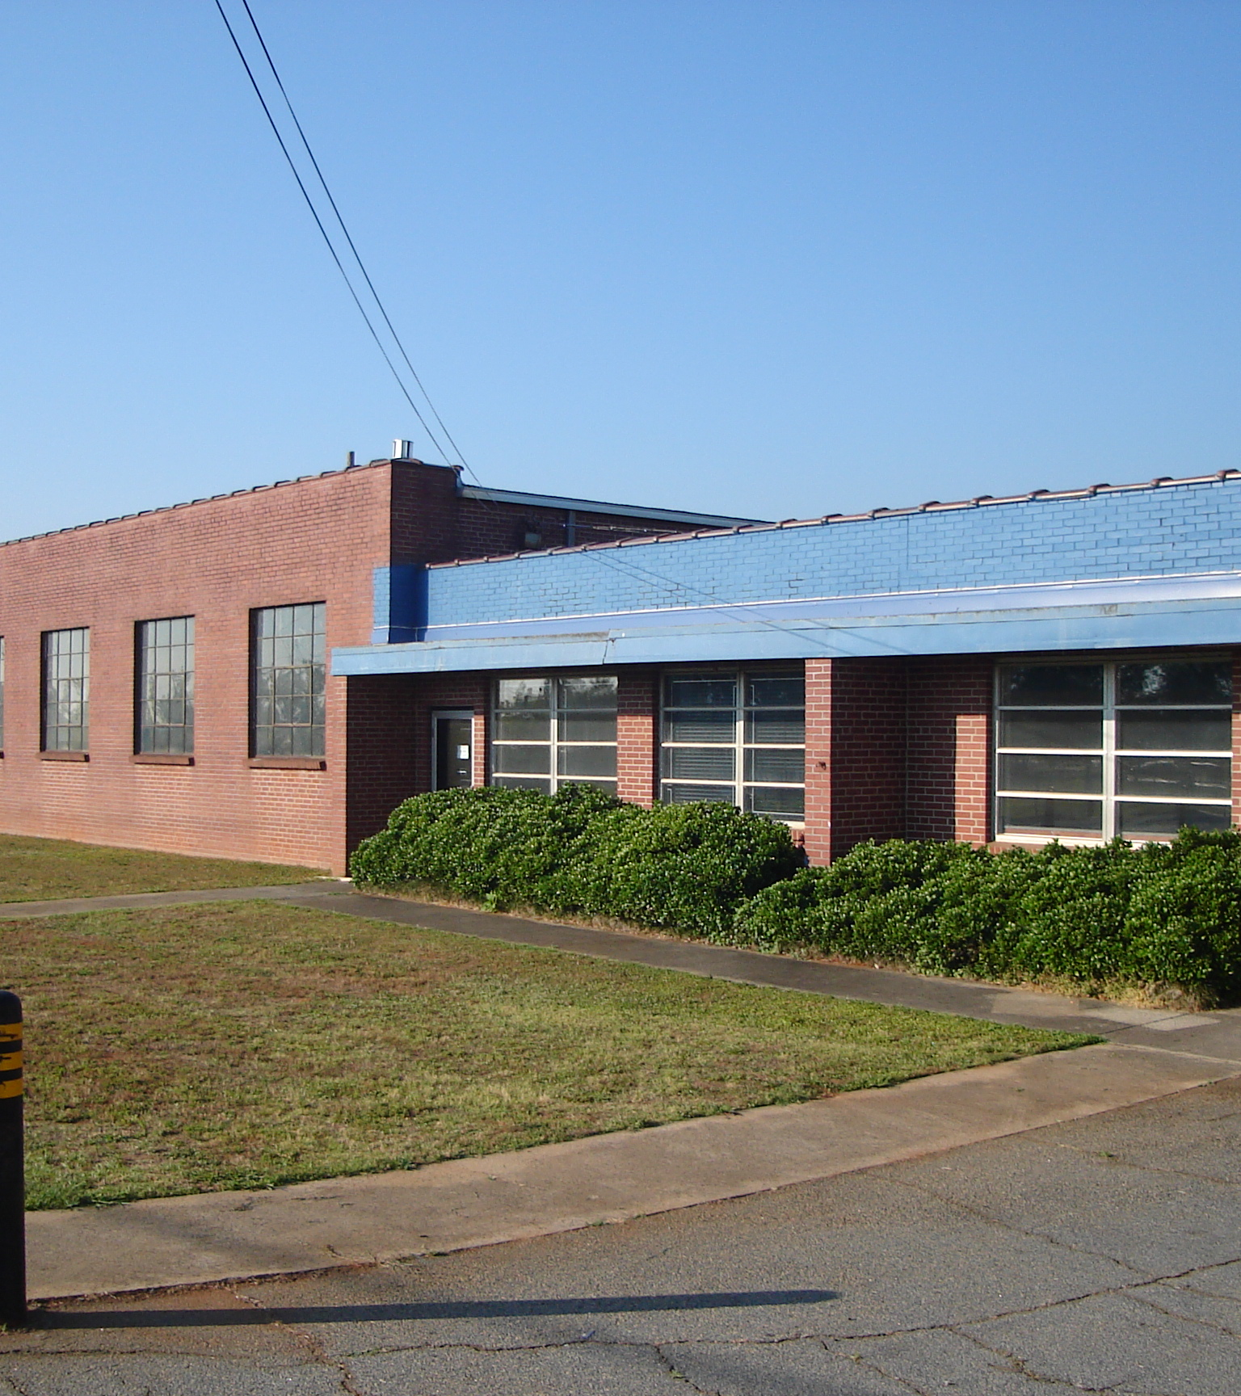
Operating and Waste History
1956 – 2000 Sheet Metal Fabrication Company
1956 – 1972 All wastes burned on site in pit.
1972 Discontinued On-site Disposal of Solid Wastes
1972 – 1984 Continued On-site Disposal of Liquid Wastes
Post 1984 All Wastes Disposed Off-Site

Slide 4
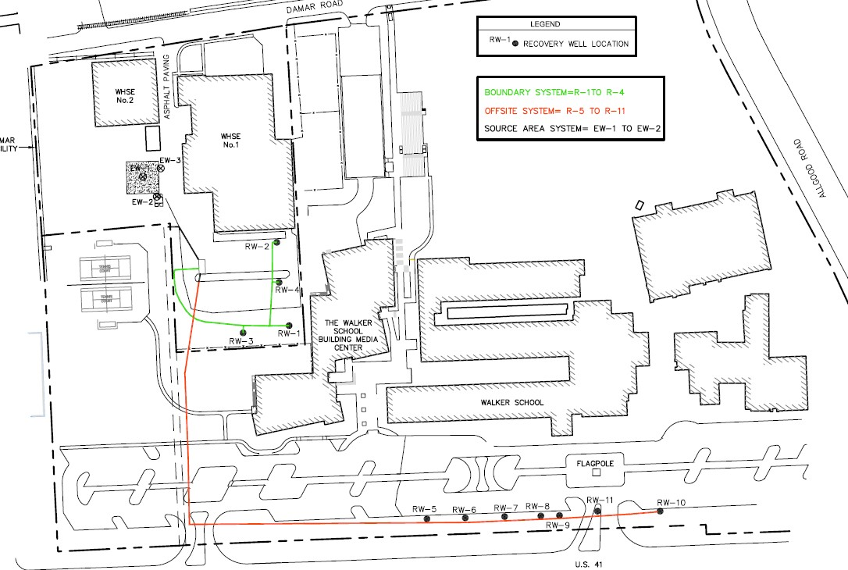
Post Closure Care Permit - Environmental Investigation & Corrective Action
Subsurface Investigations Identify Chlorinated Contamination in Soil and Groundwater
Two Groundwater Recovery Systems Installed (On-Site & Adjacent Property) – Split GW Plume
GW and SVE System installed at Former Landfill (5,000# recovery in 2 years)
Vapor Intrusion Study demonstrates no exposure risk at adjacent property

Slide 5
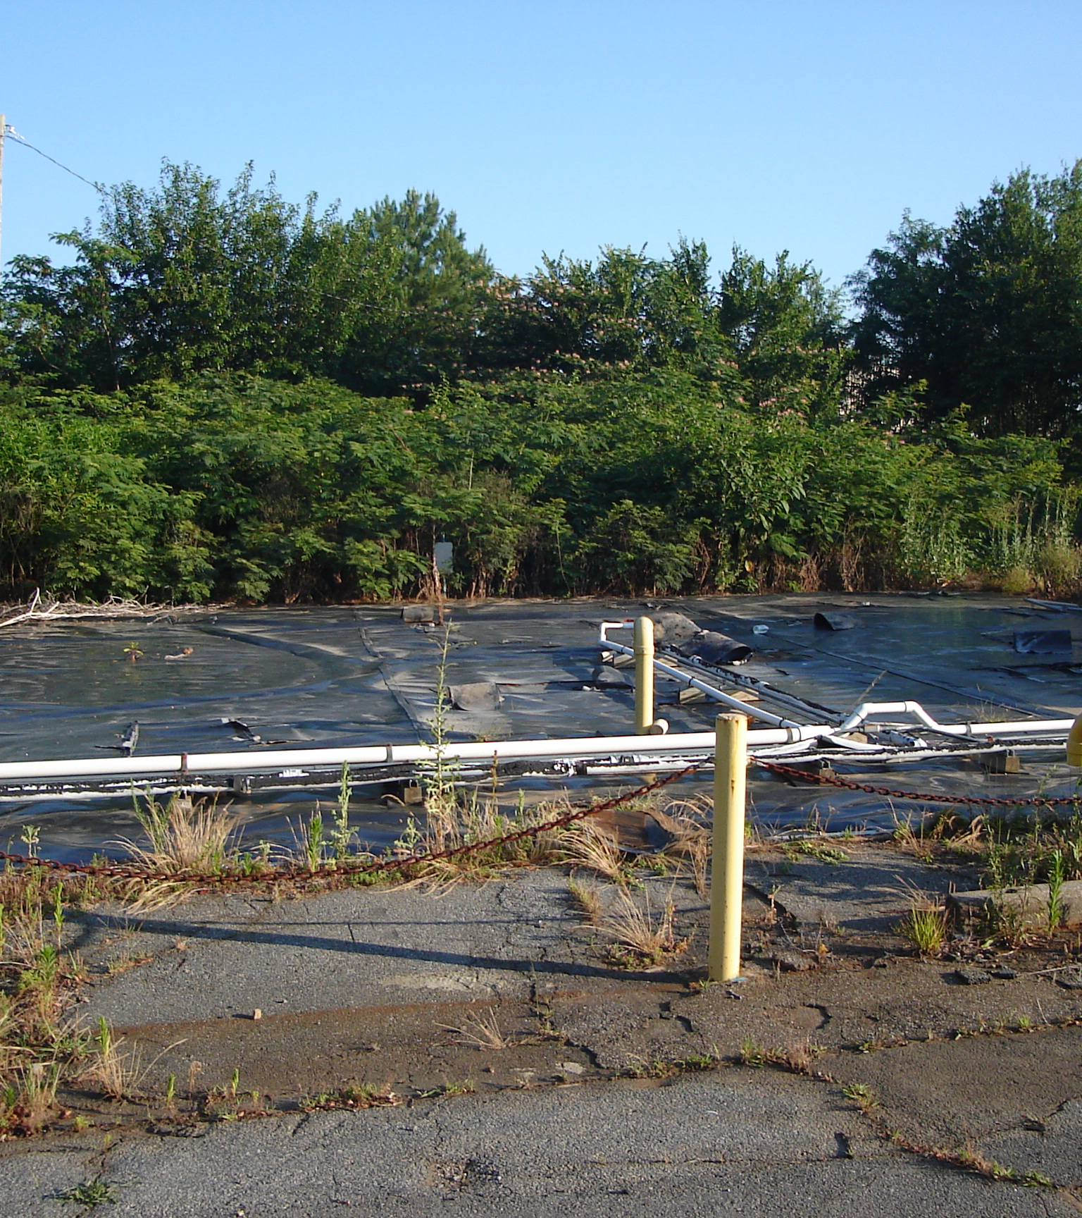
Regulatory History
1988 Disposal Area Closed in Place with concrete cover and identified as RCRA Unit
1993 GA EPD issued HW Post Closure Care Permit
2006 Adjacent Property owner negotiates purchase of the Damar Property
2006 Condition of Property Purchase is termination of RCRA Permit with Acceptance and Remediation under the Georgia Brownfield Program

Slide 6
TRANSACTION ISSUE
How to take a RCRA Site and put into Brownfield Program

Slide 7
ENVIRONMENTAL STRATEGY
Never Been Done or Attempted
Termination of RCRA Permit
Brownfield Application
Residential Risk Reduction Standards
Remediation per RCRA Corrective Action Plan
Dual Application for Early RCRA Termination and Prospective Purchaser Compliance Status Report
DAMAR Consent Order
EPD Concurrence of Remedial Actions
Trust Fund for Post Closure GW Recovery and Monitoring

Slide 8
REMEDIATION AND DEVELOPEMENT

Slide 9
Facility Demolition

Slide 10
Clean Closure of RCRA Unit

Slide 11
Potassium Permanganate Injections

Slide 12
Potassium Permanganate Soil Mixing

Slide 13
Groundwater Recovery and Treatment – 3 Years Post Remediation
Monthly discharge reports to POTW
POTW requested that KMNO4 not be removed

Slide 14
Groundwater Monitoring
Install 2 wells (A&B) downgradient of former disposal area
18 years

Slide 15
Groundwater Monitoring – 17 Years Post Remediation
Monitoring Well | 2003 PCE Concentration | 2024 PCE Concentration | Decrease %
MW-17R | 7200 | 43 | 99.4
MW-21 | 2200 | 61 | 97.2
MW-22 | 3200 | 5.4 | 99.8
MW-23 | <5 | <5 | NA
P-5R** | 270 | 22 | 91.9
MW-A** | 1700 | 320 | 88.24
MW-B** | 780 | 580 | 25.6

Slide 16
Site Closure
Well Abandonment
Site Restoration

Slide 17
Questions
wsp.com

